Slide 1
Strategic Planning and Performance Group of the Department of Health
Working as a Foundation Dentist
in the health service in
Northern Ireland

Slide 2
Areas to be covered today
Part 1 HSC structure
Part 2 Role of SPPG
Part 3 Record Keeping
Part 4 Prescribing
  Practical Advice
  Clinical Advice
  Antimicrobial Stewardship
Part 5 Misc

Slide 3
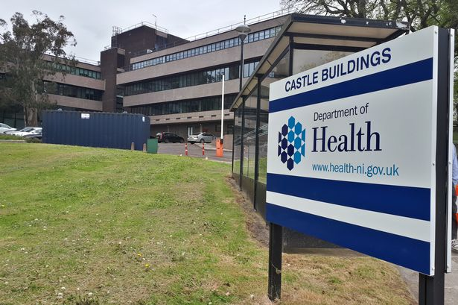
Part 1 HSC Structure

Slide 4
DoH/Minister
RQIA
RQIA
CDO
Policy
SPPG
LCGs
NIMDTA
BSO
GDPs/GPs/ Independent & Private Sector/ Voluntary & Community
PHA
Trusts
PCC

Slide 5
Main roles
Healthcare Policy Group of the Department of Health
Minister + civil servants advising politicians in The Assembly
  Formulates and sets policy
  the GDS regulations
  the SDR
  sets the Dental Budget for the Board
  negotiates contracts

Slide 6
Minimum Standards for Dental
Care and Treatment (Dept. of Health)
Describes the standards of care to be provided from the patient’s perspective
There are 15 Standards
Applicable to both health service and private care.
These may form the theme(s) for RQIA practice inspections and include:
  Choosing your dental service
  The quality of your care and treatment
  Medical and other emergencies
  Children, young people and vulnerable adults
https://www.health-ni.gov.uk/publications/professional-dental-guidance-publications
Notes:
Web link provided in Slide 80 (Titled-Handouts) of presentation.

Slide 7
General Dental Services Regulations
(Terms of Service)
Please note that these Regulations apply to individual practitioners and not to practices
For all dentists on the Dental List
Principal/Associate/Assistant/Deputy
Role of corporates

Slide 8
General Dental Services Regulations
(Terms of Service)
Key areas:
  Care quality
  Infection Control standards met
  Health and Safety Compliance
  Radiological Regulations Compliance
  CPD compliance (both clinical audit, and peer review and GDC requirements)
Compliance with QA returns (practice based)

Slide 9
Statement of Dental Remuneration
List of health service dental treatments and their associated fees

Slide 10
Main roles
Strategic Planning and Performance Group of the Department of Health
Implements policy, the GDS Regulations and the SDR set by the Healthcare Policy Group
commissions services from contractors (dentists) within a budget set by the Healthcare Policy Group
monitors performance of the dentists – RDS and Probity reviews, prescribing, CA and PR compliance
takes action as required. In relation to dentistry this is done directly with GDPs, practitioners in any pilot (PDS) and salaried GDPs

Slide 11
Main roles
Chief Medical Officer Group of the Department of Health
Chief Dental Officer
Provides professional support to the Minister, MLAs, and civil servants

Slide 12
Main roles
RQIA
  Registers and inspects all dental practices where ANY private work is carried out and inspects all practices that declare themselves wholly health service
Trusts – secondary care and CDS
  Are commissioned (in relation to dentistry) to provide hospital and community dental services
Patient and Client Council (PCC)
  Advocates on behalf of patients

Slide 13
Business Services Organisation ‘BSO’
“broad range of business support functions and specialist professional services to the health and social care sector in Northern Ireland”
Family Practitioner Services (primary care) Medicine, Pharmacy, Dentistry, Ophthalmic
Dental services for patients and contractors e.g.
  Dental list
  Dental payments
  Clinical audit

Slide 14
Contact Number
BSO Dental Payments 028 953 60333

Slide 15

Part 2 Role of the Strategic Planning and Performance Group

Slide 16
Main roles
Strategic Planning and Performance Group of the Department of Health
Implements policy, the GDS Regulations and the SDR set by the Healthcare Policy Group
commissions services from contractors (dentists) within a budget set by the Healthcare Policy Group
monitors performance of the dentists – RDS and Probity reviews, prescribing, CA and PR compliance
takes action as required. In relation to dentistry this is done directly with GDPs, practitioners in any pilot (PDS) and salaried GDPs

Slide 17
SPPG – Who we are
Michael Donaldson
AD(D)
Donncha O’Carolan
and William Priestley
Joint Regional Lead – GDS and Governance
Sinead Preston
Regional Lead – CDS, HDS and Public Health
7 Dental Advisers plus one vacant post (~6 WTE)

Slide 18
8 Dental Advisers DAs (~6 WTE)
Joe McGrady (South Eastern LCG / BSO)
Jonathan Montgomery (Northern LCG / BSO)
William Priestley (Belfast LCG / RDS) Julie Collins (Southern LCG / Orthodontics)
Julie Kelly (Northern & Southern LCG / OS pilot)
Derek Maguire (Southern LCG / OOH / Probity)
Gerry Cleary (Western LCG / Prescribing / Probity)
David Marshall (RQIA and Inspections)

Slide 19
Monitoring Processes
Referral Dental Services
Probity
Prior Approval
Prescribing of CDs
Clinical Audit and Peer Review
Complaints
Quality Assurance Returns
Adverse Incidents

Slide 20
Referral Dental Services
Monitor the quality of health service dental work
  Quality of care
  Quality of record keeping
  Compliance with GDS Regulations
  Compliance with IR(ME)R
  Probity
Provide information for policy makers

Slide 21
What the RDS looks like
Three yearly cycle
Patient Examinations
Records Reviews
Follow-up if necessary

Slide 22
Learning points from last years FDs
Quality of care
  Non-treatment of diagnosed disease
  Radiograph interpretation
Record keeping
  Contradictory records
Probity issues
  Loads of them

Slide 23
Probity Services
Correct payment for necessary and appropriate activity carried out by qualified persons in accordance with Regulations

Slide 24

Verification
A Probity Review checks:
Claim against Payment
If treatment was carried out
If treatment was necessary
Quality of treatment
If patient exists

Slide 25
What makes you an outlier?
Volume of claims -number and value
Average cost per claim
Exemption/remission vs non-exempt different prescribing patterns
Unusual claim patterns e.g. split estimates – incomplete treatment

Slide 26
Codes to look out for
0111 charting and BPE recorded
1011 perio > 1 visit but not on same day!
1441 evidence of early caries in record or caries removal as it is a restoration
1501 Incomplete root filling-discretionary fee (post-op rad)
2201 soft tissue extraction – record flap/sutures
1742/3 temporary crown
1425 buccal cusp tip in first molars
2941 heat cured occlusal appliance (BG) adjustments

Slide 27
Codes (continued)
3701 acute conditions – pericoronitis, ulcers, herpetic lesions
but NOT chronic abscesses
2311 Treatment of infected sockets

Slide 28
Prior Approval Process
Pre-treatment Examination – Dentist notified by DB26
BSO Dental Officers review cases on behalf of the Dental Committee
Dental Committee - Appeals Procedure
Current waiting times for approval = 2-4 weeks. Complex cases may take longer.

Slide 29
Dental Committee
Statutory Committee
  Chairman appointed by Minister
  Members nominated by 4 Board LDCs, 1 DPC (BDA) representative, 1 BSO nomination
Six experienced GDPs
Committee usually meets monthly at the BSO
Appeal available to DoH – CDO decision or outside specialist referral
Notes:
Between January 2011 and December 2011, there were 143 cases sent to the Dental Committee
41 were Orthodontic cases
were General Cases
10 Orthodontic cases were approved by the Dental Committee
13 General cases were approved by the Dental Committee
31 Orthodontic cases were not approved by the Dental Committee
89 General cases were not approved by the Dental Committee

Slide 30
Management of Underperformance
Peer to peer engagement
Action plans
  Targeted CPD
  Mentorship
  Audit
  Follow-up reviews
Referral to the “Regional Professional Panel”
  Refer to NHS Resolution / GDC / PSNI /Reference Committee
Referral to the HSC Disciplinary Procedures
Notes:
Between January 2011 and December 2011, there were 143 cases sent to the Dental Committee
41 were Orthodontic cases
were General Cases
10 Orthodontic cases were approved by the Dental Committee
13 General cases were approved by the Dental Committee
31 Orthodontic cases were not approved by the Dental Committee
89 General cases were not approved by the Dental Committee

Slide 31

Part 3 Record Keeping

Slide 32
What is a clinical record?
Everything relating to the patient’s treatment, i.e.
  Record card, HS45, HS45PR, HS45DC, DB114(Ortho), Radiographs, photographs, study models, receipts, lab documents, Statements of Manufacture(SOM), details of prescribed drugs, etc.
Medico legal... Referral letters and reports are also included in the definition above
Patient records must be retained for 6 years (GDS Regs)
Notes:
A valid HS45PR form requires:
A Claim Reference Number
The dentist’s name, address and contract number
Evidence of exemption/remission seen/not seen
The patient’s DOB and CHI
Completed exemption/remission status
The patient’s signature(s) and dates(s) on parts C or D and on part E.

Slide 33
Why do we need clinical records?
To satisfy legal or regulatory requirements
(the content of records is the responsibility of the dentist even when dictating to someone else)
To verify treatment
To assure a third party
  RDS
  Probity
  Prior Approval
  GDC
  PSNI
  Lawyers

Slide 34
How much detail do we need?
GDS Regulations:
“A dentist shall keep a full, accurate and contemporaneous record”
GDC Standard 4.1
“You must make and keep complete and accurate patient records.”

Slide 35
What does “full” or “complete” mean?

Slide 36

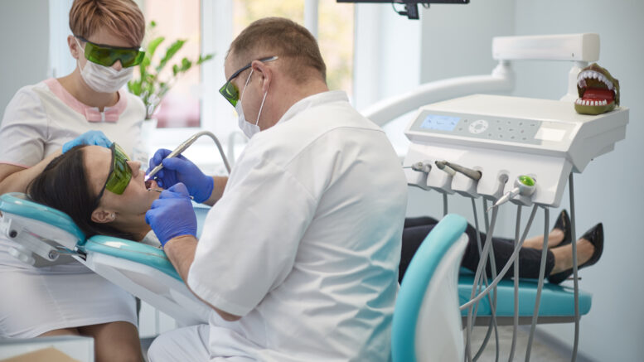
Record Keeping Workshop

Slide 37

Part 4 Prescribing

Slide 38
What can dentists prescribe?
For all prescriptions, dentists should only prescribe medication that:
    Meets the identified dental needs of the patient
    That you are competent in prescribing

Slide 39
Health Service and Private Patients
Dentists can prescribe any medication in the BNF Dental Formulary on an HS21D prescription. A HS21D prescription is exclusively for the use of health service patients for whom the dentist- prescriber agrees to provide general dental services at the date of issue of the prescription
Dentists can prescribe any medication in BNF on a private prescription (to meet the identified dental needs of your patients). Exceptions are schedule 2 & 3 controlled drugs (apply for a PCD1 pad)
Remember that patients can purchase appropriate OTC if not POM
CD stock orders requisitions – use form CDRF1
Notes:
There are no limitations on the number or type of medicines that you dentists can administer or prescribe to a private patient under your care although dentists have an ethical responsibility to restrict your prescribing to areas in which they are competent.

Slide 40
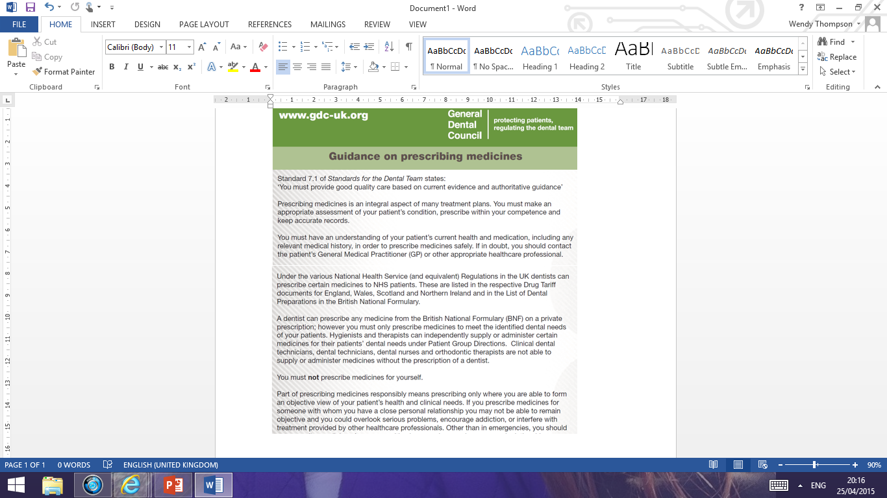
Notes:
GDC has issued a leaflet giving specific guidance on prescribing medicines
Can be down loaded from the website
Themes we’ll see coming through the rest of this presentation:
Only prescribe within your competence
Keep accurate records – including diagnosis to identify the dental need

Slide 41
Points to Consider before Prescribing
Is prescribing necessary: risks v benefits
Check Medical History – contraindications, interactions
Caution in potential high-risk groups e.g .
      Pregnancy/Breastfeeding
      Elderly
      Children
      Patients on anticoagulants
Adequate information should be provided to the patient e.g. clear instructions, benefits of medication, potential side-effects and suitable disposal
Notes:
Medicines should be prescribed only when they are essential and, in all cases, the benefit of administering the medicine should be considered in relation to the risk involved. This is particularly important during pregnancy where the risk to both mother and foetus must be considered (for further details see Appendix 4 of the BNF, Pregnancy).
Medical histories should be checked and updated at the start of each new course of treatment and, ideally, reviewed at each patient visit. Knowledge of the medicines being taken by a patient will allow you to check for any drug interactions before prescribing or supplying medicines in connection with the patient's dental treatment.
The doses stated in the BNF are intended for general guidance and represent, unless otherwise stated, the usual range of doses that are generally regarded as being suitable for adults. Medicines suitable for use with children will have the recommended range of doses against individual entries in the BNF. See children’s BNF.
Old people, especially the very old, require special care and consideration when they are being prescribed medicines. Drug therapy of this group is complicated by the physical and mental changes that accompany old age. Also issues such as polypharmacy and unable to swallow tablets?
All patients should be told how to dispose of any medicines that are no longer required, for example, by returning them to the community pharmacist. Medicines should not be disposed of via the sewerage system (for environmental reasons), through the domestic waste system or shared with others.

Slide 42
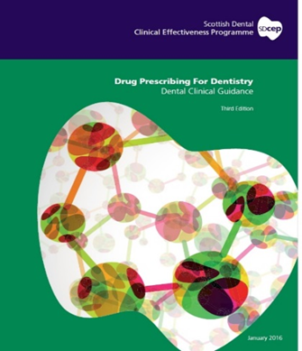
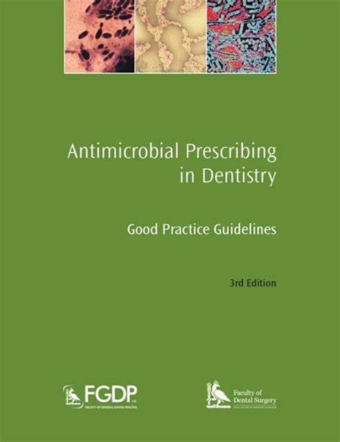
Current Guidance around prescribing
BNF, Scottish Dental Clinical Effectiveness Programme (SDCEP) ‘drug prescribing for dentistry’ guidelines and CGD ‘Antimicrobial Prescribing in Dentistry: Good Practice Guidelines’ are all useful resources for guidance on prescribing

Slide 43
HS21D Form for Health Service prescriptions
Product Code HS21D
1 pad with 100 scripts in each
6-digit number above product code - useful to check sequence
Cypher number = 10 + DS number
Unique 11-digit reference number

Slide 44
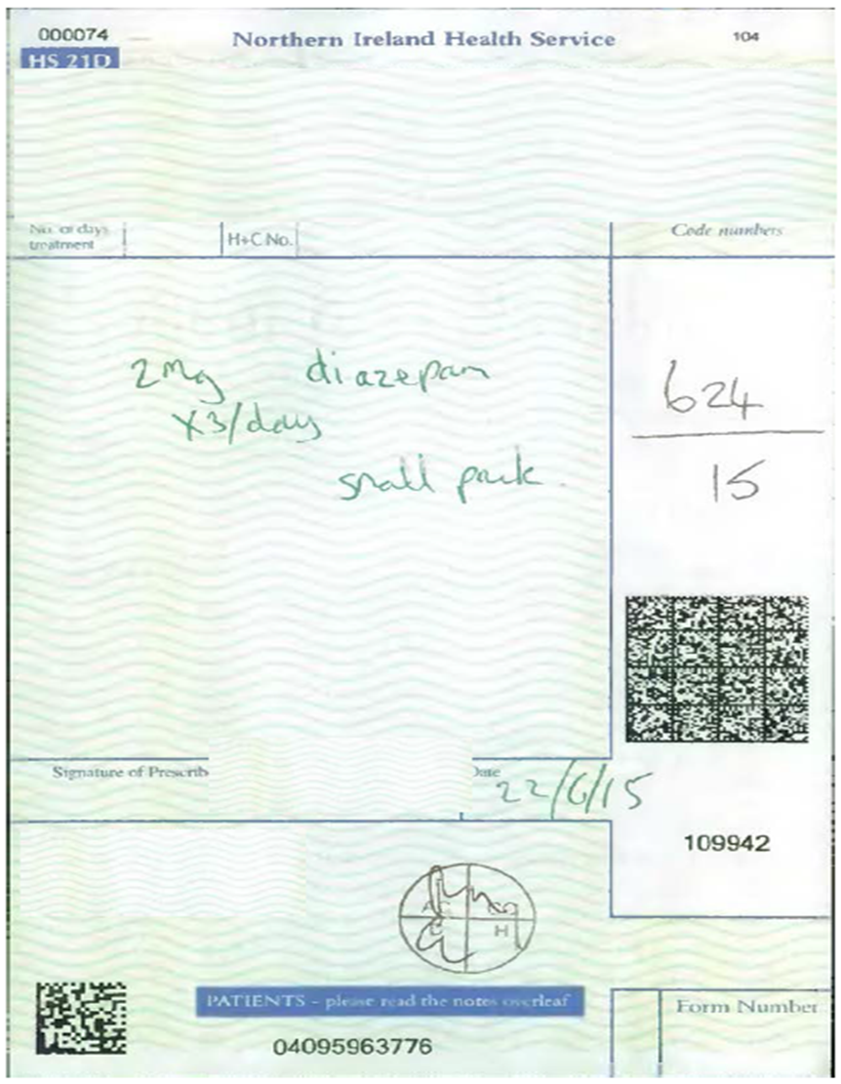

Slide 45
Prescription Order Process
https://bso.hscni.net/directorates/operations/family-practitioner-services/dental-services/contractor-information/dental-prescribing-guidance/prescription-forms/
Online form for ALL primary care orders
DLRT (NI) Ltd in Lisburn

Slide 46
Writing Prescriptions
For all NHS and private prescriptions, the prescription must:
  be written in indelible ink
  be signed in ink by the prescriber (ensure legible)
  be dated
  specify the prescriber’s address and profession
  include the name and address of the patient
  The age and date of birth of the patient should be stated, and it is a legal requirement in the case of POMs to state the age for children under 12 years.
  Include details of the medication – name, strength, appropriate quantity and clear instructions on dose, frequency and number of days treatment
Notes:
Avoid the unnecessary use of decimal points. Quantities of 1
gram or more should be written as 1g etc. quantities of less than
1 gram should be written in milligrams e.g. 500mg, not 0.5g
When decimals are unavoidable, a zero should be written in front of
the decimal point where there is no other figure e.g. 0.5ml, not .5ml
Dose and frequency should be stated; for preparations to be taken
‘as required’ a minimum dose interval should be specified
The names of medicines and preparations should be written clearly
and not abbreviated, using approved titles only
The quantity to be supplied should be clear. The number of days
treatment should be indicated
Prescriptions for controlled drugs have additional legal requirements.

Slide 47
Practical Advice
Avoid ‘excessive prescribing’ antimicrobials!
For medication prone to abuse (CDs), write the quantity in words and figures four tabs
Draw a diagonal (or spiral) line across the blank part of the form
Add in ‘two or three items only’ where appropriate
Ensure alterations are clear and initialled
Make sure to familiarise yourself with and adhere to the individual practice protocol

Slide 48
Prescription Security
there must be appropriate written security policies, procedures and systems in place in each dental practice to reduce the risk of prescription theft and misuse’ ….. March 3rd 2017
Should be a nominated person take responsibility for prescription security procedures
Share policy with staff and appropriate training PROVIDED
Register formally recording the ordering, receipt and issue of prescription forms must be kept
Guidance for Prescription Security available at
https://bso.hscni.net/wp-content/uploads/2024/03/Prescription-SecurityGuidanceV11.pdf
Notes:
Blank NHS prescription forms are of considerable value and should be stored securely. The stealing and misuse of prescription forms could be minimised by the following precautions:
do not leave the prescription pad visible or unattended if called away from the surgery; when not in use, keep prescription forms in a locked drawer within the surgery
alterations are best avoided but if any are made they should be clear and unambiguous; add initials against alterations
if prescriptions are to be collected they should be kept in a safe place

Slide 49
Prescription Costs
Approx £20 to £40 to fully process a prescription
Does not include the cost of the actual
medicines
Alternatively
Paracetamol to purchase OTC 25p to £3.00

Slide 50
Using colleagues’ pads
Responsibility – prescriber has a duty of care to prescribe only within their competence – are you, as the owner of the pad, satisfied that they have complied with this?
Foundation training
Inform the SPPG if assistants, locums and Dental Foundation trainees in place - Form Den Ph1 available on BSO website
Importance of script log ‘who wrote what…….’
Controlled drug monitoring, RDO and Probity checks
Print name beside signature box and do not deface!

Slide 51
CD Monitoring
Community pharmacists forward dispensed private and NHS prescription forms to the BSO
The SPPG is responsible for monitoring CD prescribing (BSO data used) on behalf of the NI CDAO
Please see dental Prescribing page of BSO website at:
https://bso.hscni.net/directorates/operations/family-practitioner-services/dental-services/contractor-information/dental-prescribing-guidance/

Slide 52
Drug | Quantity to be queried
Diazepam 2mg / 5mg tablets | > 10 tabs per script
Diazepam 10mg tablets | Any quantity per script
Diazepam liquid 2mg/5ml | Quantity > 50ml
Temazepam 10mg/20mg | > 5 tabs per script
Temazepam liquid 10mg/5ml | > 20mls per script
Dihydrocodeine 30mg tablets | > 16 tabs or if routinely prescribed i.e. more than 2 prescriptions / month for quantity > 16 tabs

Slide 53

Antimicrobial Resistance
The emergence and spread of antibiotic resistance is a global concern and is a major threat to public health
Prudent and appropriate use of antibiotics in line with current clinical guidelines will slow the emergence of bacterial resistance and will preserve the usefulness of existing drugs for future generations
UK has produced its second 5-year national action plan setting out ambitions and actions in support of the 20-year vision for antimicrobial resistance

Slide 54
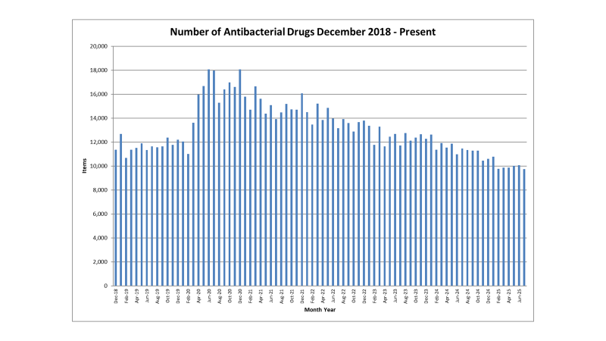

Slide 55
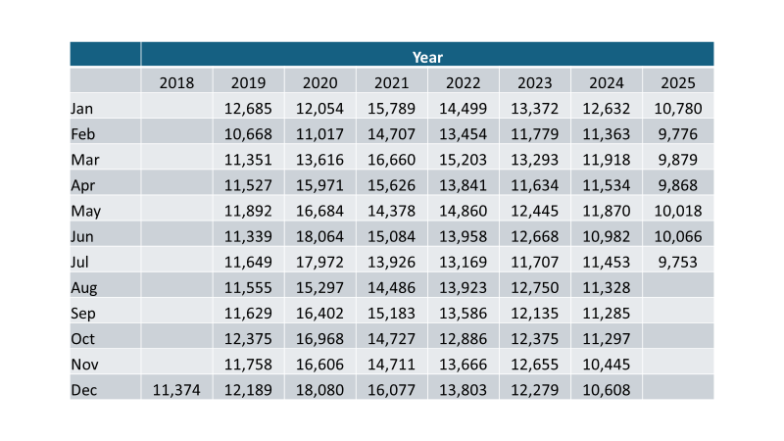

Slide 56
When To Prescribe for a Dental abscess?
Antibiotics are not appropriate in cases where the infection is localised to the peri-radicular tissues. This indicates that the infection is being adequately managed by the immune system.
SDCEP guidelines advise establish drainage if pus is present and remove the cause of infection:
- RCT
- Extraction
- Appropriate analgesics if required and review

Slide 57
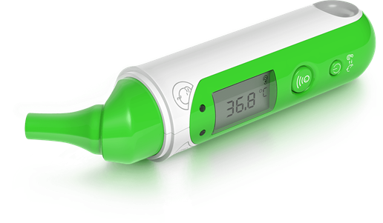
Oral Bacterial infections (including dental abscess)
Antibiotics are appropriate in the presence of any of the following:
- Evidence of spreading infection (swelling, cellulitis, lymph node involvement)
- Systemic involvement: fever, malaise, body temperature <36 or >38 degree celsius
- Persistent swelling despite local treatment for NUG or pericoronitis
- Immediate drainage not achieved with local measures for a dental abscess

Slide 58
Antibiotics may also be required:
If treatment is not possible or has to be delayed e.g. community referral required for extraction in anxious/un-cooperative patient
or
Patients with certain medical conditions:
- Immunocompromised
- Following SDCEP Advice on the Provision of Antibiotic Prophylaxis Against Infective Endocarditis for patients with certain cardiac conditions

Slide 59

Useful Links
Prescribing page on BSO website
https://bso.hscni.net/directorates/operations/family-practitioner-services/dental-services/contractor-information/dental-prescribing-guidance/
- Dental Antimicrobial Stewardship Toolkit
https://www.gov.uk/guidance/dental-antimicrobial-stewardship-toolkit#contents

Slide 60

Part 5 Miscellaneous

Slide 61
General Dental Services Regulations
(Terms of Service)
Please note that these Regulations apply to individual practitioners and not to practices
For all dentists on the Dental List
Principal/Associate/Assistant/Deputy
Role of corporates

Slide 62
Complaints
Definition
“Any expression of dissatisfaction which requires a response”
What you need to do ….
Appoint a designated practice complaints officer
Develop a Practice-based complaints procedure.
Develop a complaints leaflet for patients
Respond in appropriate timescales
Monitor/take cognisance of issues being raised
Learn from complaints

Slide 63
Referrals
Each practitioner is responsible for referring patients for hospital/ specialist care, as appropriate
New practitioners should acquaint themselves with local specialists
Referral Guidelines for Specialist Hospital
Dental Services:
http://www.hscbusiness.hscni.net/services/2470.htm

Slide 64
Introduction of IOTN
Since April 2014, all health service orthodontics cases treated and submitted/claimed for payment of items listed in the SDR, must fulfil the criteria of IOTN ≥3.6
No prior approval is required but any case submitted for payment and adjudicated as not achieving this criteria will have the full fee recovered.

Slide 65
Mixing HS and Private treatment
NHS/Private treatment in one course of treatment- permissible with patient consent
NHS/Private treatment on one tooth in one course of treatment – not permissible

Slide 66
Charging additional fees (NHS +)
“Levying additional charges additional to those stipulated in the SDR”
Would constitute a breach of the GDS regulations, even if the patient has consented to such an additional charge.
If the patient is unaware that the charge is additional to HS charges, the practitioner may be open to an allegation of fraud.
PPE

Slide 67
How to find us!
Directorate of Primary Care contacts:
Western Office 028 953 61010
Northern Office 028 953 62849
Belfast Office 028 953 63926
South East Office 028 953 63926
Southern Office 028 953 62104

Slide 68
Useful websites
Forms including HS48 and HS50 forms
www.hscbusiness.hscni.net/services/2371.htm
Minimum Standards for Dental Care and Treatment
http://www.hscbusiness.hscni.net/services/2668.htm
Statement of Dental Remuneration
http://www.hscbusiness.hscni.net/services/2069.htm
Other websites that may be of use
https://www.health-ni.gov.uk/topics/dentistry
www.hscboard.hscni.net
www.hscbusiness.hscni.net
http://www.hse.gov.uk/risk/index.htm
www.rqia.org.uk
www.gdc-uk.org

Slide 69

Thank you for your attention

