Slide 1

Film Handling
Saturday 18th October 2025
Erin Gregg

Slide 2
AIM
The aim of this lesson radiography dental nurses should be confident with film handling, this includes storage, processing and film faults. They should also be familiar with the correct filing and retrieval of patient data.

Slide 3

OBJECTIVES
On competition of training, the radiography dental nurse should be able to describe storage of film – protection from heat, damp and radiation and securely and safely store image receptors to maintain their integrity.
They should be able to describe conventional film processing and correctly process conventional film.
Radiography Dental Nurse should be able to describe film faults and recognise how to rectify them.
They should be able to describe the correct filing and retrieval process and be able to exchange information securely maintaining patient’s confidentiality.

Slide 4
Learning content:
Be confident with film handling and maintaining patients' confidentiality

Slide 5
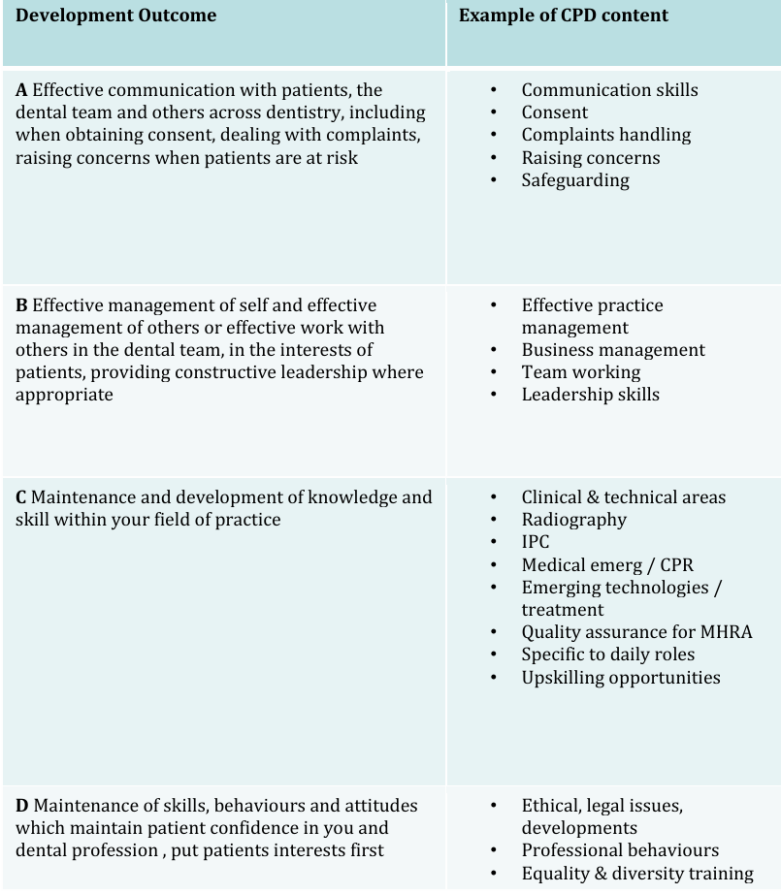
GDC outcomes:
A,B,C,D

Slide 6
Film Storage
All radiographic film deteriorates with time
Manufactures put dates on the packets as a guide
It does not mean the film automatically becomes unusable after this date
Storage conditions have an effect on the deterioration rate.

Slide 7
Ideally films should be stored:
In a refrigerator in cool, dry conditions
Away from all sources of ionizing radiation
Away from chemical fumes including mercury and mercury containing compounds
With boxes placed on their edge to prevent pressure artefects

Slide 8

Intensifying screen maintenance
Intensifying screens should last for many years if looked after correctly. Maintenance should include:
Regular cleaning with a proprietary cleaning agent
Careful handling to avoid scratching or damaging the surface
Regular checks for loss of film/screen contact

Slide 9
Conventional film
Old-style method of dental imaging that uses a physical film packet with light sensitive silver halide crystals to capture an x-ray image.
This is then developed using chemicals
This method required a physical development process which takes time and can result in lower image quality compared with modern digital x-rays

Slide 10
How it works
X-ray exposure
X-ray machine emits a beam of x-rays that passes through your teeth and jawbone
2. Film absorption
Denser structures like teeth and bones, absorb more x-rays, while less dense tissues allow more x-rays to pass through
3. Image capture
The x-ray film packet, placed inside the mouth, is exposed to the x-rays that pass through, creating an invisible image on the silver halide crystals in the films emulsion
4. Film development
After exposure, the film is removed and processed in a chemical developer to reveal the image of the teeth and surrounding structures.

Slide 11
Advantages
High image quality – excellent for detailed examinations
Can not be altered – integrity of film images remains
No extra training required

Slide 12
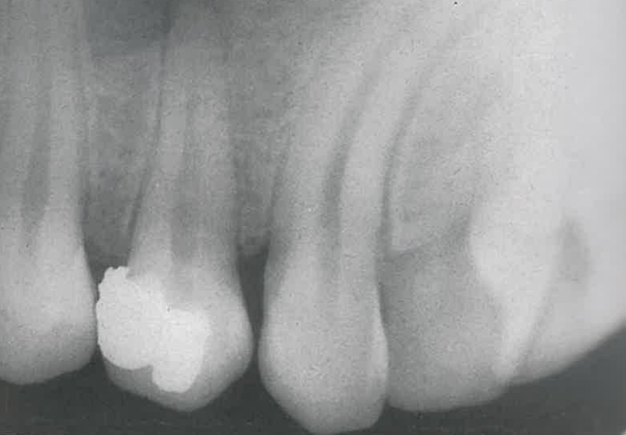
Disadvantages
Time – film needs to be developed which takes time
Repeat x-rays – if film isn’t clear process needs to be repeated
Radiation dose – conventional film uses more radiation than digital
Storage and handling – required physical storage

Slide 13
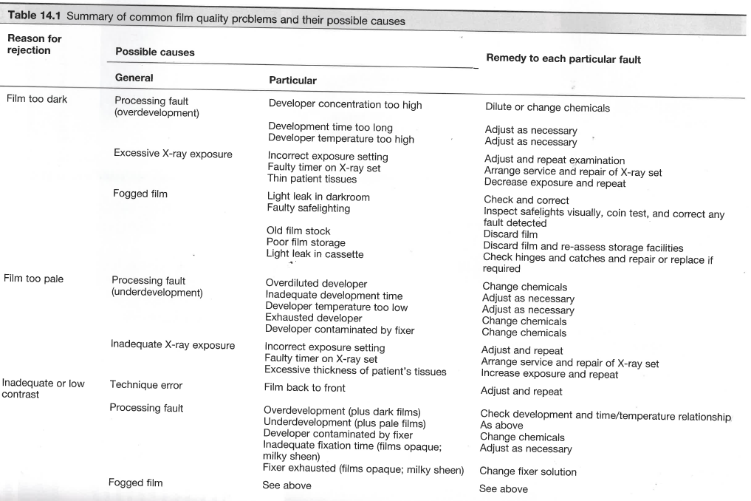
Typical film faults

Slide 14
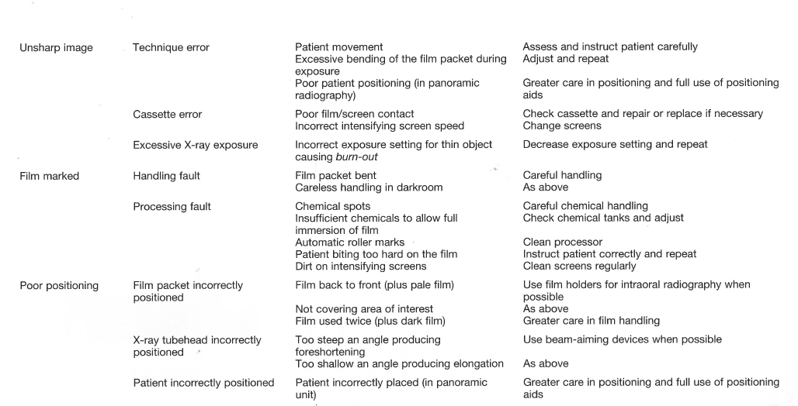

Slide 15
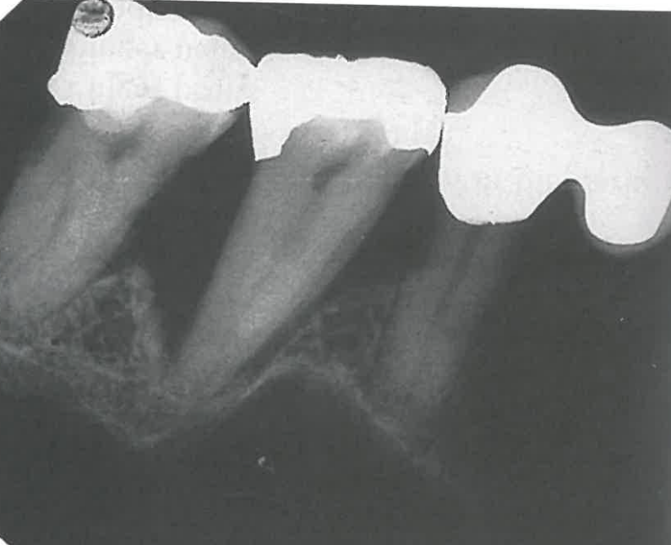
Film too dark
Overexposure:
Faulty x-ray equipment e.g. timer
Incorrect exposure time setting by the operator
Overdevelopment:
Excessive time in the developer solution
Developer solution too hot
Developer solution too concentrated

Slide 16

Fogging:
Poor storage conditions – allowing exposure to stray radiation
too warm
Old film stock
Faulty cassettes allowing stray light in
Faulty dark room/processing unity
Too thin patient tissues

Slide 17
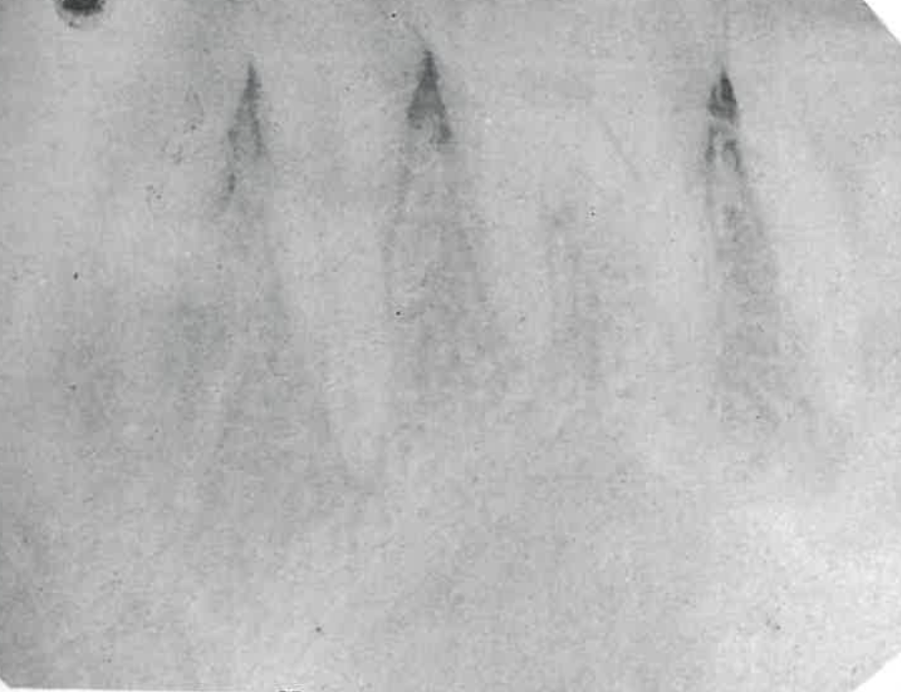
Too pale
Underexposure:
Faulty x-ray equipment e.g. timer
Incorrect exposure time setting by the operator
Failure to keep timer switch depressed throughout exposure
Underdevelopment:
Inadequate time in the developer solution
Developer solution too cold
Developer solution too dilute
Developer solution exhausted
Developer contaminated by fixer

Slide 18
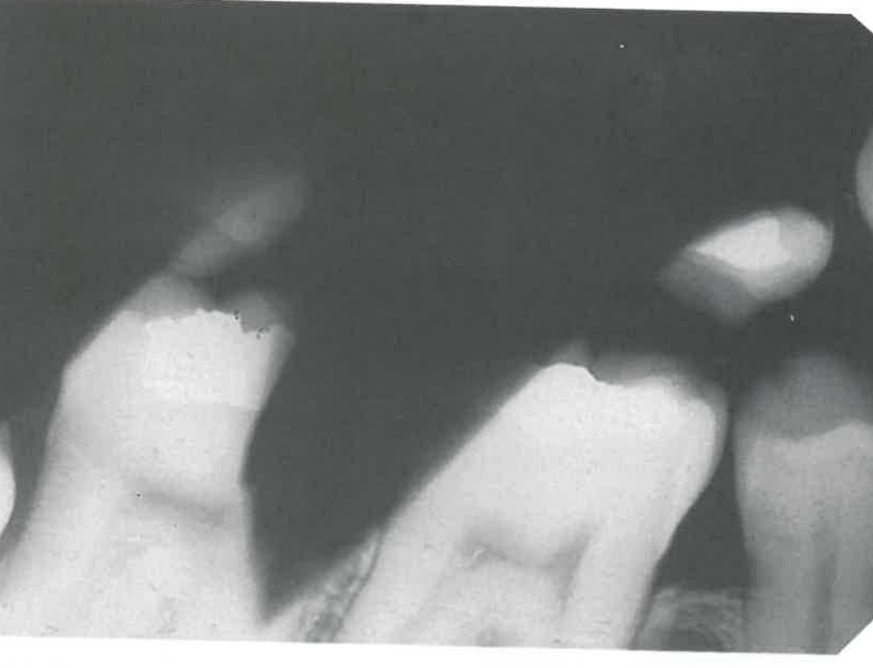
Excessive thickness of patients tissues
Film packet back to front

Slide 19
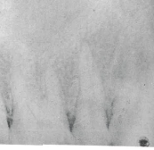
Film with inadequate or low contrast
Processing error:
Underdevelopment
Over development
Developer contaminated by fixer
Inadequate fixation time
Fixer solution exhausted

Slide 20
Image unsharp and blurred
Movement of the patient during exposure
Excessive bending of the film packet during exposure
Poor film/screen contact within a cassette
Film type – image definition is poorer with indirect action film than with direct action film
Speed of intensifying screens – fast screens result in loss of detail
Overexposure – causing burn out of the edges of a thin object
Poor position in panoramic radiography

Slide 21
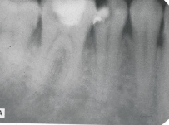

Slide 22
Film marked
Film packet bent by operator
Careless handling of the film in the darkroom resulting in:
Fingerprints, fingernails, bending, static discharge
Processing errors
Chemical spots, under fixation, roller marks, protective black paper becoming stuck to film, insufficient chemicals to immerse film fully
Patient biting too hard on film packet
Dirty intensifying screens in cassettes

Slide 23
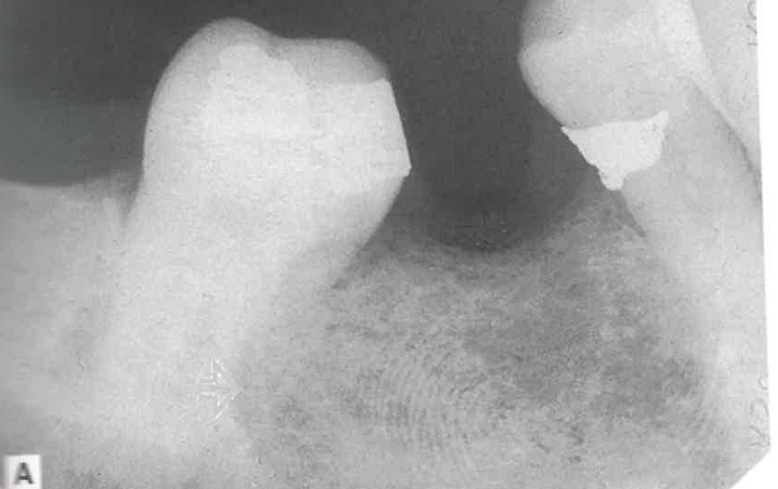
Finger print impression on emulsion

Slide 24
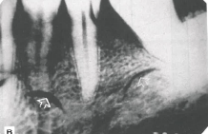
Finger nail marks

Slide 25
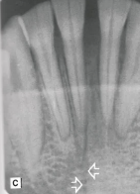
Sharply bent film, damaging emulsion

Slide 26
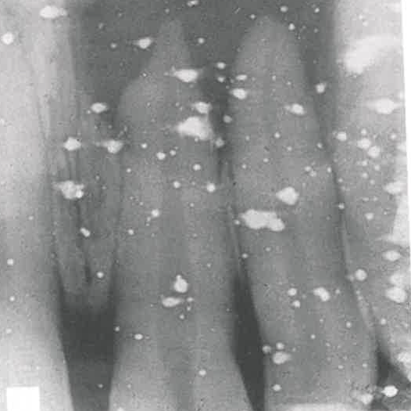
Fixer splashes on the emulsion before film placed in developer

Slide 27
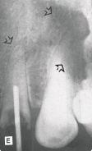
Marks caused by residual emulsion remaining following inadequate fixation

Slide 28
Correct filing and retrieval of x-rays
To file and retrieve patient radiographs, properly label and organise them using a systemic approach like patient ID or name, date, type of radiograph then store them in a secure, organised system.
This can be physical folders or digitally. This ensues quick and accurate retrieval by consistently applying your labelling and indexing methods.

Slide 29
Filing dental radiographs:
Labelling:
Patient identification – clearly label each radiograph with the patient’s fill name and a unique patient ID number
Date of radiograph – include date radiograph was taken
Type of radiograph – indicate the type of radiograph e.g. bitewing

Slide 30
Organisation:
Physical filing – use colour coded folders for different patients, or number/letter coded filing systems that align with the patient’s ID
Digital filing – store digital radiographs in the patient’s electronic record within a specialised dental software. Ensure the software’s features for attaching files to the patient records are used properly, with the radiograph saved to the correct patient chart.

Slide 31

Systemisation:
Consistent method – adopt a consistent filing system and adhere to it for all patients to prevent errors and ensure ease of access.
Backup system (digital) – for digital radiographs, ensure a robust backup system is in place to prevent data loss.

Slide 32
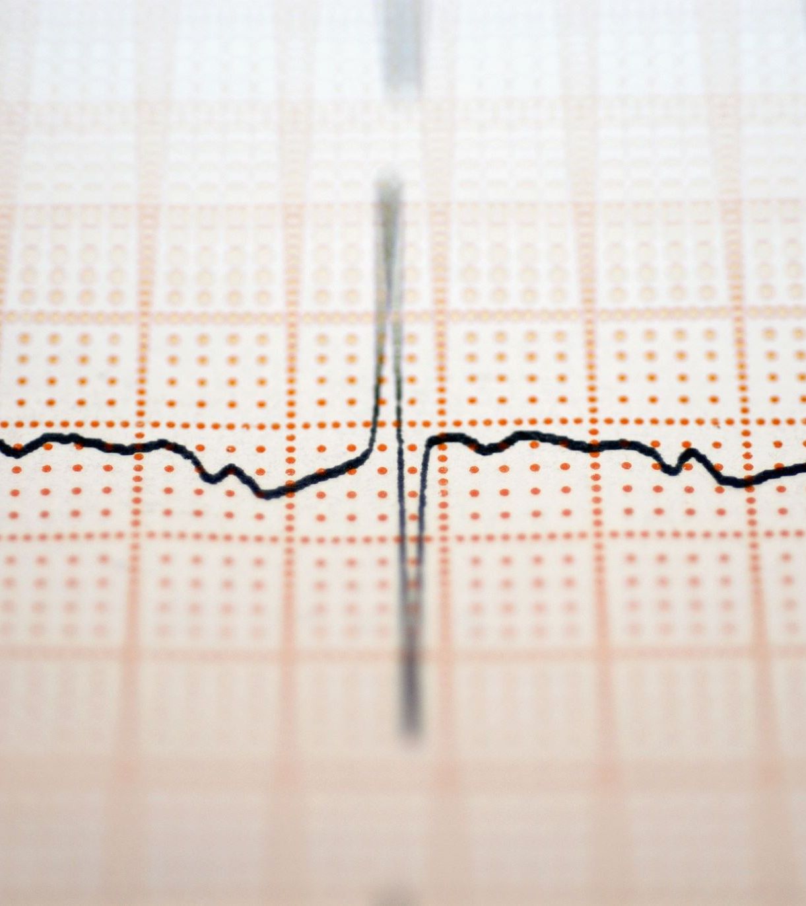
Retrieving dental radiographs:
Search strategy:
Patient name/ID – use the patients name or ID number as the primary search term in your physical or digital filing system.
Date: if you have multiple radiographs for a patient, use the date the radiograph was taken to narrow down your search.

Slide 33
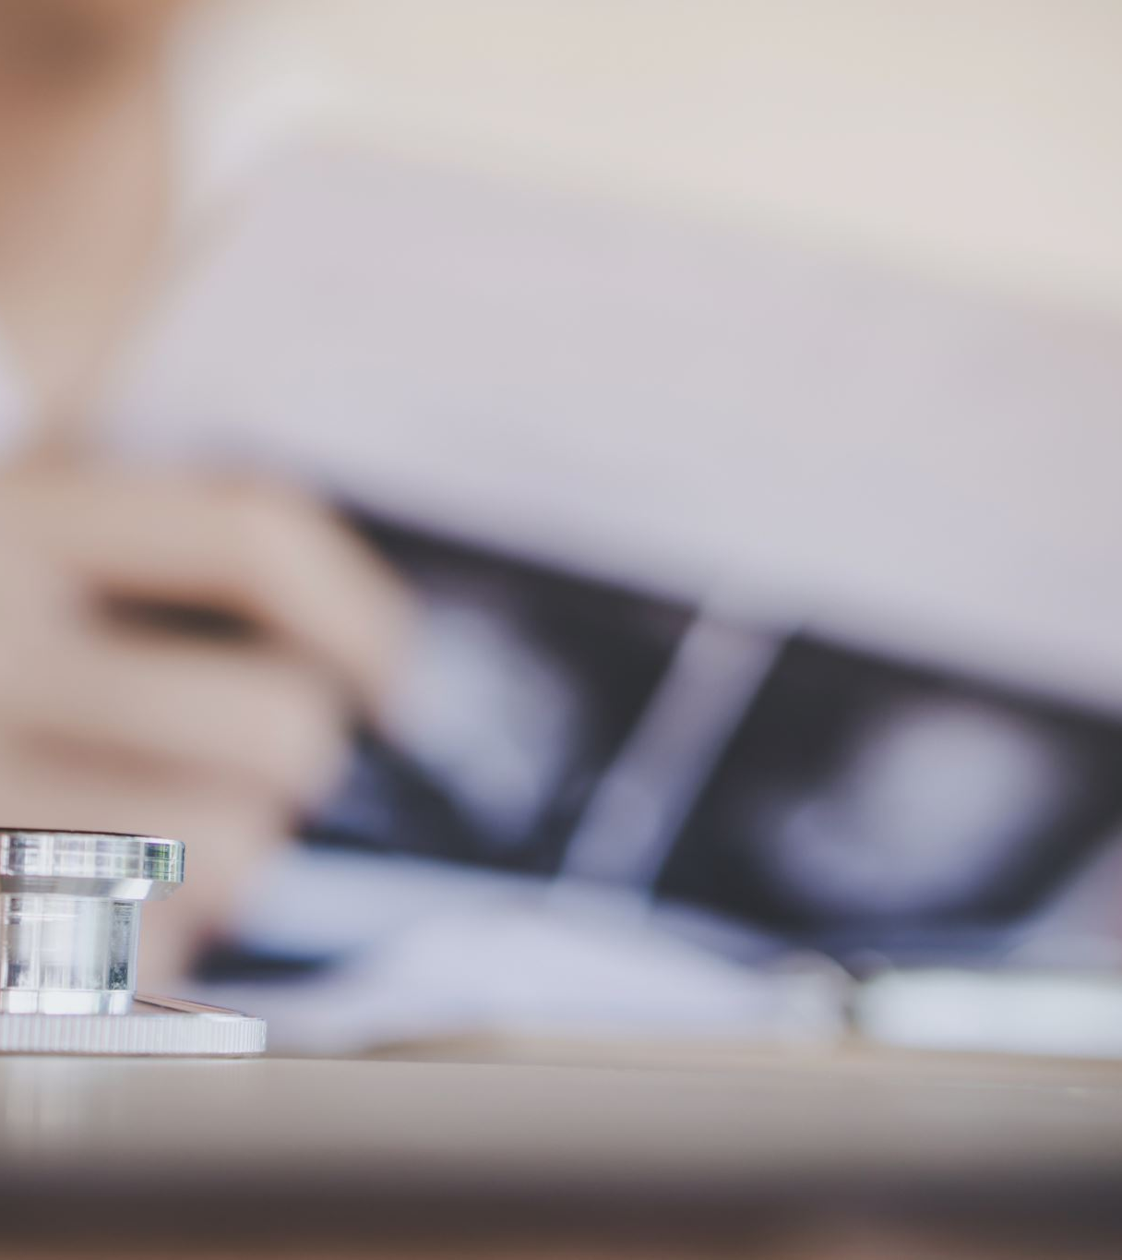
Verification:
Double check: always double check the radiograph to ensure it belongs to the correct patient and is the correct date before use.
Quality check: verify the image quality is sufficient for its intended purpose, as poor quality images can lead to misinterpretation or diagnostic errors.

Slide 34
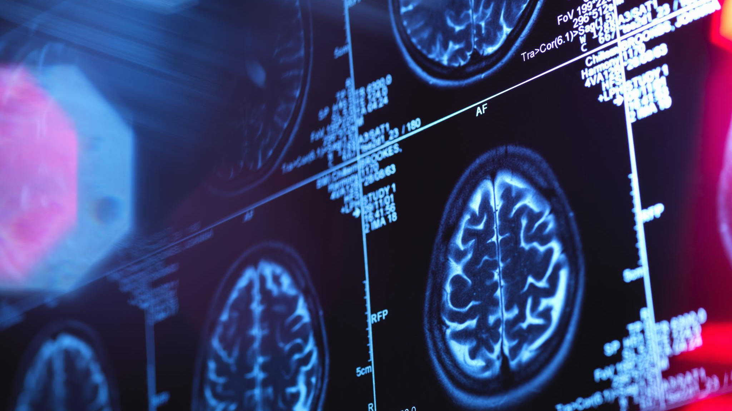
Troubleshooting:
Lost or incorrectly filed: if a radiograph cannot be found, retrace your steps in the filing system or check alternative locations. If it is digital, ensure they x-ray was saved to the correct chart and has not been accidently deleted.

Slide 35

Make and keep accurate and complete contemporaneous patient records
To create and maintain accurate and complete dental records, make entries contemporaneously in ink or electronically, including the patients compliant, history, examination findings, diagnosis, treatment options and consent.
Date and sign each entry
Identify all staff involved
Use standard dental abbreviations
Ensure all records are clear, legible and secure.
Amendments must be clearly marked, dated and signed
Records should be retained and disposed of according to current legislation
Understand and meet your responsibilities under relevant data protection legislation
Remember patients have the right to access copies of their records
Follow national advice on the retention and disposal of patient records

Slide 36
Principles of retrieval and utilisation of data stored in clinical systems:
This centres on confidentiality, security, integrity and availability, alongside legitimate use, purpose limitation and patient awareness.
Data must be accurately recorded, regularly updated, and accessible for direct care and approved secondary uses like research, which requires appropriate de-identification and a robust data governance framework.

Slide 37
Core principles for data retrieval and utilisation:
Confidentiality and privacy – patient data must be protected from unauthorised access or disclosure, aligning with principles like Caldicott principles which govern the sharing of sensitive information.
Security – systems and processes for handling clinical data must have security measures at or exceeding those for primary use, ensuring the protection of patient data.
Integrity – data must be accurate, complete and trustworthy to ensure reliable decision-making and correct record keeping.
Availability – data should be readily accessible to authorised healthcare professionals for direct patient care and other legitimate purposes, such as research and analysis.
Legitimate purpose and purpose notification – information should only be used for specific, justified purposes, with careful consideration of whether data use is compatible with the original context of collection.
Openness and patient notification – patients should be aware of the collection, storage and use of their data, including for secondary purposes.
Data minimisation – only the necessary amount of information should be shared or accessed for any given purpose
Data quality – data must be correctly recorded, regularly updated and maintained to ensure its usability and reliability.

Slide 38
Principles of confidentiality
The Caldicott Principles are the primary set of principles that apply to confidentiality in the UKs health and social care sector. These 8 principles ensure that people’s confidential information is used appropriately, securely and ethically by requiring justification for use, limiting access to only what is necessary and ensuring people understand their responsibilities regarding data protection.

Slide 39
The 8 Caldicott Principles:
Justify the purpose – every use or transfer of confidential information must have a clear, valid and documented purpose
Use only when necessary – confidential information should only be used when absolutely necessary to achieve the specified purpose
Use the minimum necessary – only the minimum amount of confidential information should be required for a specific function should be used
Access on a strict need-to-know basis: assess to confidential information should be restricted to those who genuinely need it to perform their duties
Everyone must understand responsibilities – all individuals involved with confidential information must be aware of their roles and responsibilities in protecting it.
Comply with the law – there must be a clear understanding of and compliance with all relevant legal requirements concerning data confidentiality
Duty to share information can be as important as duty to have regard for confidentiality: in certain circumstances, sharing information for individual care or public interest can be as crucial as maintaining confidentiality
Inform patients and service users: individuals should be informed about how their confidential information is being used and their rights regarding it

Slide 40

Retrieving and transferring patient data
To retrieve and transfer dental patient data, the patient typically requests the transfer, signs a release form, and the old practice sends the records securely. This may be a physical transfer of a file or x-rays or an electronic transfer. Dental practices must protect patient confidentiality by ensuring the transfer is secure and complies with data protection laws, such as GDPR.

Slide 41
Verify the request – ensure you have clear instruction from the patient to transfer the records
Verify the new recipient – confirm recipient is authorised to receive patients information
Secure the transfer – transfer the records using a secure and encrypted method. If electronic, ensure the transfer link is secure, if physical use secure methods like recorded delivery
Keep records safe – whether electronic or paper, maintain patient confidentiality and secure the data against accidental loss or damage
Adhere to data protection laws – comply with data protection legislation (e.g. GDPR) to protect patient rights and ensure the accuracy and security of the data.

Slide 42
Dental patient confidentiality is required so that dentists and their staff protect patients’ personal health information from unauthorised disclosure. This duty is a cornerstone of the dentist-patient relationship, fostering trust and encouraging patients to share complete health information for safe and effective care. Disclosure is only permitted with a patients informed consent or when legally required, such as to protect the patient or society in certain circumstances.

Slide 43
Why confidentiality is essential:
Trust – patients need to feel secure sharing sensitive information to receive proper treatment
Patient autonomy: patients have a right to control their health information and decide who it is shared with
Legal and professional consequences: breeching confidentiality can lead to investigations by regulatory bodies like the GDC, potential legal action from patients and disciplinary measures for dental professionals

Slide 44
Who is bound by confidentiality:
Dental professionals – this ethical and legal obligation applies to all dental staff
Data controllers – the practice itself, as the data controller, is responsible for implementing robust data protection policies

Slide 45
Circumstances for disclosure:
With patient consent – patients can authorise the sharing of their information with third parties, such as colleagues, or other individuals
Required by law – these are expectations when disclosure is legally mandated, such as a court order
Public interest – in rare cases, disclosure may be justified to protect the patient or the broader community

Slide 46
How to protect patient information:
Secure data: implement secure systems for both digital and manual health records
Staff training: ensure all staff understand the importance of confidentiality and relevant policies and procedures
Avoid risks: do not store identifiable information on personal devices like lap tops or mobile phones, which can lead to accidental breaches
Follow guidance: adhere to relevant professional and governmental guidance, such as that from the GDC to maintain high standards of data security.

Slide 47
Referring a patient when necessary:
A dental nurse refers a patient for future treatment by identifying the need for care beyond their scope of practice, obtaining informed consent, documenting the discussion and making the referral to the appropriate dental professional, this is a necessary part of their professional responsibilities.
The referral must be in the patient’s best interests and documented in their notes.

Slide 48
Steps to referring a patient:
Identify the need – recognise the signs or symptoms that require treatment
Ensure informed consent – explain to the patient: treatment needed, why it is necessary, risks and benefits, available alternatives, the costs
Obtain patient consent – the patient must give informed consent to the referral, and this must be documented in their notes
Document the referral – document referral discussion and reasons for referral
Make the referral

Slide 49
Key principles:
Patients best interests
Vigilance – if a sign or symptom indicating urgent referral is required, it must be acted upon without delay
Written record – providing a written explanation to the patient and documenting in the notes is essential
Scope of practice – dental nurses must adhere to the GDC standards for delegating and referring appropriately.

Slide 50
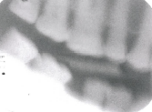
Question 1:
Describe the faults you see on this film-captured bitewing radiograph. How could the operator attempt to prevent the problems when retaking the radiograph?

Slide 51
Answer
There is conning off at the base of the image. This can be corrected by ensuring that the film is placed correctly in a film holder in the patients mouth with careful alignment of the film holder, spacer cone and collimator. The patients teeth are not biting together, and the image is blurred due to movement. Careful instruction to the patient prior to radiographic exposure can prevent movement and ensure the teeth contact the bite block.

Slide 52
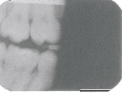
Question 2:
Describe the faults you see on this film-captured bitewing radiograph. How could the operator attempt to prevent the problems when retaking the radiograph?

Slide 53
Answer
There is coning off at the top of the image. This can be corrected by ensuring that the film is placed correctly in the holder with careful alignment of the film holder and spacer cone. The right premolar region and lower right first molar teeth are not seen due to a fogged film. This is because half of the film has been exposed to light prior to processing. Light exposure to a film may be a result of operator carelessness but also can occur if there is light ingress into a dark room or damage to the day light hood of an automatic film processor

Slide 54
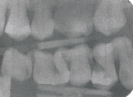
Question:
Describe the main fault in this film captured radiograph. How has this occurred?

Slide 55
Answer
The film has been exposed twice during separate radiograph examinations. There is a periapical image superimposed over a bitewing radiograph with a resultant double, dark image. Care must be taken to ensure that when a film has been exposed to x-rays that it is either processed immediately or placed to one side so that it can not be reused while further exposures are performed.

Slide 56

Additional reading
Radiography and Radiology for Dental Care Professionals
Eric Whaites & Nicholas Drage

