Slide 1

Quality Assurance
Saturday 8th November
Erin Gregg

Slide 2
AIM:
By the end of this session Dental Nurses should be confident with quality assurance, quality control and be able to participate in quality assurance programme within the practice.

Slide 3

Objectives
On completion of training, the radiography dental nurse should be able to describe quality assurance and quality control, they should be able to participate in quality assurance programme and lead a QA programme if needed.
01
Dental Nurses should be able to describe the use of 2 point quality rating scale for radiographs. This includes recognising acceptable and not acceptable film and the relevance of each.
02

Slide 4
Learning content:
Describing quality assurance and quality control along with the 2 point quality rating scale for radiographs. Recognising acceptable and not acceptable films.

Slide 5
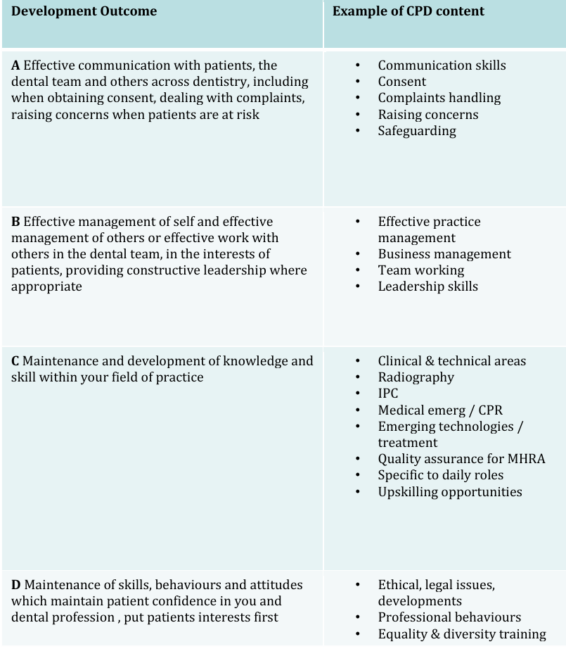
GDC content:
ABCD

Slide 6
What is a Quality Assurance programme?
According to WHO a quality assurance programme is an organised effort by the staff operating a facility to ensure that diagnostic images produced by the facility are of sufficiently high quality so that they consistently provide adequate diagnostic information at the lowest possible cost with the least possible exposure of the patient or staff to radiation.

Slide 7
What does this mean?
In other words, it is a system of procedures and checks to help ensure that the quality of the radiographs you produce are excellent, every single time.

Slide 8
Terminology
Quality control – the specific measures for ensuring and verifying the quality of radiographs produced.
Quality assurance (QA) – the arrangements to ensure that the quality control procedures are effective and that they lead to relevant change and improvement.
Quality audit – the process of external reassurance and assessment that quality control and quality assurance mechanisms are satisfactory and that they work effectively.
Image quality – compare all image against image quality criteria
Audit – review of records, the person with overall responsibility for the QA programme will undertake a full audit programme every 12 months.

Slide 9
Aims of a QA programme:
Produce diagnostic radiographs to a consistently high standard
Reduce the number of repeat radiographs
Determine all sources of error and allow their correction
Increase efficiency
Reduce costs
Reduce the radiation dose to patients and staff

Slide 10
Main areas to be addressed by the QA programme:
Staff training and updating
Image quality and film reject analysis
Working procedures
Patient dose and x-ray equipment
Darkroom, image receptors and processing
Audit

Slide 11
Look into the QA programmes within your own practice.

Slide 12
Dental radiographs are graded using a two point system.
A – Diagnostically acceptable
N – Diagnostically not acceptable
This replaced the older 3 point system and is recommended by guidance from the Health and Social Care and the Faculty of General Dental Practice.
The goal is to achieve at least 95% of digital images and 90%of film images rated as A

Slide 13
Grading scale
A – Diagnostically acceptable:
The image has no errors only minimal ones in patient preparation, exposure, positioning, processing and is of sufficient quality to answer the clinical question
N –Diagnostically not acceptable:
Errors in the patient preparation, exposure, positioning, processing, or reconstruction render the image diagnostically useless.

Slide 14
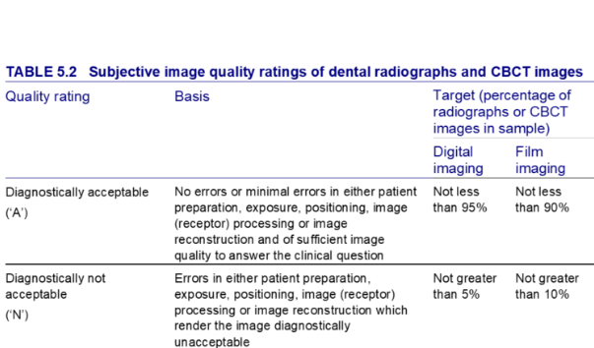

Slide 15
Quality targets
Digital images:
At least 95% should be ‘A’ (diagnostically acceptable) and no more than 5% should be ‘N’ (not acceptable)
Film images:
At least 90% should be ‘A’ (diagnostically acceptable) and no more than 10% should be ‘N’ (not acceptable)

Slide 16
How to audit quality:
Regular audits – perform audits at regular intervals, for example every 6 months
Record grades – every x-ray image should be graded ‘A’ or ‘N’ on the day it is taken, with the grade recorded in the patient’s notes
Analyse rejected images - biannual audits of unacceptable images can help identify patterns and causes of poor quality
Take corrective action – if quality targets are not being met, a qualified person must take action to improve the situation.

Slide 17
Recognising acceptable and not acceptable film and the relevance of each.
The primary indicator for recognising an acceptable dental radiograph is its diagnostic quality.
The radiograph should clearly and accurately display the necessary anatomical structures so a dentist can correctly diagnose and plan treatment.
An unacceptable film has errors that compromise its diagnostic value, making it potentially useless and requiring a retake, which increases radiation exposure

Slide 18
Recognising Acceptable Radiographs
An acceptable radiograph, classified as ‘A’, has minimal to no errors and provides sufficient information to answer the clinical question.

Slide 19
Key characteristics include:
High Contrast and Density:
Contrast: Allows for a clear distinction between different tissues, such as enamel, dentine, and bone.
Density: Refers to the overall darkness or lightness of the film, which must be correct to show all relevant structures.
Accurate Positioning:
Complete Anatomical Coverage: Ensures the entire tooth and surrounding structures, including root tips and supporting bone, are visible.
Minimised Distortion: Achieved when the X-ray beam is correctly aligned, preventing teeth from appearing stretched (elongated) or squashed (foreshortened).
Open Contacts: On a bitewing radiograph, a clear view of the space between teeth is necessary to detect interproximal decay.
Image Clarity:
Sharpness and Detail: Crucial for accurate diagnosis.
No Motion Blur: Ensures a clear and focused image, which is caused by patient movement.

Slide 20
Recognising Unacceptable Radiographs
An unacceptable dental radiograph, classified as ‘N’, has errors that render it non-diagnostic. These are often categorised by the type of error:

Slide 21
Technique and Positioning Errors:
Cone Cut: A clear or white unexposed area with a curved edge, resulting from the X-ray beam not being centred over the sensor.
Elongation: Teeth appear stretched and distorted due to insufficient vertical angulation.
Foreshortening: Teeth appear short with blunt roots due to excessive vertical angulation.
Horizontal Overlap: The contact points between teeth are overlapped, blocking the view of interproximal decay. This is caused by improper horizontal angulation.
Missing Apices or Bone: The film does not capture the root tips or sufficient surrounding bone due to incorrect film placement.
Tilted Occlusal Plane: The image of the biting surface is slanted, often caused by improper film placement.

Slide 22
Exposure Errors:
Underexposed: The image is too light and grainy, lacking detail, caused by insufficient radiation.
Overexposed: The image is too dark, obscuring anatomical structures, caused by excessive radiation.
Backward Placement of Film: Placing the film backward causes a faint image with a distinctive pattern from the lead foil.

Slide 23
Processing or Handling Errors:
Blurred Image: Any movement of the patient, sensor, or X-ray tube during exposure results in an unsharp, blurred image.
Artefacts: Any foreign objects left in the patient’s mouth (e.g., jewellery, glasses) or marks on the film from handling.
Fingerprint Marks: Touching the film with contaminated gloves during handling can leave a smudge.
Double Image: Re-exposing a film that has already been exposed creates a superimposed, undiagnostic image.

Slide 24
The Significance of Quality Assessment
To maintain high standards, dental professionals use quality assurance programs to conduct regular audits. The aim is for at least 95% of digital images and 90% of film images to be diagnostically acceptable.

Slide 25
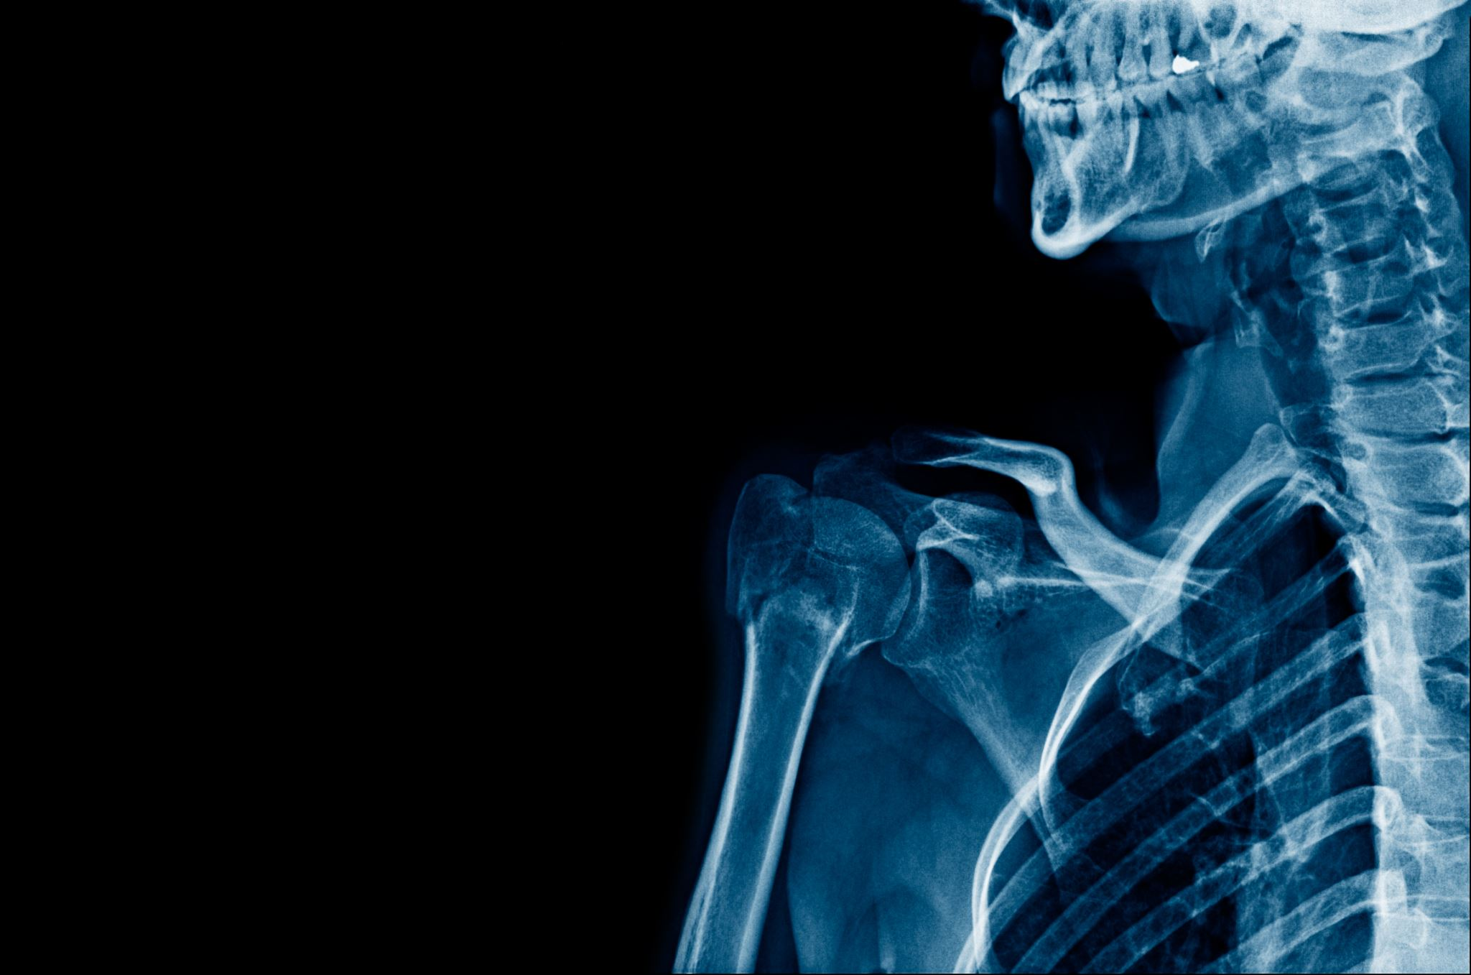
Question 1
In radiography what is meant by the term quality control?

Slide 26
Answer to question 1
Quality control is a process to review the quality of all factors involved in production; in radiography these are the specific measures for ensuring and verifying the quality of the radiographs produced.

Slide 27
Question 2
In radiography what is meant by the term quality assurance?

Slide 28
Answer to question 2:
Quality assurance is any systemic process of checking to see whether a product or service being developed is meeting specified requirements. Quality assurance ensures that the quality control procedures are effective and if there are problems that they are recognised quickly and corrected promptly.

Slide 29
Question 3
According to the World Health Organisation definition, what are the aims of a quality assurance programme in dental radiography?

Slide 30
Answer to question 3
The quality assurance programme aims to produce radiographic images of sufficiently high quality that ensure consistently adequate diagnostic information at the lowest possible cost and lowest radiation dose to patient.

