Slide 1
The role of an Oral Health Educator: Planning and evaluation of oral health promotion
By Tracy Doole

Slide 2
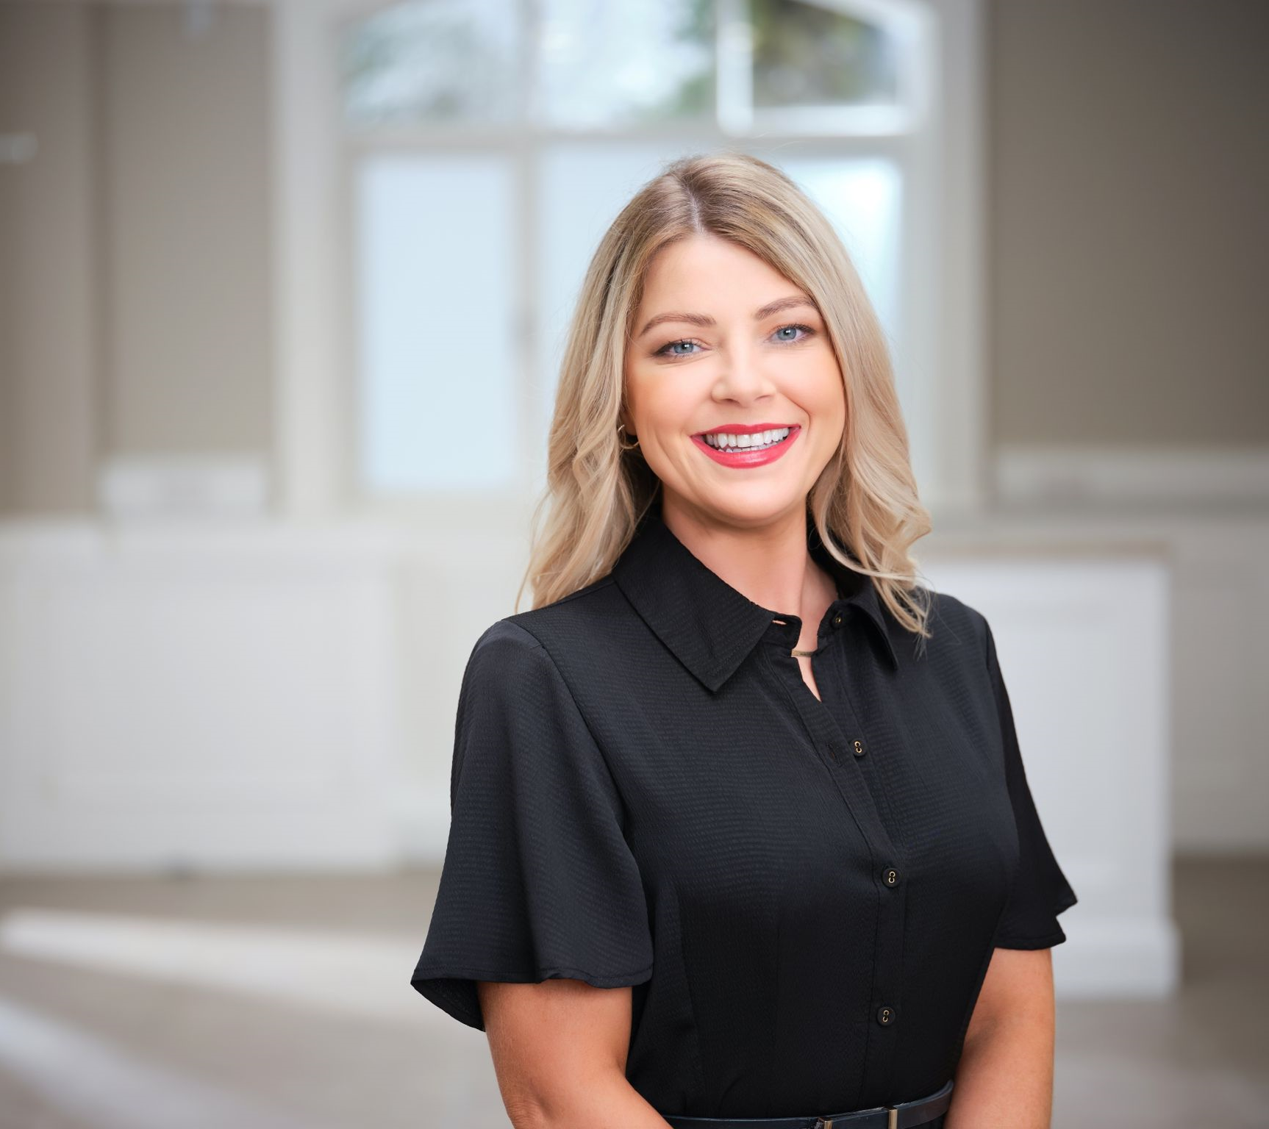
About me……..
15 + years in dentistry.
Award winning Dental Hygienist.
Private Referral Periodontal & Implant Practices.
BSDHT Executive Council Member & Regional Council Rep for NI regional group.
NSK Clinical Educator.
Clinical Representative for Young Innovations.
PG Diploma in Education, coaching & mentoring.

Slide 3
Let me hear about you !

Slide 4
Aim
To enhance understanding of the professional role of an Oral Health Educator (OHE) and develop knowledge and skills in planning, delivering, and evaluating effective oral health education.

Slide 5
Objectives
Define the role and responsibilities of an Oral Health Educator within the wider healthcare team.
Identify the key principles of oral health promotion and education.
Explain the process of planning an oral health education session, including needs assessment and goal setting.
Describe effective methods for delivering oral health education to diverse target groups.
Outline strategies for evaluating the impact and effectiveness of oral health education.

Slide 6
Learning Outcomes
Demonstrate knowledge of the scope and significance of the Oral Health Educator’s role in promoting oral health.
Apply the principles of health education when planning an oral health education activity.
Select appropriate educational delivery methods tailored to the needs of specific audiences (e.g., children, elderly, vulnerable groups).
Critically reflect on the effectiveness of oral health education sessions through evaluation tools and feedback.
Integrate planning, delivery, and evaluation to improvement for oral health education practice.

Slide 7
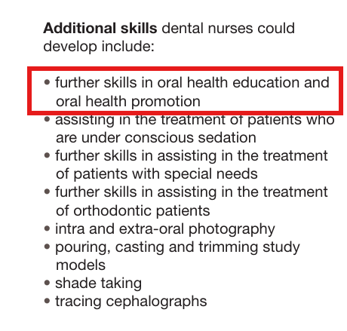
Oral Health Educator

Slide 8
NEBDN Syllabus
5.5.1 organisational requirements and limitations which may affect the success of a Preventative Dental Unit including:
Assessment of ideologies/beliefs
Access to services
Budget/finance
Resources and visual aids
Management and facilities
5.5.2 methods of planning, delivering and evaluating oral health education to patients and small groups
5.5.3 methods of evaluation and the appropriateness of these
5.5.4 different resources that may be used to develop appropriate oral health data, including:
Information Technology
Clinical Research
Literature Reviews
5.5.5 the stages of an oral health promotion exhibition
5.5.6 demographic and social trends, UK and international oral health trends, determinants of health and inequalities in health and the ways in which these are measured and current patterns

Slide 9
What is Oral health Education?

Slide 10
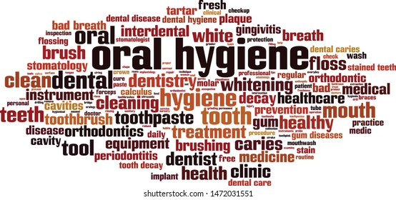

Slide 11

Aims of an Oral Health Educator:
To promote good oral health practices among individuals, communities and populations through education and awareness.
To prevent oral diseases by encouraging regular dental care and healthy lifestyle choices.
To empower individuals with knowledge and skills to take responsibility for their own oral hygiene.
To reduce health inequalities by targeting vulnerable and high-risk populations with tailored oral health interventions.

Slide 12
Objectives of an Oral Health Educator:
To deliver oral health education sessions in schools, care homes, community centers, and clinical settings.
To educate individuals on effective oral hygiene techniques, including brushing, flossing, and dietary habits.
To develop and distribute educational materials such as leaflets, posters, and digital content to support oral health promotion.
To collaborate with dental teams, schools, public health services, and other stakeholders to implement oral health initiatives.
To assess oral health needs within specific populations and tailor programs accordingly.
To monitor and evaluate the impact of oral health education programs and modify approaches as needed.
To keep up-to-date with current guidelines, research, and innovations in oral health promotion.

Slide 13
Role of an Oral Health Educator
1. Primary prevention – prevention of the onset of disease through risk education, e.g. OHI ,immunization HPV, encouraging non-smoking.
2. Secondary prevention – preventing the progression of disease, e.g. screening and other methods of early diagnosis.
3. Tertiary prevention – reducing further disability and suffering in those already ill; preventing recurrence of an illness, e.g. rehabilitation, patient education, palliative care.

Slide 14
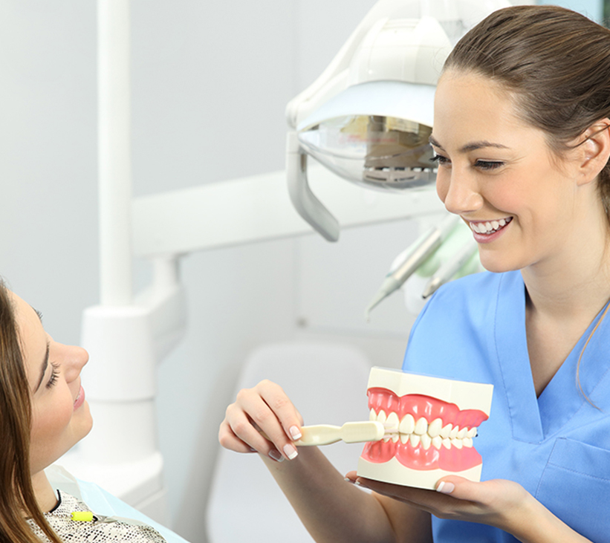
Where & What Settings?
General Dental Practice
Community Dental Service
Hospitals
Early Years Groups
Schools
Care Homes
Outreach Programs

Slide 15
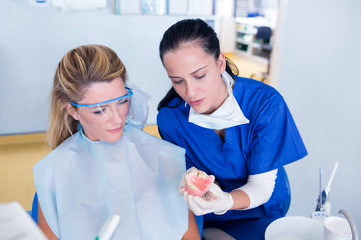
General Dental Practice
Direct Patient Education:
Oral health educators can provide one-on-one oral health education to patients during appointments, helping them understand and improve their oral hygiene routines.
Workshop Facilitation:
They can run workshops for specific groups, such as parents or children, to promote preventative care.
Material Creation:
Oral health educators can develop and distribute in-practice materials like posters, brochures, and interactive resources to reinforce key oral health messages.

Slide 16
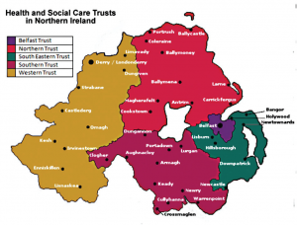
Community Dental Service
Community Outreach:
OHE can work in community centers, schools, nurseries, and public events, delivering oral health messages and promoting healthy habits.
Care Homes:
OHE can provide oral health education and support to older adults and their caregivers in care homes.
Hospitals:
OHE can work with patients in hospitals, offering oral health advice and education, particularly for those with specific health needs.
Early Years Groups:
OHE can work with young children and their families in early years settings to promote good oral health practices from a young age.

Slide 17

Other Settings
Online Platforms:
Oral health educators can create and share content online, such as blog posts, videos, and social media updates, to reach a wider audience.
Workplaces:
They can also provide oral health education in workplaces, promoting healthy habits among employees.
Charities:
They can volunteer with dental charities, participating in oral health initiatives and outreach programs.
Research:
Some oral health educators may work in research settings, studying oral health behaviors and the effectiveness of different interventions.

Slide 19
Oral health Education , what's it all about ?
Communication
conveying key oral health education/messages to a variety of patients in a variety of settings!

Slide 20
3 qualities of an OHE
Warmth – communication through non-verbal behaviours
Empathy – perceiving and understanding a situation from the viewpoint of another
Respect – an awareness that others are entitled to have feelings and perceptions different from those of the professional

Slide 21

Education
OHE pass on expertise and their own feelings about what is being taught.
Patients absorb this new information, acquires new knowledge and develops new skills and attitudes
Teaching doesn’t “ just happen “ it has to be learned/studies and planned meticulously.

Slide 22
Educational Theory
TONES
TANNAHIL
Model for health promotion (1993)
Illness is not the responsibility of the individual alone……many factors contribute to it , including social and environmental circumstances.
Model for health Promotion (1980s-1990s)
Health Education – Enhancing well‑being through knowledge, attitudes, and positive behaviours.
Prevention – Reducing disease risk via medical and behavioural interventions.
Health Protection – Using legislative, public health agency, or social measures to safeguard population health.

Slide 23
TANNAHILL Update
Framework Evolution in Practice
More recently, frameworks adapting Tannahill’s ideas have categorized intervention strategies into six types:
Environment – Altering social, economic, or physical conditions.
Policy – Organizational, local, or national policy measures.
Setting-based – Interventions in specific places or communities (e.g., schools, workplaces).
Techniques – Educational, behavioural, and engagement methods.
Provider – The people or organisations delivering interventions.
Resource – Materials or products used within interventions. These categories reflect broader approaches and address a wider scope than the original three spheres.
Health promotion: the Tannahill model revisited - ScienceDirect

Slide 24
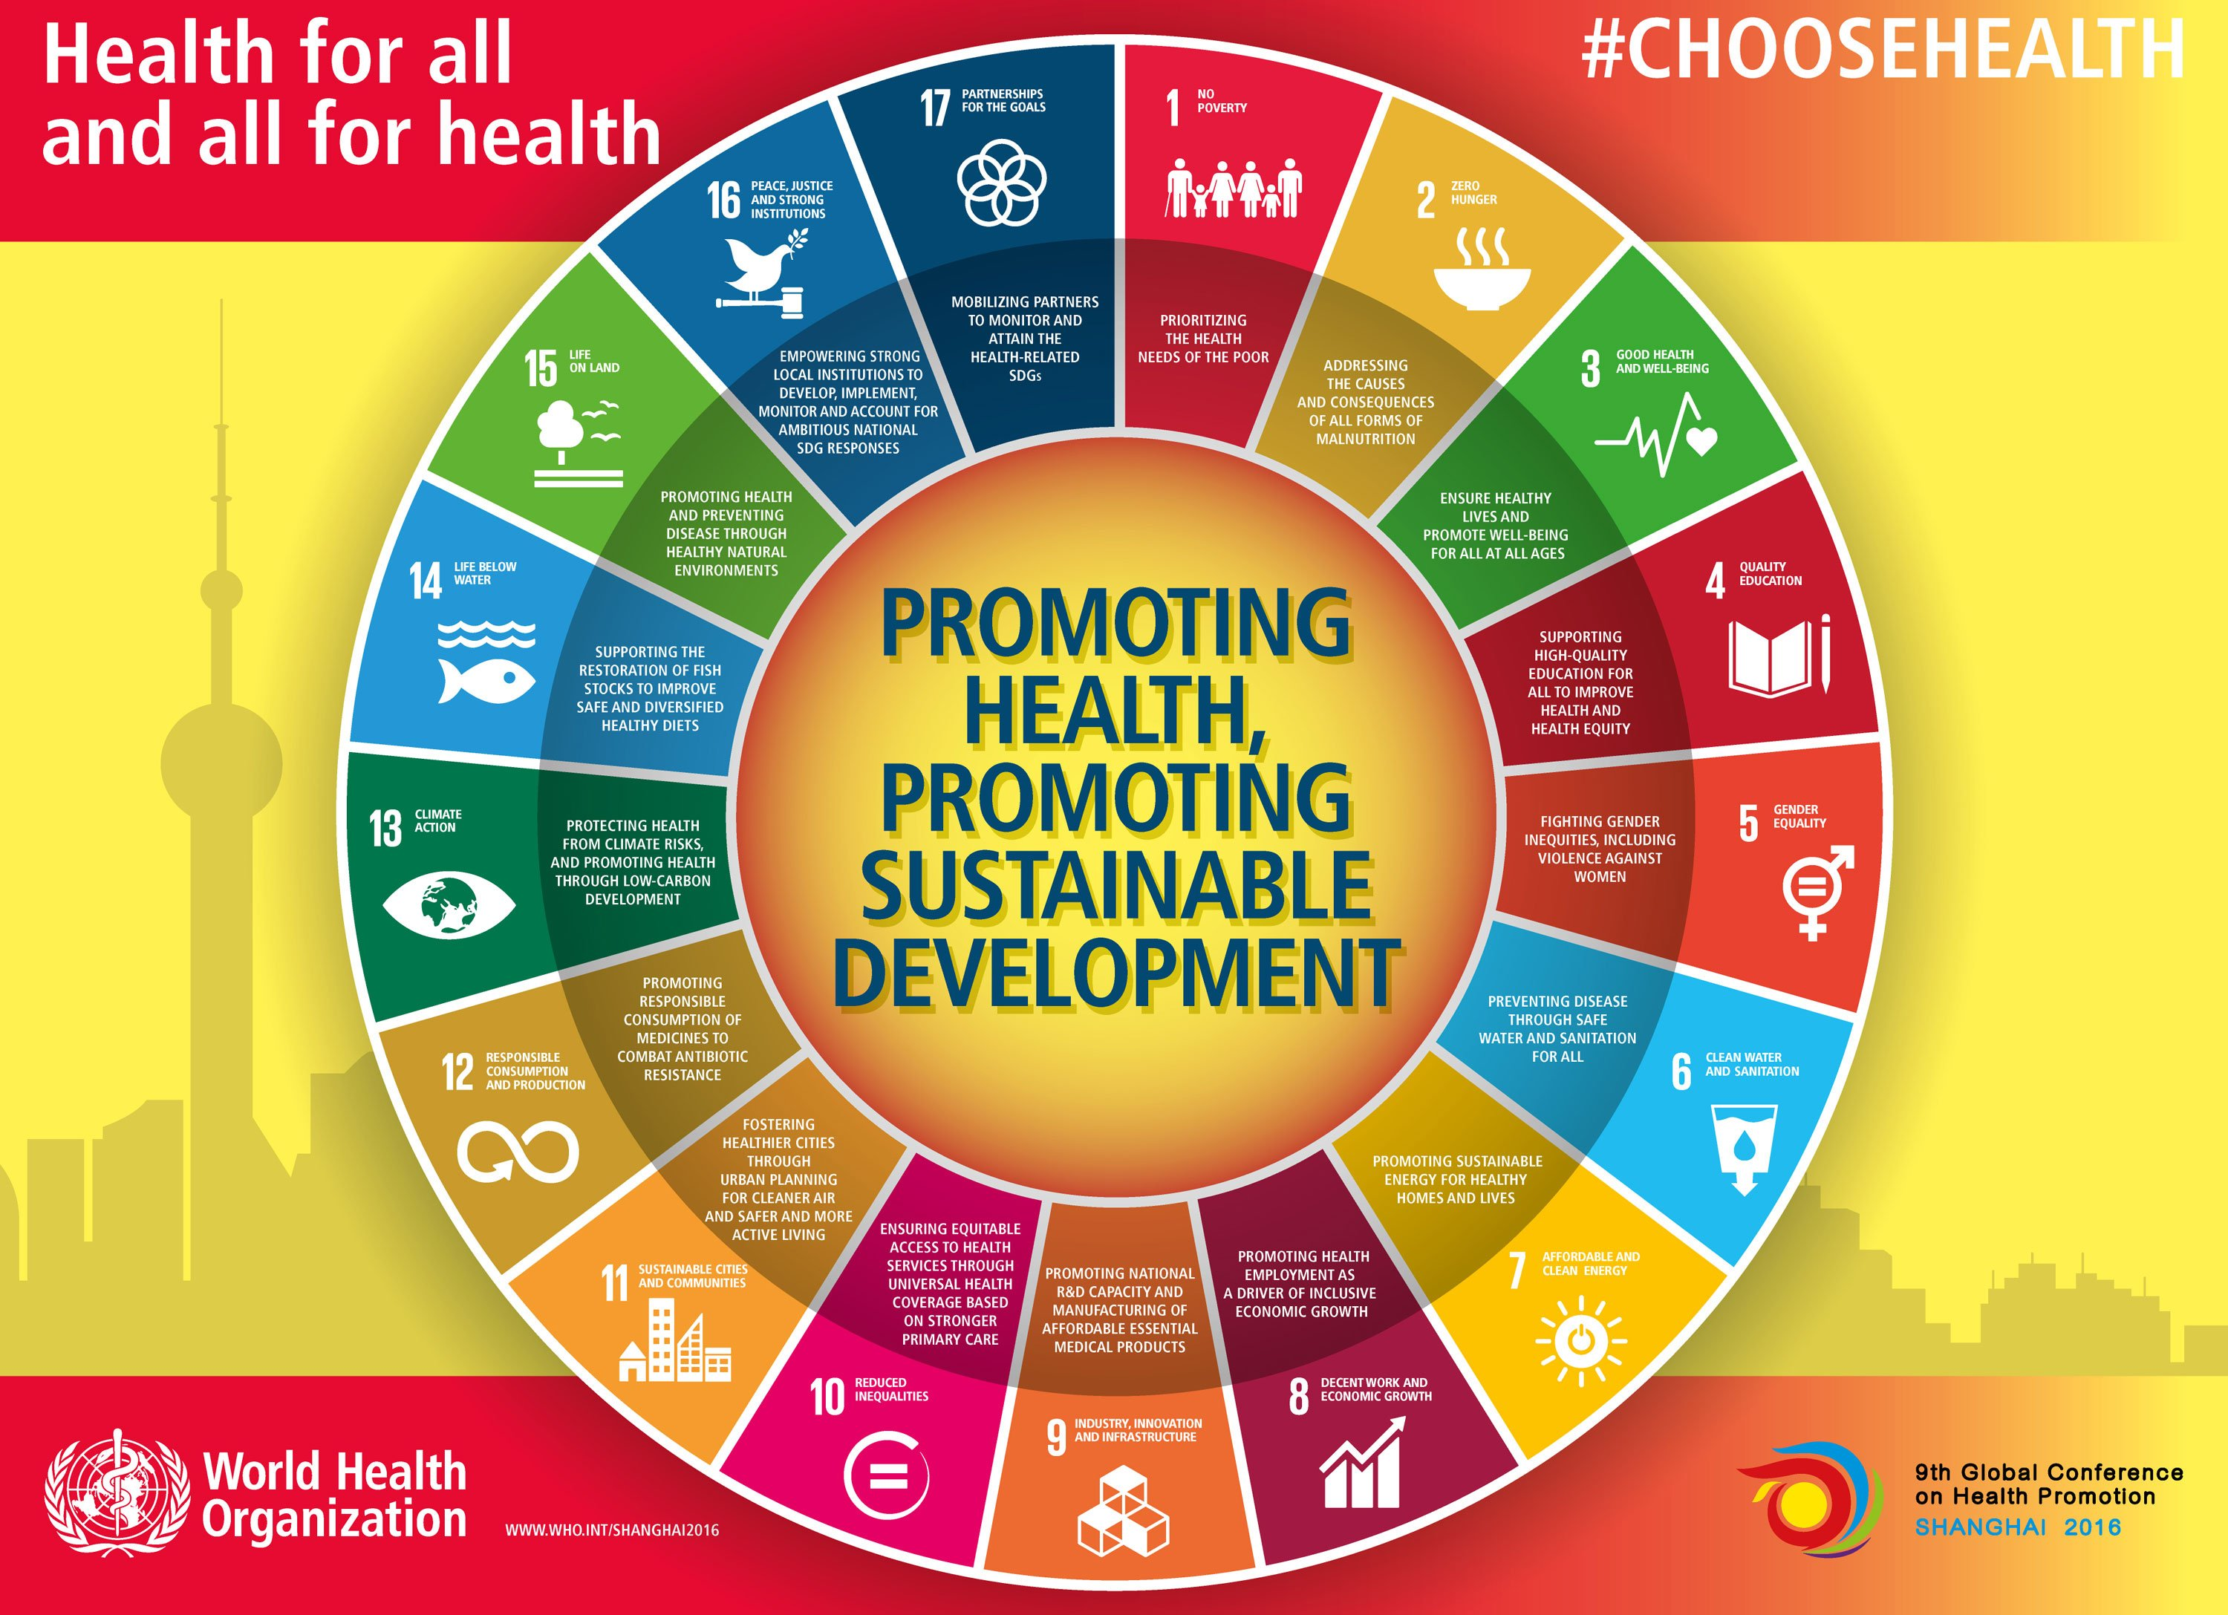
Oral Health Education
Notes:
Health promotion WHO

Slide 25

K A B
Prior to structuring a session, it is vital to decide the learning domain which it falls into:

Slide 26
3 domains for learning
Knowledge related (cognitive) – Receiving new information or explanation and thus increasing knowledge and understanding e.g. caries or periodontal disease process.
Attitude related- Forming or changing attitude, beliefs, values, opinions e.g. nervous patient being persuaded to attend a dental appointment or changing the patient perspective “all dentist are greedy for money”
Behavior related- Acquiring and/or improving on a new or existing skill e.g. toothbrushing…interdental cleaning…denture care

Slide 27
Structuring a lesson
Aims are broad, general statements of what you want to achieve. They describe the overall purpose or goal.
Objectives are specific, measurable steps you take to achieve the aim. They break down the aim into actionable tasks.
Lesson plan - detailed chronologically.
Evaluation -to gauge how successful elements of the lesson were.
*Individual or group sessions

Slide 28
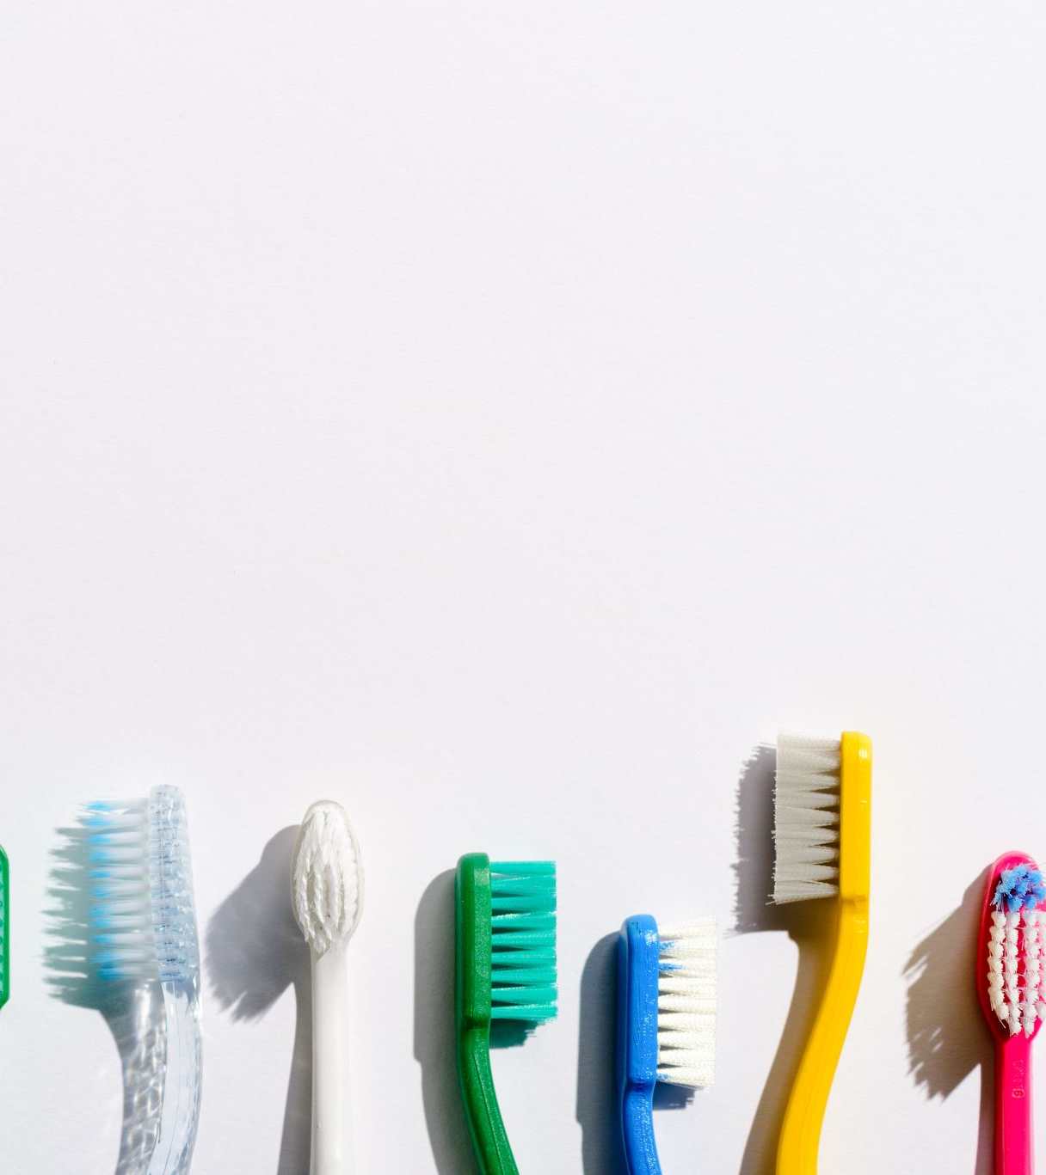
Aim
Statement of intent, purpose or goal
Brief
Clear
Simple
Concise
Comprehensive
Example : I aim to teach effective toothbrushing

Slide 29
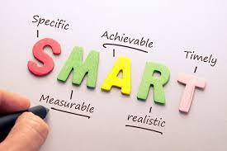
Objectives
State what the patient or group will be able to achieve at the end of the session.
SMART
S – Specific: The goal should be clear and specific.
M – Measurable: You should be able to track progress and measure the outcome.
A – Achievable: The goal should be realistic and attainable.
R – Relevant: It should align with broader goals or values.
T – Time-bound: The goal should have a clear deadline or timeframe

Slide 30
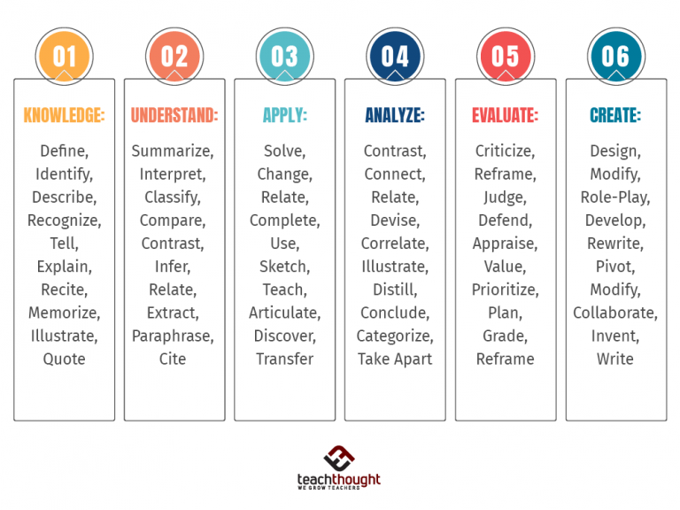
Objectives
Examples of measurable objectives: explain, describe, state, demonstrate and discuss
Avoid words such as understand , feel etc as they are unmeasurable!

Slide 31
Let's have a go!

Slide 32

How are we going to achieve said aims & objectives?

Slide 33
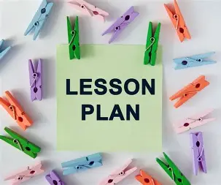
Lesson plans
Keep to the topic
Refer to objectives
Keep to teaching method
Keep to timescales
Assess how well the patient learned
Evaluate the lesson

Slide 34
Lesson Plan Example
Timing | Objectives | Subject | Method | Recourses | Evaluation Method
10.00am | Introduction | Aims & Objectives of todays session | Talk | N/a | Body Language
10.05am | Objective 1 | What is plaque | PowerPoint Presentation | Computer Equipment | Questions & Answers
10.15am | Objective 2 | What dental diseases are caused by plaque | PowerPoint Presentation | As Above | Verbal Feedback
10.30am | Objective 3 | Why & how to do we remove plaque | PowerPoint Presentation/demonstration | As above plus Toothbrush models & toothbrushes | Questions & Answers /Visual evaluation

Slide 35
Learning Styles
The VARK model is a popular framework used to describe different learning styles, helping individuals understand how they best absorb and process information. It was developed by Neil Fleming and stands for:
VARK =
Visual
Aural
Read/Write
Kinesthetic

Slide 36
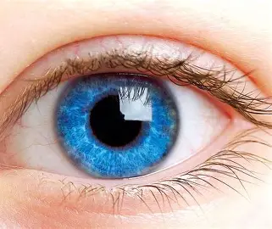
1. Visual (V) Learners
How they learn best: Through images, diagrams, charts, graphs, symbols, and spatial understanding.
Preferred materials: Maps, infographics, color-coded notes, mind maps.
Study tip: Use visuals to represent information (e.g., flowcharts, diagrams).

Slide 37
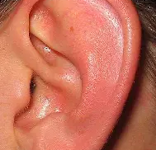
2. Aural / Auditory (A) Learners
How they learn best: By hearing and speaking.
Preferred materials: Lectures, discussions, podcasts, music, oral presentations.
Study tip: Read notes aloud, use rhymes or record lectures and listen to them.

Slide 38

3. Read/Write (R) Learners
How they learn best: Through written words.
Preferred materials: Textbooks, handouts, lists, essays.
Study tip: Take detailed notes, rewrite information, use bullet points and headings.

Slide 39
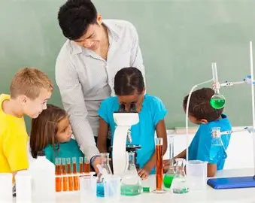
4. Kinesthetic (K) Learners
How they learn best: Through hands-on experience and real-life examples.
Preferred materials: Labs, simulations, fieldwork, role-playing, physical activity.
Study tip:Use physical objects, do practice-based activities, and connect concepts to real-world examples.

Slide 40
Multimodal Learners
Many people don’t fit into just one category—they may prefer a combination of two or more VARK styles.
These learners can switch between styles depending on the situation or subject.
VARK Questionnaire: How do you learn best?

Slide 41
Planning an oral hygiene session
Obtain background information on the individual/group you will be teaching.
Decide upon the topic.
Write clear aims and objectives.
Select teaching methods and other resources needed.
Plan assessment & evaluation.
Create the lesson plan.
Rehearse (if required/possible)

Slide 42
Planning-Things to consider
Venue (if not a PDU) location, access, size of room, facilities available
Size of group- if too big, individual attention cannot be given
Prior knowledge e.g. age
Subject relevance-topic meet their needs
Timing-not loo long , can lead to boredom & distraction
Special needs-? Physical or mental impairment
Learning abilities-highly intelligent /slow learners
Minority ethnic groups/language barriers
Social Class – think finances
Resources/motivational aids- patient friendly/easy to read, age appropriate
Cost –keep to budget

Slide 43
Preventive Dental Unit
A PDU is ideally a self contained are where OHE can be given to Individuals or small groups without interruption to provide education & preventive advice , rather than reactive treatment.
( there isn’t always room for a separate PDU but a good educator will always find a way to adapt )☺
Enthusiasm & Support from employers/employees
Budget
Suitable Location
Well trained staff to motivate & communicate your vision.

Slide 44
Preventive Dental Unit
Location:
A spare room
A partitioned area
An adapted corner/area of a dental surgery
Waiting room ( outside of surgery time) *
*Remember GDC Confidentiality
Design:
Ideally non-clinical /non-threatening area
Good lighting
Easy access ( elderly disabled)
Robust Furniture
Easily cleaning worktops (variety of heights- children, teenagers, adults etc)
Sinks
Space for Displays-e.g.posters
Larger mirrors
Motivational aids –e.g.leaflets
Appropriate Toys e.g. play foods/books about visiting the dentist /tooth models

Slide 45
Preventive Dental Unit
Organisation:
Patient Referrals
Well organised appointment system- length of appointments (small children short attention span), recall time, referrals.
Evaluation procedures-Feedback e.g. Clinical notes, coloured cards/stickers
Other things to consider:
Catchment area: city –centre, rural, suburban, industrial, ethnic minority.
Timings- E.g. lunch or dinner times, after schools, transportation links

Slide 46
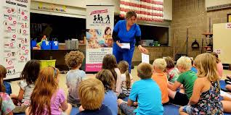
Outside a PDU
Visit venue prior to education talk to check the following:
Car parking/disable access
Size of room
Position of room? Upstairs
Lighting & electrics
Facilities e.g. computer equipment, overhead projector , Flip charts
Fixture and fittings - table, sinks, mirrors
Book date with venue/organiser- DON’T FORGET TO CONFIRM NEARER THE TIME
Obtain background information from teacher, care home staff/group leader
Decide on Visual aids, posters, displays , toothbrushes etc

Slide 47
Let's have a go!

Slide 48
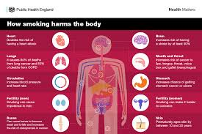
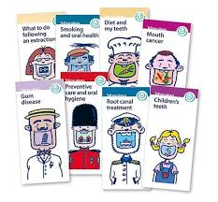
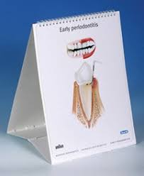
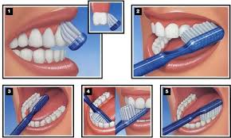
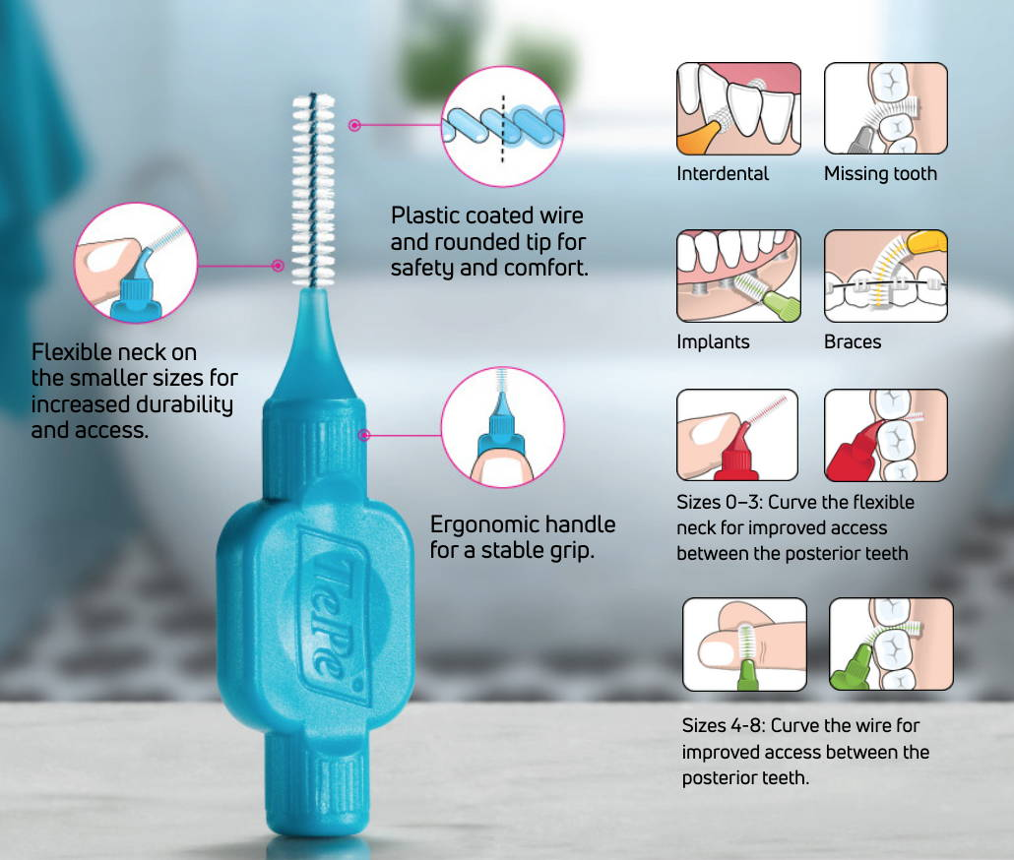
Resources & Materials
1. Printed Materials
Leaflets & Brochures – e.g., brushing techniques, flossing, diet advice, smoking cessation.
Posters & Infographics – simple visuals for waiting rooms, schools, or community clinics.
Flipcharts – step-by-step visuals for demonstrations, especially in group sessions.

Slide 49
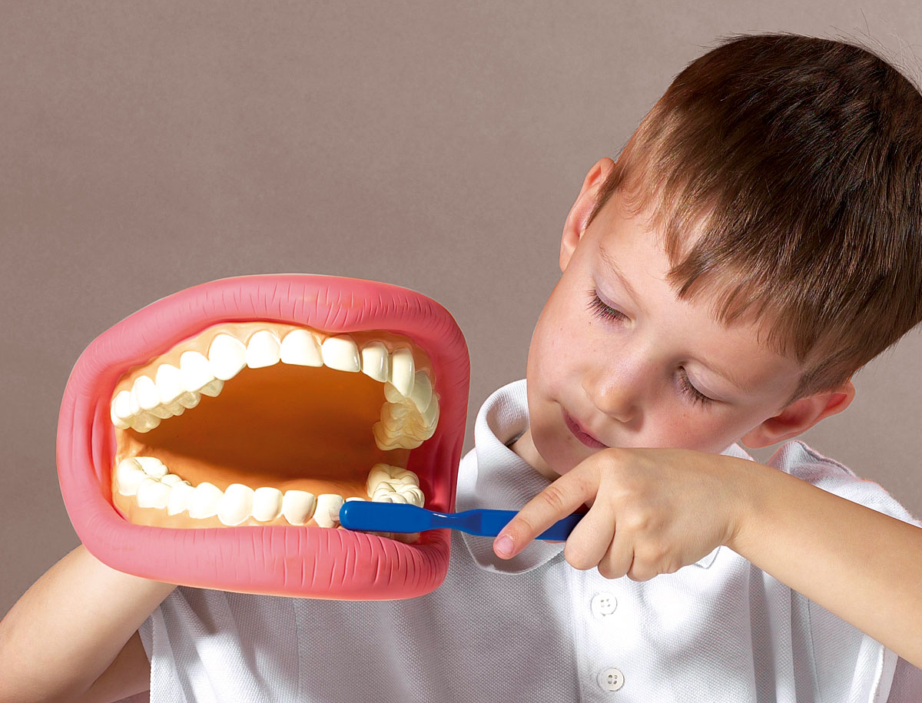
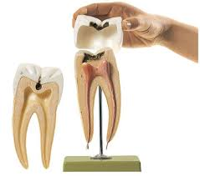
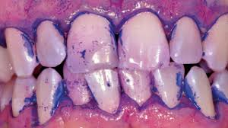
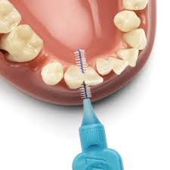
Resources & Materials
3. Demonstration Models & Tools
Large Toothbrush & Oversized Model Teeth – for teaching brushing and interdental cleaning.
Plaque Disclosing Tablets/Gels – to show patients where they’re missing during brushing.
Floss & Interdental Brushes – to demonstrate correct technique.
Removable Denture & Appliance Models – for care instructions.

Slide 50
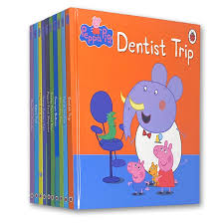
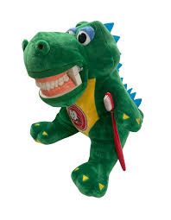
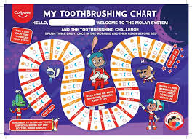
Resources & Materials
4. Educational Kits for Children
Toothbrushing Packs – toothbrush, toothpaste, stickers, timers.
Storybooks & Comics – explaining dental visits and oral health in child-friendly language.
Games & Activities – puzzles, colouring sheets, toothbrushing charts.

Slide 51
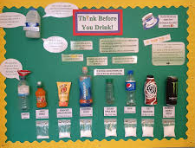

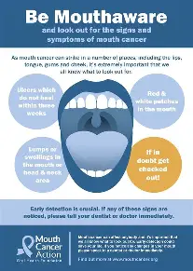

Resources & Materials
5.Community & School-Based Materials
Oral Health Campaign Packs – e.g., World Oral Health Day materials.
Interactive Workshops – with props like sugar content displays, “guess the sugar” games, healthy food models.

Slide 52
Content!
Must be scientific evidence based

Slide 53

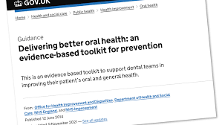

Content
✅ Key Sources of Evidence:
Public Health England – Delivering Better Oral Health Toolkit (DBOH)
Cochrane Reviews (oral health interventions)
NICE Guidelines (oral health promotion, caries prevention)
World Health Organization (WHO) oral health recommendations
FDI
SDCEP
BSPD
BSP

Slide 54
Evaluations
Why ?

Slide 55
Evaluations
Benefits for Educators
Professional Growth:
Evaluation provides evidence of successes and areas for improvement, supporting personal career development and ongoing professional growth.
Improved Practice:
It offers insights into teaching practices, helping educators reflect on their work and develop more effective teaching strategies.
Refinement of Teaching:
Regular evaluation allows teachers to adjust their methods and responses to current students, rather than waiting until the end of a course.
Benefits for Students
Enhanced Learning:
By identifying misconceptions or ineffective approaches, evaluation helps ensure that learning objectives are met, leading to better student outcomes.
Tailored Support:
Evaluation can highlight students who need targeted individual support or intervention, allowing for timely assistance.
Better Course Design:
Feedback from evaluations helps in redesigning courses to be more effective for current and future learners.

Slide 56
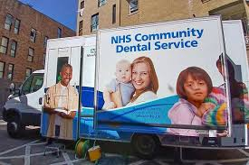

Evaluations
Benefits for Institutions
Program Improvement:
Evaluation helps assess the overall effectiveness and efficiency of programs and initiatives, ensuring resources are directed toward practices that deliver results.
Informed Decision-Making:
Data from evaluations provides evidence for decision-making related to curriculum development, resource allocation, and staff development.
Accountability:
It provides a mechanism to ensure that teaching and learning objectives are achieved and that efforts are effective and efficient.

Slide 57
Evaluations
Knowledge-Based Evaluation:
Pre- and Post-Questionnaires – test what people know before and after an education session.
Quizzes / Oral Q&A – quick checks for understanding during or after teaching.
Reflection Sheets – patients or students write what they’ve learned.

Slide 58
Evaluations
Skill-Based Evaluation:
Return Demonstration – patient shows you brushing or interdental cleaning technique.
Checklists – used by the educator to assess technique accuracy.
Simulation Models – learners practice on models and are scored on performance.

Slide 59
Evaluations
Behavioural Evaluation:
Self-Reported Behaviour Changes – e.g., frequency of brushing, sugar intake, smoking.
Brushing Charts / Diet Diaries – especially for children to track routines.
Follow-Up Appointments – check if advice is being put into practice.
Body Language – are they closed of? Are they maintaining eye contact?

Slide 60
Evaluations
Clinical / Oral Health Outcomes:
Plaque Scores – using plaque disclosing tablets before and after education.
Bleeding Index / Periodontal Charting – to check improvement in gingival health.
Caries Incidence – tracking reduction in new cavities over time.

Slide 61
Evaluations
Attitudinal & Perception Evaluation:
Surveys / Likert Scales – to measure changes in attitudes (e.g., importance of flossing).
Focus Groups / Interviews – to explore opinions, barriers, and motivation.
Feedback Forms – simple “Was this useful?” style questions.

Slide 62
Resources
https://southerntrust.hscni.net/service/dental-services/
https://setrust.hscni.net/service/community-dental-service-2/
https://www.northerntrust.hscni.net/services/dental-services/
https://westerntrust.hscni.net/service/community-dental-services/
https://belfasttrust.hscni.net/service/dental-services/
Delivering better oral health: an evidence-based toolkit for prevention - GOV.UK
Oral Hygiene TIPPS | Prevention and Treatment of Periodontal Diseases in Primary
Better Health Start for Life Top Tips For Teeth | Campaigns | Campaign Resource Centre
teethmatter.pdf

Slide 63
Resources
The British Society of Periodontology | BSP
Home- BSPD
Scottish Dental Clinical Effectiveness Programme – SDCEP
About us | FDI World Dental Federation
Oral health- WHO
Colgate® Professional | Home
Professionals- TEPE
Resources and courses for dental professionals- Oral B

