Slide 1
RoC
Expanded Case Study (ECS)
Saturday 4th October
Erin Gregg

Slide 2
AIM
The aim is to use this lesson plan as a guide to assist Dental Nurses to confidently write up their ECS and be aware of how to format the document.

Slide 3
Objectives
By the end of this lesson dental nurses will be confident on what content to include in their ECS RoC and how to present it.

Slide 4

Learning content:
This session is designed to provide dental nurse oral health educators with the necessary support and knowledge to successfully complete the Extended Case Study section of their Record of Competency.

Slide 5
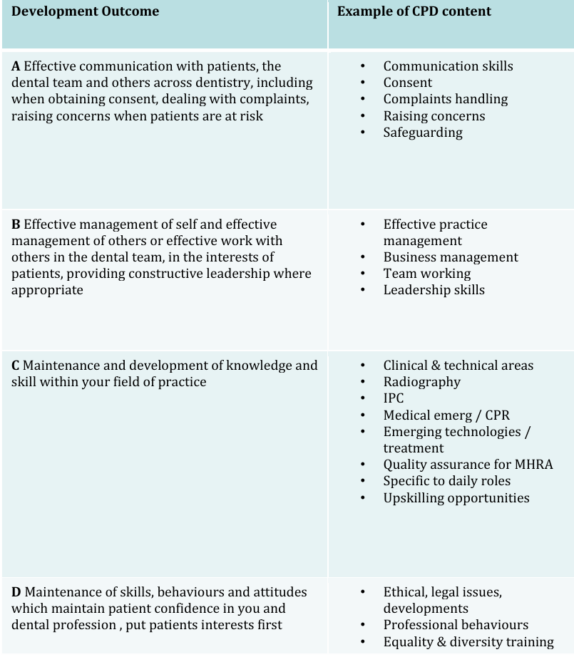
GDC outcomes:
A,B,C,D

Slide 6
Requirements
Choose one patient for the production of a detailed case study. The patient may already be included in the PCAS

Slide 7
Typed in a standard size 12 font
The text should be double spaced
The case study should be separated under the subheadings given (discussed in later slides)
Patients must be non-identifiable
e.g. – Patient A, blacking out patients eyes in images, patient details blacked out of any forms used
Written consent for photography must be sought and help in patients records for future reference
References are expected to be used to support information within the case study. These are expected to be referenced in the standard way
Word count must be declared. This includes sub headings but does not include the list of references/appendices
The case study must be original and your own work
Word count – 2250 - 2750

Slide 8
1 ECS from patient group:
Pregnant / nursing mother
Parents of pre school children (under 4)
Parents of primary school children (5-11)
Adolescent (12-15)
Adults (16-64)
Seniors (65 and older)
Special needs / medically compromised

Slide 9
ECS subheadings
Source of patient referral
Who referred the patient and any specific information the referral contained
Age of patient
The patients age must be described and the relevance this has on the patient’s oral health, e.g. reliance on parents / carers, the key oral health risks / targets for the age group
Patient’s presenting problem
Describe the specific oral health problem(s) that you have been asked to advice upon. The severity and prognosis of the condition should also be described including the results of any objective assessments that have been undertaken, e.g. BPE score

Slide 10
Other health problems affecting the patient
Detail any relevant medical history. This would include conditions that have contributed to the current oral health needs or where poor oral health may be a risk factor
Discuss the way in which oral health is affected or may affect these conditions should be described
Anonymous copies of medical histories may be included as an appendix

Slide 11
General social circumstances
Work through the patient’s social circumstances and where relevant describe:
How they affect the current oral health
How they may be barriers to obtaining or providing oral health care
How they may affect the way in which you plan / deliver oral health education
Any general health information you may need to deliver, e.g. smoking cessation

Slide 12

Contacts with other disciplines
Detail why and how they may have had to communicate with other disciplines, e.g. members of the oral health team, wider health team, social care team, education providers
Needs of patient
Describe the current oral health needs of the patient as detailed in the clinical records, highlighted by talking to the patient or observed by looking at the patient

Slide 13
Assessment of patient’s knowledge, skills and attitudes
Describe how they have completed this assessment, their findings and how these modify, complicate or simplify the oral health education required
Aims and Objectives
Clearly state their aims and objectives for their role in the oral care plan
These should be reasonable, meet current best practice, be achievable and measurable
Attempt to prioritise these points

Slide 14
How to write aims & learning objectives
Lesson Aim:
This is your overall goal for the session – the big picture outcome you hope to achieve by the end.
Example:
To raise awareness of how to prevent dental caries through good oral hygiene and dietary choices.

Slide 15
Learning objectives:
These are specific, measurable things the patient should be able to do or show by the end of the session. They are how you assess whether your aim has been met.
Good objectives are:
Realistic – achievable within a short session
Patient focused – what they’ll do not what you’ll do
Measurable – something you can observe or check

Slide 16
Objective examples
By the end of the session:
The patient will be able to demonstrate the correct tooth brushing technique using a model.
The patient will be able to identify one sugary food or drink they can reduce or swap out in their diet
The patient will be able to state how often they should visit the dentist.

Slide 17
Vague Objective: | Measurable alternative
Understand proper brushing | Demonstrate correct brushing technique
Understand the importance of dental visits | State how often they should see a dentist
Know what causes caries | Identify one cause of tooth decay (e.g. sugar)

Slide 18
Planning and format
Demonstrate that you have developed a carefully planned programme of oral health education
The format of each stage of the process should be described
The template lesson plan (provided at the end of the RoC) should be completed
Resources and teaching aids
Describe any resources and teaching aids used
Justify the use of each aid, photographs may be included

Slide 19
Evidence based research
Evidence of research should be observed throughout the case study. Describe any research they have done which related to the patient’s needs, oral condition or general condition which hasn’t been included elsewhere
Limitations
Describe any barriers faced when caring for this patient and how this impacted on the planning and delivery of the sessions

Slide 20
Methods of evaluation
Detail all of the ways in which they evaluated to initial stage of the oral health education, e.g. questioning, examination, disclosing, feedback from parents / carers

Slide 21
Results
State the results of the above evaluation. These should be related to the initial aims and objectives
Aims and objectives that have been met should be acknowledged
Aims and objectives that have not been met should be acknowledged
State how you plan to modify the plan to address this

Slide 22

Changes patient / self
Reflect on any change in the patient following this period of care. This will include their oral health, but also their attitudes, knowledge and priorities
List any specific changes in themselves following this treatment in particular anything new they have learned or anything they have found does not work well
Follow up visits
Describe any follow up care arranged for the patient with yourself or another clinician
The reason for and timing of the follow up should be detailed

Slide 23
Achieved aim & objectives/learning outcomes
Now look back again at your initial or modified aims and objectives and for each state how fully it has been met and how you have assessed this
Where there are outstanding elements you must suggest how these could be tackled differently in the future
Self-Reflection
Complete a section of self-reflection. They should describe what you did well and what they did less well
How this experience has altered or reinforced your clinical practice should be described
Any further training or research needs should be identified

