Slide 1

Patient anxiety, expectations and experience of dental care
Saturday 4th October 2024
Erin Gregg

Slide 2
Aim
Provide dental nurse oral health educators with the knowledge to describe and recognise patient anxiety, levels of anxiety and how to communicate in an appropriate manner to improve oral health care.

Slide 3
Objectives
On completion of training dental nurse oral health educator should be able to describe varying levels of patient anxiety, experience and expectations of dental care.
Dental nurse oral health educator should be able to identify patient anxiety and communicate in an appropriate manner to improve oral health care

Slide 4
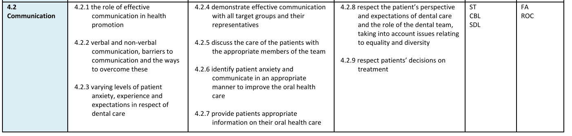

Slide 5
What is anxiety?
Anxiety is an unpleasant emotional state characterised by fear and a variety of physical symptoms.
Dental anxiety ranges from mild uneasiness to panic attacks
When a person refuses to attend the dentist this is knowns as dental phobia
Dental anxiety and phobia lead to avoidance of dental care

Slide 6
Look for verbal and non-verbal cues such as:
Apprehension
Fast pulse rate
Over breathing
Raised blood pressure
Sweating
Tremor
Dilated pupils
Incontinence

Slide 7
Anxiety can be categorised into 4 levels
Mild – normal helpful response
Moderate – a narrowing of focus
Severe – significant reduction in the perceptual field. Symptoms such as increased heart rate
Panic – overwhelming level of fear which results in impaired functioning

Slide 8
Cycle of dental anxiety
Dental fear
Delayed visiting
Dental problems
Symptom driven treatment

Slide 9
Sources of anxiety
Negative past experience
Fear of the unknown
Second-hand learning
Fear of needles
Loss of control
Media representations
Information and communication

Slide 10
Consequences of high anxiety
Poor oral health
Treatment difficulties
Behavioural issues

Slide 11
Strategies for managing anxiety
Provide control
Relaxation and distraction
Create a calming environment
Regular visits

Slide 12
Expectations Vs Experience
Anticipated pain
Misaligned expectations
Emotional v physical experience

Slide 13
Factors influencing experience
Type of procedure
Patient – Dentist relationship
Distress tolerance

Slide 14
Managing anxiety and improving experience
Open communication
Managing expectations
Building rapport
Using distraction technique
Regular dental visits

Slide 15
Communicate by actively listening, expressing empathy and speaking clearly and slowly in simple terms.
Offer reassurance, provide clear information, help them learn long term coping strategies like deep breathing techniques

Slide 16

Further reading:

Slide 17

Question

