Slide 1
Barriers to Communication
Oral Health Education 2025
Catriona Thornton

Slide 2

Aims:
To have a better understanding of the barriers to communication that may impact on the delivery of oral health education

Slide 3

Objectives:
Recognize, understand, and mitigate the obstacles that hinder clear and accurate information exchange
Enhance productivity: Clearer communication prevents errors in tasks, helps meet deadlines, and ensures that everyone is aligned on what needs to be done and why.
Identify patient anxiety and communicate in an appropriate manner

Slide 4

Learning Content:
This training session is intended to create an understanding of the importance of respecting the patient’s perspective and expectations of dental care and the role of the dental team, taking into account issues relating to equality and diversity

Slide 5
Development Outcomes:
This course meets the criteria for the
GDC's development outcomes A,B,C and D

Slide 6
GDC Focus on Standards
Principle 2 : Communicate effectively with patient's
2.1 You must communicate effectively with patients – listen to them, give them time to consider information and take their individual views and communication needs into account
2.1.1 You must treat patients as individuals. You should take their specific communication needs and preferences into account where possible and respect any cultural values and differences.
2.1.2 You must be sufficiently fluent in written and spoken English to communicate effectively with patients, their relatives, the dental team and other healthcare professionals in the United Kingdom.

Slide 7
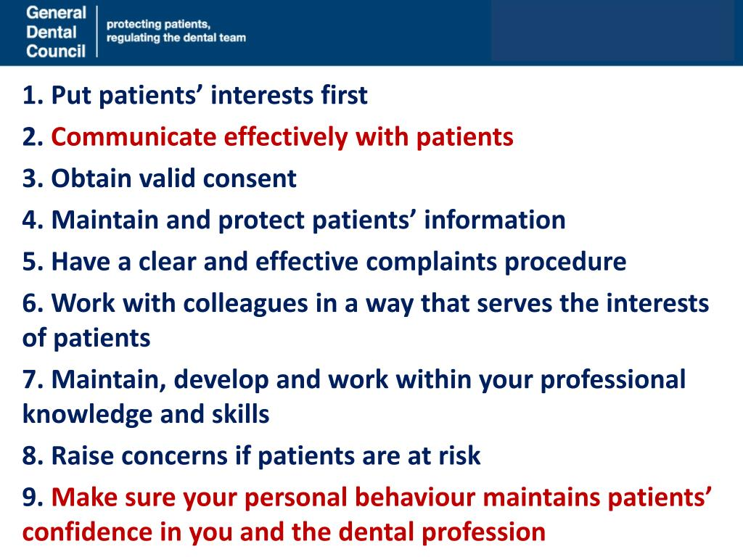
General
Dental protecting patients
Council regulating the dental team

Slide 8
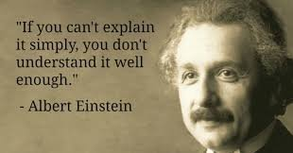
A barrier is anything that will get in the way of communication:

Slide 9

Barriers to effective communication:
Barriers to effective communication are obstacles that impede the successful transmission and understanding of a message.
These can include:
Physical factors like distance and noise.
Psychological factors like stress or emotional state
Language and cultural differences
This can also include poor listening skills, issues with the message itself like jargon or information overload.

Slide 10

Specifically, the barriers to effective communication are:
Language
Age difference
Content
Lesson preparation
Over emphasis of the cognitive domain
Class management
Teaching strategies
Media
Culture
Socio economic status
Attitudes and motivation
Noise

Slide 11
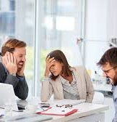
Physical barriers:
Environment issues with background noise, poor office layout, or a lack of privacy can make it hard to communicate.
Physical distance, such as in remote work setups, can reduce connection and make communication less effective.
When someone has physical conditions that create communication difficulties, for example, being breathless, not having any teeth or being in pain.

Slide 12

Emotional and Psychological barriers:
Strong emotions like anger, stress, anxiety, or depression can affect the ability to concentrate and communicate clearly or in a sensible way.
Fear of judgment can make individuals hesitant to express themselves openly.
Unresolved conflict between people creates a significant barrier to open and effective communication.
Sitting too close could be intimidating making an individual feel uncomfortable. Sitting too far away could show lack of interest or concern.
Stereotyping can lead to misunderstandings and failure to communicate with empathy.

Slide 13
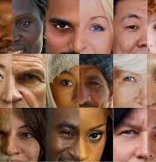
Language and cultural barriers:
Differences in native languages or accents can lead to miscommunication.
Variations in communication styles, values, and nonverbal cues across cultures can cause misunderstandings.
Using specialized or technical terms that the audience may not understand creates a barrier to clarity.
Generalisations about a group of people that are wrong and misleading.
An example would be that ‘all older people are hard of hearing’.

Slide 14
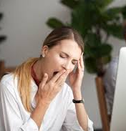
Message-related barriers:
Poor clarity with being vague, ambiguous, or overly complex explanations can obscure the intended message.
Providing too much information at once can overwhelm the listener and lead to them missing key points.
A lack of attention, jumping to conclusions, or preparing a response while the other person is still speaking impedes effective listening.
Unorganized information makes it difficult for the receiver to follow and understand.

Slide 15

Other barriers:
Conducting a private conversation in an inappropriate or public place is a barrier.
Think carefully about where and when private and confidential conversations should take place.
Not giving individuals time to say what they want may make them feel rushed and reluctant to express their true wishes.
When the technological aids known to be the best way for someone to communicate are not available.

Slide 16

Poor communication:
Poor communication can quickly lead to confusion and distress.
The process of exchanging information through communication is not always straightforward.
If the information shared is inaccurate or misleading, mistakes can be made which can result in poor care.

Slide 17
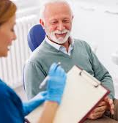
Reducing barriers to communication:
As an Oral Health Educator you should do what you can to reduce any barriers to communication.
The most effective way to make sure that you are meeting someone’s communication needs and providing person-centred care is to know as much as possible as you can about them.

Slide 18
A ‘communication passport’
This helps to provide vital information about the patient's needs, wishes and preferences.
It pulls together the information into a format that is easy to read, often with pictures and photographs.
Putting something like this together with an individual can be another good way of getting to know them well and understanding their needs.
Your organisation might have a suggested format but at a simple level you can put one together with the individual to suit them.

Slide 19
Regular feedback:
It is important to get regular feedback about your communication style and methods from the people you provide care and support to so that you can continue to improve how you communicate.
You could also increase your awareness of different communication needs and methods through taking up learning opportunities.
Experience will help you to develop a variety of new methods of communication and selecting the best one in each situation.
Be creative. Open body language and a positive, non-judgemental attitude will further help reduce barriers. Your communication skills should be seen as a toolbox, using the right tool for the right job and choosing a different tool if one doesn’t work well.

Slide 20
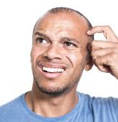
Checking understanding:
Checking that communication has been understood is an essential part of the process.
This means to think about the main points of the conversation or communication and shorten or simplify them in order to repeat them back to the individual.
This will help to check your and their understanding.
A vital skill that checks understanding is summarising.

Slide 21

Summarising:
A summary should bring together the main points of an exchange of information.
This will allow the individual to correct you if necessary. This can help you to check that you have correctly understood.
Questions are another way of checking whether a message has been received.
Make sure you ask questions in a way that the individual has to provide a detailed response (open questions), rather than asking questions which require only a ‘yes or ‘no’ reply (closed questions).
For example: ‘What do you like to do in your spare time?’ However, closed questions can be useful in some situations.

Slide 22
Additional information and support:
Information and support on particular communications needs can be found from specialist associations and charities, especially those specialising in particular disabilities or medical conditions.
Websites can provide material on forums, services or groups in the local area that you could attend or use to find out more.

Slide 23

In addition:
Some local charities offer specific human aids such as befrienders, advocates or mentors.
A befriender could support an individual in overcoming emotional difficulties that are a barrier to their communication.
An advocate could communicate on an individual’s behalf if their skills are very limited.
A number of additional key experts available to support individuals with their communication needs include speech and language therapists, interpreters, translators, and clinical psychologists or counsellors.

Slide 24
Further learning:
Further learning can come from:
Other Dental professionals
A wide range of courses and qualifications.

Slide 25

Confidentiality:
Confidentiality is an essential principle in health and social care and forms the basis of all ways of working and codes of practice.
The basis of a good working relationship is trust.
This is dependent on the individual being confident that personal information about them is treated confidentially.
Information about someone must only be shared with others involved in their care and support on a ‘need-to-know’ basis.
Any information should not usually be disclosed without the person’s informed consent.
The circumstances when information must be shared even if the individual does not give consent are listed later in this section.

Slide 26
The right to confidentiality:
An individual’s right to confidentiality also means that a person’s notes or details must always be stored securely, for example in a locked cupboard, and not be left where they can be seen by unauthorised people.
Computers or mobile devices such as electronic tablets need to be protected by a password and firewall.
When talking about an individual you must ensure no others can overhear you.

Slide 27

It is essential that you obey the laws about confidentiality, particularly:
Data Protection Act 1998 - This Act says that every person has the right to confidentiality, to know which information about them is collected and that this data is up-to-date.
Data should not be held for longer than necessary and everyone has the right to refuse to give information.
Human Rights Act 1998 – This Act determines a number of basic rights for any citizen of the UK. The important one in this context is the right to respect for private and family life, home and correspondence.

Slide 28

Limits to confidentiality:
Individuals should provide their consent for the transfer of information.
However, this may not always be possible and there will be occasions when information normally considered confidential needs to be shared. Examples of occasions when confidentiality may have to be broken are:
a person is likely to harm themselves
a person has been, or is likely to be, involved in a serious crime
a person is likely to harm others
your safety is placed at risk
a child or vulnerable adult has suffered, or is at risk of suffering, significant harm.

Slide 29

Communication in summary:
Communication may take place face-to-face, by telephone or text, by email, internet or social networks, by written reports or letters.
It requires you to listen or read (and understand) as well as to speak or write.
Whether you are communicating face-to-face, on the telephone or in written form, always be respectful, try to match your method of communication to the individual’s needs and be aware of confidentiality

Slide 30
References and Further Reading:
World Health Organization (WHO) https://www.who.int WHO Strategic Communications Framework for effective .
https://www.legislation.gov.uk/ukpga/1998/42/contents
https://standards.gdc-uk.org/pages/principle2/principle2#standards
Advanced Dental Nursing
https://www.bbc.co.uk/bitesize/guides/z6v847h/revision/4
https://www.bda.org/representation/priorities/improving-oral-health
https://www.dentalhealth.org/caring-for-the-elderly
https://www.dental-update.co.uk/content/communication-in-dentistry/the-importance-of-communication-in-dentistry
https://carelearning.org.uk/qualifications/level-2-diploma-care/communication-care-settings/3-1-identify-barriers-to-effective-communication/

Slide 31
