Slide 1

Management, Leadership & Working with Others
Development of self and others
Saturday 22nd November 2025
Erin Gregg

Slide 2
AIM:
The aim of this lesson is to describe and demonstrate to Dental nurses their professional responsibility in developing themselves and their team.
This will be done by describing methods for giving and receiving feedback for professional development.
Demonstrate how to utilise effective feedback for professional development, research, and source information on new technologies.
Explain how to accurately assess their own capabilities and limitations for quality patient care, seeking advice from supervisors or colleagues when necessary.
Demonstrate how to develop an awareness of legal and professional requirements for providing oral health education.
Dental Nurses should be open to constructive feedback to enhance knowledge and skills.
Show willingness to develop and maintain professional skills, knowledge, and competence.
Recognise the impact of new techniques and technologies.

Slide 3
OBJECTIVES:
On completion of training dental nurse oral health educator should be able to describe and demonstrate their own professional responsibility in the development of self and the rest of the team.
They should be able to describe methods of gaining and giving feedback for professional development of self and others.
Dental nurse oral health educators should be able to utilise the provision and receipt of effective feedback in the professional development of self and others, undertake research and source information on new technologies.
Dental nurse oral health educators should be able to accurately assess own capabilities and limitations in the interest of high-quality patient care and seek advice from supervisors or colleagues where appropriate.
Dental nurse oral health educators should develop an awareness of their legal and professional requirements in relation to providing oral health education, be open to constructive feedback to develop their knowledge and skills, show a willingness to develop and maintain professional skills and knowledge and competence and recognise the impact of new techniques and technologies.

Slide 4
Learning content:
Professional Responsibility and Development:
- Describe and demonstrate their professional responsibility in the development of self and the wider team.
- Describe methods for both gaining and giving feedback to support the professional development of themselves and others.
- Utilise the effective provision and receipt of feedback to enhance professional development.
Knowledge, Research, and Self-Assessment:
- Accurately assess their own capabilities and limitations to ensure high-quality patient care.
- Know when to seek advice from supervisors or colleagues.
- Undertake research and source information on new technologies relevant to the role.
Commitment to Ongoing Learning and Compliance:
- Develop an awareness of the legal and professional requirements related to providing oral health education.
- Demonstrate a willingness to develop and maintain professional skills, knowledge, and competence.
- Be open to constructive feedback to further develop knowledge and skills.
- Recognise the impact of new techniques and technologies on their practice.

Slide 5
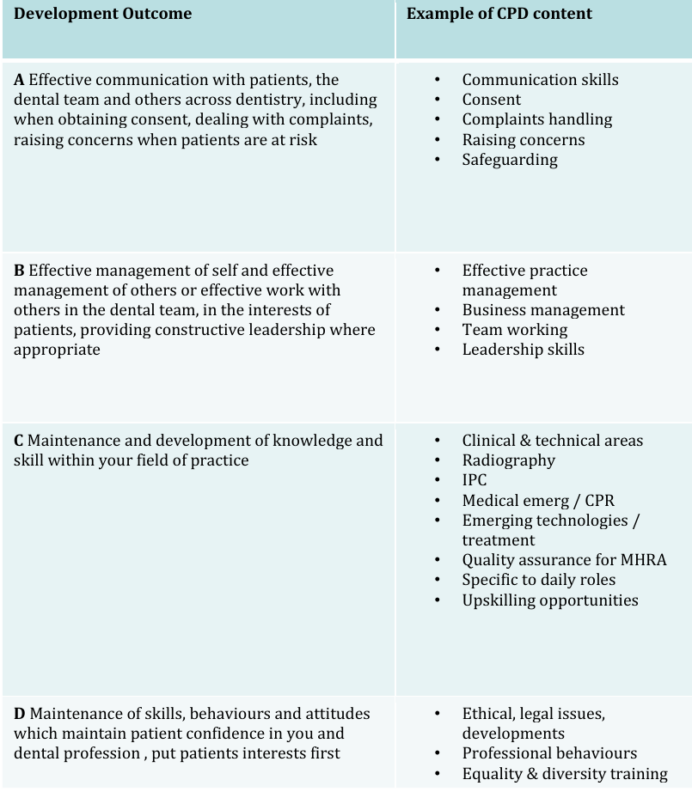
GDC outcomes:
A,B,C,D

Slide 6
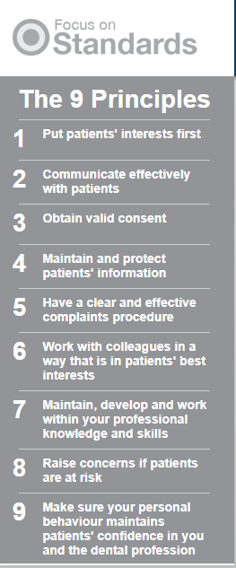
Dental nurses are professionally responsible for developing themselves by maintaining and expanding their clinical skills, professional knowledge and competence through continued CPD, staying up to date on new technologies, assessing their capabilities and taking an active
role in their professional development plan.

Slide 7
To develop the team they must communicate effectively, treat colleagues with respect, value everyone’s contributions, share knowledge, contribute to a positive workplace culture and help resolve any issues by using proper channels.

Slide 8
Responsibilities for professional development:

Slide 9
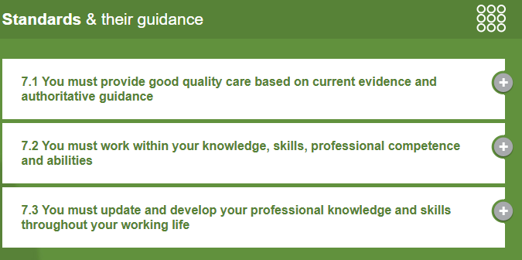
Maintain competence and knowledge:
Continuously update and enhance clinical and non-clinical skills to provide high standard patient care. Always adhering to GDC standards for professional development

Slide 10
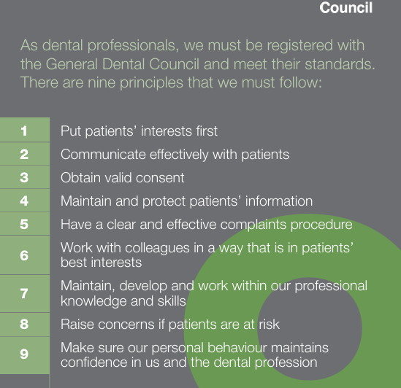
Link to GDC standards
Standards for the dental team

Slide 11

Stay up to date with current technology:
Evaluate and integrate new techniques and technologies into clinical practice to improve service

Slide 12

Self-assessment:
Assess your own capabilities and limitations into clinical practice to improve service.

Slide 13

Professional Development Plan:
Create and follow a PDP to set and achieve personal development goals, ensure these goals align with professional requirements and contribute to improved patient care.

Slide 14
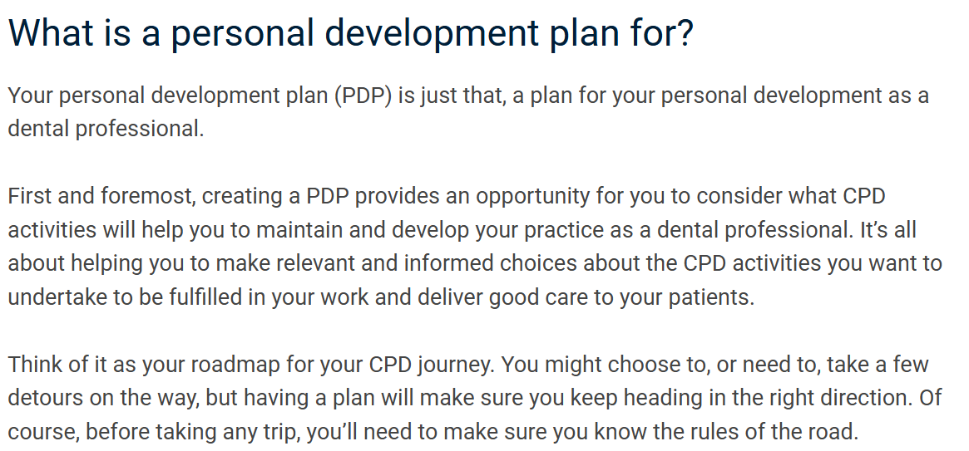

Slide 15
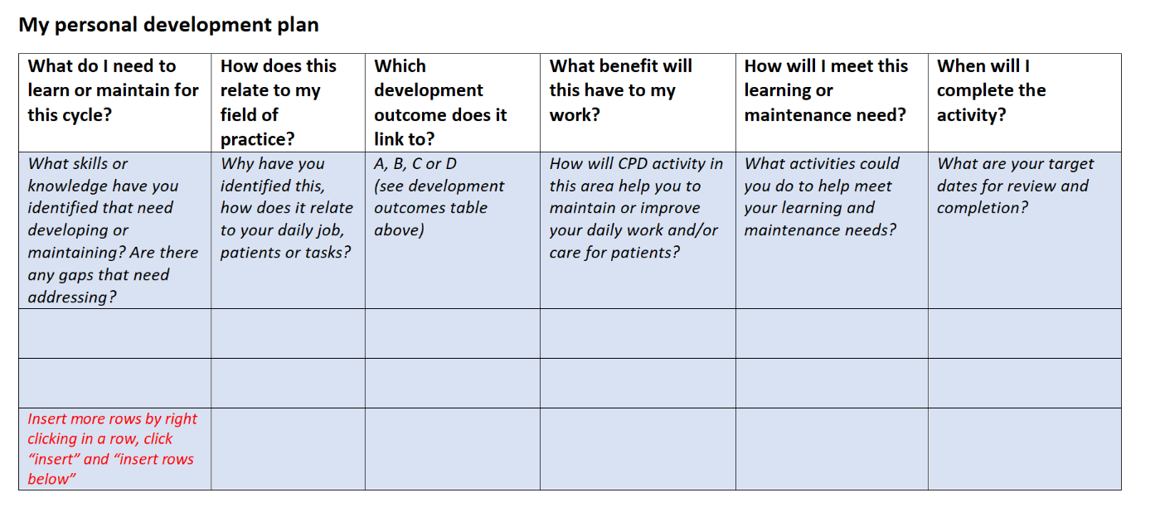

Slide 16
Critical reflection:
Use critical reflection to identify any learning needs and plan for future development

Slide 17
Professional conduct:
Maintain professional attitudes and behaviour in all interactions.

Slide 18
Responsibilities for team development:

Slide 19

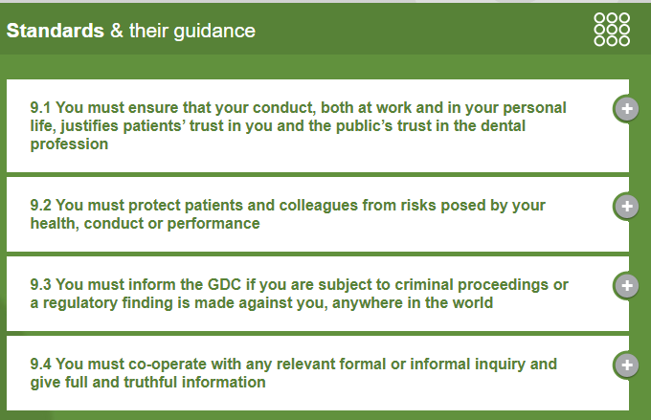
Value and respect colleagues:
Treat all team members with fairness, dignity and respect, valuing everyone’s contributions

Slide 20
Effective communication:
Communicate clearly and effectively with all members of the dental team

Slide 21

Knowledge sharing:
Share your knowledge and skills with other team members to foster a learning environment

Slide 22
Support and collaboration:
Work collaboratively to provide appropriate care for patients, understanding how different roles complement each other

Slide 23
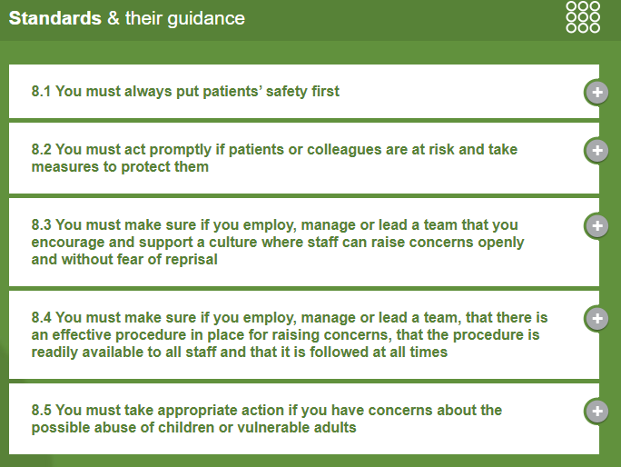
Address concerns:
Use the proper channels to address any concerns or issues with colleagues

Slide 24
Mentoring:
By demonstrating good practice and a commitment to their own development, dental nurses can influence and guide less experienced team members.

Slide 25
Methods of gaining and giving feedback for professional development of self and others
Dental nurses can improve professional development by actively seeking and giving constructive feedback though methods such as reflective practice, regular team meetings, PDPs, peer review.

Slide 26

Methods for gaining feedback:

Slide 27

Reflective practice:
Keep a reflective diary to document thoughts or clinical experiences, linking them to your learning goals and demonstrating growth.

Slide 28

Ask for specific examples:
When receiving feedback, ask for concrete examples to understand the issue and alter it.

Slide 29
Attend team meetings:
Participate in team meetings to foster collaborate reflection and gain peer insights into your practice.

Slide 30

Create a PDP:
Develop a PDP to guide your leaning and provide a structured way to identify areas for improvement and track progress.

Slide 31
Seek open & honest conversations:
Cultivate a positive team culture where colleagues feel comfortable sharing candid feedback and rising concerns in a safe space.

Slide 32

Methods for giving feedback:

Slide 33

Be timely:
Provide feedback as close to the event as possible to ensure it is relevant and easily recalled.

Slide 34

Be specific and objective:
Focus on factual observations and clear examples rather than vague statements or personal judgement

Slide 35

Offer solutions:
When identifying a problem, suggest practical solutions or ways to change behaviour

Slide 36

Balance with positives:
Start with positive aspects of performance before addressing areas for improvement to create a more receptive environment.

Slide 37

Be professional:
Avoid personal attacks and focus on behaviours not traits. Ensure feedback is constructive and supportive.

Slide 38
Focus on patient care:
Frame feedback within the contact of improving patient care and maintaining high standards.

Slide 39
Encourage reflection:
Incorporate reflective activities into feedback and discussions to help colleagues process and learn from experiences.

Slide 40
Accessing own capabilities and limitations in the interest of high quality patient care:

Slide 41
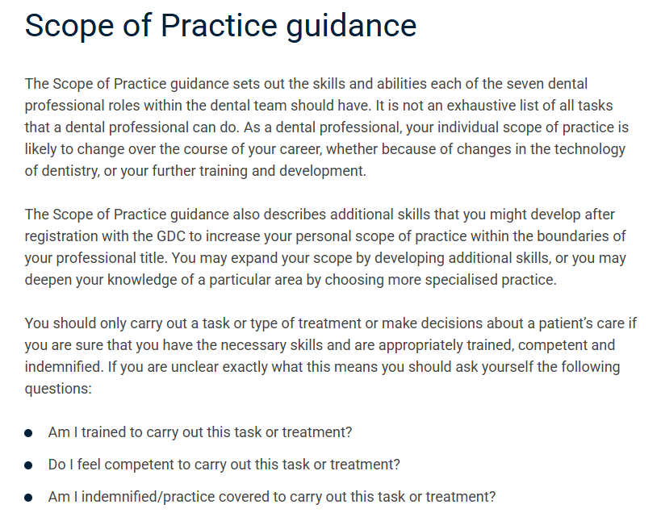
Understand the scope of practice:
Be familiar with this GDC document and understand specific treatments, procedures and decisions you are qualified to undertake
GDC publishes revised Scope of Practice guidance -
The updated guidance will take effect on 1 November 2025. The current version will remain in effect until then.

Slide 42

CPD:
Engaging in ongoing learning and training is essential for maintaining and developing professional knowledge and competence. This allows nurses to stay up to date with best practice.

Slide 43
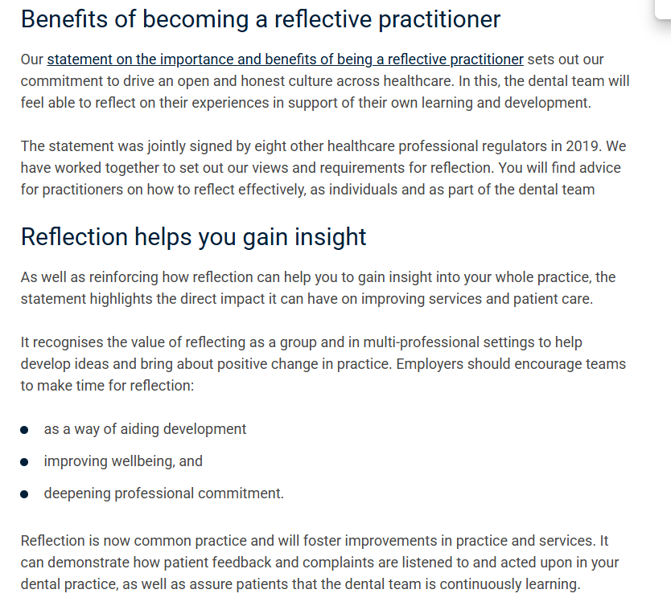
Reflective practice:
This evaluates a dental nurse's actions, identifies areas for improvement and shows learning from experiences which enhances skills and understanding

Slide 44
Seeking advice:
When faced with patient care which extends beyond a nurses current knowledge or skills, dental nurses should seek guidance.

Slide 45
Why is this important for patient care?
Patient safety
Professional responsibility
Effective treatment
Building trust

Slide 46

Legal and professional requirements in relation to providing oral health education
Dental nurses can provide oral health education under the prescription of the Dentist after gaining a post qualification such as the NEBDN Certificate in Oral Health Education.

Slide 47
GDC registration:
As a registered professional a dental nurse must work within the GDC’s scope of practice and standards for the dental team.

Slide 48

Post-registration qualification:
To give OHE advice to patients a dental nurse requires specific training and a qualification.

Slide 49
Dentist’s support and direction:
The qualification required support and supervision from an employing dentist. The advice provided must be under their direction and within their scope of practice.

Slide 50
Competence and training:
Dental nurses must only carry out tasks or provide advice if they are appropriately trained, competent and have the necessary skills.

Slide 51
Ethical and accurate information:
All information provided must be accurate, not misleading, and follow clinical guidelines.

Slide 52
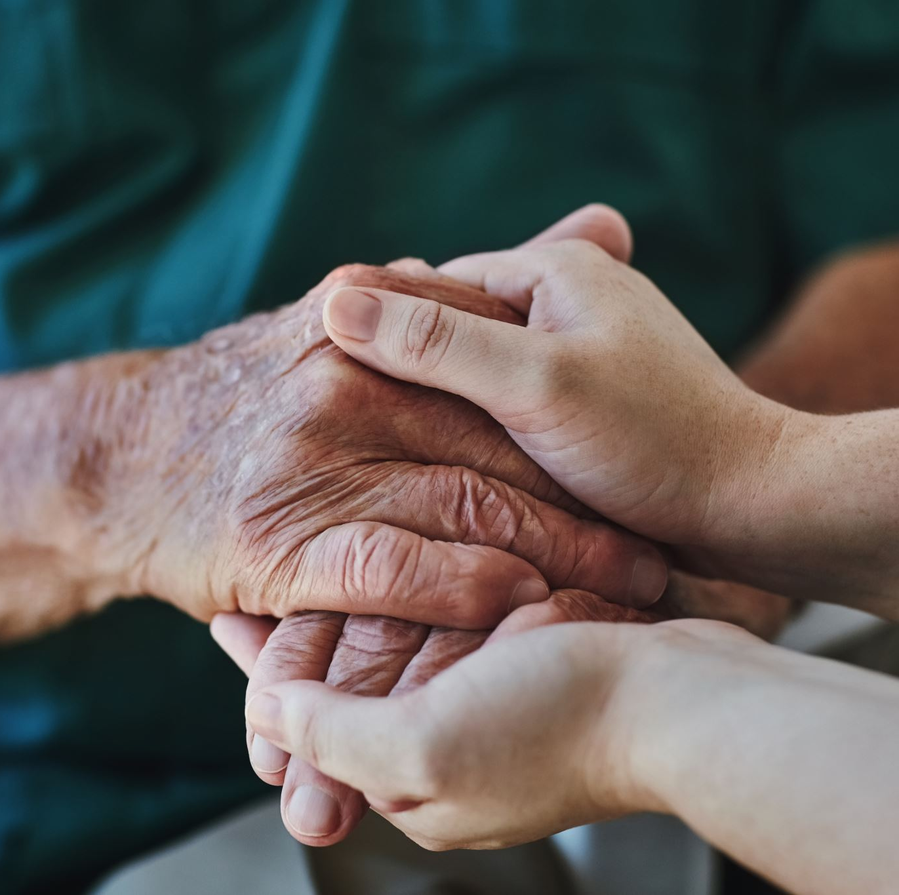
Holistic patient care:
Advice should be tailored to individual needs, taking into account the patients overall health and needs.

Slide 53

Question 1:
Explain what a PDP is

Slide 55
Further reading:
Delivering better oral health: an evidence-based toolkit for prevention - GOV.UK

