Slide 1
Clinical Teams:
Special Care Dental Nursing 2025
Catriona Thornton

Slide 2

Aims:
To understand how the clinical teams work together to provide high-quality oral care for individuals with significant additional needs by ensuring safe, inclusive, and comprehensive treatment

Slide 3

Objectives:
To provide tailored dental care that addresses the specific needs of each patient.
Offering reassurance and support to patients with learning disabilities, or other complex needs.

Slide 4

Learning Content:
This training session is intended to create an understanding on the importance of working with other healthcare professionals.

Slide 5

Development Outcomes:
This course meets the criteria for the GDC's development outcomes A,B,C and D

Slide 6
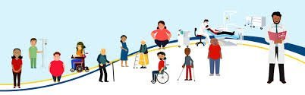
Key aspects of Special Care Dentistry in Northern Ireland:
Special Care Dental teams cater to individuals with:
Learning disabilities
Physical disabilities
Severe mental illness
Significant anxiety or phobias
Housebound individuals, and those with significant medical conditions.

Slide 7
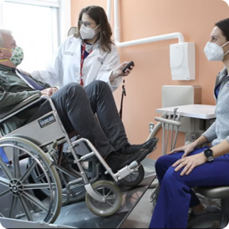
Special Care Dentistry:
Clinical teams in Northern Ireland focus on providing dental care for patients who, due to various health or social care needs, and cannot be treated in a general dental practice.
These teams work within the Community Dental Service and may also be involved in research and oral health promotion initiatives.
Referrals to these teams are typically made by general dental practitioners when a patient's needs exceed the scope of their practice.

Slide 8
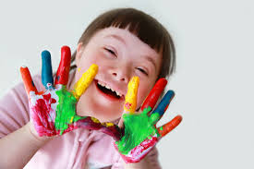
Referral Process:
Patients are typically referred by their general dental practitioner to the Community Dental Service.
Clinical Settings:
Special Care Dental services may be delivered in community dental clinics, hospital settings, or through outreach programs, including mobile dental units.

Slide 9
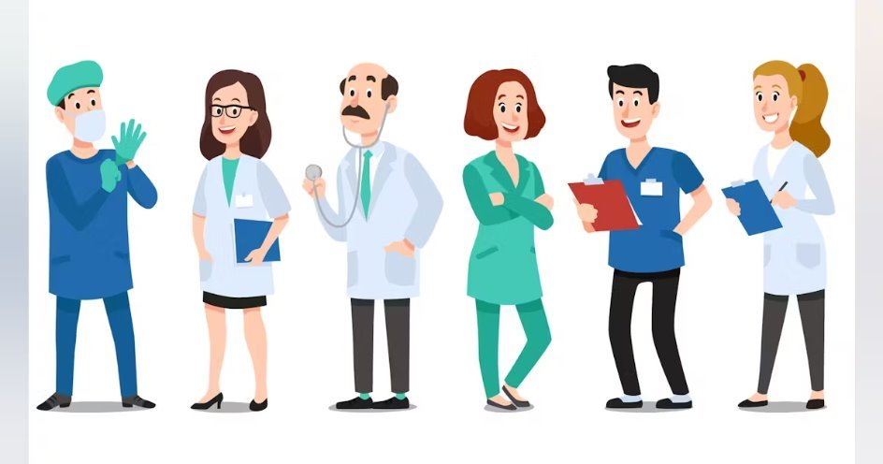
The Extended Care Teams:
In special care dental nursing, the extended care team includes professionals beyond the immediate dental team.
Such as speech therapists, social workers, and physiotherapists, to address a patient's broader needs.
Working within an effective team, whether general or multidisciplinary, is crucial for patient safety, coordinated care, and better health outcomes.
Notes:
Such as speech therapists, social workers, and physiotherapists, to address a patient's broader needs. Working within an effective team, whether general or multidisciplinary, is crucial for patient safety, coordinated care, and better health outcomes, as it improves communication, leverages diverse expertise, and allows for comprehensive care plans. The importance of multidisciplinary team (MDT) working specifically lies in its ability to bring together different perspectives and skills to provide holistic, patient-centred care, especially for complex cases, fostering trust, shared goals, and integrated strategies for improved treatment and support.

Slide 10
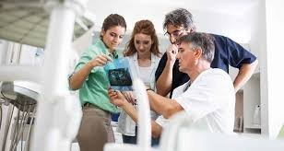
ECT In Special Care Dentistry:
Speech and Language Therapists for communication or swallowing difficulties.
Physiotherapists to address physical limitations that might impact access or comfort.
Occupational Therapists to help with daily living activities and adapting the environment.
Social Workers to provide support and manage social factors affecting a patient's health.
Notes:
Health and social care professionals who work alongside the dental team are there to support a patient with complex needs.

Slide 11
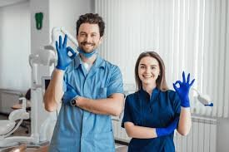
The Importance of Working as Part of an Effective Special Care Team:
An effective dental team, often extended, improves patient care in several ways :
Clear roles and responsibilities, along with strong communication, minimize errors and adverse events.
Coordinated care leads to more comprehensive treatment plans and better management of complex conditions.
A harmonious team provides a more positive and patient-centered experience for all involved.
Involving patients and families in the decision-making process fosters trust and ensures their needs are central to their care.
Notes:
Enhanced Safety:
Clear roles and responsibilities, along with strong communication, minimize errors and adverse events.
Better Outcomes:
Coordinated care leads to more comprehensive treatment plans and better management of complex conditions.
Improved Patient Experience:
A harmonious team provides a more positive and patient-centred experience for all involved.
Patient Empowerment:
Involving patients and families in the decision-making process fosters trust and ensures their needs are central to their care.

Slide 12
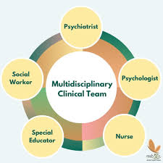
The Importance of Multidisciplinary Team Working:
Comprehensive Decision-Making
Build trust and a shared purpose, allowing for constructive challenge and alternative perspectives on patient care.
By involving different disciplines, providing coordinated care that addresses a patient's full range of needs.
Facilitated by clear communication channels, MDTs reduce misunderstandings and potential communication breakdowns between various professionals.
Notes:
MDTs are crucial for providing integrated care, particularly for patients with multiple complex needs. Their importance includes:

Slide 13
References and Further Reading:
https://www.scie.org.uk/integrated-care/multidisciplinary-teams
https://www.gdc-uk.org/news-blogs/blog/detail/blogs/2022/02/23/professionalism-working-with-the-dental-team-to-support-patients-with-additional-needs
https://www.researchgate.net/publication/239755386_Special_care_dentistry_and_the_dental_team
https://www.magonlinelibrary.com

