Slide 1
Guidelines and Outside Bodies
Special Care
Dental Nursing 2025
Catriona Thornton

Slide 2

Aims:
To distinguish, discover and recognize the guidelines and relevant information from significant bodies within Special Care Dentistry.

Slide 3

Objectives:
Increase knowledge by accessing and using information from relevant bodies for the support of patient care.
Protect, promote and maintain the health, safety, and well-being of the public by maintaining our public register of qualified dental professionals.

Slide 4

Learning Content:
This training session is intended to create an understanding on the importance of providing high-quality dental care to patients with complex needs due to physical, intellectual, mental, medical, or social impairments and learning the correct local referral management processes for accessing special care services

Slide 5

Development Outcomes:
This course meets the criteria for the GDC's development outcomes A,B,C and D

Slide 6

Standards & Guidelines:
Special care dental nurses operate under the professional standards set by the (GDC)in the UK, focusing on patient care, individual needs, and ethical practice.
This sets out detailed guidelines on conduct, performance, and ethics in the "Standards for the Dental Team" document.
The key guidelines emphasize the understanding of patient's disabilities and mental capacity, managing anxiety, and ensuring safety.
The key principles include putting patients' interests first, communicating effectively, maintaining confidentiality, acting with honesty and integrity, working with colleagues professionally, and ensuring personal behaviour upholds public confidence in the profession

Slide 7
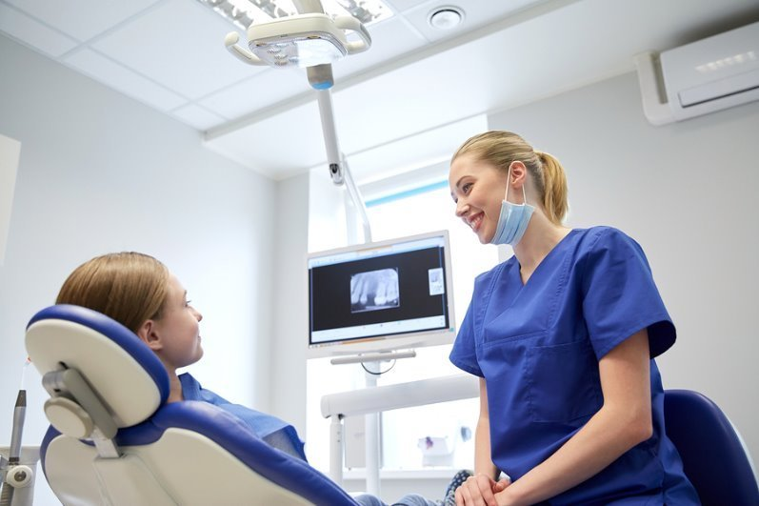
Guidelines:
Listen to patients and carers, respect their dignity, culture, and values, and involve them in decisions about their treatment.
Act with integrity and honesty, taking personal responsibility for actions, and upholding the GDC's Standards for the Dental Team.
Be open and honest with patients, carers and colleagues when something goes wrong.
Carefully consider less restrictive anxiety management techniques before general anaesthesia, especially for patients lacking mental capacity.
Tailor the environment to meet patient needs.
Gather information about a patient's social and medical history, including any speech, hearing, or mobility difficulties, to tailor care.
Notes:
Patient-Centred Care:- Listen to patients and carers, respect their dignity, culture, and values, and involve them in decisions about their treatment.
Professional Responsibility:- Act with integrity and honesty, taking personal responsibility for actions, and upholding the GDC's Standards for the Dental Team.
Duty of Candour:- Be open and honest with patients, carers, and colleagues when something goes wrong.
Managing Anxiety and Capacity:- Carefully consider less restrictive anxiety management techniques before general anaesthesia, especially for patients lacking mental capacity.
Environmental Safety:- Tailor the environment to meet patient needs.
Communication:- Gather information about a patient's social and medical history, including any speech, hearing, or mobility difficulties, to tailor care.

Slide 8
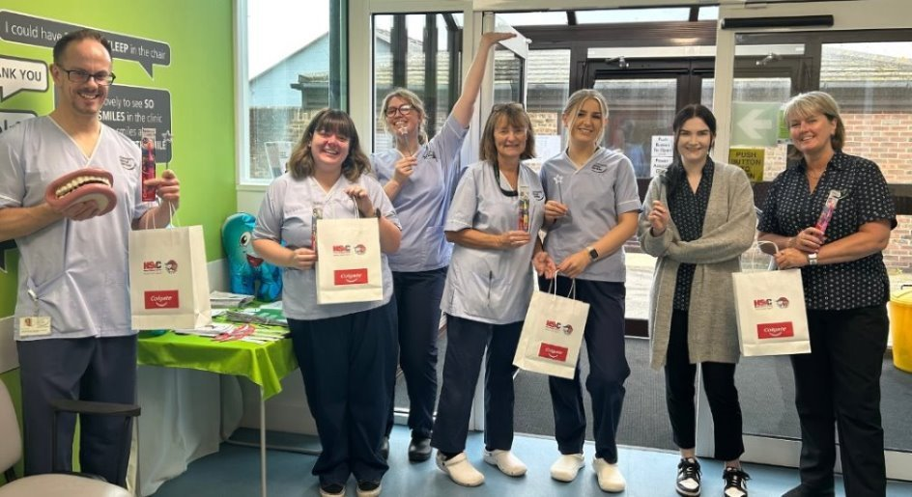


Local outside bodies:
In Northern Ireland, the HSC Community Dental Service is the primary outside body that provides special care dentistry for individuals with disabilities or medical conditions that prevent them from attending a general dental practice.
The service operates under the Northern Ireland Health and Social Care (HSC) system, with specific guidance from the Regulation and Quality Improvement Authority (RQIA) ensuring standards of care.
Quality Standards for Health and Social Care The Department of Health sets the broader policies and strategies for oral health, including guidelines for the provision of special care dentistry and the necessary training for dental professionals
Notes:
Quality Standards for Health and Social Care The Department of Health sets the broader policies and strategies for oral health, including guidelines for the provision of special care dentistry and the necessary training for dental professionals

Slide 9



Relevant bodies for special care dental nurses include:
The General Dental Council (GDC), is the UK's dental regulatory body that oversees dental professionals and sets the professional standards and ethical guidelines for all dental professionals, including special care dental nurses.
The National Examining Board for Dental Nurses (NEBDN), which offers the Certificate in Special Care Dental Nursing.
British Society for Special Care Dentistry (BSSCD) that provides specific guidance documents and policy recommendations for the oral care of people with disabilities and other special care needs.

Slide 10
References and Further Reading:
https://www.gdc-uk.org/standards-guidance/standards-and-guidance/standards-for-the-dental-team
https://standards.gdc-uk.org/pages/principle1
https://www.nidirect.gov.uk/articles/dental-care-people-disabilities
https://www.rqia.org.uk/RQIA/files/d1/d106601f-5b56-4eab-9d05-8cd1b52359e8.pdf
British Society for Special Care Dentistry (BSSCD) is an organisation that provides specific guidance documents and policy recommendations for the oral care of people with disabilities and other special care needs.
National Institute for Health and Care Excellence (NICE) for risk assessments
https://www.nimdta.gov.uk/dental-training/dental-continuing-education/continuing-education-courses/
International Association for Disability and Oral Health - https://www.iadh.org/
dental-nursing.co.uk provides articles and resources on special care dentistry.

