Slide 1
Patient Safety
Special Care
Dental Nursing 2025
Catriona Thornton

Slide 2

Aims:
To provide an update on the importance of Patient Safety.

Slide 3

Objectives:
Identify the patient's safety and the risks involved
Understand the risks associated with a patient's condition and adapting care accordingly.
Describe the measures to ensure the dental clinic environment is safe for patients with special needs.
Implement infection prevention measures, maintaining a clean and safe clinical environment
Notes:
Identify the patient's safety and the risks involved including safety measures and the importance of clear and concise communication with patients, carers and work colleagues.

Slide 4
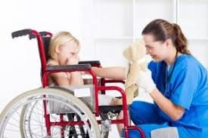
Learning Content:
This training session is intended to create an understanding of the importance of Patient Care and the key factors in recognising the barriers to care that the patient's situation presents, and knowing how to reduce those barriers.

Slide 5

Development Outcomes:
This course meets the criteria for the GDC's development outcomes A,B,C and D

Slide 6
Standards:
The General Dental Council (GDC) protects patient safety in Northern Ireland by registering qualified dental professionals
Principle 8.1 : You must always put the patients’ safety first!
The GDC sets and promotes professional standards for the dental team, including principles on putting patients' interests first, communication, and consent.

Slide 7
Requirements:
In Northern Ireland, dental professionals are required by the General Dental Council (GDC) on CPR, AED usage, and dealing with unconscious individuals
Regular, at least annual, updates in resuscitation training are essential, with a focus on both adult and pediatric CPR.
Notes:
In Northern Ireland, dental professionals are required by the General Dental Council (GDC) to be trained in resuscitation and have the skills to manage medical emergencies, including cardiorespiratory arrest.

Slide 8
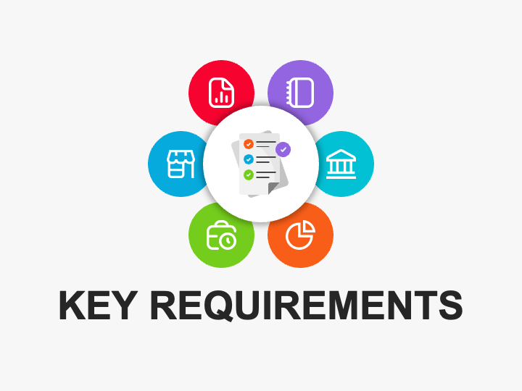
Key Requirements:
Mandatory Training: - All GDC registrants must receive up-to-date training in resuscitation and emergency management.
Compliance:- Training should be aligned with the standards set by the UK Resuscitation Council and the General Dental Council's guidance for dental professionals on medical emergencies.

Slide 9
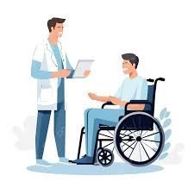
Prioritize the additional needs of our patients:
Every patient may require:-
Adjustments to the dental environment
Communication methods
Treatment approaches to ensure they receive the appropriate care.

Slide 10

Special care dentistry involves:
Identifying patient-specific risks
Having a patient-centred approach
Knowing the common and potential risks
The care being delivered by specialized teams in varied settings
Notes:
Identifying patient-specific risks from physical, medical, developmental, sensory, cognitive, or social impairments, and adapting treatment to ensure safety and efficacy.
A patient-centred approach that provides comprehensive oral health services for adults and adolescents with complex needs due to physical, sensory, intellectual, mental, medical, social, or emotional impairments or disabilities.
Common risks include medical emergencies, bleeding, impaired co-operation, and compromised healing, often due to conditions like epilepsy, heart disease, learning disabilities, or sensory sensitivities.
Care is delivered by specialized teams in varied settings, including hospitals, community clinics, and patient homes, and integrates medical, dental, and social care to improve oral health and quality of life for individuals who cannot access routine dental services.

Slide 11
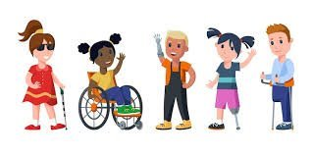
Physical Limitations:
Patients with physical disabilities may require:-
Special equipment for transfer to and from the dental chair or have difficulty maintaining a comfortable position during treatment.
Notes:
Examples of physical limitations include conditions affecting mobility and dexterity, such as cerebral palsy, multiple sclerosis, spinal cord injuries, and amputations, as well as sensory impairments like blindness and hearing loss. Other physical limitations stem from chronic illnesses like arthritis and epilepsy, or conditions present from birth, such as spina bifida. These limitations can make everyday activities like walking, balancing, reaching, and coordinating body parts difficult

Slide 12

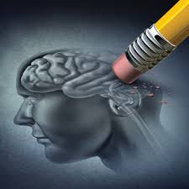
Cognitive & Learning Disabilities:
Individuals with cognitive Impairments or learning disabilities may require:
Extra time
Patience
Desensitization techniques to reduce anxiety and facilitate cooperation with treatment.
Notes:
Examples of cognitive and learning disabilities include specific learning disorders like dyslexia (reading), dyscalculia (math), and dysgraphia (writing), as well as conditions like Autism , Attention-Deficit/Hyperactivity Disorder (ADHD), intellectual disabilities, and effects from brain injuries or conditions like stroke. These disabilities affect an individual's ability to process information, learn, remember, or focus,

Slide 13
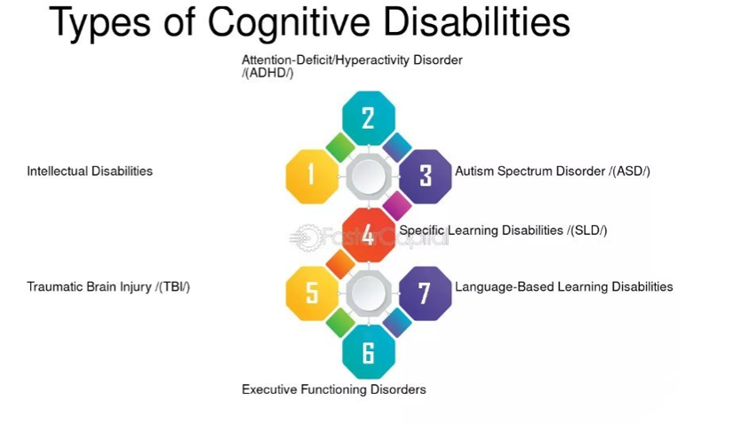

Slide 14
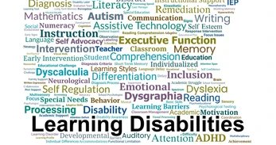

Slide 15
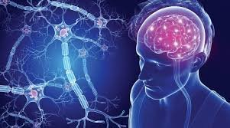

Medical Conditions:
Patients with complex medical conditions may need:
Special precautions
Management strategies to address potential risks associated with dental procedures.
Notes:
Examples of patients with complex medical conditions include those with progressive neurological disorders like Parkinson's disease or Huntington's disease, long-term chronic conditions such as diabetes or severe asthma, spinal cord injuries, acquired brain injuries, genetic conditions like cystic fibrosis, and conditions requiring extensive, ongoing, and personalized care

Slide 16
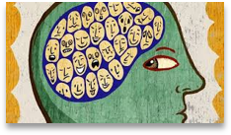
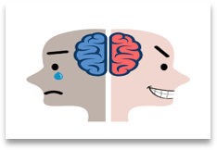
Mental Health Issues:
Individuals with mental health conditions may require:
Adjustments to the dental setting
A communication style to address potential anxiety or behavioural challenges.
Notes:
Examples of mental health issues include Anxiety Disorders,Attention-Deficit/Hyperactivity Disorder (ADHD), Autism Spectrum Disorder (ASD)
Bipolar Disorder, Borderline Personality Disorder, Depression, Eating Disorders, HIV/AIDS and Mental Health, Obsessive-Compulsive Disorder (OCD)
Schizophrenia, Suicide Prevention , Traumatic Events and Post-Traumatic Stress Disorder (PTSD)

Slide 17
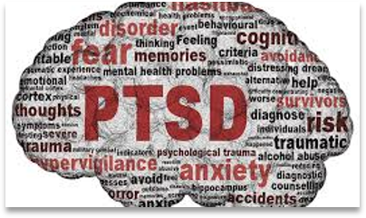
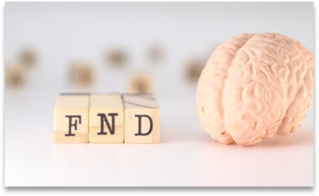
Sensory Sensitivities:
Some patients may have:
Heightened sensitivity to sensory stimuli, such as noise, light, or tastes, which may require adjustments to the dental environment or treatment approach.
Notes:
Examples of sensory sensitivity include avoiding loud noises, being overwhelmed by bright lights or strong smells, discomfort with certain clothing textures, and difficulty with food tastes. Individuals might show extreme reactions to common stimuli, such as intense discomfort with sudden sounds like fireworks, difficulty with personal care like hair washing, or seeking certain sensations, like deep pressure, to help regulate their system. These sensitivities can manifest as either being over-responsive (hypersensitive) to sensory input or under-responsive (hyposensitive).

Slide 18
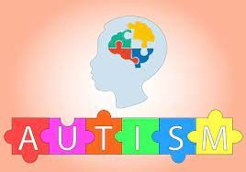
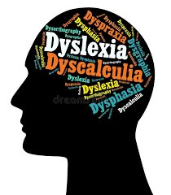
Communication Barriers:
Patients with communication difficulties may require:
Alternative methods of communication, such as visual aids or augmentative communication devices, to express their needs and understand treatment information
Notes:
Communication barriers in healthcare include language differences, complex medical jargon, lack of health literacy, cultural barriers, environmental factors like noise, patient and provider emotional states such as fear or anxiety, physical limitations affecting communication, technology issues, and organizational factors like time constraints or fragmented care systems. These barriers can lead to misinterpretations, delayed care, and poor patient outcomes.

Slide 19
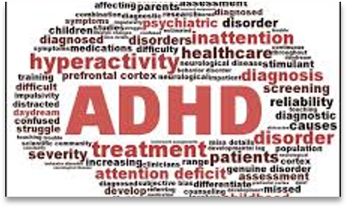
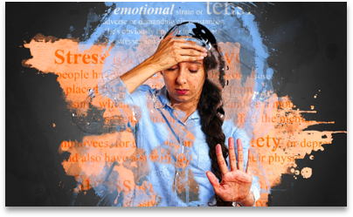
Social Impairments:
Individuals with social impairments may benefit from:
A supportive and understanding environment that addresses their specific needs and anxieties related to dental care
Notes:
Examples of social impairments include difficulty interpreting nonverbal cues like facial expressions and body language, struggling to initiate or maintain conversations, avoiding social interactions or preferring isolation, difficulty understanding and applying social "rules," and problems with forming and sustaining relationships. These impairments can manifest in various conditions, such as Autism Spectrum Disorder (ASD) and social anxiety disorder.

Slide 20
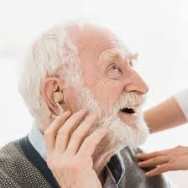
Adapting care involves:
Comprehensive risk assessments
Communication strategies
Tailored treatment planning,
Managing anxiety with techniques and relaxation methods
Using specialized equipment for transfer and treatment
Collaborating with other healthcare professionals.
Notes:
Examples of comprehensive risk assessments include fall risks, infections, manual handling, hazards etc.
Examples of communication strategies include active listening, using clear and concise language, employing both verbal and nonverbal cues (like body language and eye contact), adapting to your audience, providing and receiving feedback
Tailored treatment plans in special care dentistry adapt standard dental procedures for patients with complex medical, physical, or intellectual disabilities, focusing on their unique needs and anxieties. Examples include using mild sedation for anxiety, modifying operative positions for physical limitations, extending appointments for cognitive challenges, involving caregivers, and collaborating with other healthcare providers to ensure safe and effective care
Specialized equipment for patient transfer and treatment includes hoists with slings, transfer boards, slide sheets, standing aids, and patient handling belts used by caregivers to safely move individuals with limited mobility between surfaces like beds, chairs, and wheelchairs.
Special care dentistry involves collaborating with various healthcare professionals, including medical doctors (to manage systemic conditions like diabetes that affect oral health), nurses (to provide care in long-term facilities), therapists (physiotherapists, speech therapists), social workers (to assess and support patients' needs), and other dental specialists (like oral surgeons or orthodontists in multi-disciplinary teams). These collaborations ensure comprehensive, patient-centered care for individuals with disabilities, complex medical histories, and other vulnerabilities, often through joint clinics, outreach services, and home visits.

Slide 21
Key considerations for providing dental care to special care patients:
Recognizing that each patient’s needs are unique
Dental services are legally obligated to make reasonable adjustments to their environment and procedures to accommodate patients with disabilities.
Collaboration with other healthcare professionals
Establishing a trusting relationship with the patient and their carers is essential for successful treatment.
Educating patients and their carers about oral hygiene practices and the importance of regular dental care is vital.
Notes:
Recognizing that each patient’s needs are unique, treatment plans should therefore be tailored to the individual's needs
Collaboration with other healthcare professionals, such as physicians, therapists, carers and social workers, may be necessary to provide comprehensive care.

Slide 22
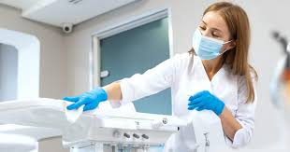
Infection control is vital for special care dental patients:
Patients may have compromised immune systems, existing medical conditions, or disabilities.
Dental procedures involve contact with blood, saliva, and other fluids, which can carry infectious agents.
In environments like care homes or dental clinics, effective infection control prevents the rapid spread of outbreaks of bacteria, viruses, and other infections.
Adhering to infection prevention and control measures ensures that both patients and staff receive safe, effective, and high-quality care.
Notes:
Increased Susceptibility that make them more vulnerable to developing severe infections:
Higher Risk of Transmission: Dental procedures involve contact with blood, saliva, and other fluids, which can carry infectious agents. Special care patients, and even their caregivers, could transmit these pathogens if proper controls aren't in place
Protection of the Dental Team: Dental professionals face occupational risks of infection from bloodborne pathogens (like HBV, HCV, and HIV) through percutaneous injuries or contact with infectious materials.
Preventing Outbreaks:
Ensuring Safety and Quality Care:

Slide 23
Principles and practice of cross infection control:
Maintaining a clean and safe care environment, safely managing waste and equipment
Understanding patient infection risk assessment
Standard Infection Control Precautions (SICPs) consistently
Personal Protective Equipment (PPE) appropriately for staff and patients.
Rigorous hand hygiene
Thorough cleaning and disinfection of surfaces and instruments
Appropriate segregation of dirty and clean areas
Providing patients with essential barriers like bibs and eye protection to prevent the transmission of pathogens.

Slide 24
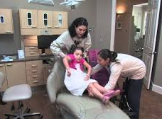
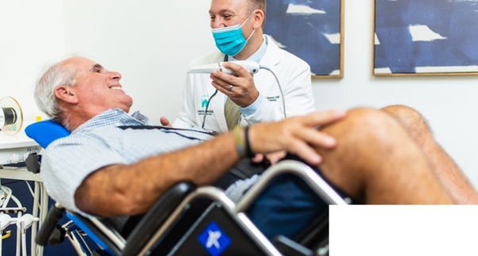
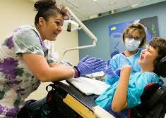
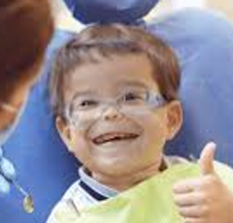
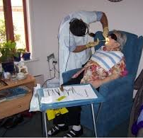
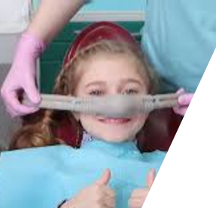

Slide 25
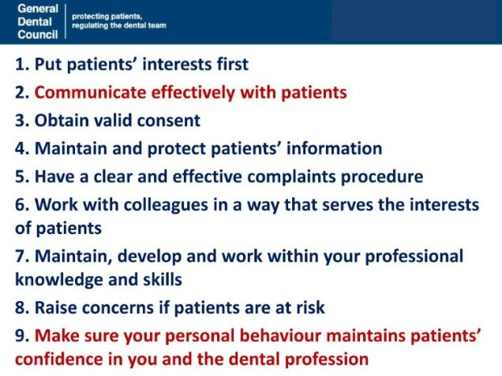

Slide 26
References and Further Reading:
https://www.gdc-uk.org/standards-guidance/standards-and-guidance/gdc-guidance-for-dental-professionals/medical-emergencies
https://standards.gdc-uk.org/pages/principle8/principle8#collapseOne
https://www.resus.org.uk/library/quality-standards-cpr/primary-dental-care
https://www.gov.uk/government/publications/oral-care-and-people-with-learning-disabilities/oral-care-and-people-with-learning-disabilities
https://www.dentalhealth.org/learning-disabilities-and-oral-care
https://www.challengingbehaviour.org.uk
https://www.gov.uk/government/publications/infection-prevention-and-control-in-adult-social-care-settings
https://www.niinfectioncontrolmanual.net

