Slide 1
Safeguarding and Integrated Care:
Special Care Dental Nursing 2025
Catriona Thornton

Slide 2

Aims:
To acknowledge the importance of the Principles of Safeguarding and how integrated care enhances safeguarding

Slide 3

Objectives:
To apply focus on patient care, patient safety, team collaboration, and efficiency between different healthcare professionals to deliver comprehensive and integrated care creating a safe environment for care.

Slide 4

Learning Content:
This training session is intended to create an understanding of:
The Safeguarding principles
Providing integrated care, and maintaining professional standards.
Notes:
Essential skills involve effective communication, identifying and reporting abuse, using pain and anxiety management techniques, and understanding integrated care pathway

Slide 5

Development Outcomes:
This course meets the criteria for the GDC's development outcomes A,B,C and D

Slide 6

Safeguarding:
Safeguarding is the protection of children, young people, and adults from harm, abuse, and neglect, ensuring their health, wellbeing, and human rights are upheld.
Notes:
It involves preventing abuse, recognizing its signs, and providing support to vulnerable individuals so they can live safely and with dignity. Safeguarding is a collective responsibility, requiring collaboration between various professionals and organisations to create environments where everyone feels protected and has their needs met.

Slide 7

One of our key duties within our roles is to safeguard the individuals around us.
Any individual can be at risk of abuse or neglect at any time in their life, including the colleagues you work with, and patients attending the practice.
In order to fully understand our roles, responsibilities and to keep updated. All dental team members must receive appropriate training annually.

Slide 8
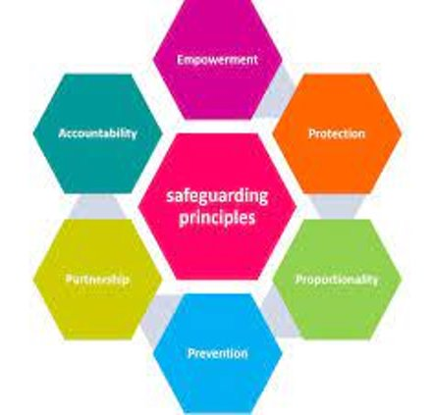
The six principles of safeguarding, as outlined in the Care Act 2014 are foundational for ensuring effective protection:
1. Empowerment
2. Prevention
3. Proportionality
4. Protection
5. Partnership
6. Accountability

Slide 9

Empowerment:
People should be supported and encouraged to make their own decisions and give informed consent.

Slide 10

Prevention:
It is better to take action to prevent harm from occurring rather than waiting for it to happen.

Slide 11

Proportionality:
The response to a situation should be the least intrusive one that is still appropriate to the level of risk presented.

Slide 12

Protection:
Support and representation must be available for those who need it most.

Slide 13

Partnership:
Local authorities and services should work together with individuals and their communities to find solutions and prevent harm.

Slide 14

Accountability:
There needs to be transparency in safeguarding practices, ensuring that everyone involved is accountable.

Slide 15



National Guidance, Local Policies and Procedures:
National guidance for safeguarding in Northern Ireland stems from legislation like the Safeguarding Board Act (Northern Ireland) 2011
Local policies and procedures for safeguarding in Northern Ireland are governed by regional frameworks set by the Safeguarding Board for Northern Ireland (SBNI) and Co-operating to Safeguard Children and Young People in Northern Ireland guidance.
Which are then implemented by Health and Social Care (HSC) Trusts and organizations.
The Children (Northern Ireland) Order 1995, the Human Rights Act 1998, and the Safeguarding Vulnerable Groups (Northern Ireland) Order 2007 provide the legal basis for safeguarding.

Slide 16
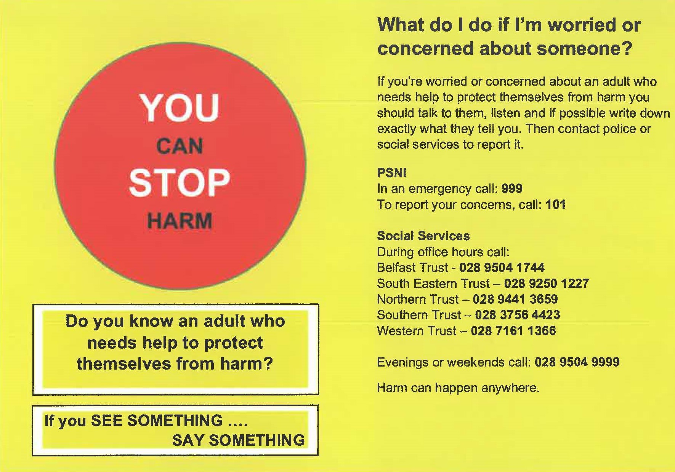

Slide 17

Referral Process:
In Northern Ireland, refer concerns about a child to a HSC Trust children's Gateway or the Regional Emergency Social Work Service outside hours.
For adults at risk of harm, contact your local HSC Trust Adult Protection Gateway team or the Regional Emergency Social Work Service for out-of-hours support.
In immediate danger, call 999; for advice, contact your GP, or another healthcare professional.

Slide 18

The steps you should take if you ever have a safeguarding concern:
Recognize the signs and indicators of abuse and neglect
Respond appropriately to concerns
Report findings to the designated authority
Record the details accurately
Refer to specialized services for further action or support
Notes:
Knowing the signs and indicators of abuse and neglect will help you to recognise when something isn’t quite right. Always trust your instincts. Whether you notice suspicious bruising on a child or worry that a vulnerable patient has missed two appointments in a row, it is your duty to recognize these instances as potential indicators of a safeguarding concern.
Once you have established a reason for concern, it is your professional duty to respond in an appropriate manner. Be aware that this does not mean you should insert yourself into any situation that could result in a negative response or make matters worse. Your safeguarding policy will detail the steps you should take to respond safely and effectively to any potential safeguarding issue. Always be sure to do this as soon as possible, preferably straight away, and under no circumstances should you ever ignore a safeguarding concern.
Your first point of contact when it comes to reporting a safeguarding concern should be your Safeguarding Lead. If you are unsure of who this person is, seek advice in a way that does not involve giving away details of the situation at hand. Remember, all safeguarding matters should remain confidential and must only be shared with people who are involved in the safeguarding process. You can often find contact details for your Safeguarding Lead in the practice’s safeguarding folder.
It’s incredibly important to make a record of everything you have seen and heard when it comes to a safeguarding incident. Do this as soon as possible after any incident and every time you speak to another individual about what happened. Write down exactly what happened, including (if possible) the exact dates and times. Include the names and details of any individuals involved and record all possible information to ensure the most accurate account of the incident. Even make a record of the date and time you escalated your concern to the practice manager or Safeguarding Lead. Be sure to keep these records in a safe location where they cannot be accessed by anyone else; this is confidential information and might be used as evidence later along the line.
If there is genuine concern for an individual’s safety, or if you think someone might be a victim of abuse, neglect, or maltreatment, you must refer your concerns to the correct authority. This will usually happen via your practice manager or Safeguarding Lead, who will escalate this with the Local gateway team, the police, or any other relevant partner agencies. In this case, you need to ensure that any supporting records and information you have about the incident or individual are passed on as well.

Slide 19

Integrated Care :
Integrated care is a worldwide trend in healthcare where organizations like;-
The NHS
Local authorities
Voluntary groups
Provide coordinated
Patient centered approach
Integrating physical, mental, and social care

Slide 20
We Need To:
Focus on
Focus on the concept of care pathways and understand that patients with complex needs often require a multidisciplinary team approach, which is essential for achieving integrated care.
Engage
Engage with other healthcare and social care professionals involved in the patient's care.
Learn
Learn to manage patient safety challenges during transitions between health and social care, as well as primary and secondary care.
Notes:
Having a Patient-Centred Approach: Focus on the concept of care pathways and understand that patients with complex needs often require a multidisciplinary team approach, which is essential for achieving integrated care.
Inter-professional Liaison: Engage with other healthcare and social care professionals involved in the patient's care.
Seamless Transitions: Learn to manage patient safety challenges during transitions between health and social care, as well as primary and secondary care.

Slide 21
Integrating Safeguarding and Clinical Team Responsibilities :
The (GDC) Standards for the Dental Team mandate that dental professionals and their clinical teams are responsible for safeguarding vulnerable patients:-
By recognizing and responding to abuse and neglect, requiring them to adhere to local safeguarding procedures and provide ongoing training.
For "integrated care," the GDC standards also highlight the importance of skill-mix within the dental team, ensuring each member works within their scope of practice to provide a comprehensive and effective level of patient care
Working both locally and regionally which focus on how we can keep people (prevention), and what we can do to provide early support to stop things getting worse (early intervention) and how we can best do that within specific communities.

Slide 22
References and Further Reading:
https://standards.gdc-uk.org/pages/principle8/principle8
https://www.cqc.org.uk/guidance-providers
https://www.gov.uk/government/publications/safeguarding-policy-protecting-vulnerable-adults
https://www.cvsni.org/wp-content/uploads/2024/06/Safeguarding-Children-Young-People-Adults.pdf
https://www.gdc-uk.org/standards-guidance/standards-and-guidance/gdc-guidance-for-dental-professionals/guidance-on-child-protection-and-vulnerable-adults
https://www.bda.org/advice/patient-care-and-safety/assessment-and-safeguarding
https://online.hscni.net/our-work/integrated-care-system-ni
https://livingautism.com/supporting-children-adults-autism-learning-disabilities-visit-dentist

