Slide 1
General Health
Special Care Dental Nursing 2025
Catriona Thornton

Slide 2
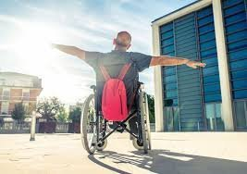
Aims:
To help generate a good general health and lifestyle modifications for individuals with impairments and disabilities.
Notes:
especially in relation to smoking cessation and lifestyle modification

Slide 3

Objectives:
Understand how to organize a correct pathway based on the individual's needs.
Create goals to improve the patient's experience and outcomes
Establish the multidisciplinary team defining their purpose

Slide 4

Learning Outcome:
This training session is intended to create an understanding on how to aid people with impairments and disabilities by using their regular patient contact to:
Provide smoking cessation advice
Deliver oral health education
Facilitate lifestyle modifications

Slide 5

Development Outcomes:
This course meets the criteria for the
GDC's development outcomes A,B,C
and D

Slide 6

Dental Nurse Role:
A dental nurse’s role in encouraging good general health for people with impairments and disabilities includes:
Identifying lifestyle risks like smoking
Using brief interventions to advise on quitting
Providing personalized support

Slide 7

Adapt communication for patients:
Ensure advice is delivered in an accessible and supportive way, respecting individual needs and abilities.
Be mindful of the patient’s disability and adapt communication to ensure they understand the advice given.
This may involve using different communication aids or methods.
Work with other healthcare professionals, to ensure a coordinated approach to the patient’s overall health to support those with special care needs.

Slide 8
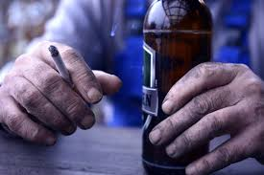
Identifying lifestyle risks:
Assess and advise.
Use brief interventions, such as the
“5 As” model :
Ask
Assess
Advise
Assist
Arrange

Slide 9

Ask:
Identify and document the patient's relevant behaviour at every opportunity.
Ask permission to discuss the topic e.g., "Can I ask how much you smoke a day" ?
Listen closely to their concerns to get a clear picture of their needs.

Slide 10

Assess:
Determine if the individual's condition is something you are trained and able to handle.
Evaluate the patient's willingness to make a quit attempt or change their behaviour.
Assess the readiness and ability to change.

Slide 11

Advise:
In a clear and personalized way, explain the risks of the current behaviour and the benefits of changing.
Provide tailored information and discuss the health risks and benefits of change.

Slide 12
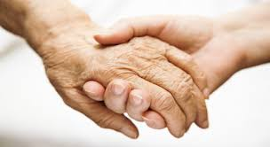
Assist:
For patients ready to change, help them develop a plan and provide resources to support them.
This can include counselling, pharmacotherapy ( medical treatment by means of drugs) or referrals to specialists.
Assist patients in setting a quit date and discuss their concerns and potential challenges.
Develop tailored smoking cessation plans based on the patient’s motivation and needs.

Slide 13

Arrange:
Schedule follow-up contact to monitor progress, provide ongoing support, and adjust the plan as needed.
Arrange for future appointments, either in person, by phone, or electronically.

Slide 14

Lifestyle and general health connections:
Tobacco use and excessive alcohol consumption are major risk factors for oral cancer.
Quitting smoking can significantly improve your oral and general health.
Poor oral health can worsen blood sugar control in people with diabetes. Regular dental check-ups are crucial if you have this condition.
There is a recognized link between chronic gum disease and cardiovascular disease.
Respiratory infections for frail or elderly individuals, poor oral health has been associated with an increased risk of developing lung infections like pneumonia.
Poor oral health can negatively impact self-confidence/ mental well-being due to issues like bad breath.
Notes:
There is a recognized link between chronic gum disease and cardiovascular disease. Bacteria from inflamed gums can enter the bloodstream and contribute to blood clots or inflammation in blood vessels.

Slide 15

Lifestyle modifications:
For individuals with impairments and disabilities these might include :
Adapting the home environment with features like ramps, grab bars, and lever handles
Adjusting diet and physical activity through personalized plans
Healthy meal choices, and appropriate exercise
Utilizing assistive technology such as smart home devices and activity trackers.
Engaging in social and community activities can also significantly benefit mental health and wellbeing.

Slide 16
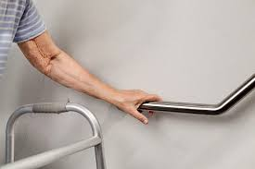
Home and daily life modifications:
Home accessibility: If the individual is struggling advise and refer to Occupational Therapy (OT) service for an assessment and information on grants
Install ramps, handrails, and stair glides for safer movement. Widen doorways, remove thresholds, and use swing-clear hinges to improve access, especially for those using wheelchairs.

Slide 17
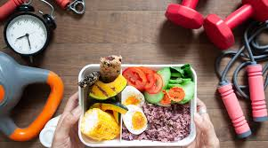
Diet and nutrition:
Focus on balanced meals prioritizing on high-quality protein sources like fish, beans, nuts and minimize sugary snacks, refined carbohydrates, and excessive portion sizes.
Stay hydrated drinking plenty of water to help your body function optimally.
Make healthy choices and plan meals and snacks in advance and make healthier swaps, such as choosing fruit over biscuits.
Track intake keeping records of food and drink intake to identify patterns and areas for improvement, and consult a GP for weight management support

Slide 18

Physical activity:
Personalize your routine with creating an exercise plan with the help of a professional who can assess your individual needs, such as an exercise physiologist.
Find inclusive activities. Look for team-based or community activities that are accessible and provide opportunities for both exercise and social connection.
Use technology like an activity trackers to monitor movement and promote an increase in physical activity.

Slide 19
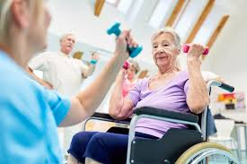
Mental and social wellbeing:
Participate in community activities to foster a sense of belonging and acceptance, which can positively impact mental health.
Explore hobbies
Find creative outlets like adaptive journaling to help manage stress and improve cognitive function.
Seek support with support groups and healthcare providers to find tailored strategies and resources for managing lifestyle changes.

Slide 20
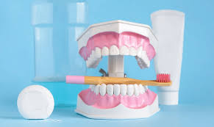
Educate on oral and general health:
Oral health is a critical component of general health, influencing overall well-being through its links to:
Heart disease
Diabetes, and respiratory infections.
Provide oral health education tailored to the patient’s specific needs and abilities, focusing on preventive care and self-care.

Slide 21

To maintain good oral and general health:
Advise daily brushing with fluoride toothpaste
Clean between teeth
Limit sugar intake
See a dentist regularly.
Lifestyle factors like tobacco use and heavy alcohol consumption also significantly increase oral health risks, including cancer.

Slide 22
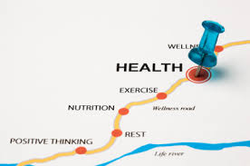
The benefits of a healthy lifestyle:
A healthy lifestyle provides numerous benefits including a lower risk of chronic disease like:
Heart disease
Type 2 diabetes
Stroke
Improved mental health
So make every contact count: Use routine check-ups as opportunities to discuss healthy behaviour's and offer support, not just for dental issues.

Slide 23
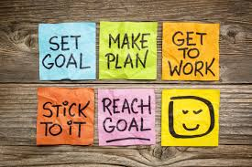
Encourage long-term success:
Help patients maintain their quit attempts and healthy habits through follow-up appointments.
Encourage long term success by building on their motivation and supporting them in their journey.
Identify opportunities to discuss lifestyle choices and signpost patients to appropriate support, such as public health nurses, or to relevant guidelines like the National Institute for Health and Care Excellence (NICE) guidelines.

Slide 24
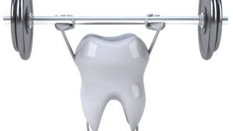
Long-term goals for general and special care dentistry:
To prevent future oral disease
Improve overall quality of life
Ensure consistent and high-quality access to care for all individuals, including those with additional needs.
This involves creating:
Personalized care plans
Providing preventative and restorative treatments
Fostering collaboration between general and specialist dental services.

Slide 25
References and Further Reading:
https://www.gdc-uk.org/standards-guidance/standards-and-guidance/gdc-guidance-for-dental-professionals/medical-emergencies
https://standards.gdc-uk.org/pages/principle8/principle8#collapseOne
https://www.nhs.uk › social-care-and-support › home-adaptions.
https://www.gov.uk/government/publications/oral-care-and-people-with-learning-disabilities/oral-care-and-people-with-learning-disabilitiies
https://www.challengingbehaviour.co.uk
NHS-continuing healthcare checklist
https://www.nidirect.gov.uk/articles/dental-care-people-disabilities
https://www.dentalhealthcareeoe.nhs.uk/services/special-care-dentistry/

