Slide 1
Risk Assessment
Special Care Dental Nursing 2025
Catriona Thornton

Slide 2

Aims:
To identify potential hazards and assess the risks they pose.
To control measures to eliminate or reduce these risks.

Slide 3

Objectives:
Implement effective options to manage risks occurring.
Ensure legal and regulatory compliance to meet legal requirements.

Slide 4

Learning Content:
This training session is intended to create an understanding on the importance of risk assessments for people with impairments and disabilities.

Slide 5

Development Outcomes:
This course meets the criteria for the
GDC's development outcomes A,B,C and D

Slide 6
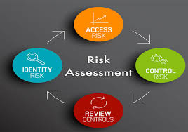
Risk assessments:
In Special Care Dentistry, risk assessments are a complex process that:
Identifies and evaluates the patient’s overall health status, anxiety levels, and specific oral health risks, as well as considering the need for modified treatment settings like general anaesthesia and ensuring the safety of both the patient and the dental team.
Mitigates health, safety, and ethical risks for patients with diverse and often significant needs.

Slide 7
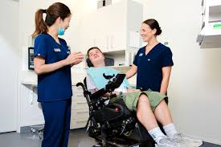
Special Care Patient's:
These patients have:
Physical
Sensory
Intellectual
Mental
Medical
Emotional
Social impairments that require special care.
The process in SCD involves a holistic, individualized approach that goes beyond standard dental care considerations.

Slide 8

Anxiety and behaviour risk:
Use tools like the Modified Dental Anxiety Scale (MDAS) and ask about specific triggers to assess a patient’s anxiety level and potential for behavioural challenges.

Slide 9

CAN YOU TELL US HOW
ANXIOUS YOU GET,
IF AT ALL, ​
WITH YOUR DENTAL VISIT?​
PLEASE INDICATE BY
INSERTING ‘X’ IN THE
APPROPRIATE BOX

Slide 10
If you went to your Dentist for TREATMENT TOMORROW, how would you feel?
 | Not Anxious  | Slightly Anxious  | Fairly Anxious  | Very Anxious  | Extremely Anxious 
If you were sitting in the WAITING ROOM (waiting for treatment), how would you feel?
 | Not Anxious  | Slightly Anxious  | Fairly Anxious  | Very Anxious  | Extremely Anxious 
If you were about to have a TOOTH DRILLED, how would you feel?
 | Not Anxious  | Slightly Anxious  | Fairly Anxious  | Very Anxious  | Extremely Anxious 
If you were about to have your TEETH SCALED AND POLISHED, how would you feel?
 | Not Anxious  | Slightly Anxious  | Fairly Anxious  | Very Anxious  | Extremely Anxious 
If you were about to have a LOCAL ANAESTHETIC INJECTION in your gum, above an upper back tooth, how would you feel?
 | Not Anxious  | Slightly Anxious  | Fairly Anxious  | Very Anxious  | Extremely Anxious 

Slide 11
Instructions for scoring (remove this section below before copying for use with patients)
The Modified Dental Anxiety Scale. Each item scored as follows:
Not anxious = 1
Slightly anxious = 2
Fairly anxious = 3
Very anxious = 4
Extremely anxious = 5
Total score is a sum of all five items, range 5 to 25: Cut off is 19 or above which indicates a highly dentally anxious patient, possibly dentally phobic

Slide 12
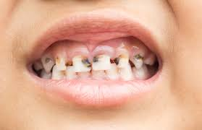
Oral health risk:
Assess risk factors for conditions like dental caries, considering a patient’s medical history, lifestyle, and oral hygiene habits.
For example, certain conditions like cerebral palsy can increase the risk of xerostomia and subsequent caries, while otitis media may increase enamel defects.

Slide 13
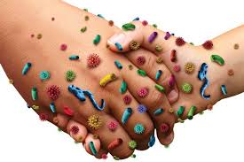
Systemic and environmental risk:
Consider the risk of infection transmission, exposure to chemicals, and the safety of the clinical environment.

Slide 14
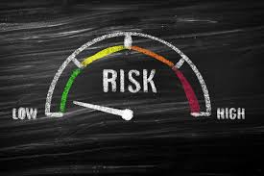
Key areas of a risk assessment:
Medical and systemic health risks
Comprehensive medical history taking is crucial to identify conditions that complicate or increase the risk of dental treatment.

Slide 15
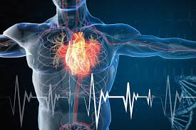
Cardiovascular disease:
A history of angina or heart failure may require early or late morning appointments to reduce stress

Slide 16
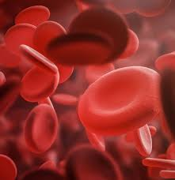
Bleeding disorders:
The risk of bleeding after an extraction for a patient on antiplatelet medication, like clopidogrel, may require treatment in a hospital setting.

Slide 17
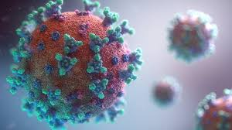
Infection risk:
Some medical conditions, such as organ transplants, may increase a patient’s vulnerability to infection from dental procedures.

Slide 18
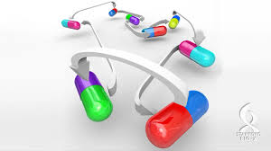
Drug interactions:
All medications must be reviewed to anticipate potential adverse interactions with dental treatments.

Slide 19

Communication and consent risks:
Special care patients, particularly those with cognitive impairments, may lack the capacity to provide valid consent for treatment.

Slide 20

Assessing capacity:
The dental team must assess a patient’s capacity to:
Understand
Weigh up
To communicate their decision regarding treatment.

Slide 21

Best interests decisions:
For patients lacking capacity, a decision must be made in their “best interests,” often in consultation with family, legal guardians, or advocates.
Supporting communication:
Simple, clear language,
“Tell-Show-Do” techniques
Visual aids can help patients with intellectual disabilities understand procedures

Slide 22

Documenting consent:
Detailed records must be kept of:
All discussions
The information provided
The consent process
Any informed refusal of treatment.

Slide 23
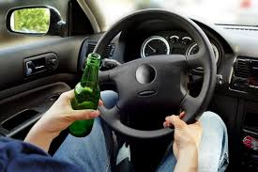
Behavioral risks:
Patients with complex needs may exhibit challenging or anxious behaviour that can impact their safety and the dental team’s ability to provide care.

Slide 24

Behavior management:
Approaches range from:
Distraction
Verbal conditioning
Conscious sedation with nitrous oxide
As a last resort, general anesthesia.

Slide 25
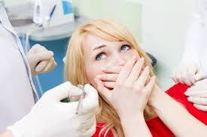
Safe environment:
The dental team must manage distractions and create a consistent, calm environment to help anxious patients cooperate.

Slide 26
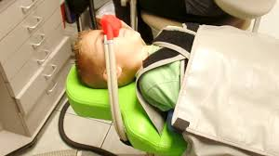
Use of restraint:
Physical restraint should be used only as a last resort, with appropriate consent and following the least restrictive methods possible.

Slide 27

Environmental and access risks:
Patients with mobility issues
Sensory sensitivities
Or behavioural challenges require an adapted clinical environment.

Slide 28
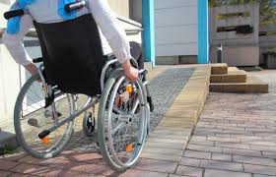
Physical access:
Practices must make “reasonable adjustments” for patients with additional needs, including accessible premises and equipment.

Slide 29
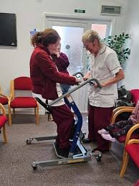
Manual handling:
Before moving a person, the individual's ability to move, their weight, and any health conditions need to be taken onto consideration.
Always respect the individual's dignity and privacy. Explain what you are going to do before you start moving them.
Use handling aids like hoists, slide sheets, or transfer boards.
Staff should be trained in how to use handling aids and how to move people safely.

Slide 30
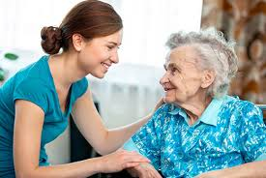
Domiciliary care:
The assessment covers the patient's medical condition, the suitability of the home environment, and the needs of the dental team.

Slide 31
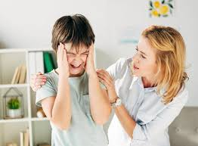
Sensory consideration:
Modifications to the clinical environment, such as:
Minimizing noise and bright lights, may be necessary for patients with autism or sensory sensitivities

Slide 32
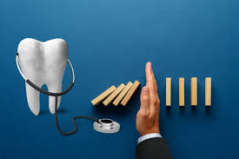
Dental-specific risks:
Certain conditions and medications can predispose special care patients to specific oral health problems.

Slide 33
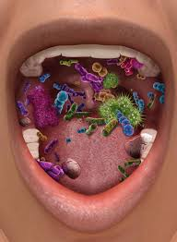
Caries risk:
Patients with intellectual disabilities often have a higher prevalence of untreated tooth decay.
A comprehensive caries risk assessment is used to tailor preventive care.

Slide 34
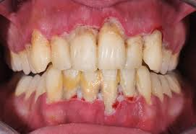
Periodontal disease:
Impaired dexterity and limited access to professional care can increase the risk of gum disease.

Slide 35
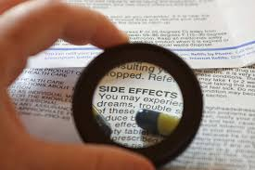
Medication side effects:
Many medications for systemic conditions can cause dry mouth (xerostomia), which increases the risk of caries and periodontal disease.

Slide 36

Risk management strategies:
Use a structured diagnostic sequence to gather information from the patient’s medical, social, and behavioural history, ensuring no crucial detail is missed.
Develop an individualized care plan with appropriate preventive interventions, modifications to treatment, and alternative approaches based on the risk assessment.

Slide 37

Caregiver training:
For patients who cannot maintain their own oral hygiene, involve caregivers in hands-on demonstrations of proper brushing and flossing techniques.

Slide 38

Communication with other providers:
Collaborate with other healthcare professionals, such as physicians and occupational therapists
To manage risks and balance treatment with other needs.

Slide 39

Regular review:
Reassess risks regularly, especially when there are changes in a patient’s medical condition or social circumstances.

Slide 40
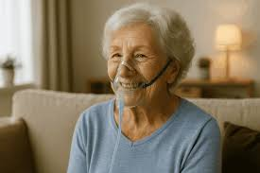
Use of risk assessment tools:
Implement standardized tools, like the Domiciliary Risk Assessment (DRA) to ensure a thorough and consistent process.

Slide 41
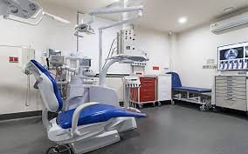
Modified treatment environment:
Arrange for treatment in a different environment if needed, such as a hospital setting for patients with a higher risk of complications from procedures like extractions.

Slide 42
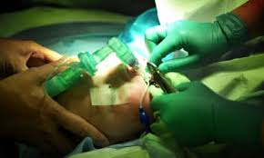
General anaesthesia:
Plan for treatment under general anaesthesia if a patient requires it and has additional needs that prevent them from receiving care in a general dental practice.

Slide 43
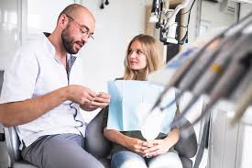
Communication and information management:
Ensure secure and efficient communication
Record transfer between providers to improve the patient’s journey and assist in incident response.

Slide 44

Professional collaboration:
Seek advice from specialists, such as an oral surgeon or special care dentistry specialist, when dealing with complex cases, such as medically compromised patients on certain drugs.

Slide 45
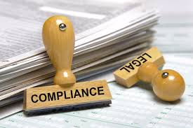
Documentation and legal requirements:
Legal obligation:- Conduct risk assessments to comply with health and safety laws and protect staff and patients from harm.
Record keeping:- Maintain detailed records of risk assessments, patient information, and treatment plans in the patient’s notes.

Slide 46
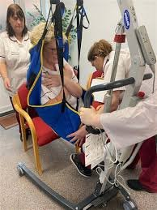
Training:
"Once the risk assessments are carried out protocols/guidelines should be documented and training implemented, so that all staff are aware of the correct manual handling procedures.
This training should be mandatory and updated at regular intervals"
"Robert Ireland – Advanced Dental Nursing page 88"

Slide 47
References and Further Reading:
https://www.bda.org/advice/patient-care-and-safety/health-safety-and-risk-assessment/
National Institute for Health and Care Excellence (NICE) for risk assessments
https://www.dental-nursing.co.uk/content/features/carrying-out-a-risk-assessment-in-a-dental-practice/
https://www.healthassured.org/mental-health-risk-assessment-template
Manual Handling Operations Regulations : The Health and Safety Executive (HSE)https://www.hse.gov.uk/pubns/priced/l23.pdf
https://dentalanxiety.wp.st-andrews.ac.uk
https://www.hse.gov.uk/msd/mac/
https://www.hse.gov.uk/simple-health-safety/risk/risk-assessment-template-and-examples
https://www.gov.uk/government/publications/management-of-risk-in-government-framework
https://www.cqc.org.uk/guidance-providers/adult-social-care/managing-risks-good
https://assets.publishing.service.gov.uk/government/uploads/system/uploads/

