Slide 1
Oral Health
Special Care Dental Nursing 2025
Catriona Thornton

Slide 2

Aims:
To improve the oral health and quality of life for people with disabilities and disadvantages and aim for better oral healthcare outcomes for people with special healthcare needs.
Notes:
To ensure individuals with physical, medical, intellectual, emotional, sensory, or social impairments receive oral care that meets their complex needs.

Slide 3

Objectives:
To enable good oral health for individuals with impairments and disabilities
Implement good all round teaching techniques and practices

Slide 4

Learning Content:
This training session is intended to create an understanding on the importance of good oral health for people with impairments and disabilities.

Slide 5
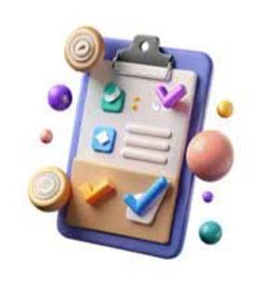
Development Outcomes:
This course meets the criteria for the
GDC's development outcomes
A,B,C and D

Slide 6
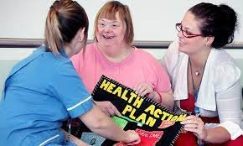
Patient education:
Dental nurses are crucial in educating patients with impairments and disabilities by:
Providing clear, adapted communication
Using visual aids
Working with carers to develop tailored oral health plans
They educate patients on:-
Preventative care
Help to manage anxiety before and during appointments
Assist with accessing necessary services like sedation or general anaesthetics when needed

Slide 7
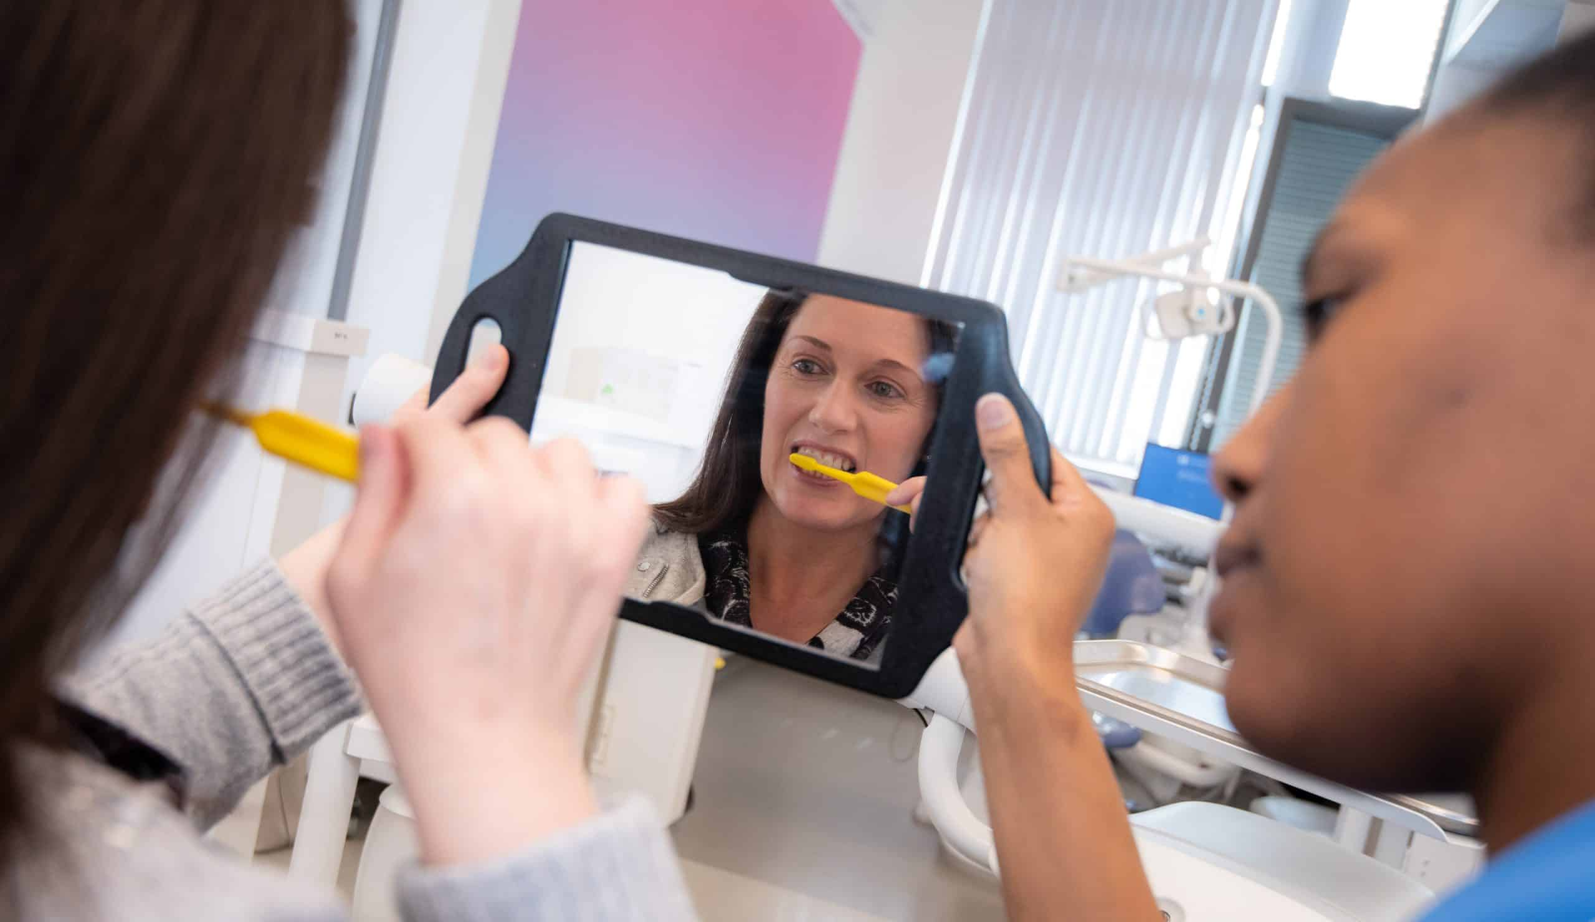
Demonstrating techniques:
Showing patients how to:
use modified brushes
floss aids
other specialized tools effectively
and provide guidance on accessing difficult areas in the mouth.
Notes:
Special care dentistry is built on providing personalized care for each patient's unique needs and abilities.
For individuals with impairments or disabilities by providing specialist knowledge, skills, and compassionate support.
Ensuring the patient and their carer receives effective and accessible treatment despite physical, medical, intellectual, emotional, sensory, or social barriers to routine dental care.

Slide 8
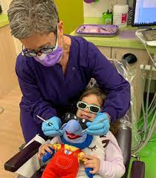
Modifying techniques:
Modifying techniques can include;-
Altering physical positions
Using visual aids
Employing behavioral approaches like 'tell-show-do' to reduce anxiety.
Notes:
Special care dental nurses employ modifying techniques to adapt standard dental care for patients with significant physical, sensory, medical, emotional, or social challenges, focusing on communication, consent, education, and tailored treatment.
The design and use of aids to oral hygiene including aspirating toothbrushes, modified toothbrush handles, Collis curve brushes etc.

Slide 9
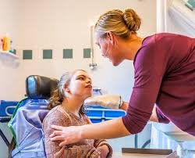
Empathetic communication:
Building a trust and a good rapport with patients is essential.
Ensuring they feel comfortable discussing their needs and concerns openly.

Slide 10
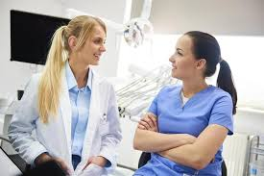
Collaboration with other professionals:
Dental nurses may work closely with:
Physical therapists,
Occupational therapists
Speech therapists to develop comprehensive oral care plans
Keep up-to-date with evidence-based guidelines and resources, such as the Delivering Better Oral Health toolkit and NICE guidelines, to provide the best advice

Slide 11
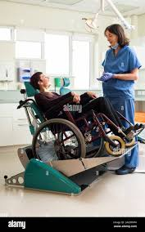
Addressing accessibility concerns:
Dental nurses can assist in:
creating a comfortable and accessible dental environment for patients with disabilities
including providing support during examinations and procedures.

Slide 12
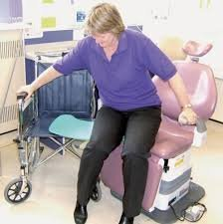
Altering physical positions:
Encourage the patient to move independently whenever possible, using their own equipment or the arms of a chair.
Altering physical positions for oral health involves both patient positioning to facilitate care and adjustments by the dentist to accommodate the patient's limitations.
For patients unable to sit in a standard chair, dentists may use a wheelchair or portable equipment.
Caregivers can help by supporting the patient's head against their body, ensuring practicality for brushing, and may need to perform the cleaning.
Accessible dental facilities, such as those with ramps and adjustable equipment, are crucial for patients with mobility issues
Notes:
This requires a risk assessment protocol that prioritizes patient safety and staff well-being, utilizing specialized equipment like reinforced dental chairs and hoists, and ensuring staff training for handling patients
Altering physical positions for oral health involves both patient positioning to facilitate care and adjustments by the dentist to accommodate patient limitations, such as physical disabilities or sensory sensitivities.

Slide 13
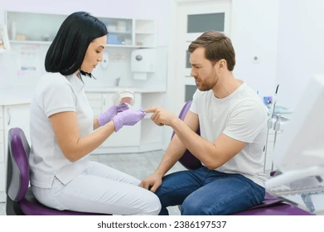
Visual aids:
Visual aids are important for special care dentistry to help patients understand and with accompanying images, models or text, reduce anxiety, increase cooperation, and make the experience less stressful for both the patient and the dental team.
Other aids include:
Communication boards
Using simple language and gestures
Notes:
Visual aids are important for special care dentistry to help patients, especially those with autism, to understand and with accompanying images or text, reduce anxiety, increase cooperation, and make the experience less stressful for both the patient and the dental team.

Slide 14
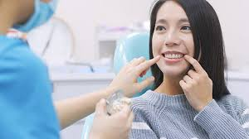
Tell:
Provide an age-appropriate and clear verbal explanation of the upcoming procedure.
Avoid Negative, emotive or frightening words to reduce anxiety.
Focus on keeping explanations simple, reassuring, and informative, helping the patient understand what will happen.

Slide 15
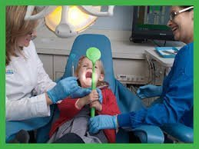
Show:
Build a rapport with the patient to help reduce fear and build a trust by allowing the patient to see and understand the tools before treatment begins.
Demonstrate the instruments and equipment that will be used.
Allow the patient's to touch and examine the tools, to become comfortable with them.

Slide 16
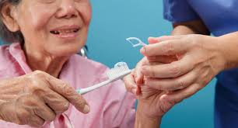
Do:
The treatment is performed exactly as it was explained and demonstrated, often using gradual steps.
Praise the patient for their cooperation and understanding, which helps reinforce the positive experience.
The TSD technique is tailored to the individual's age, prior dental experiences, and individual needs
Notes:
Building Rapport:
A strong rapport between the dental team and the patient is essential for the technique to be effective.
Patience and Empathy:
Understanding and acknowledging a patient's fears and anxiety is crucial for building trust and creating a positive experience.

Slide 17
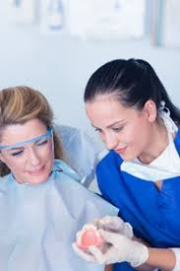
Key considerations for providing Oral Health to special care patients:
Recognizing that each patient’s needs are unique
Dental services are legally obligated to make reasonable adjustments to their environment and procedures to accommodate patients with disabilities.
Collaboration with other healthcare professionals may be necessary to provide comprehensive care.
Preventive oral health care is crucial for special care patients to minimize the need for complex.
Establishing a trusting relationship with the patient and their carers is essential.
Educating patients and their carers about oral hygiene practices and the importance of regular dental care is vital.

Slide 18
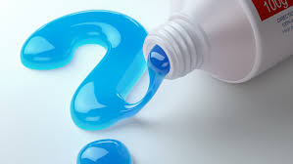
The importance of topical fluoride treatments:
Topical fluoride treatments are important in Northern Ireland
They are a key preventive measure against tooth decay
Studies and trials in have evaluated the effectiveness of treatments which strengthen enamel, reduce acid attacks, and improve overall oral health outcomes.
By strengthening tooth enamel, topical fluoride makes teeth more resistant to decay and can help arrest existing lesions, shifting dental care towards prevention.
Notes:
They are a key preventive measure against tooth decay, a significant public health issue, especially for children who have the worst oral health in the UK.

Slide 19
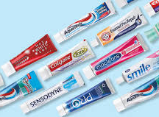
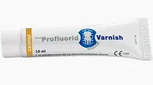
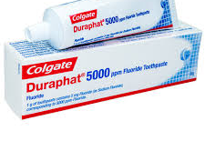
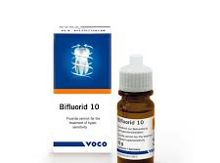
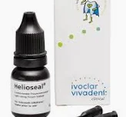
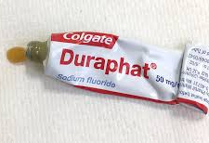
Different application methods:
Fluoride can be applied topically in various forms:
Toothpaste
Varnish
Professionally-applied gels.

Slide 20

The relevance and importance of diet:
Diet plays a significant role in maintaining oral health.
Consuming sugary and acidic foods and drinks can contribute to tooth decay and gum disease.
Dental nurses can provide dietary advice to patients, encouraging them to choose healthier food options and limit sugary intake.
Food and drink selection for individuals with disabilities, particularly those with swallowing difficulties, specific dietary modifications may be necessary to prevent choking hazards.

Slide 21
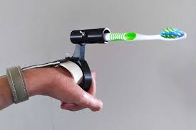
The design and use of aids to oral hygiene:
Aspirating toothbrushes:
These brushes have a built-in suction mechanism that helps remove debris and plaque, particularly for individuals with difficulty swallowing or excessive saliva.
Modified toothbrush handles:
Handles designed with larger grips or ergonomic shapes can make brushing easier for people with limited dexterity.
Collis curve brushes:
These brushes are specifically designed to reach and clean the back teeth effectively, especially for individuals with difficulty accessing these areas.

Slide 22
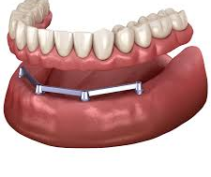
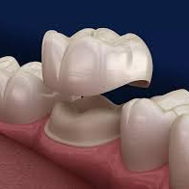
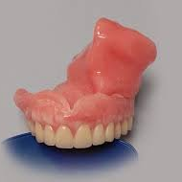
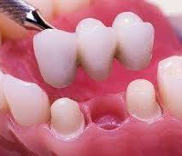
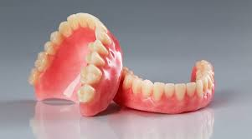
The care of Dental prostheses:
Dentures
Partial dentures
Obturators
Implants
Bridges
Crowns
Dental nurses should educate patients on the correct cleaning methods to prevent plaque buildup and infection.

Slide 23
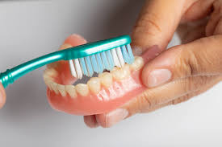
Proper daily cleaning instructions for removable appliances:
Protect and clean the dental prosthesis over a sink filled with water or a towel to catch it if it is accidentally dropped.
Use the right cleaner and a denture-specific brush or a soft toothbrush, along with a mild liquid soap or denture cleaning paste.
Avoid using regular toothpaste, as its abrasive properties can damage the prosthesis over time.
Brush thoroughly cleaning all surfaces of the prosthesis, making sure to remove all food debris and denture adhesive. Pay close attention to grooves and clasps.
Rinse well after brushing, rinse the prosthesis thoroughly with cold water.

Slide 24
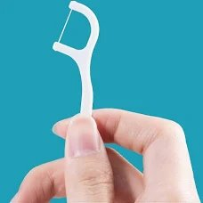
Proper daily cleaning Instructions:
Brush twice daily using a soft-bristled toothbrush and fluoride toothpaste, concentrating on the area around the restorations and the gum line.
Floss daily using and guide floss under the restorations to remove plaque and food particles.
Use interdental brushes to effectively clean hard-to-reach areas under the restorations .
Consider an electric toothbrush this can be more effective for cleaning compared to a manual one.
Use of a water flosser, this can help remove food particles from hard-to-reach areas, but it does not replace flossing.

Slide 25
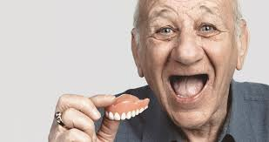
Fitting and adjustments:
Regular checkups are essential to ensure prostheses
Fit properly
Function effectively
Correct cleaning
Denture/Partial denture being removed at night

Slide 26
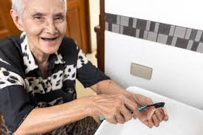
Modifications for special needs:
In some cases, prostheses may need to be modified to accommodate specific disabilities, such as difficulty with removal or placement.

Slide 27
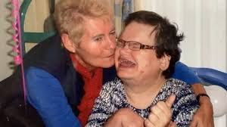
Common Modifications:
This may include:
Changes to the socket design
Adjustments for issues like excessive sweating or changes in residual limb shape
Incorporating features to help with weak or impaired dexterity.

Slide 28
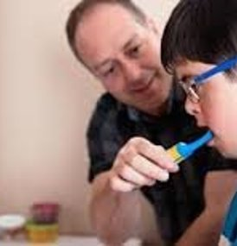
To implement and to promote good oral health for people with disabilities:
Implement individual teaching techniques that involve:
Tailoring communication
Using visual aids
Involving caregivers.
Create a supportive environment
Providing hands-on demonstrations for both the individual and their caregiver
Adapting tools or routines to accommodate physical or cognitive challenges.

Slide 29
References and Further Reading:
https://www.dentalhealth.org/dental-care-for-people-with-special-needs
British Society for Disability and Oral Health - http://www.bsdh.org
International Association for Disability and Oral health - https://www.iadh.org
https://www.dental-nursing.co.uk/content/features/oral-health-promotion-for-special-care-patients
Delivering Better Oral Health an evidence-based tool kit Third Edition Department of Health (currently being updated)
Special Care in Dentistry. Handbook of Oral Care Authors, Crispian Scully, Pedro Diz Dios, Navdeep Kumar
Holistic Oral Care. A guide for Health professionals. Second Edition, Authors, Janet Griffiths, Steve Boyle
BDA Clinical Guide to Special Care Dentistry Authors, Fiske and Dougall
NICE guidelines

