Slide 1

Domiciliary
Care
Cathy McCabrey
Special Care Dental Nursing

Slide 2
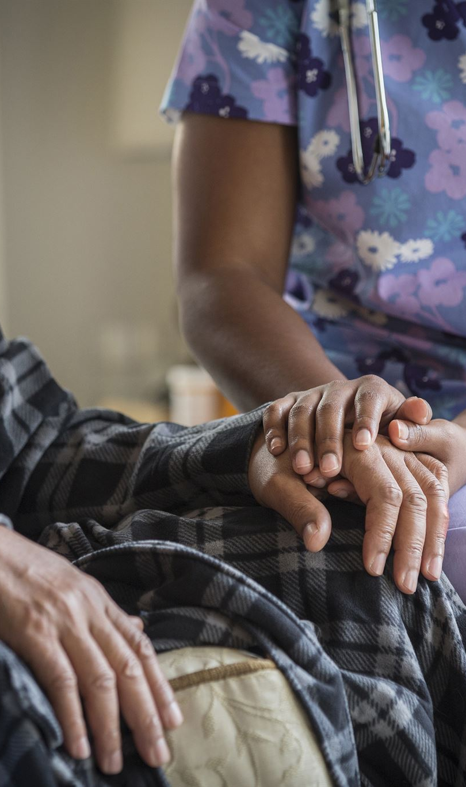
Aims and Objectives
Aim: To increase awareness of the importance of providing domiciliary
care to those patients in need
At the end of this session you will be able to:
Describe what is meant by domiciliary care
Explain why a domiciliary visit is necessary
List treatments that are suitable in a domiciliary setting
State why the need for domiciliary care has increased
Describe the availability of domiciliary care
Explain why it is necessary to liaise with health and social services
Explain how referrals are made
Recognise the importance of carrying out an initial assessment
Explain what information is needed at the initial assessment
List what health and safety issues need to be considered
State the importance of maintaining patient confidentiality and consent
List the limitations of domiciliary care

Slide 3
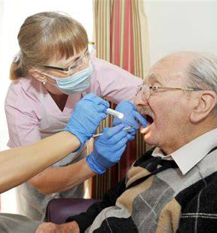
What is Domiciliary Care?
Domiciliary care is a valuable service that provides dental treatment for patients in their own home, residential/nursing home, sheltered housing, day care centres, hospital, learning support centres or special schools.
Designed for patients whose circumstances make it impossible, unreasonable or impractical to attend a dental clinic due to their physical disability, medical health, frailty or other special care needs
Focuses on maintaining comfort, dignity, and oral health in a familiar environment.
Promotes patient centred care tailored to individual needs.

Slide 4
Why is Domiciliary Care necessary and why the need for domiciliary care has increased?
For patients who are housebound / bedridden who’s circumstances make it impossible unreasonable or impractical for them to receive care in a dental clinic
Patients are living longer and are retaining their own natural teeth which increases the need
As patients’ medical condition deteriorates they have restricted access to dental services
Patients living in residential care such and those with learning disability / mentally compromised, older people and patients in insecure units are more likely to have poor oral health with inadequate or restricted access to services
Research has shown specific associations between poor oral hygiene and aspiration pneumonia which accounts for 48% of all chest infections in nursing homes which sadly can be fatal. It is suggested that were regular oral hygiene is not provided for residents the odds of pneumonia associated deaths are tripled
Patients receiving palliative or end of life care
Domiciliary care can improve the oral health, general health and quality of life of patients.

Slide 5
Treatments
Suitable Treatments | Unsuitable Treatments
Examinations Oral hygiene advice and instruction Scale and Polish Temporary dressings Simple restorations Simple extractions Fluoride applications Prescriptions Dentures and adjustments | Due to the complexity, duration, or equipment requirements: Permanent fillings Difficult extractions Root canal treatment Crown and bridges work Implants Orthodontic treatment

Slide 6
availability of domiciliary care in Northern Ireland
In Northern Ireland dental care is provided by three branches of dentistry:
Community dental service
General dental practitioners
Hospital dental service
CDS is a small service of approximately 90 dentists that provide most domiciliary visits. Hygienists and therapists will also provide treatment and preventative advice in domiciliary settings under the direction of a dentist.
General dental practice tends to be more cost effective for patients than for dentists as longer treatment appointments reduce financial viability. Therefore, few domiciliaries are carried out by GDP’s.
The Hospital dental service care for the most complex patients requiring specialist treatment - they would seldom provide domiciliary care.

Slide 7
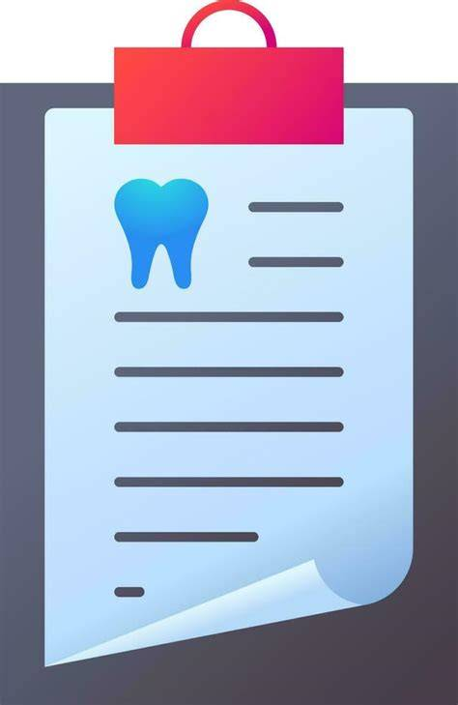
Why it is necessary to liaise with health and social services
To gain patient's medical history, social history and past dental experiences.
To gain support from patients next of kin to ensure oral healthcare is built into the patient’s daily care plan.
Some patients may need to be referred to hospital services for more specialist treatment and interventions.
Dentist may need to liaise with GDP’s, GP's, consultants, social workers, carers, family NOK to gather comprehensive information and build a fuller understanding of the patient’s needs

Slide 8
How referrals are made
Referral letters or telephone referrals from GPP’s, care homes, district nurses, GP,s Social workers.
Self referral from patient or carers/NOK.
Care home or Residential home following admission to care home.
All new patient referrals should follow this acronym to gain as much information as possible:
C Check full address and get useful directions
A Appointment date and time and letter sent
M Medical history, inc. allergies & medications
P Parking facilities
I Information about who will be present at apt.
N Name of dental team visiting for security
G Gain access, keypad lock, locations of keys, pet etc.

Slide 9


Importance of initial assessment appointment
Telephone the patient or carer on the day of the appointment to confirm that everything is in order and the visit can proceed as planned
Try to be punctual. Carer may have made special arrangements to be available for appointment
Establish at the outset the relationship of any carer to the patient
The clinician must have a chaperone present in the interest of personal and patient safety
Confirm the patient's personal details
Consult with the carer regarding the patient's capacity to give reliable history and valid consent
Check the reason for and the source of referral as an update in past medical/dental history is often necessary
Established that confidentiality is not being compromised by the presence of carers or support workers
Manage patient and carer expectations from the outset

Slide 10

Health and Safety
Domiciliary care takes place in a wide range of settings, where the dental team have limited control over the working environment. It is essential to ensure privacy, confidentiality, and access to basic facilities such as water and electricity are always maintained
Risk assessment should be carried out at each new location, ensuring clear access to patient and a work area. It is important to use circuit breaker plugs on electrical equipment and maintaining safe operating practices.
Patient safety and safety of their home is paramount
Identification from the dental team should always be produced
Personal safety is also important therefore a chaperone should always be present
Manual handling training must be up to date with regards to transporting and carrying equipment
Adequate car insurance must be obtained to carry out work business and transport equipment
Personal alarms and or mobile phones should be carried by the dental team

Slide 11

Cross infection control
Standard Infection Control Precautions must always be followed.
Maintain the same high standards as in a clinical setting, adapting procedures to the domiciliary environment.
Hand hygiene before, during, and after treatment using soap and water or alcohol gel.
Use appropriate PPE: gloves, mask, eye protection, disposable apron.
Lay a clean barrier on work surfaces. Avoid placing contaminated items directly on patient furniture.
If possible, use single-use items, dispose of them after each patient.
Minimise aerosol generation where possible.
Dispose of waste and PPE in accordance with trust policy
Return used instruments to the clinic in a sealed, rigid container for sterilisation.
Disinfect all reusable equipment before storage or reuse.
Clean and decontaminate transport boxes, bags, and portable equipment.
Perform hand hygiene after all cleaning tasks.
Participate in regular infection control training and audits.

Slide 12

Patient Confidentiality
Maintain the same level of confidentiality as in a clinical setting.
Ensure private discussions with patients whenever possible, avoid sensitive conversations in front of others unless the patient agrees.
Patient records must be stored in a locked bag or case during transport, not left unattended in vehicles or care homes, handwritten notes must be typed and uploaded to patients digital chart upon return to clinic.
Electronic devices should be password-protected and encrypted.
Share information only with relevant healthcare professionals involved in the patient’s care, and with consent.
Follow GDPR guidelines and trust confidentiality policies.

Slide 13
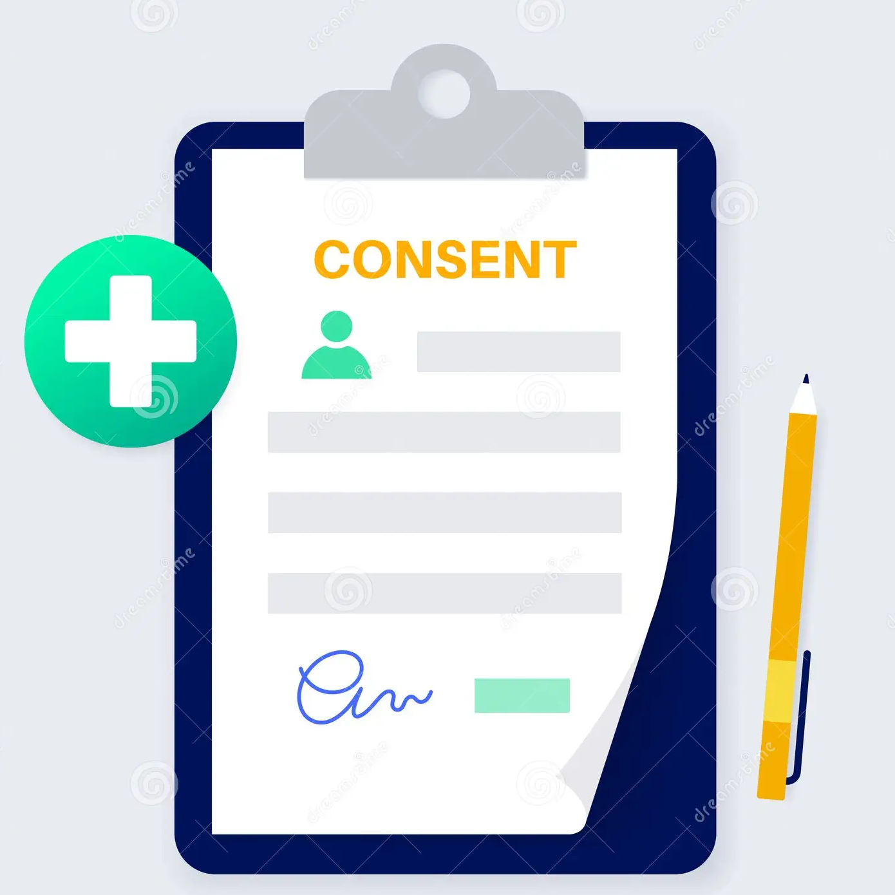
Consent
Valid consent must always be obtained before starting any treatment.
Consent can be written, verbal or implied
Assume all adults have capacity to consent unless proven otherwise.
If capacity is in doubt e.g. dementia, learning disability:
  Assess in line with the Mental Capacity Act 2005, 2016.
  Consult with next of kin.
  Make decisions in the patient’s best interests, considering deprivation
  of liberties safeguards. Clearly record how consent was obtained and any discussions held.
Reassess consent at each visit, especially if the patient’s condition changes.
Keep up to date with all trust and GDC training regarding MCA and safeguard children, adults and vulnerable adults

Slide 14
Limitations of domiciliary care
For the Patient | For the Dental Team
Limited treatment options – lack of specialist equipment xrays, high speed hp Reduced Quality of Care – poor lighting and patient access Invasion of privacy Disruption of normal routine Patients may be wary of letting strangers into their homes Embarrassment with regards to social/house conditions | Limited Equipment and Facilities Difficult Working Conditions – improvising with head torch Infection Control Difficulties Safety and Security Concerns - working in unfamiliar environments Time Inefficiency Communication and Record Keeping No back up in an emergency scenario Physical Strain - manual handling and working in awkward positions

Slide 15
Thank you for listening!
Reading List:
British Society for Disability and Oral Health (BSDH)
British Society for Gerodontology
Regulation and Quality Improvement Authority (RQIA) / Trust guidelines on Domiciliary Dental Care in NI
A Clinical Guide to Special Care Dentistry

