Slide 1
Dental Care Provision
Ensuring comprehensive oral health services for all
By Cathy McCabrey
NIMDTA Special Care Dental Nurse Course
Notes:
---

Slide 2
Overview of Dental Care Provision
Notes:
Title Slide

Slide 3

Aim & Objectives
- Raise awareness about the provision of dental services in Northern Ireland
- Explain the role of the general dental service, the community dental service and the hospital dental service.
- Describe the use of mobile dental units, listing the advantages and disadvantages.
- Understand the management of oral health care for homeless people and patients from the travelling community.

Slide 4
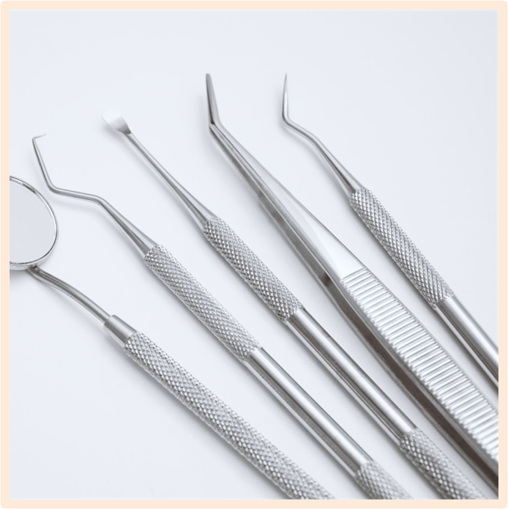
Dental Care provision in Northern Ireland is carried out in various settings and is tailored to individual patient need.
General Dental Services
General Dental Practice is the most common setting. Can include NHS and Private dental treatment
Provides routine care by general dentists, therapist and dental hygienist.
Main role is to deliver primary dental care to the community including regular checkups, radiographs, restorations including crown and bridge work, oral hygiene and preventative advice, periodontal care, trauma/emergency care and dental aesthetics like bleeding
Widely available, convenient and familiar setting
Continuity of Care, building trust and good relationship with clinician
Comprehensive range of care
Gateway to specialist or hospital dental service if more complex treatment is required.

Slide 5
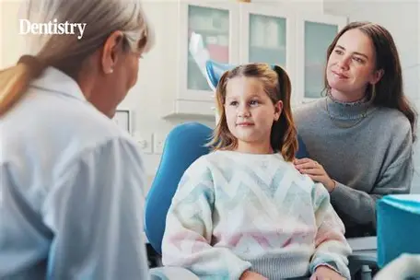
Community Dental Service
CDS provides dental care for patients who cannot easily access treatment in GDP
Focuses on special needs patients including physical, learning, mental, medical disabilities, housebound patients and homeless patients
Delivers care in community clinics, schools, domiciliary care and mobile dental units
Provides sedation and general anaesthetic services for children with extensive dental needs and high anxiety
Offers Oral Health Promotion campaigns, toothbrushing programmes and fluoride varnish applications
Conducts Oral Health Assessments and screening to collect data to inform public health polices and future planning
CDS works closely with GDP’s and can act as a referral point for patients requiring specialist treatment

Slide 6

Hospital Dental Service
Provides complex and specialist dental care for patients that cannot be managed in GP or CDS
Specialist dental treatment includes oral and maxillofacial surgery, oral medicine, complex restorative dentistry, paediatric dentistry, orthodontics, special care dentistry for medically compromised patients
Provide emergency treatment for trauma, fractures, infections, bleeding and post op complications for GP and CDS
Often linked to dental schools and teaching hospitals
Provides advice, diagnostic support and treatment planning for other dental professionals

Slide 7
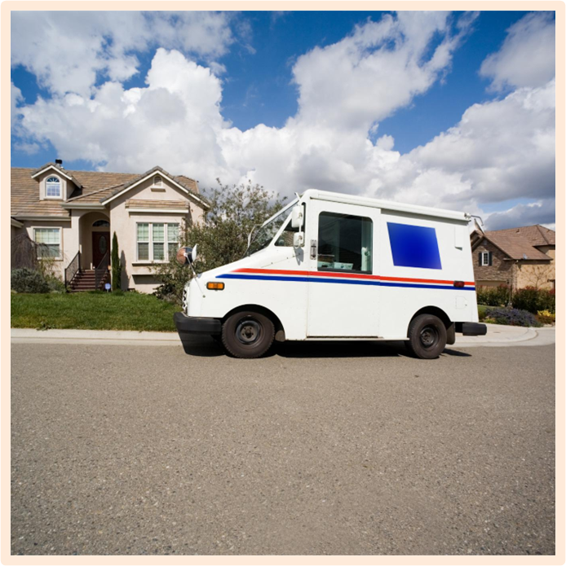
Mobile Dental Units
Mobile Dental Units are specially equipped vehicles that contain electricity and water to facilitate the use of dental equipment
Improves access to dental treatment for patients who cannot easily travel to clinics
Brings dental care directly to schools, care homes or rural remote areas
Provides care for vulnerable and special groups of patients including homeless population, prisoners, refugees or underserved communities
Treatments include examinations, radiographs, S/P, restorations and simple extracations, OHA and preventive treatments
Can be needed during public health emergencies or disaster relief efforts to provide urgent emergency care

Slide 8
Mobile Dental Units:
Advantages | Disadvantages
Convenience, brings care to underserved or remote communities | Limited range of treatment
Reduce travel barriers for patients | Space and equipment constraints
Promotes OH and educational programmes | Maintenance and running costs
Flexible and Mobile | Weather or transport issues may disrupt service

Slide 9
Management of oral health care for homeless people and patients from the travelling community

Slide 10
People who are homeless or travellers including Gypsy, Roma and Traveller communities often face major barriers to accessing dental care.
Challenges include lack of permanent address, difficulty to register with GDP, irregular lifestyle, low income, low OH awareness, limited access to hygiene facilities, higher likelihood of illness/disease
CDS plays a key role in caring for these patients
Use of mobile dental units near shelters, traveller sites or community centres
Offer outreach dental teams to visit hostels
Provide drop-in sessions or flexible appointment clinics
Work in partnership with homeless charities, traveller community liaison groups, social services, GP’s, nurses and public health teams
Staff training to help understand cultural sensitivities and barriers faced by transient or homeless populations.
Distribute oral hygiene kits through shelters or outreach programs
Build trust and encourage regular attendance through positive reinforcement and continuity of care.

Slide 11
Thank you for listening!
Further Reading:
Special Care in Dentistry: Crispian Scully and Pedro Diz Dios
Dental Management of the Medically Compromised Patient: James W Little
Clinical Guide to Special Care Dentistry: J Foske, A Dougal and D Lewis
https://www.bsdh.org
Journal of Disability and Oral Health

