Slide 1
Management of Oral Conditions
Cathy McCabrey
Special Care Dental Nursing
Notes:
---

Slide 2
Aims and Objectives
Notes:
Introduction to Oral Conditions

Slide 3
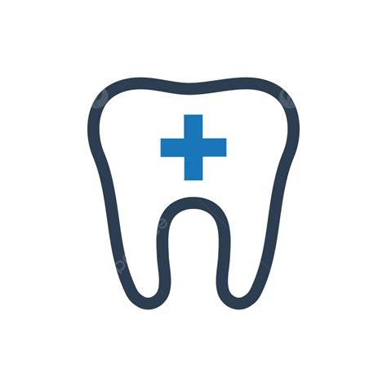
Aims
To increase awareness so you can recognise oral conditions such as xerostomia, mucositis, oral candidosis, denture stomatitis, apthous ulcers and other suspicious oral lessons.
Enhance your confidence and competence in delivering patient centred oral healthcare for patients with special needs.
Notes:
Oral conditions encompass a wide range of diseases and disorders that affect the mouth, teeth, gums, and related structures. These conditions can significantly impact an individual's overall health, quality of life, and ability to eat, speak, and socialize. Common oral conditions include dental caries (tooth decay), periodontal disease (gum disease), oral cancer, and various infections and lesions. Understanding the causes, symptoms, and preventive measures for these conditions is essential for maintaining good oral hygiene and health. Oral health is closely linked to systemic health, with poor oral hygiene contributing to conditions such as cardiovascular disease, diabetes, and respiratory infections. Therefore, promoting awareness and education about oral conditions is a critical component of public health initiatives.

Slide 4
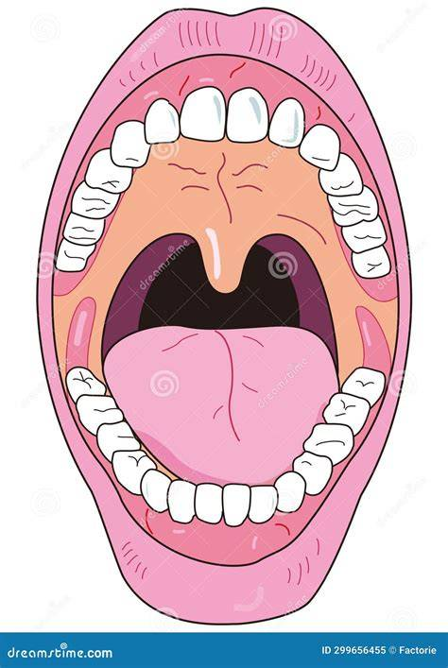
Objectives
Understand how general health and oral health are connected
Recognise common conditions of the oral mucosa
Explain methods to help prevent and manage the most common oral conditions
List products and medications to help alleviate the symptoms of xerostomia, mucositis, oral candidosis, denture stomatitis, apthous ulcers
Notes:
Oral conditions encompass a wide range of diseases and disorders that affect the mouth, teeth, gums, and related structures. These conditions can significantly impact an individual's overall health, quality of life, and ability to eat, speak, and socialize. Common oral conditions include dental caries (tooth decay), periodontal disease (gum disease), oral cancer, and various infections and lesions. Understanding the causes, symptoms, and preventive measures for these conditions is essential for maintaining good oral hygiene and health. Oral health is closely linked to systemic health, with poor oral hygiene contributing to conditions such as cardiovascular disease, diabetes, and respiratory infections. Therefore, promoting awareness and education about oral conditions is a critical component of public health initiatives.

Slide 5
Why oral health matters…
Notes:
Introduction to Oral Conditions

Slide 6
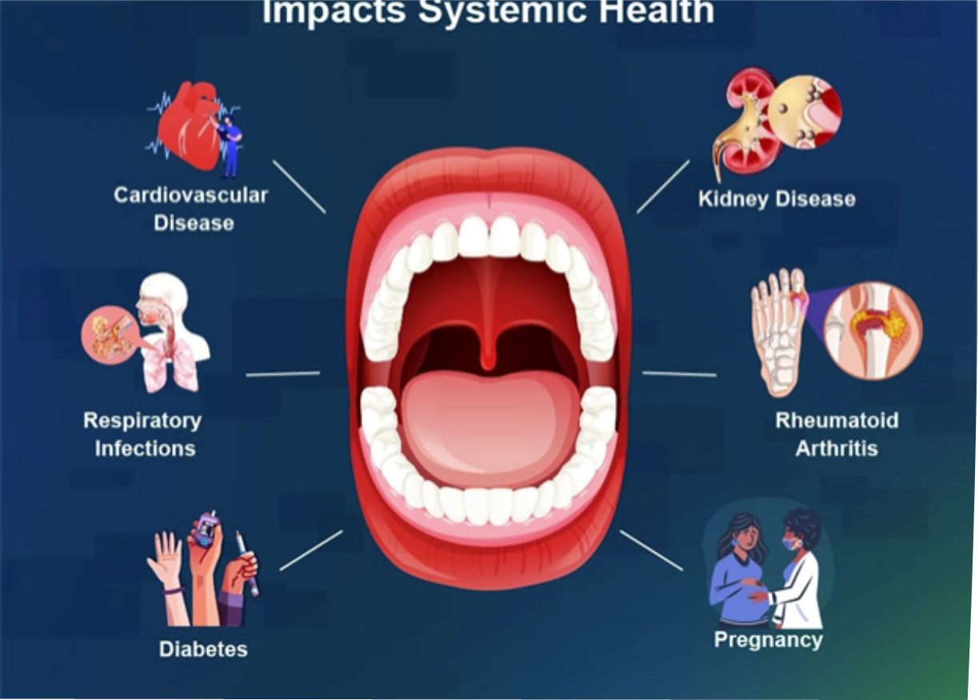
The mouth and body are linked
Poor oral health can worsen general health
Pain, infection and difficulty eating can affect wellbeing
Notes:
Oral cancer includes malignancies of the lips, tongue, cheeks, floor of the mouth, and other oral tissues. It is a serious condition that can be life-threatening if not diagnosed and treated early. Risk factors for oral cancer include tobacco use, excessive alcohol consumption, human papillomavirus (HPV) infection, and prolonged exposure to the sun (for lip cancer). Symptoms may include persistent sores, lumps, or patches in the mouth, difficulty swallowing, and changes in speech. Early detection through regular dental examinations and awareness of symptoms is crucial for improving outcomes. In addition to cancer, various benign lesions such as ulcers, cysts, and white or red patches may occur in the oral cavity. These lesions can be indicative of underlying systemic conditions or local irritations and should be evaluated by a healthcare professional.

Slide 7
Common oral conditions…
Notes:
Introduction to Oral Conditions

Slide 8
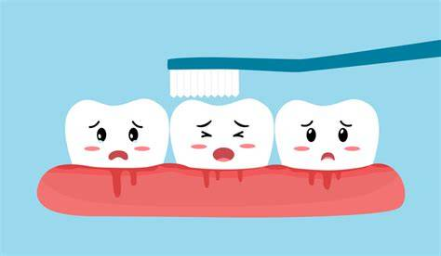
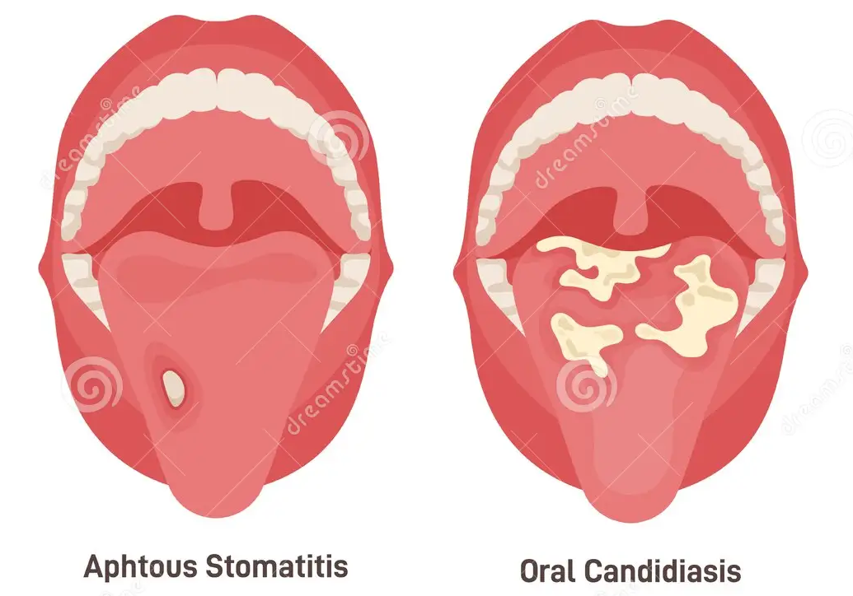
Dental Caries
Periodontal disease
Xerostomia
Mucositis
Oral candidasis
Denture stomatitis
Apthous ulcers
Other suspicious oral lessons
Notes:
Oral cancer includes malignancies of the lips, tongue, cheeks, floor of the mouth, and other oral tissues. It is a serious condition that can be life-threatening if not diagnosed and treated early. Risk factors for oral cancer include tobacco use, excessive alcohol consumption, human papillomavirus (HPV) infection, and prolonged exposure to the sun (for lip cancer). Symptoms may include persistent sores, lumps, or patches in the mouth, difficulty swallowing, and changes in speech. Early detection through regular dental examinations and awareness of symptoms is crucial for improving outcomes. In addition to cancer, various benign lesions such as ulcers, cysts, and white or red patches may occur in the oral cavity. These lesions can be indicative of underlying systemic conditions or local irritations and should be evaluated by a healthcare professional.

Slide 9
Dental Caries and Periodontal Disease
Notes:
Dental Caries and Periodontal Disease

Slide 10
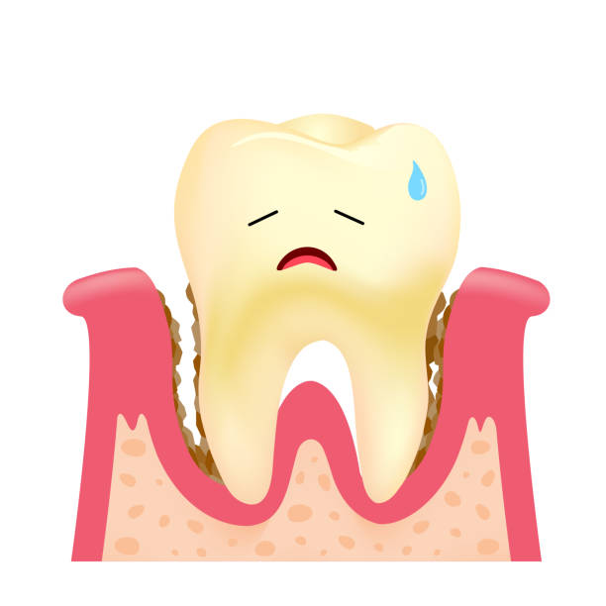
Linked to diet: frequency of sugary foods/drinks and poor oral hygiene
Fluoride helps prevent dental caries
Adapted toothbrushes and electric toothbrushes can make oral hygiene easier
Notes:
Oral cancer includes malignancies of the lips, tongue, cheeks, floor of the mouth, and other oral tissues. It is a serious condition that can be life-threatening if not diagnosed and treated early. Risk factors for oral cancer include tobacco use, excessive alcohol consumption, human papillomavirus (HPV) infection, and prolonged exposure to the sun (for lip cancer). Symptoms may include persistent sores, lumps, or patches in the mouth, difficulty swallowing, and changes in speech. Early detection through regular dental examinations and awareness of symptoms is crucial for improving outcomes. In addition to cancer, various benign lesions such as ulcers, cysts, and white or red patches may occur in the oral cavity. These lesions can be indicative of underlying systemic conditions or local irritations and should be evaluated by a healthcare professional.

Slide 11
Xerostomia
Notes:
Identification and Risk Factors

Slide 12
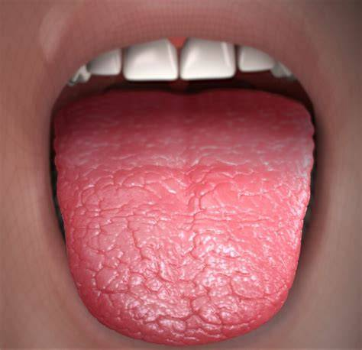
What is Xerostomia:
Also known as dry mouth
Patients don’t produce enough saliva to keep mouth moist and wet
Can range from mild to sever
Causes of Xerostomia:
Side effects from medication e.g. ACE inhibitors, diuretics, anti-depressants
Diseases such as Sjogren’s syndrome, Diabetes, Parkinson disease
Some cancer treatments e.g. radiation therapy
Nerve damage
Dehydration
Mouth breathing
Notes:
Preventing oral conditions involves a combination of good oral hygiene practices and lifestyle modifications. Regular brushing with fluoride toothpaste, flossing, and using mouthwash can significantly reduce the risk of dental caries and gum disease. Routine dental visits for professional cleaning and early detection of issues are also essential. Lifestyle choices such as avoiding tobacco and limiting alcohol intake play a critical role in reducing the risk of oral cancer and other conditions. A balanced diet rich in fruits, vegetables, and whole grains supports overall oral health. Public health campaigns often emphasize the importance of these preventive measures and aim to increase access to dental care services, especially in underserved communities. Education and community outreach are key components in promoting oral health and preventing disease.

Slide 13

Symptoms of Xerostomia
Sticky thick saliva
Soreness or burning sensation
Bad taste
Halitosis
Dysphagia difficulty chewing/swallowing
Sore hoarse throat
Higher caries risk
Notes:
Preventing oral conditions involves a combination of good oral hygiene practices and lifestyle modifications. Regular brushing with fluoride toothpaste, flossing, and using mouthwash can significantly reduce the risk of dental caries and gum disease. Routine dental visits for professional cleaning and early detection of issues are also essential. Lifestyle choices such as avoiding tobacco and limiting alcohol intake play a critical role in reducing the risk of oral cancer and other conditions. A balanced diet rich in fruits, vegetables, and whole grains supports overall oral health. Public health campaigns often emphasize the importance of these preventive measures and aim to increase access to dental care services, especially in underserved communities. Education and community outreach are key components in promoting oral health and preventing disease.

Slide 14
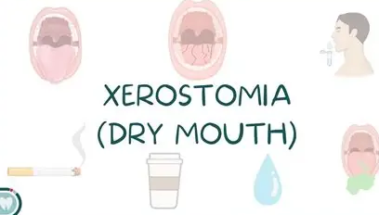
Prevent and Manage
Seek alternative to medication if the cause
Stay hydrated
Chew sugar free chewing gum
Moisten foods
Use lip balm
Excellent oral hygiene
Topical fluoride varnish application for dentate patients
Avoid alcohol, limit caffeine and fizzy drinks
Do not smoke
Consider saliva stimulating tablets/pastilles e.g. Orthana lozenges
Introduce artificial salvia gels or sprays e.g. biotene, oralieve
Notes:
Preventing oral conditions involves a combination of good oral hygiene practices and lifestyle modifications. Regular brushing with fluoride toothpaste, flossing, and using mouthwash can significantly reduce the risk of dental caries and gum disease. Routine dental visits for professional cleaning and early detection of issues are also essential. Lifestyle choices such as avoiding tobacco and limiting alcohol intake play a critical role in reducing the risk of oral cancer and other conditions. A balanced diet rich in fruits, vegetables, and whole grains supports overall oral health. Public health campaigns often emphasize the importance of these preventive measures and aim to increase access to dental care services, especially in underserved communities. Education and community outreach are key components in promoting oral health and preventing disease.

Slide 15
Other Oral Mucosal Conditions
Notes:
Identification and Risk Factors

Slide 16
Candidosis or oral thrust is a fungal infection caused by an overgrowth of the yeast Candida. It can appear anywhere in the mouth. It appears as a creamy white slightly raises lesions.
Mucositis is a very painful condition that causes inflammation of the lining of the mouth, often caused by chemotherapy/radiation therapy.
Denture stomatitis is common condition affecting denture wearers. It causes inflammation and redness under the denture. It is caused by yeast or fungus candidia
Apthous Ulcer is a painful white/yellow lesion with a red border. Often found on the floor of the mouth, tongue or buccal mucosa. Causes are minor trauma, irritants from toothpaste (SLS), nutritional deficiencies e.g. vitamin B12, Crohn’s disease.
Notes:
Management and treatment of oral conditions vary depending on the specific disease and its severity. Dental caries are typically treated with fillings, crowns, or root canal therapy, while periodontal disease may require scaling and root planing, medications, or surgical interventions. Oral cancer treatment often involves a combination of surgery, radiation therapy, and chemotherapy. Early diagnosis and a multidisciplinary approach are essential for effective management. Pain control, infection management, and rehabilitation are important aspects of treatment, especially in advanced cases. Patient education and follow-up care are crucial for preventing recurrence and ensuring long-term oral health. Dental professionals play a vital role in guiding patients through treatment options and providing support throughout the recovery process.

Slide 17
Spotting and Reporting Changes
Notes:
Oral Hygiene and Lifestyle Modifications

Slide 18
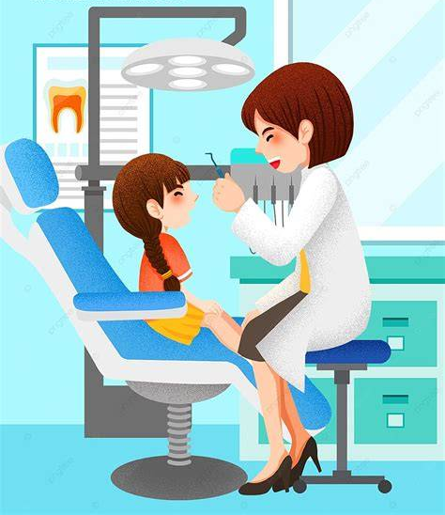
Know what is normal and what is not
Look out for unusual ulcers, lumps and colour changes
Report anything suspicious early
Notes:
Preventing oral conditions involves a combination of good oral hygiene practices and lifestyle modifications. Regular brushing with fluoride toothpaste, flossing, and using mouthwash can significantly reduce the risk of dental caries and gum disease. Routine dental visits for professional cleaning and early detection of issues are also essential. Lifestyle choices such as avoiding tobacco and limiting alcohol intake play a critical role in reducing the risk of oral cancer and other conditions. A balanced diet rich in fruits, vegetables, and whole grains supports overall oral health. Public health campaigns often emphasize the importance of these preventive measures and aim to increase access to dental care services, especially in underserved communities. Education and community outreach are key components in promoting oral health and preventing disease.

Slide 19
Prevention is better than cure!
Notes:
Identification and Risk Factors

Slide 20

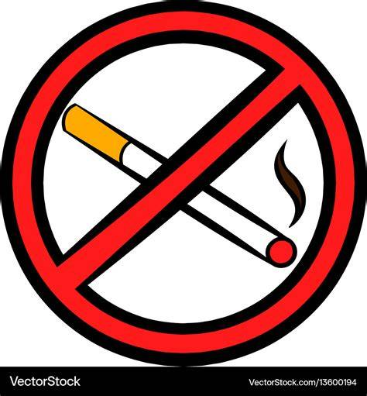


Establish good oral hygiene regime
Encourage daily brushing twice a day with fluoride tooth
Teach to spit, do not rinse technique
Remove dentures at night, clean daily and soak overnight
Keep sugary foods and snacks to a mealtime and to a minimum
Avoid alcohol, limit caffeine and fizzy drinks
No smoking
Stay hydrated
Regular dental examinations every 6 months
Support and educate parents and carers
Tailor advice to each patient’s individual needs
Notes:
Preventing oral conditions involves a combination of good oral hygiene practices and lifestyle modifications. Regular brushing with fluoride toothpaste, flossing, and using mouthwash can significantly reduce the risk of dental caries and gum disease. Routine dental visits for professional cleaning and early detection of issues are also essential. Lifestyle choices such as avoiding tobacco and limiting alcohol intake play a critical role in reducing the risk of oral cancer and other conditions. A balanced diet rich in fruits, vegetables, and whole grains supports overall oral health. Public health campaigns often emphasize the importance of these preventive measures and aim to increase access to dental care services, especially in underserved communities. Education and community outreach are key components in promoting oral health and preventing disease.

Slide 21
Useful Products and Medications
Notes:
Clinical Approaches to Oral Conditions

Slide 22
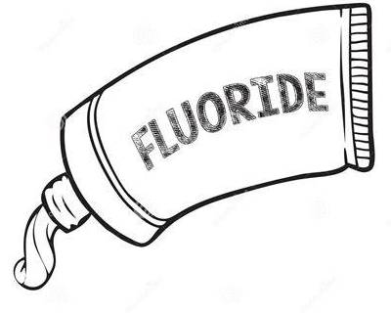

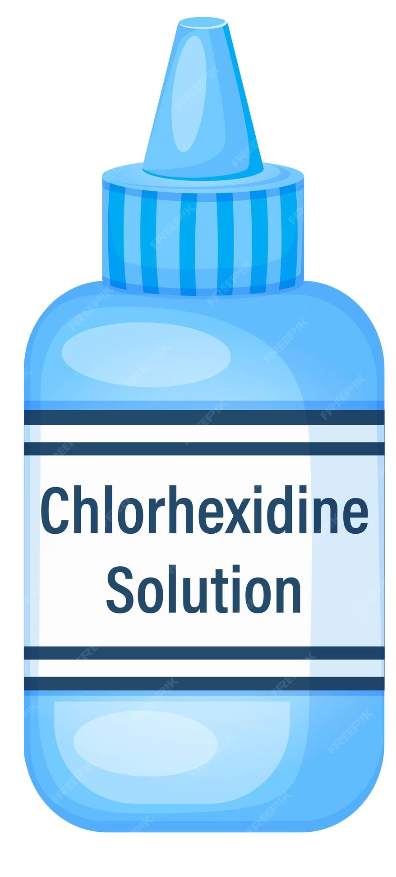
Fluoride toothpaste and varnish
Hot saline mouth rinses
Chlorhexidine mouthwash
Saliva substitutes and gels
Antifungal rinses for candida
Pain relief tablets, sprays, gels for ulcers and mucositis
Notes:
Preventing oral conditions involves a combination of good oral hygiene practices and lifestyle modifications. Regular brushing with fluoride toothpaste, flossing, and using mouthwash can significantly reduce the risk of dental caries and gum disease. Routine dental visits for professional cleaning and early detection of issues are also essential. Lifestyle choices such as avoiding tobacco and limiting alcohol intake play a critical role in reducing the risk of oral cancer and other conditions. A balanced diet rich in fruits, vegetables, and whole grains supports overall oral health. Public health campaigns often emphasize the importance of these preventive measures and aim to increase access to dental care services, especially in underserved communities. Education and community outreach are key components in promoting oral health and preventing disease.

Slide 23
Thank you for listening!
Further reading material:
- A Clinical Guide to Dentistry - J Fiske, A Dougall and D Lewis
- Holistic Oral Care - Janet Griffiths, Steve Boyle
- Medical Problems in Dentistry - Crispan Scully
Notes:
Clinical Approaches to Oral Conditions

