Slide 1
Health & safety
Orthodontic Nursing

Slide 2
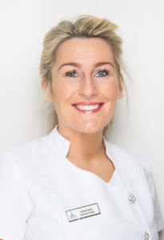
My name is Donna Forde
I am an Orthodontic Therapist based in Zen Orthodontics in Newry.

Slide 3
AIMS of presentation
To convey information on health and safety within a dental dractice, and to demonstrate good practice and protocols.
OBJECTIVES
To identify workplace safety and prevention of accidents, illnesses and suffering within a Dental practice.
Apply and promote safe working practice and understand health & safety requirements.

Slide 4
Gdc development outcomes
GDC Development outcomes A & C
A – Effective communication with patients, the dental team and others across dentistry, including obtaining consent and dealing with complaints
C – Maintenance and development of knowledge and skill within your field of practice. For example, cross infection control.
Notes:
GDC development outcomes – College of General Dentistry (cgdent.uk)

Slide 5
TOPICS WE WILL DISCUSS
CROSS INFECTION CONTROL
WASTE DISPOSAL
HEALTH & SAFETY AT WORK
LEGAL & ETHICAL ISSUES
COMPLAINTS
CONSENT

Slide 6
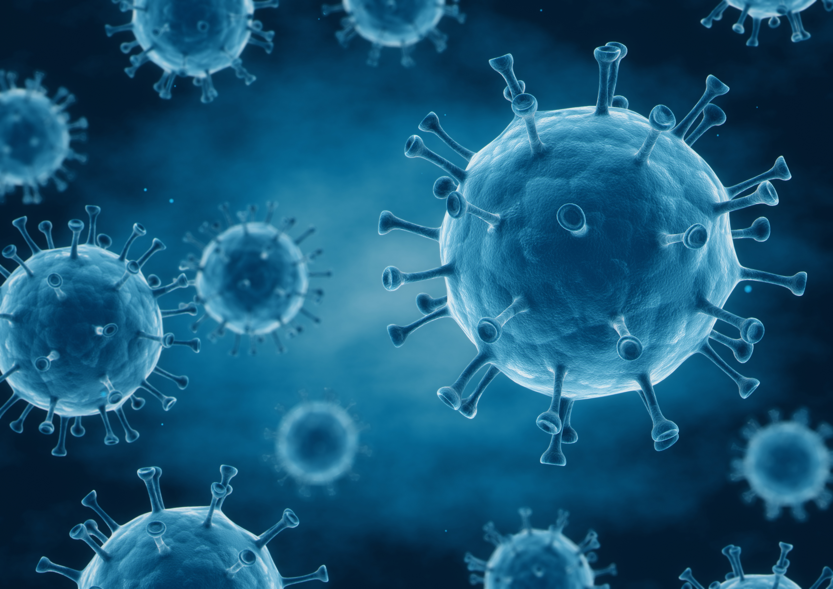
Cross infection control

Slide 7
What is infection Control
Cross infection also known as cross transmission or cross contamination, is the spread of harmful microorganisms like bacteria and viruses from one person, object or place to another.
Cross infection can be caused by bacteria, viruses, fungi and protozoa.
Notes:
Cross infection can occur in a number of ways
Direct contact – one person can spread an infection to another through direct Physical contact
Indirect Contact – an infection can spread indirectly between people.
Airborne – An infection can spread through air when someone coughs or sneezes

Slide 8
BACteria & Fungi
Some bacteria are healthy and some will cause harm to stop the harmful bacteria we can build up a natural immunity
Use antibiotics
Bactericidal agents - kill bacteria
Fungi – Can be seen by human eye and bacteria can only be seen by microscope
Notes:
stop bacteria reproducing when conditions become unfavorable Bacteria protects itself by forming a hard outer coating until conditions are favorable again – Spores
Fungi are more complicated organisms than viruses and bacteria.

Slide 9
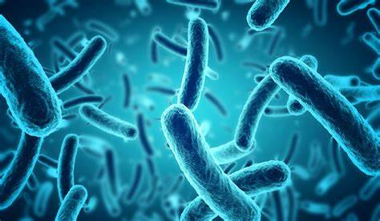
Bacterial Diseases
Tuberculosis TB
- Incidence on the increase
- Droplet of direct contact
- Immunisation
- Cross infection Control
Methycillin Resistant Staphylococcus Aureus MRSA control
- Mainly on patients leaving hospital
- No special precautions
- Infected clinical staff should not take part in invasive procedures

Slide 10
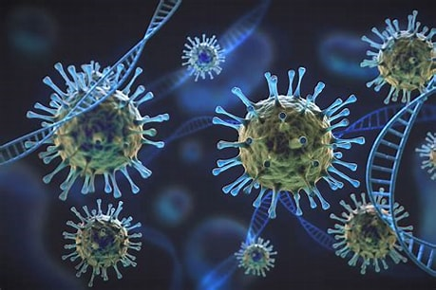
VIRUSES
Viruses are the smallest of the micro organisms and can cause a vast range of damage to the human body viruses are all potential pathogens and need a living host cell to survive There are three types of prevention:
Acquired immunity
2. Vaccination
3. Antibodies

Slide 11
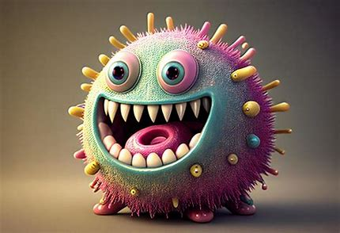
Virus Related Diseases
Human Immune Deficiency Virus,HIV
Acquired Immune Deficiency Syndrome, AIDS
Blood, saliva, semen
Not easily transmissible
Fatal - No immunisation/cure
Hepatitis B
Very infectious, can be fatal
Blood, saliva, body fluids
Immunisation available
Carriers may not know they have it

Slide 12
Types on cross infection transmission
Direct Transmission
Blood borne transmission
Parenteral transmission
Indirect Transmission
Airbourne transmission
Droplet Infection
Aerosol

Slide 13
WAYS TO PREVENT INFECTION CONTROL
Standard precautions
Social cleanliness
Decontamination
Disinfection
Sterilisation
Asepsis
Personal Protective Equipment
Vaccinations
Training
Infection control policy

Slide 14
Clinical environment
All necessary records are required for the treatment to be carried out Minimum items only out on work tops.
Wipe down with hypochlorite solution or alternative,.
Handwashing Protective Personal Equipment Applied –Gloves, Visors, Masks Update patients Medical History –Important at every visit
Notes:
–declutter surgery, Instruments sterile and pouched or covered Prevents Instruments from getting dirty and emphasize that they are clean to patients

Slide 15
Remove barriers
Wipe down and disinfect the surgery
Wear full PPE, disposable apron and heavy duty rubber gloves
Dispose of all sharps first
Scrub instruments or use Ultrasonic/washer disinfector
Visually inspect under an illuminated magnifier for signs of debris or damage
Sterilise instruments, spaced not touching
Store correctly – pouched dated for 365 days
Correct waste disposal of all clinical waste

Slide 16
STERILIZATION
An autoclave can be steam or vacuum and must reach 134˚c 2.2 bar pressure for 3 minutes .
Ensure that the instruments are correctly prepared, the trays must not be overloaded with all instruments spread out and open
If any injuries happen they must be reported and logged under RIDDOR -Reporting of Injuries Diseases and Dangerous Occurrences Regulations

Slide 17
Personal Protective Equipment is an essential part with our practice.
Goggles, Mask, Gloves, Uniform, Shoes
Whilst being treated patients should wear the following: Goggles, Bib
Notes:
PPE falls in line with the Health and Safety at Work Act of 1974 and HTM01-05 Whilst treating patients clinical staff must wear the

Slide 18
Cross infection control
All practices must have a written policy which should contain what the practice is aiming for with regards to cross infection and how they are planning to prevent it from happening. The Policy must be:
Followed routine by all staff
Updated regularly
On display for everyone to see

Slide 19
It is a GDC requirement that Cross Infection CPD is completed regularly within you CPD Cycle
When disinfecting appliances or impressions you should be following the guidelines of HTM01-05
• Rinse under cold running water –to remove saliva, blood or debris
• Immerse in disinfectant as per manufacturers instructions
• Rinse again
• Alginate impressions should be wrapped in a damp tissue
• Send to the laboratory with details of the disinfection procedure and appropriate paperwork, remember all laboratory work must be disinfected before it is placed in the patients mouth.
Notes:
When disinfecting appliances or impressions you should be following the guidelines of HTM01-05.

Slide 20

WASTE Disposal

Slide 21
Material infected with blood, saliva or other body fluid must be sealed in yellow/orange plastic sack which must be collected by an authorized licensed carrier and a transfer note received on collection.

Slide 22
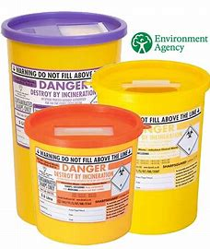
SHARPS
Sharps must be disposed of immediately after a procedure to limit the possibility of a puncture wound.
What can be placed in the Sharps container?
Orthodontic wires, brackets, bands or burs. Sharps must be stored in a ridged puncture proof container, not overfilled. The container must be kept separate from other waste whilst waiting collection for incineration.

Slide 23
Health and safety at work
We must be comply and be aware of the following
Health and Safety at Work Act 1974
Fire Precautions (Workplace) Regulations 2005
Health and Safety (First Aid) Regulations 2013
Control of Substances Hazardous to Health (COSHH) 2002

Slide 24
Reporting of Injuries, Diseases and Dangerous Occurrences Regulations (RIDDOR)
• Environmental Protection Act
• Special waste and Hazardous waste
• Risk Assessments

Slide 25

Legal and ethical issues

Slide 26

Please ensure you are up to date with the GDC Standards
The 9 Principles
1 Put patients' interests first
2 Communicate effectively with patients
3 Obtain valid consent
4 Maintain and protect patients' information
5 Have a clear and effective complaints procedure
6 Work with colleagues in a way that is in patients' best interests
7 Maintain, develop and work within your professional knowledge and skills
8 Raise concerns if patients are at risk
9 Make sure your personal behaviour maintains
Notes:
https://www.gdc-uk.org/education-cpd/students-and-trainees/becoming-a-member-of-the-dental-team/student-case-studies/principle-6

Slide 27
https://www.gdc-uk.org/education-cpd/students-and-trainees/becoming-a-member-of-the-dental-team/student-case-studies/principle-6

Slide 28

consent
Before a health professional examines, treats or cares for competent adult patients, they must obtain the patients consent.
3 Principles of valid consent
It must be voluntary, the patient has made the decision
Informed
The person consenting must have capacity to make the decision
Notes:
General Dental Council - Obtain valid consent (gdc-uk.org)

Slide 29
In the UK all people aged 16 and over are generally considered to be able to consent to their own dental treatment.
Every adult has the right to make their own decisions and must be assumed to be able to do so, unless they show otherwise.
All patients should be deemed capable of making a decision unless they cannot:
• Understand the information given to them
• Retain the information long enough for them to make a decision
• Weigh up the information available to make a decision
• Communicate their decision
Notes:
If there is any doubt in whether a person can consent assess whether the patient is able to give informed consent. Does the patient understand and can weigh up the information needed to make the decision in question?

Slide 30
Informed consent must be given without hesistation
The patient must understand the treatment and be aware of alternatives, they must be made aware of any risks associated with the treatment or any foreseeable complications
Consent needs to be obtained at every appointment & documented.
• They should be made aware of the option of no treatment with costs and payment details explained
• The information must be given in a form they can understand i.e. for those with a visual impairment it may be provided in the form of audio tapes

Slide 31

Complaints policy must BE
Be easily visible and easy for the patients to use
Allow for complaints to be dealt with quickly, in a full and fair way
Respect patients confidentiality
Be clearly written without complicated language
Provide clearly explained outcomes for the patient
Ensure information is passed to the practice management to improve service

Slide 32
All discussions must be held in private
• Taken seriously – attentive listening, use appropriate body language
• Allow patient to express views without interruption
• Take notes, sum up and confirm the problem and record the complaint accurately and document
• Apologize for what has gone wrong - this does not confirm liability or negligence
• Make intended actions known and inform patient when complete (action complaint)

Slide 33
Written complaints must be:
• Acknowledged within 2 working days
• Investigated thoroughly
• Reported to the patient in writing within 10 working days giving a written report of the investigations
• Sympathetic and apologetic, if appropriate, give the patient an opportunity for further discussion

Slide 34
safeguarding
You must have a DBS check (basic disclosure check) this is the employers responsibility and must be done prior to you starting work
It is a legal requirement for any person working with children or vulnerable adults, it provides details of any convictions, cautions, reprimands or warnings held on the police national computer

Slide 35
ANY QUESTIONS?
Practical cross infection demo?

Slide 36
WELL DONE & THANK YOU FOR LISTENING

