Slide 1


IOTN & PAR
WELCOME TO THE PRESENTATION

Slide 2



Donna Forde
I am an Orthodontic Therapist at Zen Orthodontics in Newry.
Qualified as an Orthodontic Therapist in 2015 through the Royal College of Surgeons Edinburgh.
Currently an examiner with the Royal College of Surgeons Edinburgh.

Slide 3
AIM & OBJECTIVES
AIM
Discuss IOTN and PAR and there use and benefits in practice.
Objectives
Identify why IOTN system is used and its importance in an Orthodontic practice.
Understand the benefits of Peer Assessment rating and how it can help identify the success of Orthodontic Treatment.

Slide 4
WHAT IS IOTN
The index of Orthodontic Treatment need (IOTN) is a rating system that is used to determine your child's eligibility for NHS Orthodontic Treatment.

Slide 5
The Index of Orthodontic Treatment need (IOTN) dental health component was developed by Shaw, Richmond and O’Brien at Manchester Dental School in the 1990’s. They were based on a number of existing orthodontic indices. Since then the UK NHS has introduced this to their use to restrict access to Orthodontic care.
Only those under 18 and with an IOTN grade of 3.6 and above are eligible for free Orthodontic treatment.

Slide 6

IOTN CONSISTS OF 2 COMPONENTS
Aesthetic Component
Dental Health Component

Slide 7
Aesthetic Component
The aesthetic component is an attempt to assess the level of dental attractiveness. It consists of a scale of ten photographs ranging from 1 (most attractive) to 10 (least attractive).

Slide 8
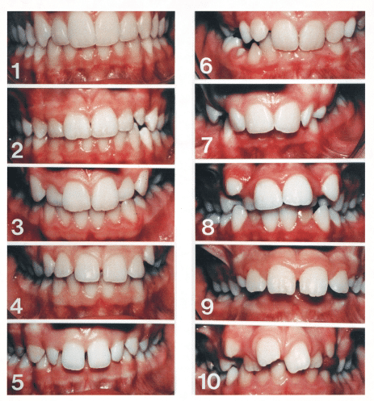

Slide 9
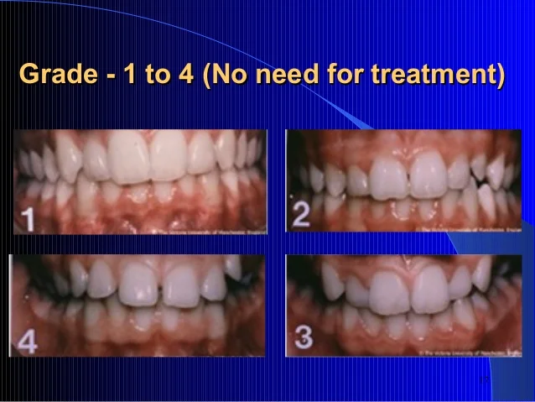

Slide 10
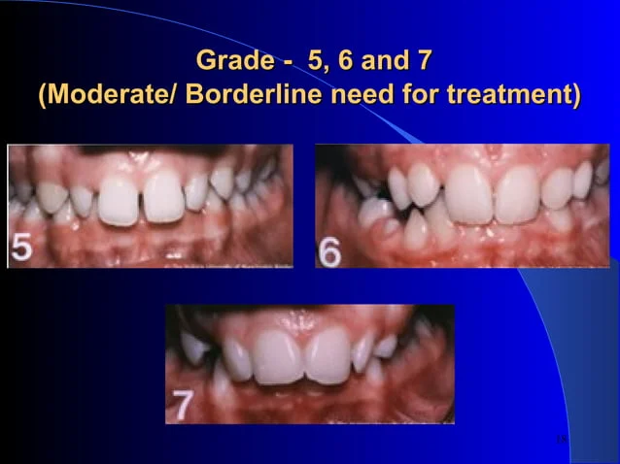

Slide 11
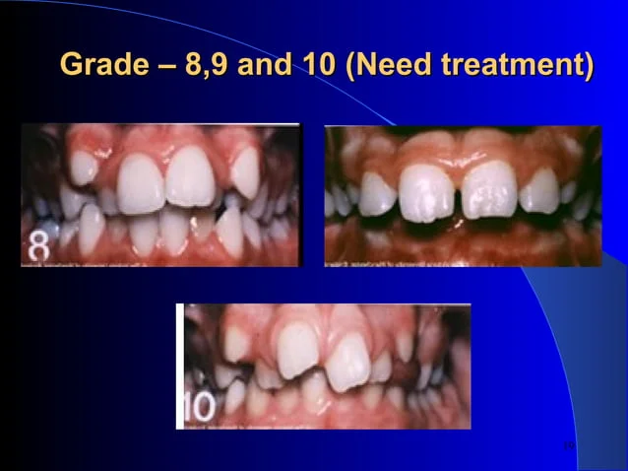

Slide 12
Recording the Aesthetic Component
Ask subject to close on their back teeth
Retract lips
• Grade the dental attractiveness of the anterior teeth The grade awarded is for overall dental attractiveness rather than specific morphological similarity to the photographs
• First impressions are usually correct

Slide 13
Pros/Cons of Aesthetic Component
PRO’s
Valid
Reproducible
Reliable
Used by 80% of consultants
CON’s
Can be subjective
Some Malocclusions aren’t featured in aesthetic component
Class 2 Div 1 complexity not differentiated
Assessment of class 3 Malocclusions

Slide 14
Dental Health Component
The Dental Health component (DHC) is part of the Orthodontic treatment need that focuses on assessing the severity of dental issues that may impact oral health. It considers overcrowding, spacing between teeth, overbites, crossbites and missing teeth.

Slide 15
Five Grades
• Grade 1 - No Need
• Grade 2 - Little need
• Grade 3 - Moderate need
• Grade 4 - Great need
• Grade 5 - Very Great Need

Slide 16
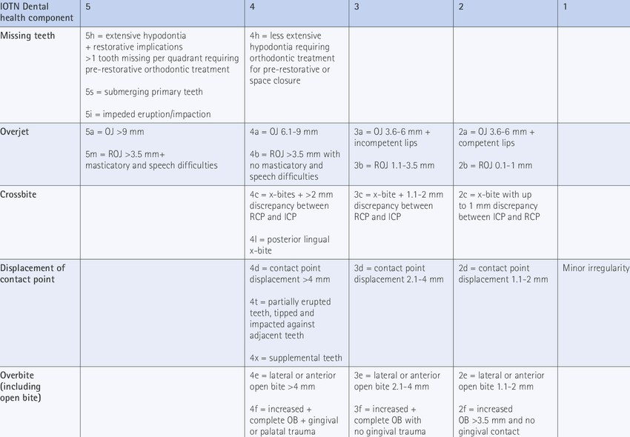

Slide 17
MOCDO
Is an acrynom used within the DH component to guide the examiner to the single worst feature of the malocclusion
M - Missing teeth
O - Overjet
C - Crossbites
D - Displacement of contact points
O - Overbite

Slide 18
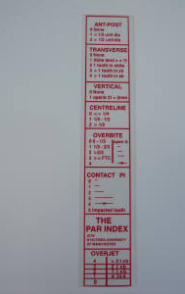
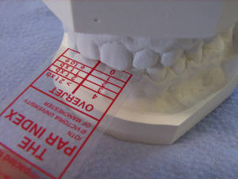
PEER ASSESSMENT RATING (PAR)

Slide 19
Peer Assessment Rating (PAR) is used to measure orthodontic treatment outcomes. A high PAR score relates to a high degree of dental irregularity or malocclusion. A low PAR score relates to a high degree of alignment and favourable occlusion.
The PAR index is a fast, simple and robust way of assessing the standard of orthodontic treatment that an individual provider is achieving.

Slide 20
Uses study models to measure the success of the treatment, must be done by a calibrated person – not the orthodontist that carried out the work
• The scores are cumulative and are recorded before and after treatment
• A reduction of 22 PAR points or more shows a great improvement in treatment.
• A reduction on PAR score of at least 30% is required for a case to be considered as improved.
• The size of the PAR score at the start of treatment gives an indication of the severity of the malocclusion
• With cases of a low pre-treatment score it is difficult to achieve a significant reduction in the PAR score

Slide 21

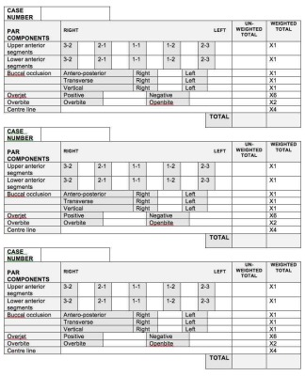
PAR SCORING SHEET
Notes:
British Orthodontic Society > Professionals & Members > Research & Audit > Quality Assurance in Orthodontics > The Peer Assessment Rating (PAR) index (bos.org.uk)

Slide 22
WEIGHTINGS FOR PAR
Labial Segments X1
Buccal Segments X1
Overjet X6
Overbite X2
Centreline X4

Slide 23
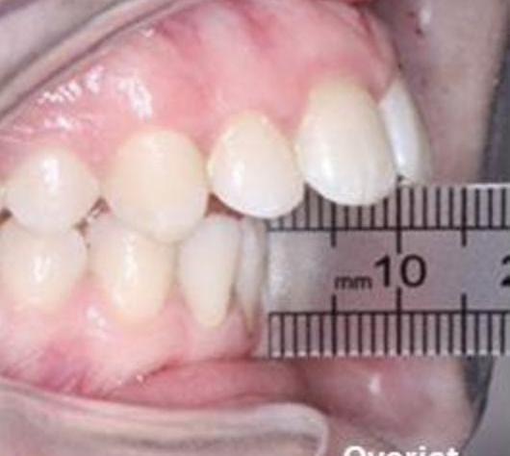
Measuring an overjet
Measure overjet to labial aspect of incisal edge of the most prominent incisor

Slide 24
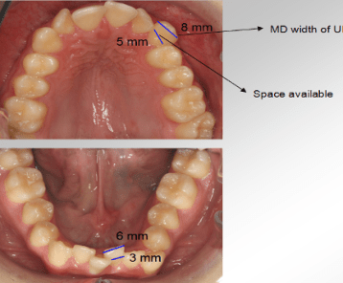
MEASURING DISPLACEMENT CONTACT POINTS

Slide 25
PRACTICAL DEMONSTRATION
Divide into 2 groups for IOTN screening study models.

Slide 26
THANK YOU FOR LISTENING
QUESTIONS?

