Slide 1
Aetiology of Malocclusion
Catherine Doherty

Slide 2
AIMS AND OBJECTIVES:
To help develop the orthodontic nurses understanding of the likely causes of malocclusion and how to treat them. By the end of the session students should be able to recognise different malocclusions and demonstrate an understanding of the treatment plans that could be used.
GDC developmental outcome: C

Slide 3
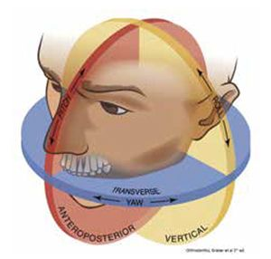
Skeletal Factors: 3 planes of space
1.AP plane : Dento-alveolar compensation/ mismatch in size of mandible or maxilla
2.Vertical Plane : Backward and forward rotations, deep bites
3. Transverse Plane :Crossbites

Slide 4
Soft Tissue Factors
1.Tone of lips
2.Lip competency: Comp or incomp lips
3.Macroglossia, tongue position. Adaptive or endogenous tongue thrust.
4.Enlarged Adenoids, mouth breathing
5.Fraenal attachement: Upper labial,lower labial fraenum.

Slide 5
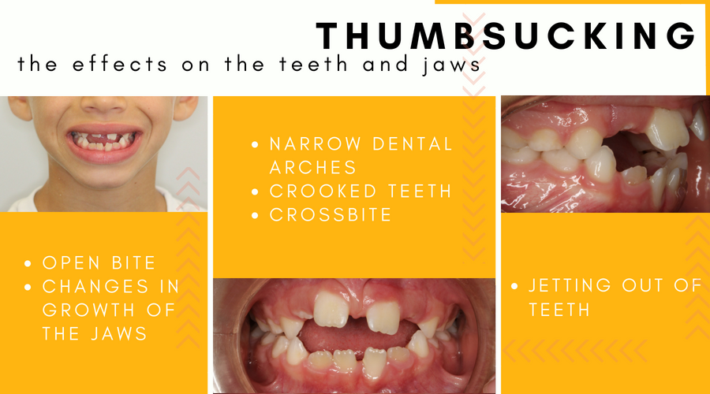
Habits: Thumb, finger ,dummy
The magnitude of a habit depends on the force applied as well as the frequency and duration.
Can present as upper incisor proclination
Lower incisor retroclination
Overbite reduction
Narrowing of upper arch
Unilateral crossbite

Slide 6
Local Factors
Variation in :
Tooth number: hypodontia, Supernumerary,early loss of deciduous teeth, extraction of permanent tooth
Tooth size:macrodonts, microdonts,dento-alveolar disproportion, bolton discrepancy
Tooth position: Ankylosis, ectopic, impacted ,transposition, primary failure of eruption.

Slide 7
Class I
When lower incisor edges occlude with or lie immediately below the cingulum plateau of the upper incisors
AETIOLOGY
SKELETAL:Can be Sk I II or III and can present with dento-alveolar compensation.
SOFT TISSUES:Usually favourable
DENTAL FACTORS:Tooth /arch size discrepancy, can lead to spacing or crowding.
ENVIRONMENTAL FCTORS: Premature loss of deciduous teeth can lead to crowding and CL shift
LOCAL FACTORS: impacted teeth, anomalies in tooth size and number

Slide 8
Treatment of Class I
Do nothing
Relief of crowding and alignment,Spontaneous movement after extraction
URA
Fixed appliances ,extraction or non extraction
Headgear
RME

Slide 9
Class II div 1
Lower incisor edge occludes posterior to the cingulum plateau of the upper central incisors. Upper incisors are often proclined and OJ increased
AETIOLOGY
SKELETAL: Sk II with retrognathic mandible, dento-alveolar compensation
SOFT TISSUES: lips are typically incompetent and pt may form an adaptive oral seal. Reduced coverage of lower lip.
Tongue thrust. 2 types. Adaptive which should stop and endogenous which cannot be stopped.
Lower lip trap, strap like lips
LOCAL FACTORS: crowding ,spacing,digit sucking or underlying mesiodens.
A habit will result in:
Increased OJ
Narrow upper arch
Proclined uppers
Low tongue position
Incomplete OB
Retroclined lowers
Buccal crossbites

Slide 10
Treatment of Class II Div I
Do nothing
URA, ABP,.
Functional appliance
Fixed appliances with extractions and class II elastics
Headgear
Surgery

Slide 11
Class II Div II
Upper central inc are retroclined and OJ minimal or decreased. Proclined laterals .
SKELETAL: retrognathic mandible, reduced lower face height and facial mandibular angle. Forward growth, deep bite, scissors bite.
SOFT TISSUES: High lower lip line, Bimax retroclination.
LOCAL FACTORS: Increases IIA, gummy smile, retroclined lower incisors,deepOB, crowding, mesiolabially rotated laterals, lack of occlusal stop.

Slide 12
Treatment of Class II div II
Do nothing
URA, ABP
Functional +/- sectional
Fixed appliances with elastics
Headgear
Surgery

Slide 13
Class III
The lower incisor edges occlude anterior to the cingulum plateau of the upper central incisors. The OJ may be decreased or reversed
SKELETAL FACTORS: Prognathic mandible
increased mandibular length, forward position of glenoid fossa, reduced maxillary length, short cranial base
Increased LFH and FMPA
Narrow maxilla or broad mandible
SOFT TISSUE: Dento-alveolar compensation,macro-glossia tongue
LOCAL FACTORS: narrow upper arch, broad lower arch, crowding in upper arch, well aligned or spaced lower, crossbites both posterior and anterior

Slide 14
Treatment of Class III
Do nothing
URA
Reverse twin block
Fixed appliances with extractions and elastics
Headgear
Surgery

Slide 15
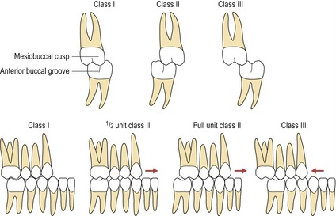
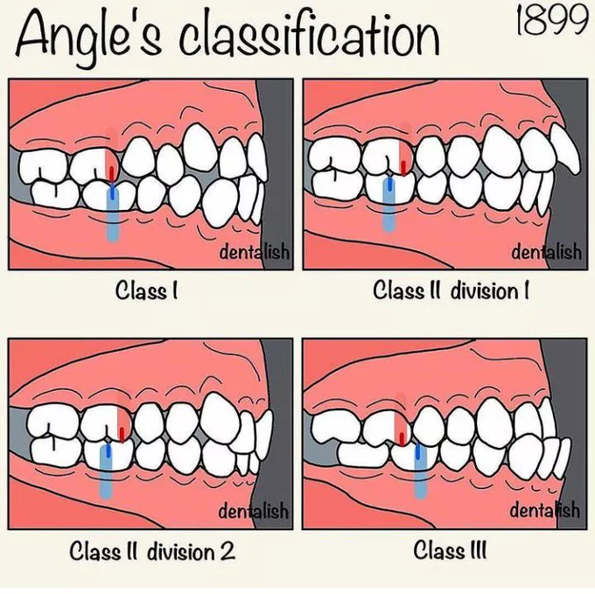
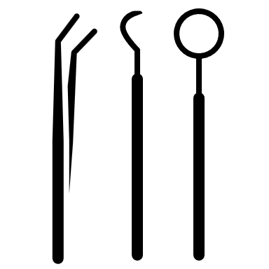
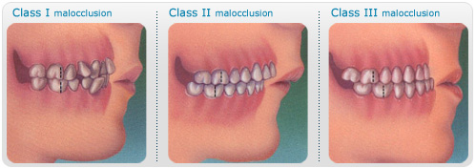
Angles classification

