Slide 1

Growth and development of mandible and maxilla
Catherine Doherty

Slide 2
AIMS AND OBJECTIVES
To understand how the mandible and maxilla develop. Understanding the normal sequence of development for primary and secondary dentition.
By the end of the session the students should be able to
differentiate between normal and abnormal growth. They should also be able to recognise anatomical landmarks associated with the jaw bones.
GDC developmental outcome : C

Slide 3
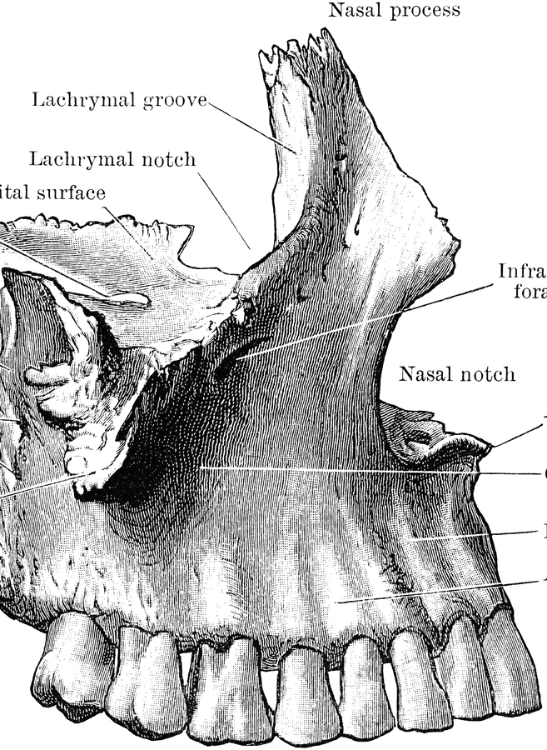
Maxilla
Forms middle 1/3rd of face
Has several foramina and bony projections
Made up of 2 bones separated above by the nasal cavity
Join together below the nose and on the front section of the hard palate
Back section of hard palate is formed by the palatine bones
Whole palate forms the floor of the nose and the roof of the oral cavity
Each side forms part of the eye socket,nose and front of cheekbone
The 2 bones are hollow within, this space is called the maxillary antrum or sinus , and lies just above the root apices of upper molars and 2nd pm teeth. If space is perforated during extraction it will cause an oroantral fistula
Sinusitis often mimics dental pain

Slide 4
Maxilla cont
The 2 bones join together in the centreline of the face at the intermaxillary suture and the lowest section forms the alveolar process
Back end of each side of the alveolar process is called the maxillary tuberosity
Several foramina allows passage of nerves and blood vessels

Slide 5
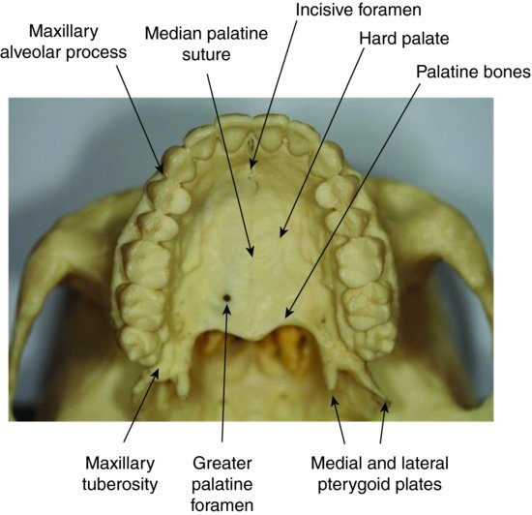
Hard palate :anatomical landmarks

Slide 6
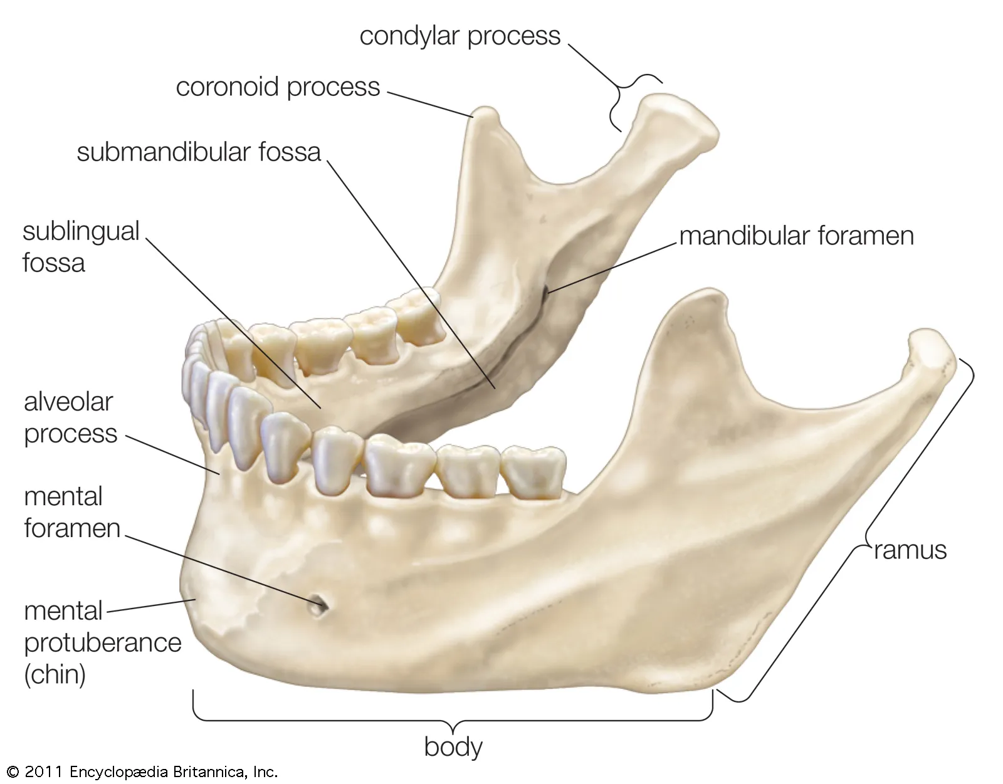
Mandible
Two bones joined in the centreline at the mental symphysis
Creates one single horseshoe shaped structure with the back end bent up vertically
The vertical section is called the ramus and horizontal section is called the body. Where they join is called the angle of the mandible
It is joined to the rest of the skull at the TMJ, moves as a hinge so mouth can open and close
The head of the condyle is the point where the mandible connects with temporal bone
The alveolar process supports all lower teeth, below this process on inner side of mandible body lies the mylohyoid ridge. The ridge on outside of process is called the external oblique ridge. This marks the base of the alveolar process.

Slide 7
Mandible cont
Front of ramus rises up to coronoid process
The dip is called the sigmoid notch
The two foramina in the mandible of interest to dentistry are
The mandibular foramen and the mental foramen.

Slide 8
Growth Rotations
Forward growth rotation will result in
Decreased lower face height
Class II malocclusion
Deepbite and increased OB
Backward growth rotation will result in
Increased lower face height
Class III malocclusion
Decreased OB

Slide 9
Class II and III and AOB
Class II presents with a retrognathic mandible. Class II div II can present with severe OB.
Class III can present with prognathic mandible.
AOB: in severe cases will require surgery

Slide 10
Surgical Intervention
Segmental procedures both mandibular and maxillary
Le Fort I, II and III(maxilla)
Vertical Subsigmoid Osteotomy
BSSO
Bimax surgery
Genioplasty

Slide 11
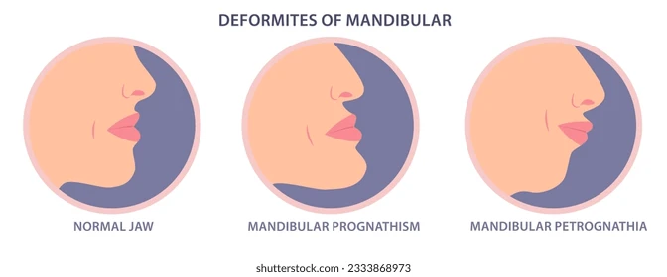

Slide 12
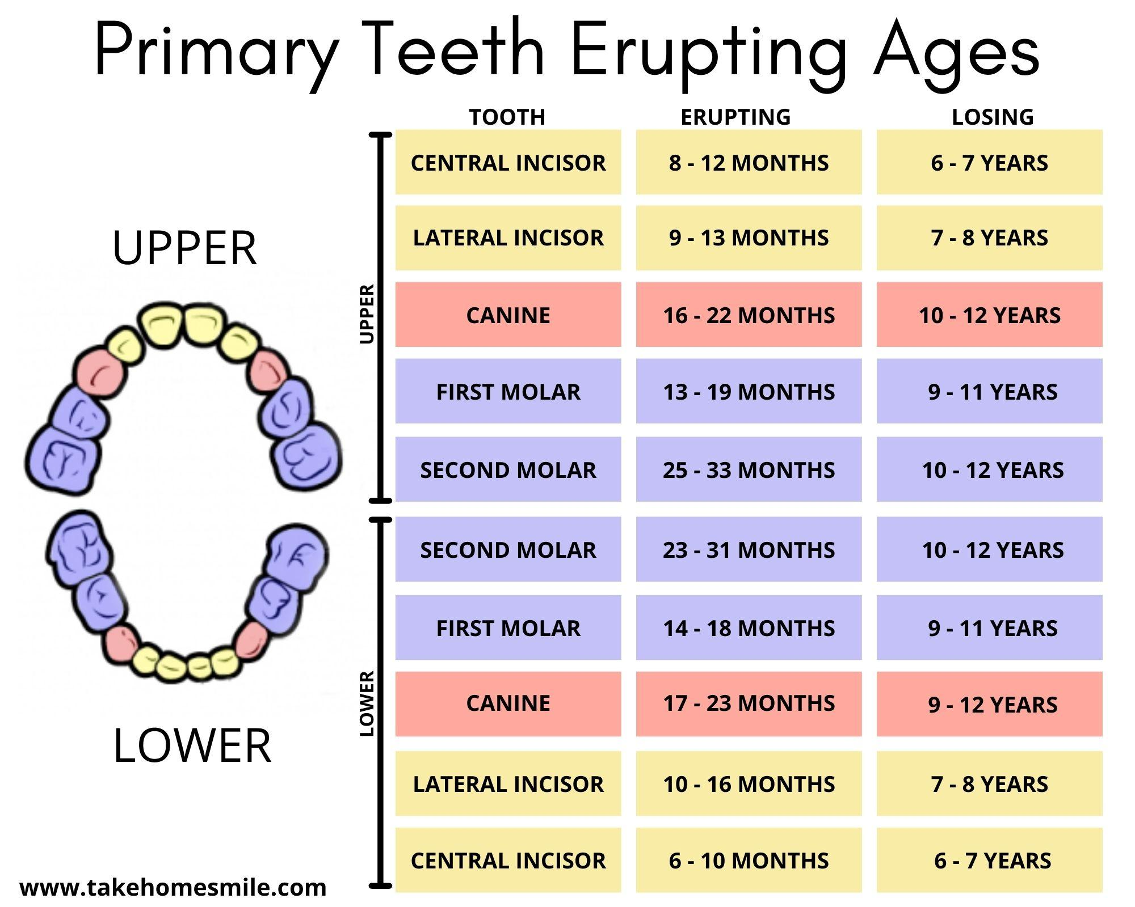
Deciduous Teeth

Slide 13
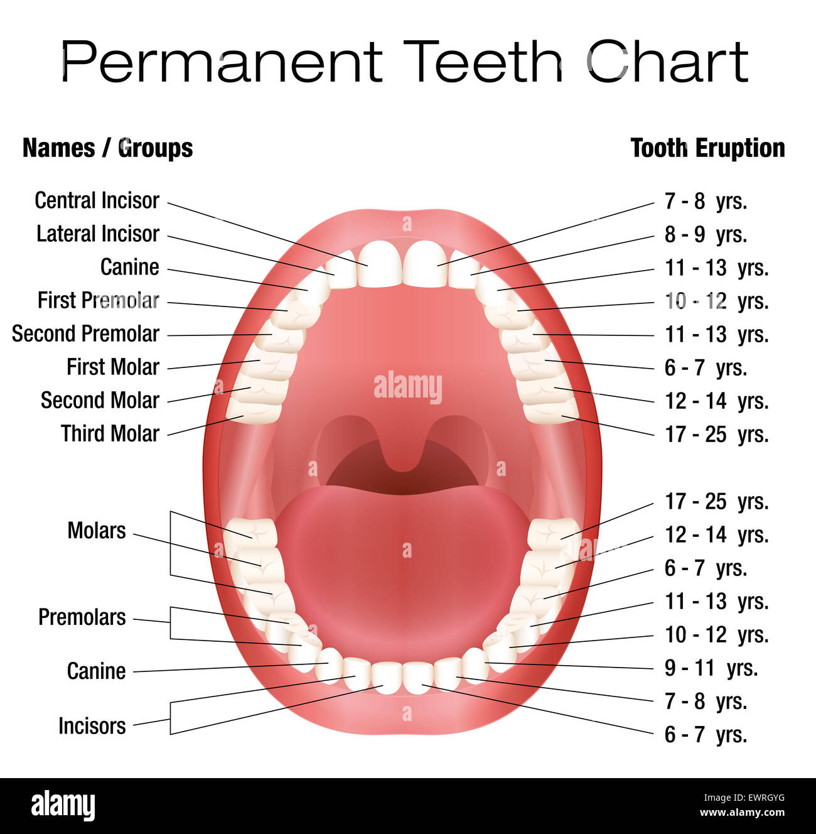
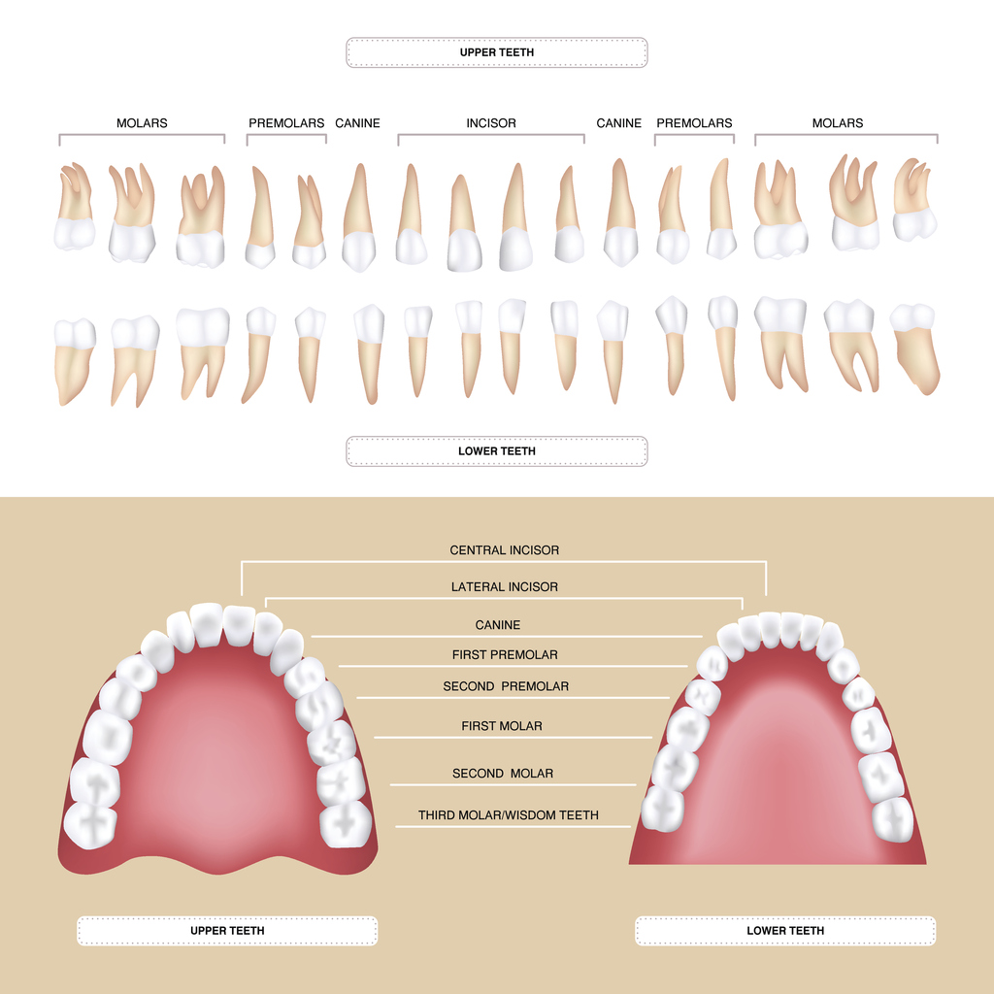
Permanent Dentition

