Slide 1

Tooth Movement
Catherine Doherty

Slide 2
AIMS AND OBJECTIVES
To understand normal exfoliation and eruption sequences. To develop knowledge on the histology of tooth movement
By the end of the session the students will be able to identify the chemicals and cells involved in tooth movement. They should understand the adverse effects of excessive force on the dentition.
GDC development outcome: C

Slide 3
Biomechanics of Tooth Movement
Centre of Resistance
The Centre of Resistance (CR) of a tooth is the region within the tooth where a rotation wants to occur when a force is applied, and upon which perfect parallel movement, called translation, occurs when a force is applied directly to it.
The resistance is considered the fundamental reference point for controlled tooth movement. Accurate determination of its location can greatly enhance the efficiency of orthodontic treatment.
center of

Slide 4
Centre of resistance
Position depends on :
Root length
Number of roots
Alveolar support

Slide 5
Force moment and Force couple
Force moment .The force is applied anywhere other than the centre of resistance. This type of force causes rotational movement only.
Force moment =magnitude of force applied to tooth x perpendicular distance between point of application and centre of resistance.
Force couple can create rotational movement, inclination and tipping of teeth and can only be applied to the exposed crown.
Force couple=magnitude of forces applied to tooth x distance between them.
Couple and moment together can create bodily movement

Slide 6
Centre of Rotation
The point around which the tooth rotates

Slide 7
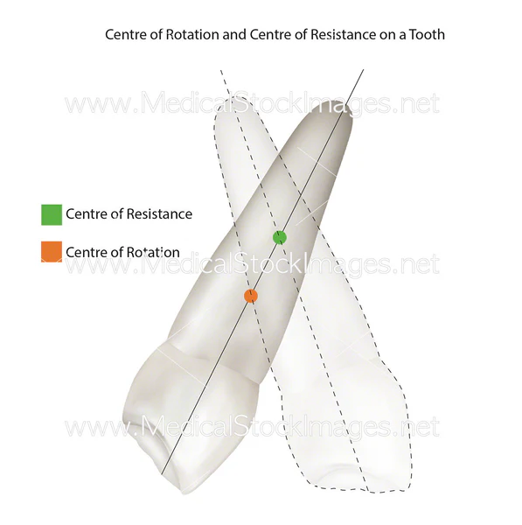

Slide 8
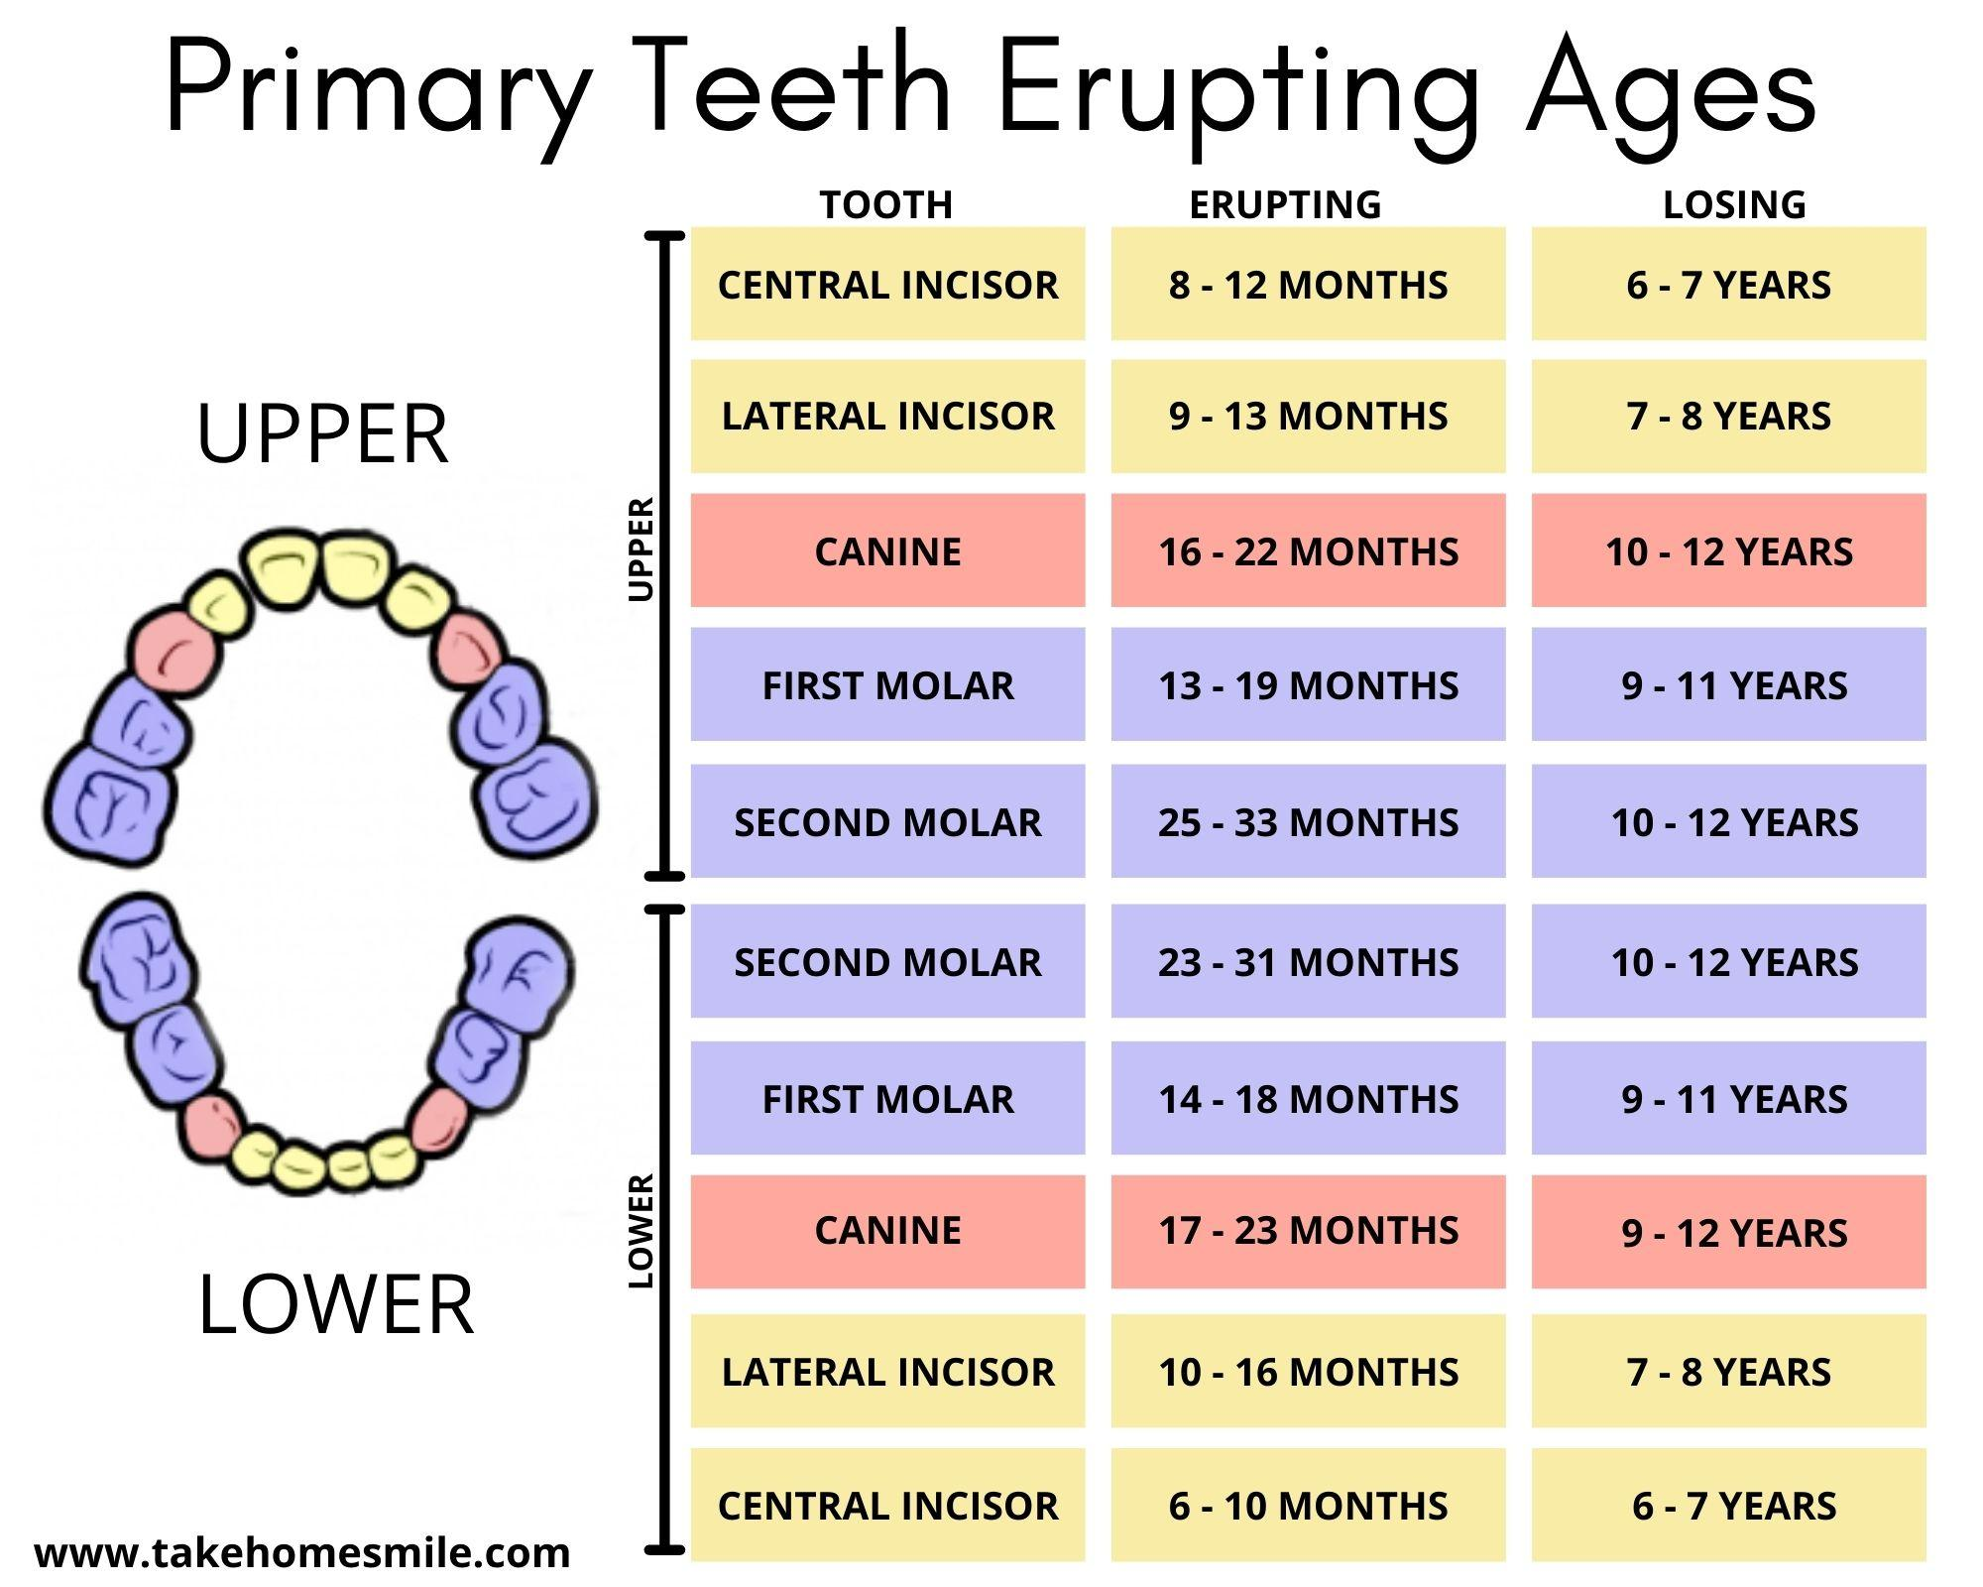
Primary Dentition

Slide 9
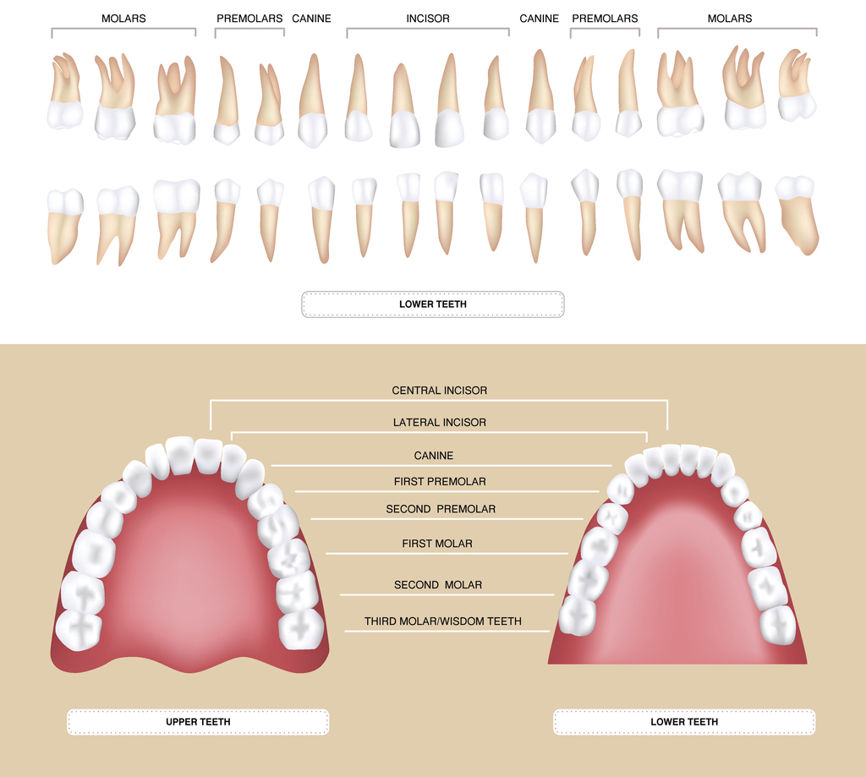
Permanent Dentition

Slide 10
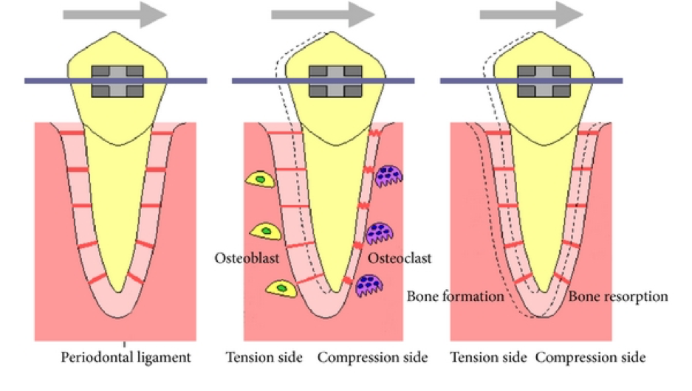
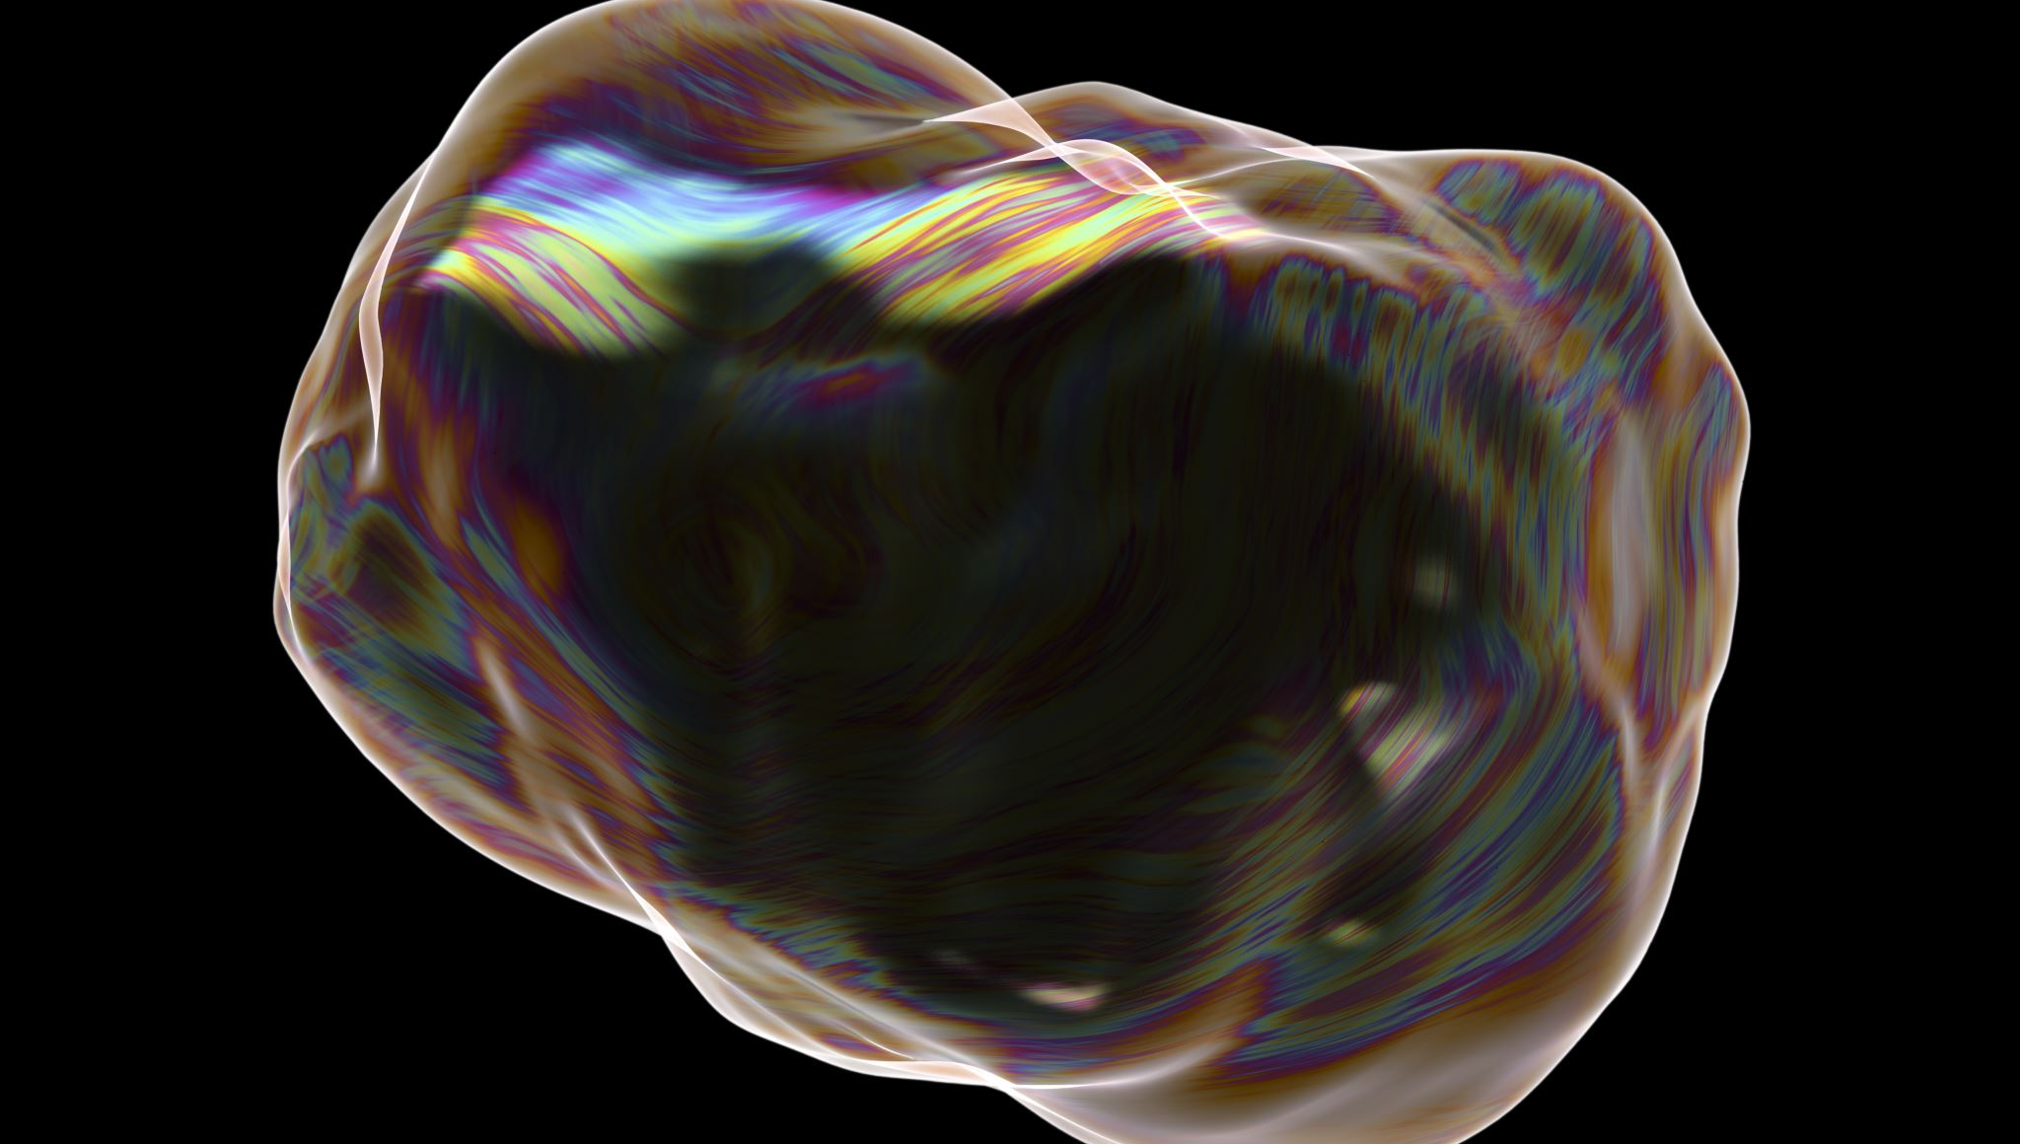
What is tooth movement?
Tooth movement occurs when tooth is moved through bone, 2 solid objects.
This is possible because of bone remodelling. The remodelling is caused by prolonged force on the tooth. The continuous force will result in remodelling of the alveolar bone, reorganisation of the PDL and tooth movement.
2 types of force :Optimum and excessive

Slide 11
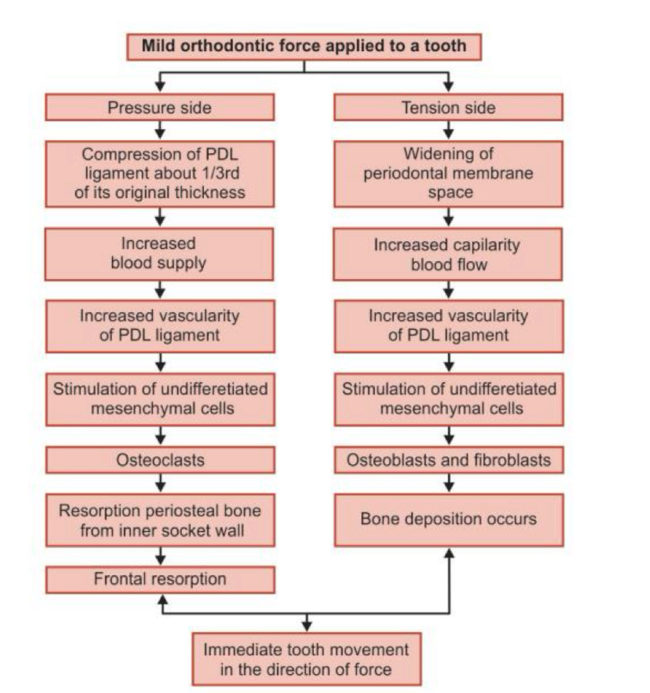
Orthodontic Force

Slide 12
Types of Movement
1. Tipping: When crown moves more than root, tooth tips around the centre of resistance, crown moves in opposite direction to root.
2:Bodily movement: Both crown and root move equally in the same direction
3.Torque: Root movement with minimal or no crown involvement.
4. Rotation: Mesial or distal force applied
5: intrusion: Tooth moved into socket causing compression of PDL
6 Extrusion: Tooth moved out of socket causing stretching of PDL

Slide 13
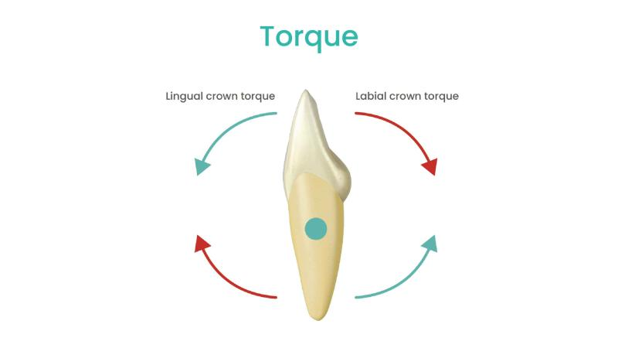
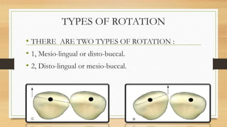
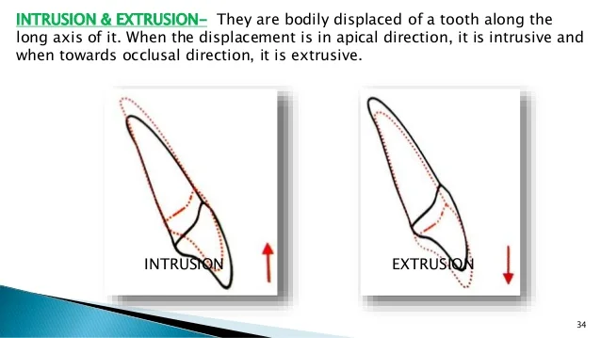
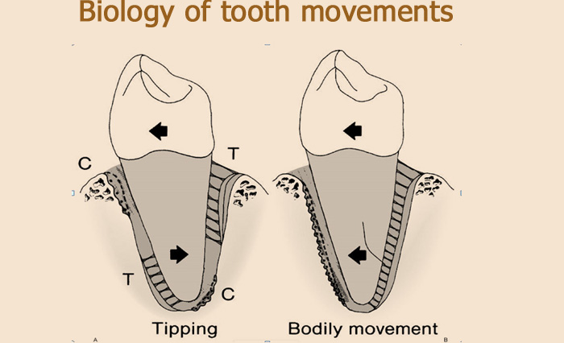
Types

Slide 14
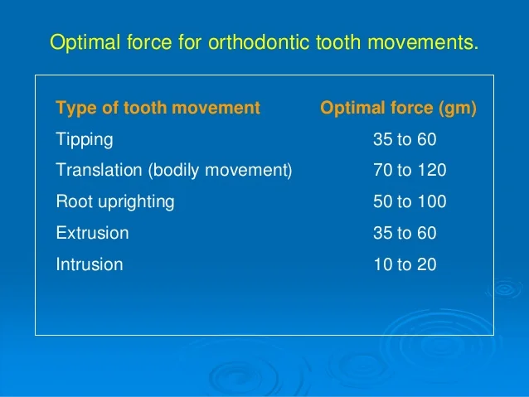
Optimal force

Slide 15
Optimum Force
When optimum force is applied to a tooth it triggers a cellular reaction.
Chemical messengers trigger the cellular response.
This results in areas of pressure and tension
Cells react to force
Alveolar bone changes result in physiological tooth movement and frontal resorption

Slide 16
Excessive Force
Heavy force applied which occludes capillary pressure
Chemical messengers trigger cellular response
Areas of pressure and tension
Cellular action
Delayed tooth movement
Alveolar bone changes resulting in pathological tooth movement and undermining resorption

Slide 17
Chemicals
Chemicals that are found in the PDL once force is applied:
1. Prostaglandin
2. Cytokines
3.Nitric oxides
These chemicals cause the release of the cells involved in the cellular response

Slide 18
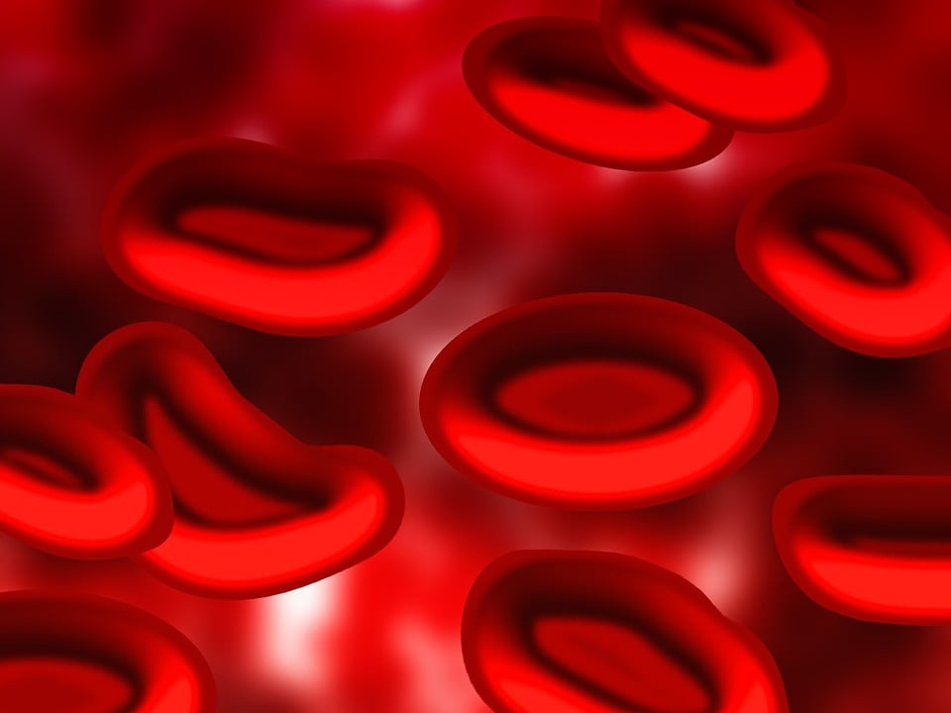
Cellular Response
Osteoblasts
Osteoclasts
Osteocytes
Fibroblasts
Cementoblasts
Cementoclasts

Slide 19
Cells Cont
Osteoblasts are found on tension side.
48 hrs after force applied.
Deposit bone
They recruit and activate osteoclasts
4 main functions: to produce bone ,to recruits osteoclasts, regulate the bone and to stop osteoclasts working

Slide 20
Cells Cont
Osteoclasts. Found on compression side 48 hrs after force applied
Large multinucleate cells that are involved in resorption
Resorption more rapid than deposition
Controlled by osteoblasts

Slide 21
Cells Cont
Osteocytes: detect the force on the bone
Fibroblasts: help with remodelling of PDL
Cementoclasts:resorb necrotic tissue and the cementum.
Cementoblasts:deposit bone around cementum

Slide 22
Resorption
2 types
Frontal resorption: occurs when optimum force is applied. No complaints from patient, tooth movement is gradual, no excessive mobility.
Undermining resorption: Occurs when excessive force is used. complaints of pain from patient, mobility of teeth, tooth movement is delayed , root resorption occurs,

Slide 23
External Apical Root Resorption
This occurs in virtually all patients undergoing orthodontic treatment. It most commonly affects upper incisors and up to 1mm of root can be lost. In 1-2% of patients half the root can be lost and can affect all teeth.
Root resorption is an iatrogenic event caused by orthodontic treatment.
It is more common when forces are excessive, when forces are optimal less resorption is seen.
Studies show there may be a genetic predisposition

Slide 24
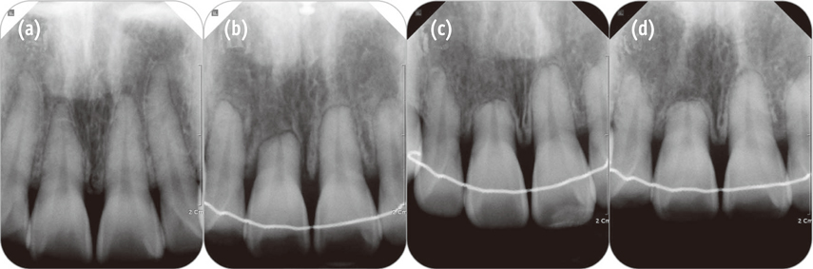
Root resorption

Slide 25
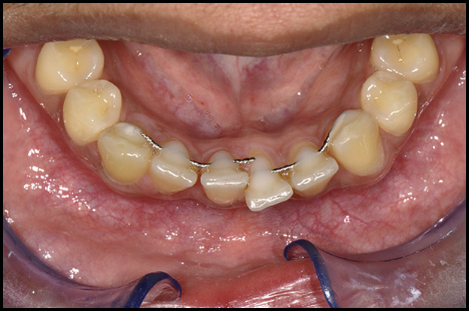
Unwanted tooth movement

