Slide 1
RETENTION
Donna Forde

Slide 2
AIMS & OBJECTIVES
The aim of todays presentation is to explore different types of retention methods in orthodontics and to discuss key factors that contribute to relapse during the retention phase of orthodontic treatment.
The objective of todays presentation is to ensure we all understand what retention is, how we can retain teeth and risk factors associated with relapse of orthodontic treatment

Slide 3
GDC DEVELOPMENTAL OUTCOMES
GDC developmental outcome
C- Maintenance and development of knowledge and skill within your field of practice

Slide 4
Learning Objectives
To understand the causes of relapse
To understand rationale for orthodontic retention
To discuss regimens of orthodontic retention

Slide 5
What is Retention?
Definition – The holding of teeth that have been moved by Orthodontic treatment to ideal aesthetic and functional positions

Slide 6
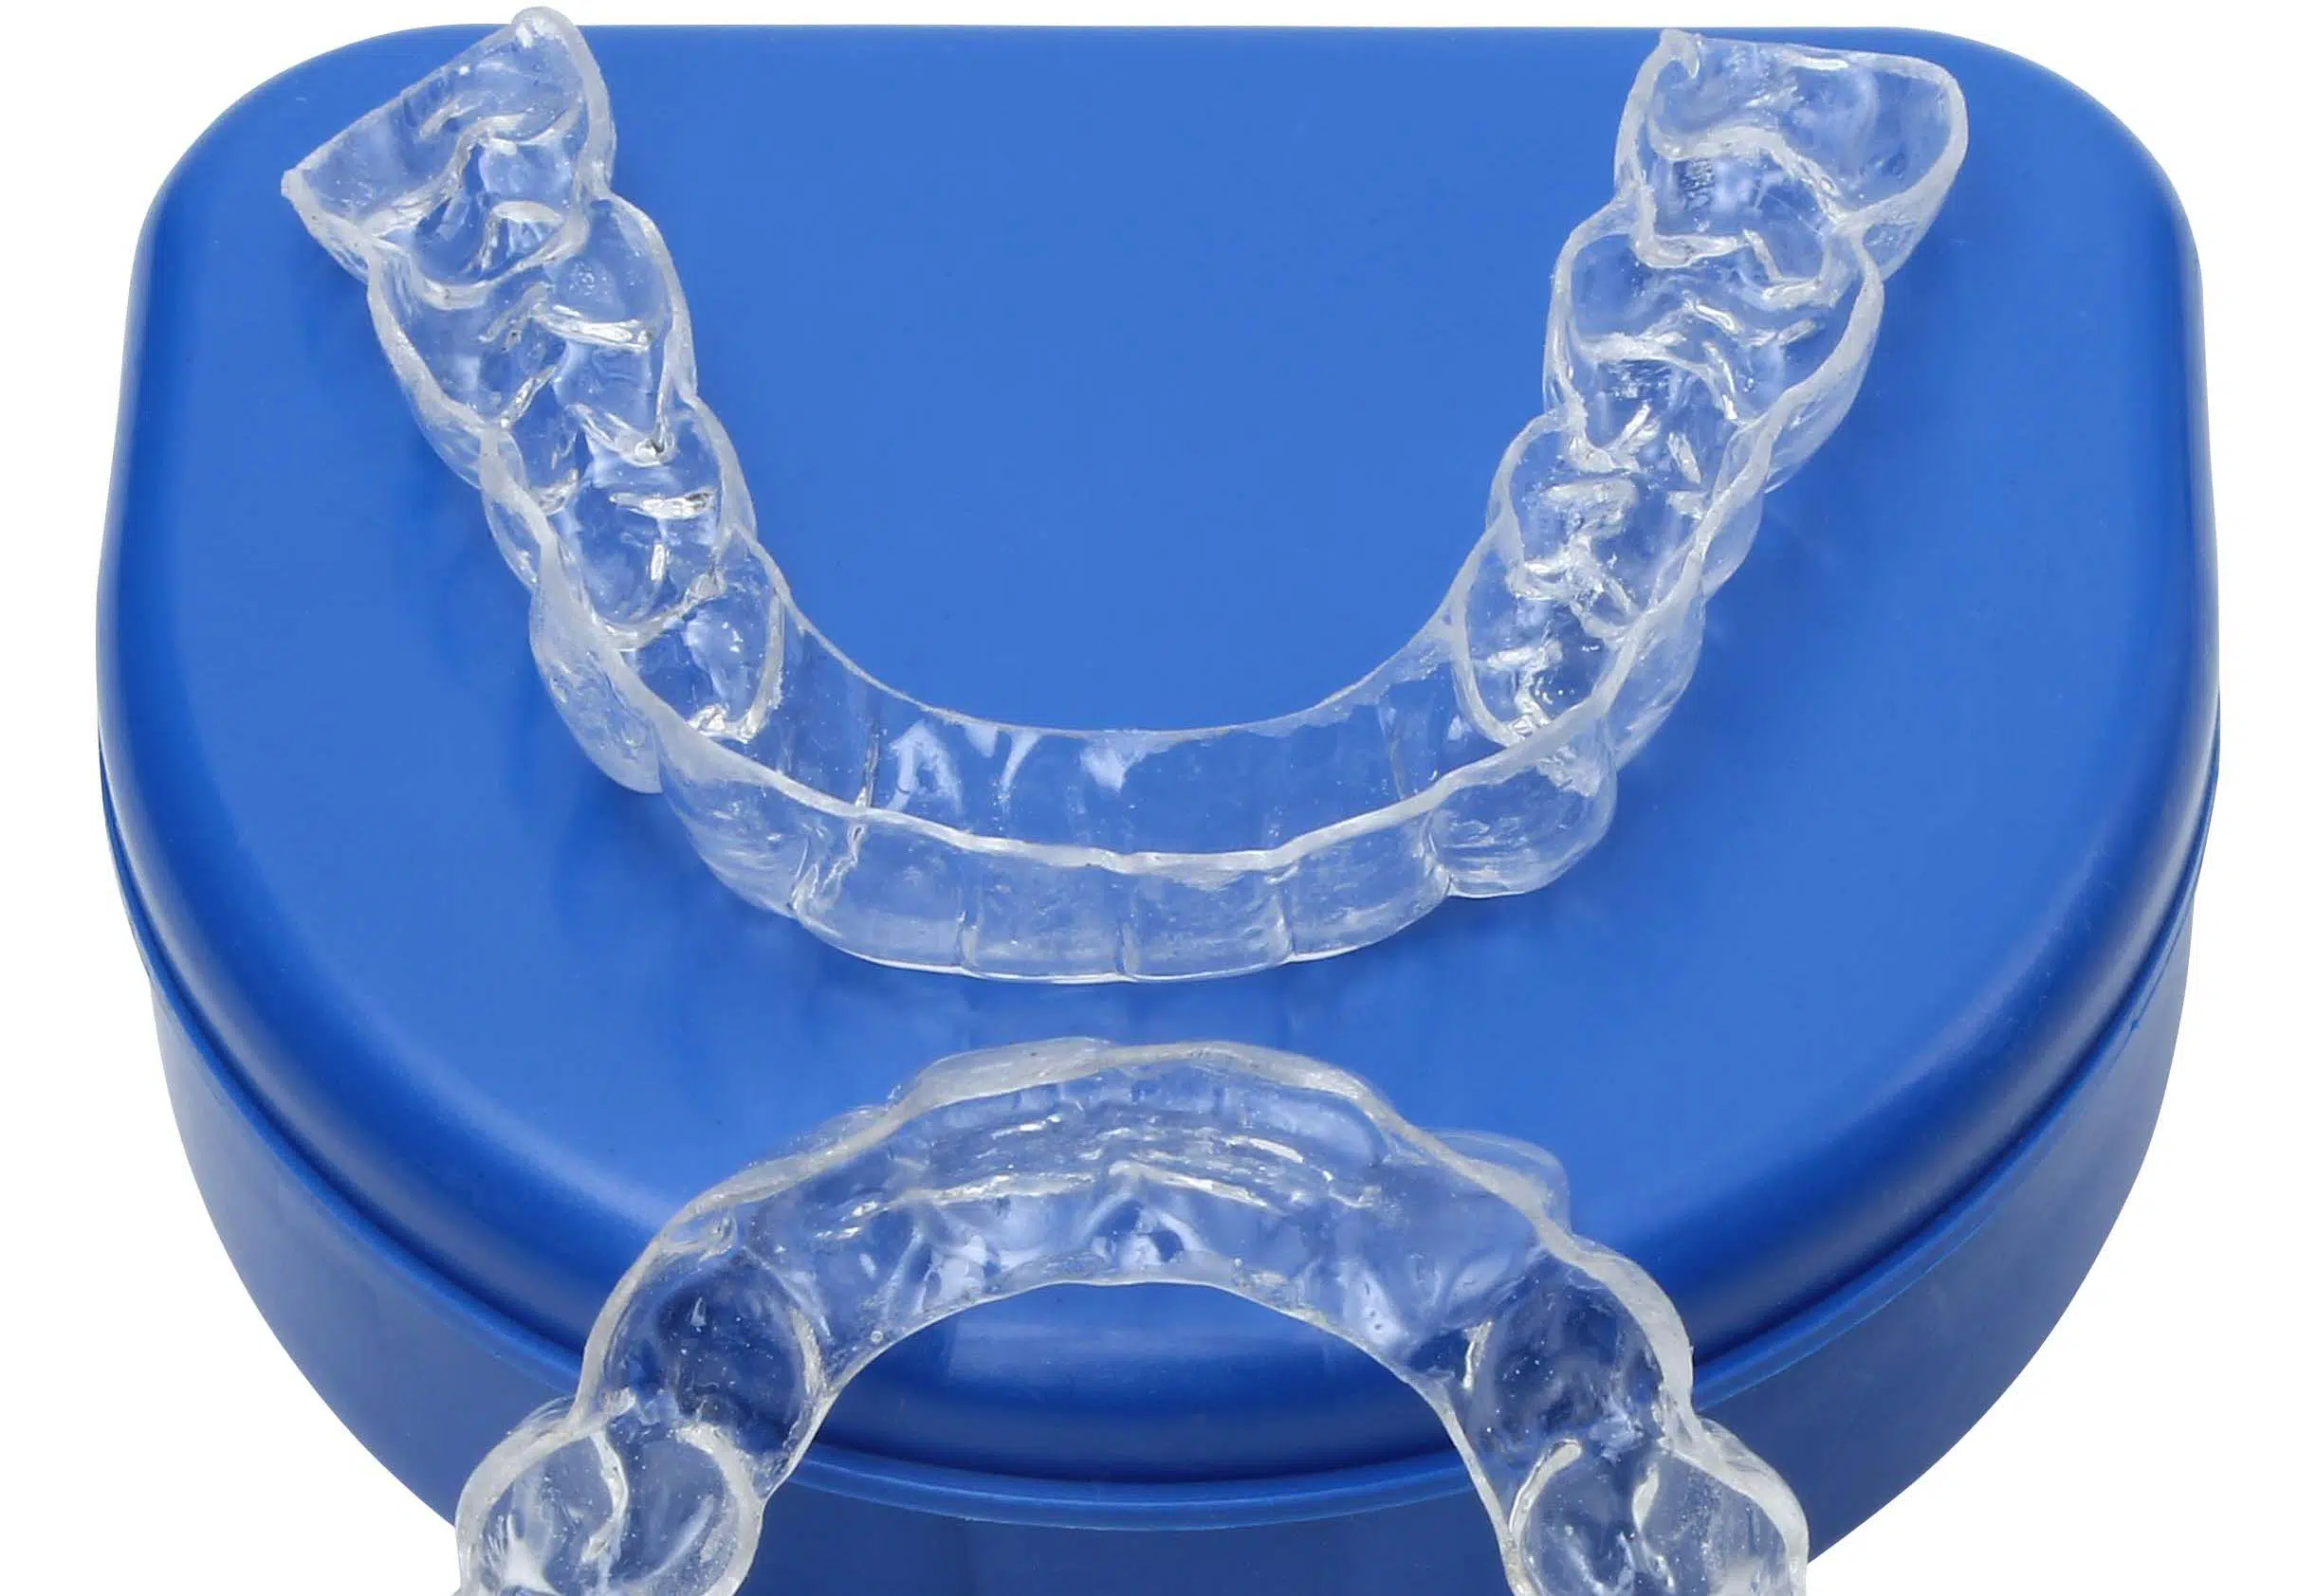
Stability – Ability of teeth and skeletal structures to remain permanent in an orthodontically treated position
Relapse – Any change in the position of teeth and skeletal structures from which they were placed by orthodontic treatment
Retention – The holding of teeth in an ideal aesthetic and functional position
The holding of teeth following orthodontic treatment in the treated positions and to maintain and hold the teeth hoe they were left following Orthodontic treatment

Slide 7
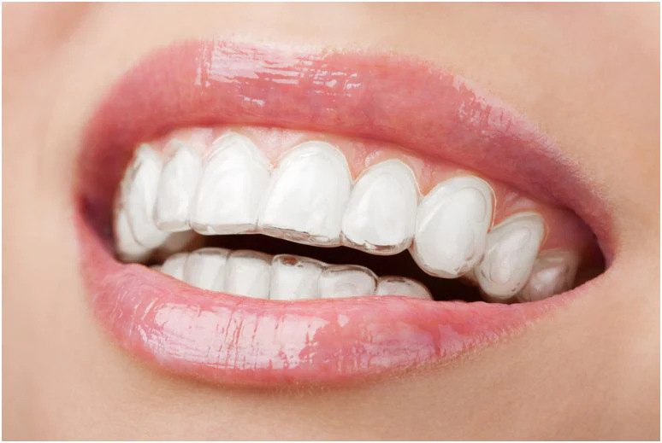
Retainers are essential for maintaining the alignment of teeth after orthodontic treatment. They prevent teeth from moving back to their original positions a process known as relapse. Retainers help to stabilize teeth and gums so that they can adjust gradually to their new positions. The stability of teeth ensures that the surrounding tissues can properly adjust and support the new alignment. Retainers should be worn every night post orthodontic treatment and should be worn for at least 8 hours every day.

Slide 8
TYPES OF RETAINERS
REMOVABLE RETAINERS
FIXED RETAINERS
Essix retainer
Vivera retainer
Hawley retainer
Begg retainer/wrap around retainer
Hawley retainer
Kesling retainer
Bonded multi strand wire (thin wire)
Bonded canine to canine (thick wire)

Slide 9
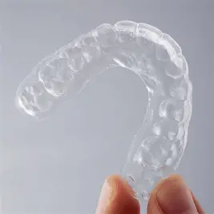
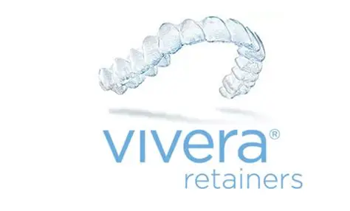
Vacuum formed retainer & Vivera Retainer

Slide 10
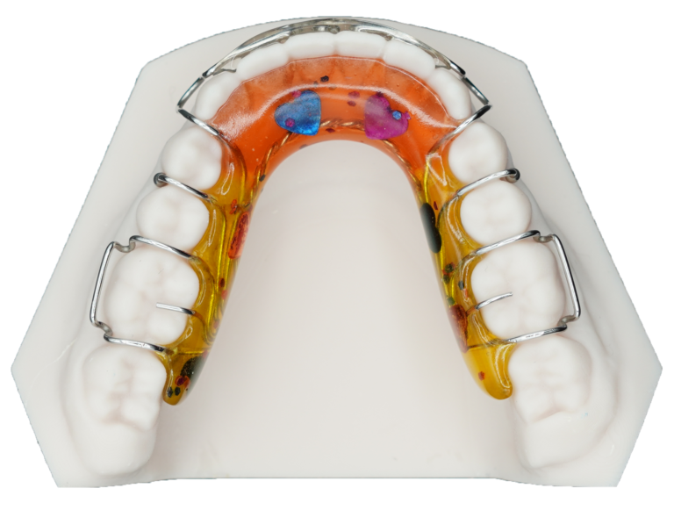
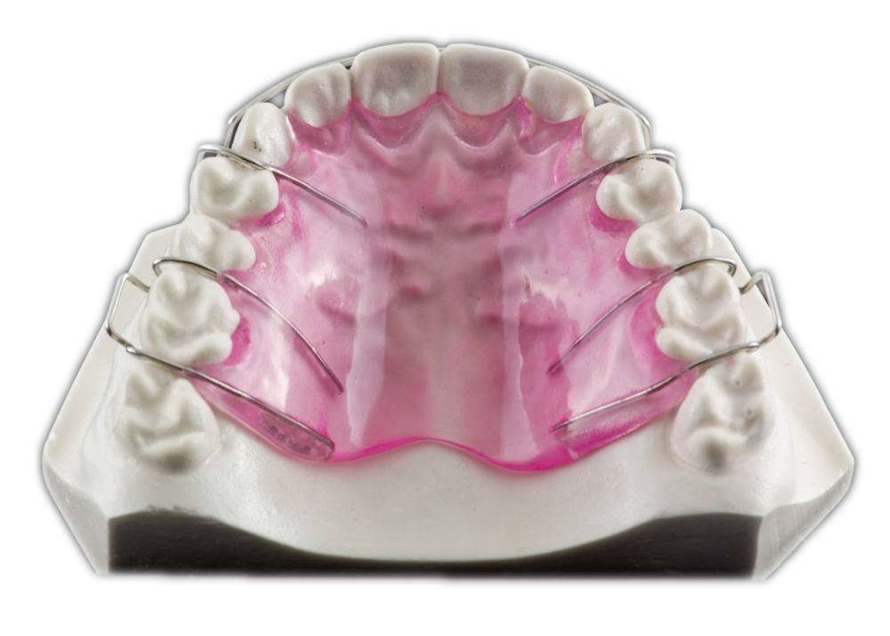
HAWLEY RETAINER
A Hawley retainer is made from stainless steel wire and an acrylic base. Clasps and labial bows are made from 0.7mm stainless steel.
A Hawley retainer can have a bumper along incisors to prevent relapse and rotations of incisors

Slide 11
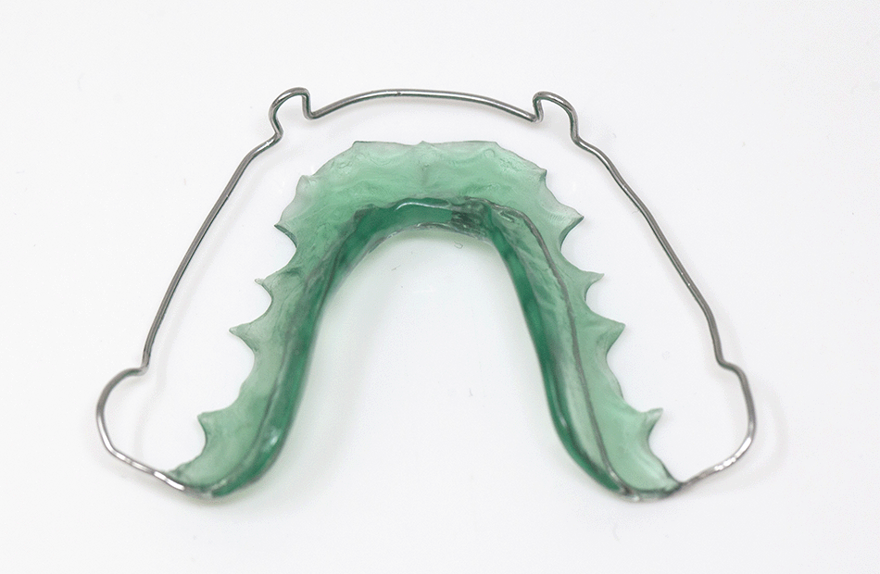
BEGG RETAINER
Made with acylic and stainless steel wire. 0.7mm s/s wire on clasps and bows
Tolerated less due to design and speech problems and poor aesthetics
Designed with a wrap around bow and designed to keep occlusal surfaces free

Slide 12
REMOVABLE RETAINERS
ADVANTAGES
DISADVANTAGES
Easier to clean as they can be removed
More flexibility when eating and drinking
Comforable
Some are cheap
Aesthetically can be better
Convenient
Can be adjusted (Hawley)
Can be lost easily
Some can be expensive
Requires discipline and compliance
Less durable
Speech and comfort issues

Slide 13
BONDED RETAINERS
ADVANTAGES
DISADVANTAGES
Constant wear
No risk of loss
Gap/ rotation maintenance
No speech impact
Don’t have to remember to wear them/ less compliance required
Isnt visible to others
Cant be easily damaged
Expensive
Uncomfortable
Maintenance of good oral hygiene – plaque catch
Metal wire can irritate the tongue
High maintenance

Slide 14

What is relapse
Relapse is officially defined by the British Standards institute as the return following correction of the features of the original malocclusion. However for patients relapse is perhaps better described as any change from the final tooth position at the end of orthodontic treatment. This may be a return towards the original malocclusion but may also be movement caused by
-Age Growth
-Gingival periodontal factors
-Soft tissue factors
-Occlusal factors
-Poor compliance

Slide 15
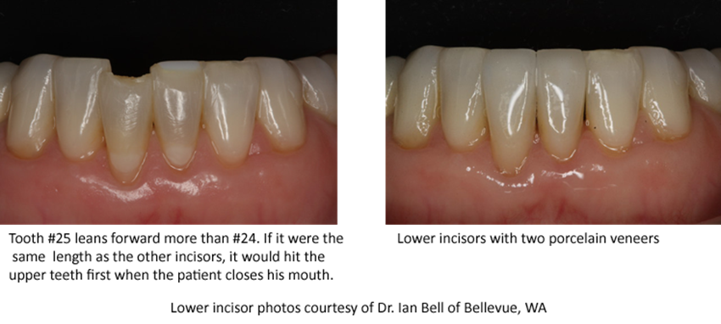
RELAPSE WHY?

Slide 16

COMPLIANCE
During the retention phase of orthodontic treatment compliance with retainers is exceptionally important. Patients should be advised that retention is life long and all research now shows that retention is to continue with wearing retainers for as long as they would like to keep their teeth straight

Slide 17
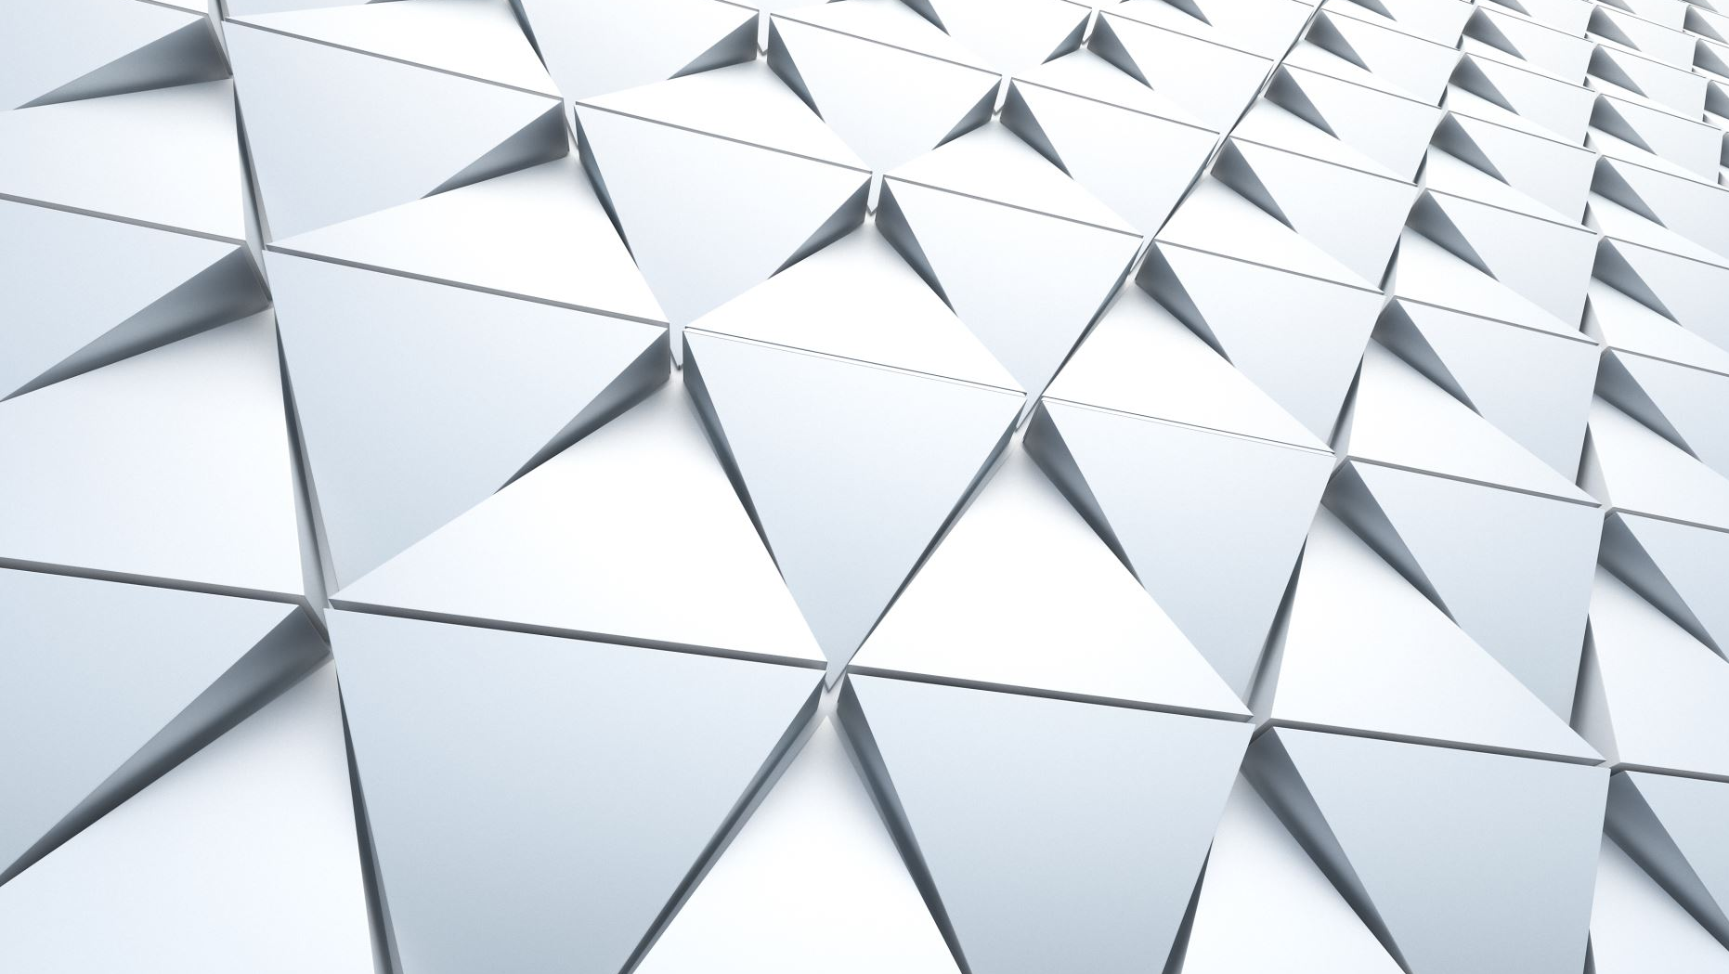
STABILITY
Tooth position is dictated by an equilibrium
of forces derived from:
➢Periodontal and gingival tissues
➢Orofacial soft tissues
➢Post treatment facial growth
➢Occlusion
Relapse occurs if this equilibrium is disturbed

Slide 18
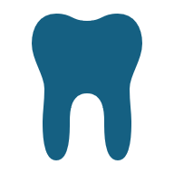
Periodontal and Gingival Fibres
Reorganisation of these tissues occurs following active orthodontic treatment
Recovery can result in relapse as periodontal structures under tension during treatment “spring back” once orthodontic appliances are removed

Slide 19
REORGANIZATION OF PERIODONTAL STRUCTURES
Bone - Newly formed osteoid and then the immature woven bone is more susceptible to remodelling. This takes - 3 months
Gingiva fibres – connective tissue found around the gingiva > 6 -12 months to reorganize
Periodontal – connective fibres to periodontal ligament - 1-2 months

Slide 20
Oro-Facial Soft Tissues
➢Teeth were initially positioned in the Neutral Zone (lips, cheeks, tongue in balance with occlusion)
➢Orthodontic treatment may change this balance
➢The greater the change in relation to the Neutral Zone, the greater the tendency to relapse

Slide 21
Post Treatment Facial Growth
➢Continued facial growth can result in occlusal changes AP changes: Class III
➢Vertical changes: AOB, increased OB
➢Late lower incisor crowding

Slide 22
Occlusion
Occlusal factors can aid stability
For example:
➢Adequate overbite following correction of an anterior crossbite
➢Adequate overbite following correction of Class 3 incisor relationship
➢Appropriate inter-incisal angle in Class 2 cases
➢Good intercuspation

Slide 23
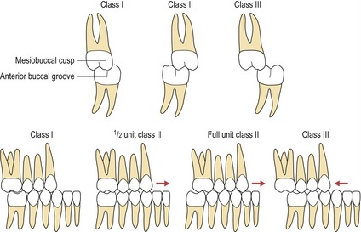
Occlusal Intercuspation
➢Good intercuspation is preferable in all cases to enhance post treatment stability
Cusp-to-cusp interdigitation is less stable–Antero-posterior (e.g. ½ unit Class 2 molar relationship)

Slide 24
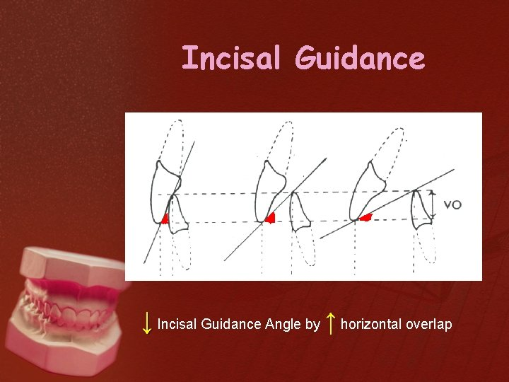

Slide 25
Orthodontic treatment choices can have a negative effect on the stability equilibrium increasing the likelihood of relapse
Examples:
➢Altering the patient’s original arch form
➢Expanding the inter-canine / inter-molar width
➢Proclining the lower incisors excessively
➢Incomplete overjet reduction
➢Incomplete correction of the inter-incisal angle

Slide 26
RETENTION REGIMES
Retention regimes differ from clinician to clinician. Some Orthodontists advise patients to wear retainers full time for the first 3-6 months then night times after this and others advise night times only from beginning.
Some advise single or dual retention – Removable only or removable retainer and a fixed retainer is fitted.
Retention is usually recommended to be life long and removable retainers worn at least 8 hours daily (usually when sleeping)
Clean removable retainers with warm soapy water and a tooth brush.
When retainers are now being used they should be kept in a retainer box and kept away from dogs or animals.

Slide 27
Role of an Orthodontic Dental nurse
Provide patient with written and verbal instructions on retention and its importance
Arrange for patient to be reviewed when in retention phase of brace treatment (usually 6 months post orthodontic tx)
Taking good accurate photographs at end of treatment to review patients progress and results

Slide 28

THANK YOU FOR LISTENING
QUESTIONS?

