Slide 1
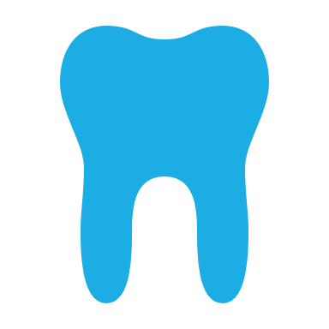
ORAL HEALTH

Slide 2

My name is Donna Forde I am an Orthodontic Therapist based in Zen Orthodontics, Newry
I Qualified in 2015 through the Royal College of Surgeons Edinburgh
I am currently an examiner with the Royal College of surgeons Edinburgh for the Orthodontic Therapy examinations

Slide 3
AIMS & OBJECTIVES
Aim
Explain the importance of oral health during orthodontic treatment and to discuss oral hygiene strategies & tips
Objectives
Describe oral hygiene regimes so that we can offer advice and instructions to patients during orthodontic treatment

Slide 4
GDC DEVELOPMENTAL OUTCOME
A & C

Slide 5
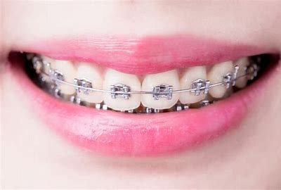
Oral Health and Care of Orthodontic Appliances

Slide 6
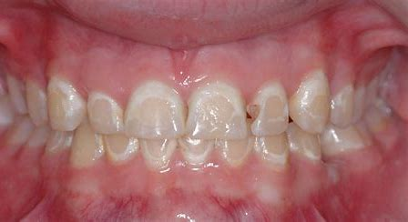
Whilst wearing either fixed or removal appliances it is imperative that patients have good oral hygiene
When patients are wearing braces diet and brushing is most important as the patient is high risk of decay and decalcification

Slide 7
Dental pLAque
Soft sticky film composed mainly of bacteria which forms on the teeth and is present in all mouths
The type of bacteria that predominates within plaque is influenced by the diet
Frequent consumption of sugars encourages multiplication of bacterial and increases the thickness of the plaque layer
The most commonly implicate plaque microorganism is Streptococcus Mutans
The amount of decay causing bacteria falls when the amount and frequency of sugars is reduced.

Slide 8
Periodontal Disease
Caused by dental plaque
Gingivitis – false pockets, reversible
Periodontitis – true pockets, irreversible
Attacks the (periodontium) supporting structures of the teeth
Gingivae • Periodontal ligament • Alveolar bone

Slide 9
Healthy Periodontium
Gingivae
Pink
Firm
Stippled
Tight cuff to tooth
Gingival crevice no more than 3mm
No bleeding
Bone and ligament intact

Slide 10
Aggravating Factors
Smoking
Unbalanced and excessive grinding
Puberty or pregnancy – hormonal changes
Open lip posture – mouth breathing
Medical conditions - AIDS, diabetes, leukemia, blood disorders. Vitamin C deficiency. • Epilepsy treated with phehytoin. • Ciclosporin – immunosuppressant drug and cytotoxic agents.

Slide 11
Plaque Retention Factors
Poor Oral Hygiene
Poor alignment increasing stagnation areas
Incompetent lip seal – dries out mucosal membrane self cleansing action of saliva is inhibited.
Effective tooth brushing difficult due to small opening.

Slide 12
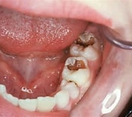
Caries
The progressive destruction of the tooth structure.
The process of demineralisation which allows the spread of decay first in the enamel and eventually to the dentine and pulp chamber, causing severe pain and infection

Slide 13
How Dental caries develops
Plaque accumulation – bacteria in the mouth form a sticky film called plaque
Acid Production - when you eat or drink something sugary or starchy the bacteria in plaque produce acid
Enamel demineralization - The acid produced by the bacteria eats away at the tooths enamel causing it to lose minerals
Cavity formation – if too many minerals are lost the enamel weakens and breaks down forming a cavity

Slide 14
Caries- Cause
High frequency intake of sugar
Frequently snacking
Not cleaning your teeth properly and for long enough, should be using cleaning aids, interdental brushes and floss to supplement brushing

Slide 15
Adult Orthodontics
As more adults are now having orthodontic treatment, we need to be aware of heavily filled teeth as they may fracture (especially if they have undergone root canal therapy)
If an adult has a heavily filled tooth it may be more suitable to extract it and move other teeth to the correct position
If the patient has a gold crown, porcelain or amalgam fillings it is more difficult to bond the brackets and may need specialist material

Slide 16
Adult orthodontics
Although we continue to grow during adulthood it is at a much slower rate than during puberty therefore any skeletal discrepancies will need to be treated by orthognathic surgery and/orthodontics, but the result will not be a successful as it will on a child
Periodontal disease is more common amongst adults therefore it is important that it is stabilised before orthodontic treatment commences
In adults there is a decreased cell turnover and a reduced blood supply to the tissues therefore tooth movement is slower and may be more painful

Slide 17

Fluoride
Hydroxyapatite crystals in enamel are changed into fluorapatite crystals which means the tooth surface is strengthened
Normally demineralisation occurs when the saliva drops to PH5.5 but fluoride will protect the enamel to a PH of 4.5
Fluoride does not protect against erosion

Slide 18
Diet and Oral Health whilst in brace treatment
Eating of hard foods - nuts, ice, crusty bread, carrots, apples may cause damage by bending wires, loosening cement under the bands or breaking the brackets and/or tubes, hard foods should be cut into small pieces
Sticky foods such as toffee or chewing gum can damage fixed appliances by bending the wires, which could make the wires exert the wrong level or direction of force or pull the cement loose.
Foods with a high sugar content - Sweets, chocolate and fizzy drinks should be avoided as they will damage the enamel, if they cannot be avoided altogether, they should be limited to meal times

Slide 19
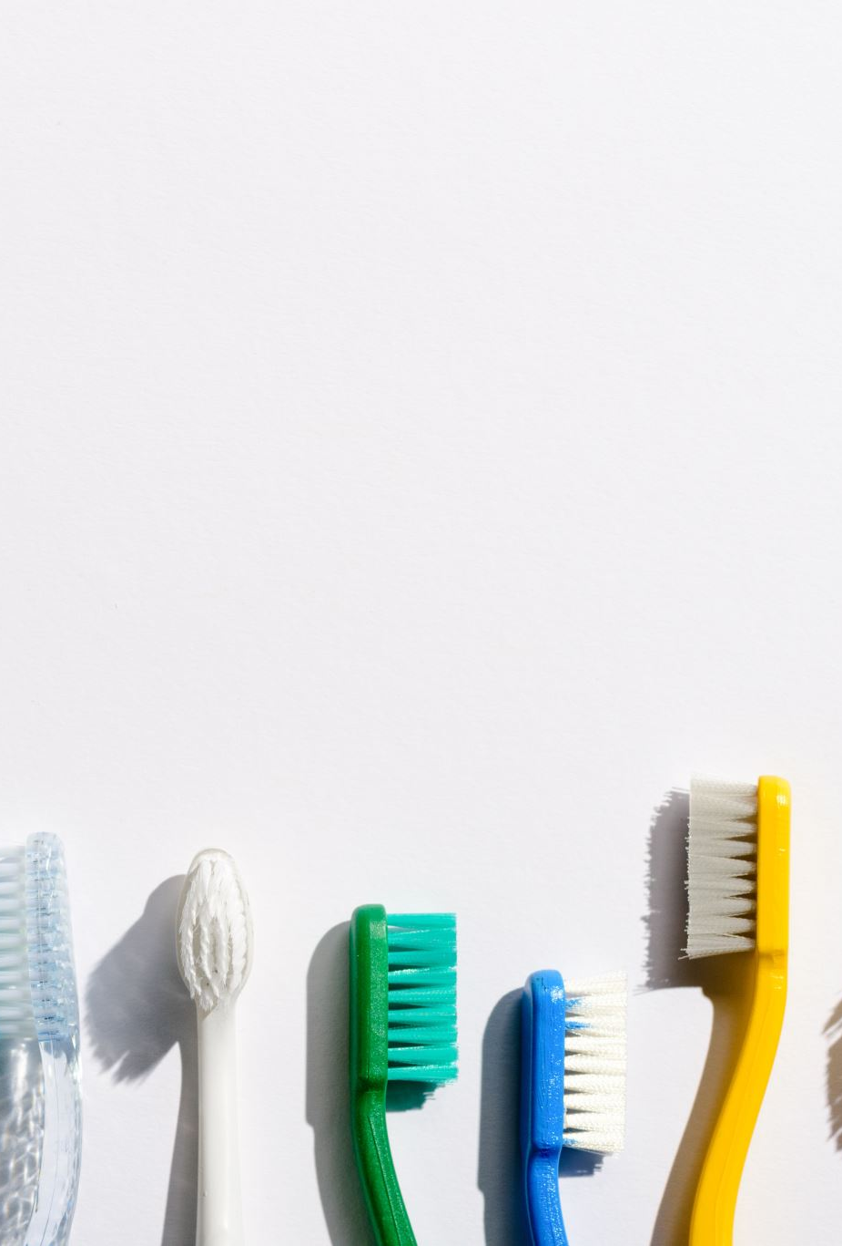
Oral Hygiene
Use small headed medium toothbrush
Use a Fluoride toothpaste 1000-1500 ppm
Spit don’t rinse
Toothbrushing should be done after ever meal
Removable appliances should be rinsed after every meal
Toothbrushes should be taken to school/work
Interdental brushes should be used daily
If possible to use super floss or floss
Use a fluoride mouth wash before bed

Slide 20
Regular Dental Check-ups
Patients must be made aware that they still need to have regular dental check ups as the orthodontist is not checking the teeth for caries

Slide 21

Well done you have completed this powerpoint If you have any questions please ask?

Slide 22
thank you
Donna FORDE
  donnamcevoy86@hotmail.co.uk

