Slide 1



NEBDN Dental Sedation Nursing
Saturday 6th September 2025
9.30am – 3.00pm
Helen McGreevy

Slide 2
Housekeeping
Register
Fire alarm
Fire assembly point
Toilets
Turn mobiles to silent
Feedback and certificates
.

Slide 3
Timetable for today
9:30 AM – 11:00 AM
Pain and Anxiety Control
Patient Assessment
11:00 AM – 11:15 AM
Break
11:15 AM – 1:00 PM
Sedation Complications
1:00 PM – 1:45 PM
Lunch
1:45 PM – 3:00 PM
Recovery and Discharge
3:15 PM – 4:30 PM
Anatomy and Physiology
Saturday 6th September 2025

Slide 4
Aims
Pain and anxiety control in dentistry
Patient Assessment
Sedation Complications
Recovery and Discharge Indicators

Slide 5


Objectives
On completion of training to be able to describe:
The history of pain and anxiety control in dentistry and the causes, signs and symptoms of dental anxiety and phobia
The importance and relevance of patient assessment for conscious sedation
Sedation related complications and how to recognise and manage them
Recovery and discharge indicators and when it is safe to discharge the patient

Slide 6
Learning Outcomes
GDC Development Outcome C
NEBDN Conscious Sedation For Dental Nurses 1.11, 3.1, 3.4, 3.6

Slide 7
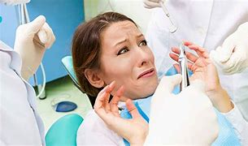
Pain and Anxiety Control in Dentistry
.
Causes, signs, symptoms of dental anxiety and phobia

Slide 8

Objectives
The history of pain and anxiety control in dentistry and the causes, signs and symptoms of dental anxiety and phobia
The difference between anxiety, fear, phobia
How anxiety is manifested
How to assess an anxious patient
How to approach/deal with a patient who is anxious
The way conscious sedation techniques have evolved
The historical link between conscious sedation and general anaesthesia

Slide 9
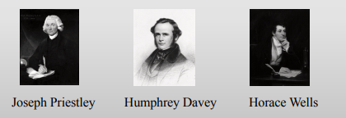
The history of pain and anxiety control in dentistry
.

Slide 10
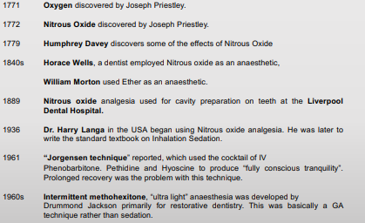
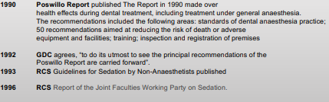
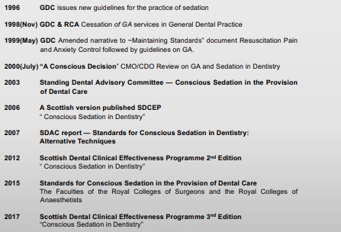
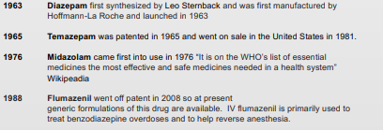
Historical Background

Slide 11
Dentally Anxious Patients
What is fear?
Innate
Developed
Phobia
.
Notes:
Research show that a very high number of the UK population suffer from disproportionate anxiety about dental treatment.
What is fear?
In-built from birth (innate)
Personal adverse experience or observing fear in others (developed)
Disproportionate fear in relation to the situation; cannot be explained away or is unreasonable; beyond voluntary control; leads to the situation being avoided (phobia)
Anxious patients expect more pain than they will actually experience.
During treatment they are in a state where they are continuously anticipating sudden pain

Slide 12
What can anxious patients have a fear of?
Needles
Choking
Noise
Blood
Confined spaces
Being operated on
Being reprimanded
Notes:
Anything else?

Slide 13
Understand and Assess Dental Fear
Reassurance
Explanation and information
Uncertainty
Notes:
Reassurance about their fears can help to establish trust and rapport between clinician and patient.
Explanation and information
Good communication leads to successful patient management
Uncertainty is the basis of many fears
Anxiety is fed by uncertainty
When not enough time spent on explaining procedure, potential discomfort, length of treatment time, cost

Slide 14
Patient Management Techniques
Behaviour management
Behavioural therapy
Conscious sedation
General anaesthesia

Slide 15
Conscious Sedation Techniques
Oral pre-medication
Oral sedation
Inhalation sedation
Intravenous sedation Midazolam
Oral sedation Midazolam
Oral sedation Temazepam
Intra nasal sedation Midazolam

Slide 16

.
Criteria for Sedation
Notes:
'Difficult patients' can be managed by Patience, Understanding and chair-side manner which is time consuming and may not be successful.
This is when the need for additional sedative techniques comes in.
To make dental treatment more acceptable to patients – alleviates fear, anxiety, perception and sensations
To give choice to patients, control gagging, provide amnesia

Slide 17
Options for care
Conscious sedation is not a substitute for effective behaviour management and local analgesia
Under 12s – behaviour management / LA or LA plus inhalation sedation
12–16-year-olds – LA plus Midazolam (all routes)
Referral
.

Slide 18

Patient Assessment
.

Slide 19
Sedation assessment to find out.......
The patient's physical ability to tolerate treatment
The patient's psychological ability to tolerate treatment
Is the proposed treatment possible under sedation?
Are there any contraindications to the use of the proposed technique?
.

Slide 20
Assessment appointment
What happens at the assessment appointment?
Notes:
What pre-operative instructions are given to your patients?
Handouts

Slide 21
Patient Assessment
What should be included on a patient assessment questionnaire?
Notes:
Notes pages 60 –62
Activity – In 2 groups produce a patient assessment questionnaire.
Include -
Patient details
History of dental treatment
Concerns
Social history
Medical status
Notes page 60 -61

Slide 22
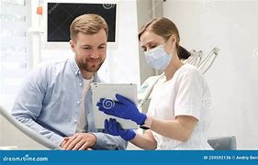
Patient Information
Clear information given to prepare the patient for treatment under sedation
Explain the procedure
Explain the pharmacological process
Benefits and risks with the selected form of sedation
.

Slide 23
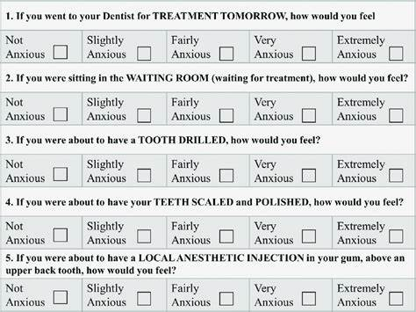
The Modified Dental Anxiety Scale
.
Notes:
Handout – fill it in and assess yourself

Slide 24
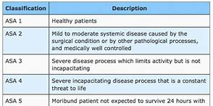
ASA Physical Status Scale
.
Notes:
Textbook page 169 - 170
The American Society of Anaesthesiologists (ASA) physical Status Scale
An assessment tool
To classify patients in terms of the risks that their medical history poses when being treated under sedation
ASA 1 & 2 – suitable for for treatment under sedation in GP
ASA 3 & 4 – should receive treatment in specialist unit or hospital
Age – Caution in very young or elderly patients. Young = unpredictable response & immature personalities Elderly –possible hightened sensitivity to sedative / reduced ability to metabolise drug – care must be taken to titrate slowly in small increments to avoid risk of overdose.
Pregnancy – avoid wherever possible. Precautions in breast feeding mothers – drug may be secreted in breast milk.
Cardiovascular / respiratory disease (significant) = sedation contraindicated.
Asthma / angina / hypertension = may be benefits to treating under sedation if anxiety aggravates their condition
Liver & kidney disease = drug abusers / alcoholics' renal & hepatic (liver) function may be impaired. May self-administer pre-meds
Psychological / psychiatric disease = may be unpredictable – medications may interact with sedatives
Obesity = may be difficult to cannulate. BMI over 25 may not be suitable. May be airway management & patient handling problems.
Severely underweight = may be malnourished

Slide 25
Blood Pressure Assessment
Blood Pressure | ASA Class
Less than 140/90 | I
140/90 - 159/94 | II
160/95 - 199/114 | III
Over 200/115 | IV
.

Slide 26
Patient's Appearance
Observe the patient
Monitor the patient
Share your observations
Remember that if a patient looks unwell, they usually are!.

Slide 27
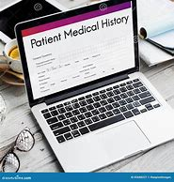
Medical History
A.S.A. Status
Medication
Airway
Pregnancy
Veins
Age
Blood Pressure

Slide 28
Observe the patient
.
Notes:
Eg:
Congested nose not suitable for IS

Slide 29
Consent
The patient is given clear and comprehensive information
Valid consent
Confirmed in writing
Usually not appropriate to be given on the day
Should be confirmed on the day of the treatment
Notes:
More on Medico-legal aspects of sedation later in the course

Slide 30
Pre-operative Instructions
Confirmation of the treatment plan
Confirmation of the effect of sedation (not GA)
Confirmation that informed consent is signed
Any pre-medication and any other medications are prescribed
Confirm that escort and care at home is in place
Pre and post written sedation instructions are given
Answer any questions that the patient may have
Notes:
Handouts for IV & IS

Slide 31
Written Records
Assessment record
Record of consent
Pre-sedation information sheet
Post-sedation information sheet
Monitoring record
Discharge sheet
What is required?

Slide 32


Clinical Environment
CQC
RQIA (NI)
.
Notes:
Clinical environment, facilities & equipment must be appropriate for the needs and safety of patients, carers and staff
Role of RQIA & CQC
Inspections
RQIA - Main Title Goes Here (rqia.org.uk)
CQC Dental mythbuster 10: Safe and effective conscious sedation - Care Quality Commission (cqc.org.uk)

Slide 33
Sedation Complications
.
Notes:
Make a list of possible sedation related complications
Do you have any experience of complications?
Importance of record keeping
Craig & Skelly P93
Over-sedation
Disinhibition
Hypotension
Venepuncture problems
Paradoxical effects
Respiratory depression
Unconscious patient
Airway obstruction
Vomiting
Anaphylaxis
Delayed recovery
Failure of sedation
Hiccups

Slide 34
Over-sedation
Gross over sedation with Midazolam
Mild over sedation with N2O
Severe over sedation with N2O
.
Notes:
Small amount of oversedation not usually an issue
Gross over sedation with Midazolam = serious respiratory depression or apnoea – needs quick & effective management
Mild over sedation with N2O = pt may panic & pull off mask
Severe over sedation with N2O = may lead to light anaesthesia

Slide 35
Disinhibition
Giggling, crying, talkativeness, panic attacks, aggression, abusive behaviour
.
Notes:
Giggling, crying, talkativeness, panic attacks, aggression, abusive behaviour

Slide 36
Hypotension
Decrease in systemic arterial BP
Requires no active treatment
Move patient slowly from supine to sitting up
BP monitoring
.
Notes:
Decrease in systemic arterial BP
Requires no active treatment
Move patient slowly from supine to sitting up
BP monitoring

Slide 37
Hiccups
May last for hours
No risk but distressing for the patient
Explain and reassure
.
Notes:
IV sedation - associated with excessive Midazolam and /or rapid delivery
Slow administration for patients susceptible to hiccups

Slide 38
Venepuncture problems
Minor problems with technique
Failure to find suitable vein
Difficult to site the cannula
Failure to obtain flashback
Painful
Post cannula removal bruising
.
Notes:
Anxiety, cold, history of IV drug abuse – difficulties in finding suitable vein

Slide 39
Paradoxical Effects
Patient becomes more anxious
Treatment may not be possible
More common in children and adolescents
.
Notes:
Best to stop treatment
Oral Midazolam may be alternative

Slide 40
Respiratory depression
Serious
Difficulty to recognise mild or moderate respiratory depression
Use of pulse oximetry with clinical monitoring
Management
.
Notes:
Management – ask patient to take deep breaths – most cases will be successful – if not –open airway – oxygen ventilation – bag. If this fails – administer Flumazenil – 500 micrograms by slow IV injection & continue ventilation & encourage breathing

Slide 41
Pulse Oximetry
The pulse oximeter measures the patient’s arterial oxygen saturation and the heart rate from a probe attached to the finger.
Patients undergoing sedation should always have an oxygen saturation well above 90%.
The pulse oximeter is essentially an early warning device.
.

Slide 42
Unconscious patient
Basic Life Support
Immediate Life Support
.
Notes:
ILS protocol
Training next class

Slide 43
Airway obstruction
Causes
Prevention
.
Notes:
Sedated patient less likely to notice and indicate breathing problems
Water & debris – use high volume suction
Rubber dam but must be removed immediately if respiratory problems

Slide 44
Nausea and vomiting
Anxious patient
Reassurance
.
Notes:
Anxious patient feels sick at thought of dental treatment
May have had nausea /vomiting in past with GA – have expection that conscious sedation will make them sick.
Patient who regularly vomits in sedation may need antiemetic med

Slide 45
Anaphylaxis
Allergy to benzodiazepines is rare
Nitrous oxide
.
Notes:
In unlikely event of anaphylaxis caused by Midazolam – use oxygen, epinephrine, assistance etc
Do NOT administer Flumazenil to reverse
N2O allergy virtually unheard of

Slide 46
Failure of Sedation
Quit while you're ahead
Alternative
Referral
.
Notes:
Sedation techniques may not always work as well as predicted
Early recognition of failure important
Quit while you're ahead
Be honest, positive, flexible
Arrange further appointment
Referral

Slide 47

Recovery and Discharge Indicators
.

Slide 48
What is the definition of recovery in dental sedation?
.
Notes:
Recovery of motor and mental functions impaired by sedation
Regaining the ability to stand and walk unaided, coordinate fine movements, judge distance & time correctly

Slide 49
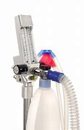
Elimination of nitrous oxide
Very rapid
95% of gas eliminated within 10 minutes – short procedure
90% of gas eliminated within 15 minutes – longer procedure (2 hours)
.
Notes:
Nitrous oxide diffuses out of blood into lung alveoli rapidly & will dilute the inspired air & lead to diffusion hypoxia – this is main reason patients are given only oxygen for 2 minutes at the end of treatment.

Slide 50
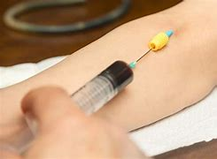
Intravenous Sedation
Midazolam metabolises in the liver
Half life of Midazolam is short (2 hours)– pharmacological effects of drug is short lived
Avoid operation of machinery and driving
.
Notes:
Notes p108
Half-life = The half-life of a drug is an estimate of the time it takes for the concentration or amount in the body of that drug to be reduced by exactly one-half (50%).

Slide 51
Delayed recovery
How long is too long?
Notes:
Recovery from N2O usually matter of minutes
Recovery from IV varies
Taking CNS Depressant drugs – may prolong recovery - Patience and careful monitoring
May need Flumazenil but not normally used when taking CNS depressants /stimulants
Exception when patient has prolonged recovery & profound respiratory depression.

Slide 52
Blood Pressure
Sedation can cause blood pressure fluctuations.
During recovery, monitoring blood pressure allows us to detect any dangerous drops or rises.
This can be checked along side pulse oximetry.
Patients are not discharged until their blood pressure, pulse and oxygen levels are stable and within normal limits.
Post Sedation

Slide 53
Intravenous Sedation Discharge
Discharge
At least I hour should have elapsed since the last increment drug was administered
Venous cannula left in situ until patient ready for discharge
Must be able to stand and walk without assistance
Discharged into the care of their escort
Both patient and escort should be given verbal and written post-operative instructions
Cannula removed with pressure over site to prevent haematoma

Slide 54
Pass the test
Negative EVE test
Accurately touch tip of nose with index finger
Rhomberg’s test
Patient able to stand with eyes closed without undue swaying
.

Slide 55
Post Op Instructions
A responsible adult must take you home and stay with you for 24 hours
Do not drive, operate machinery or handle dangerous items.
For 24 hours, avoid alcohol, important decisions, signing legal documents and caring for dependants.
Eat light foods, rest and be patient as your body recovers from the effects of the sedation.
After conscious sedation

Slide 56

Thank you
Questions?
.

