Slide 1


Intravenous Sedation Equipment and Technique
Saturday 4th October
11.15- 1.00
Helen McGreevy

Slide 2
Aims
To understand what equipment is required to
undertake IV sedation safely
To understand how other pieces of equipment can help provide safer care
To understand the safe technique for undertaking
IV sedation in a dental environment

Slide 3
GDC Outcomes
GDC Development Outcome C
NEBDN Conscious Sedation for Dental Nurses 3.5.9 & 11

Slide 4
Where should sedation be carried out?
General/specialist dental practice
Oral Surgery Dept. of local hospital
Community Dental Service
Teaching hospital

Slide 5
How to decide where the patient should be sedated?
We take into consideration:
Reasons for anxiety
Degree of anxiety
Age
Medical history (ASA)

Slide 6
Selection of patients for sedation/referral
Consideration of :
Dentistry required
Attitudes
Social background

Slide 7

Planning for IV Sedation
The patient should be given written and verbal instructions
Assessment should be at a separate visit
Fasting
Controversial
4 hours solids, 2 hours clear liquids or 2 hours for both?

Slide 8
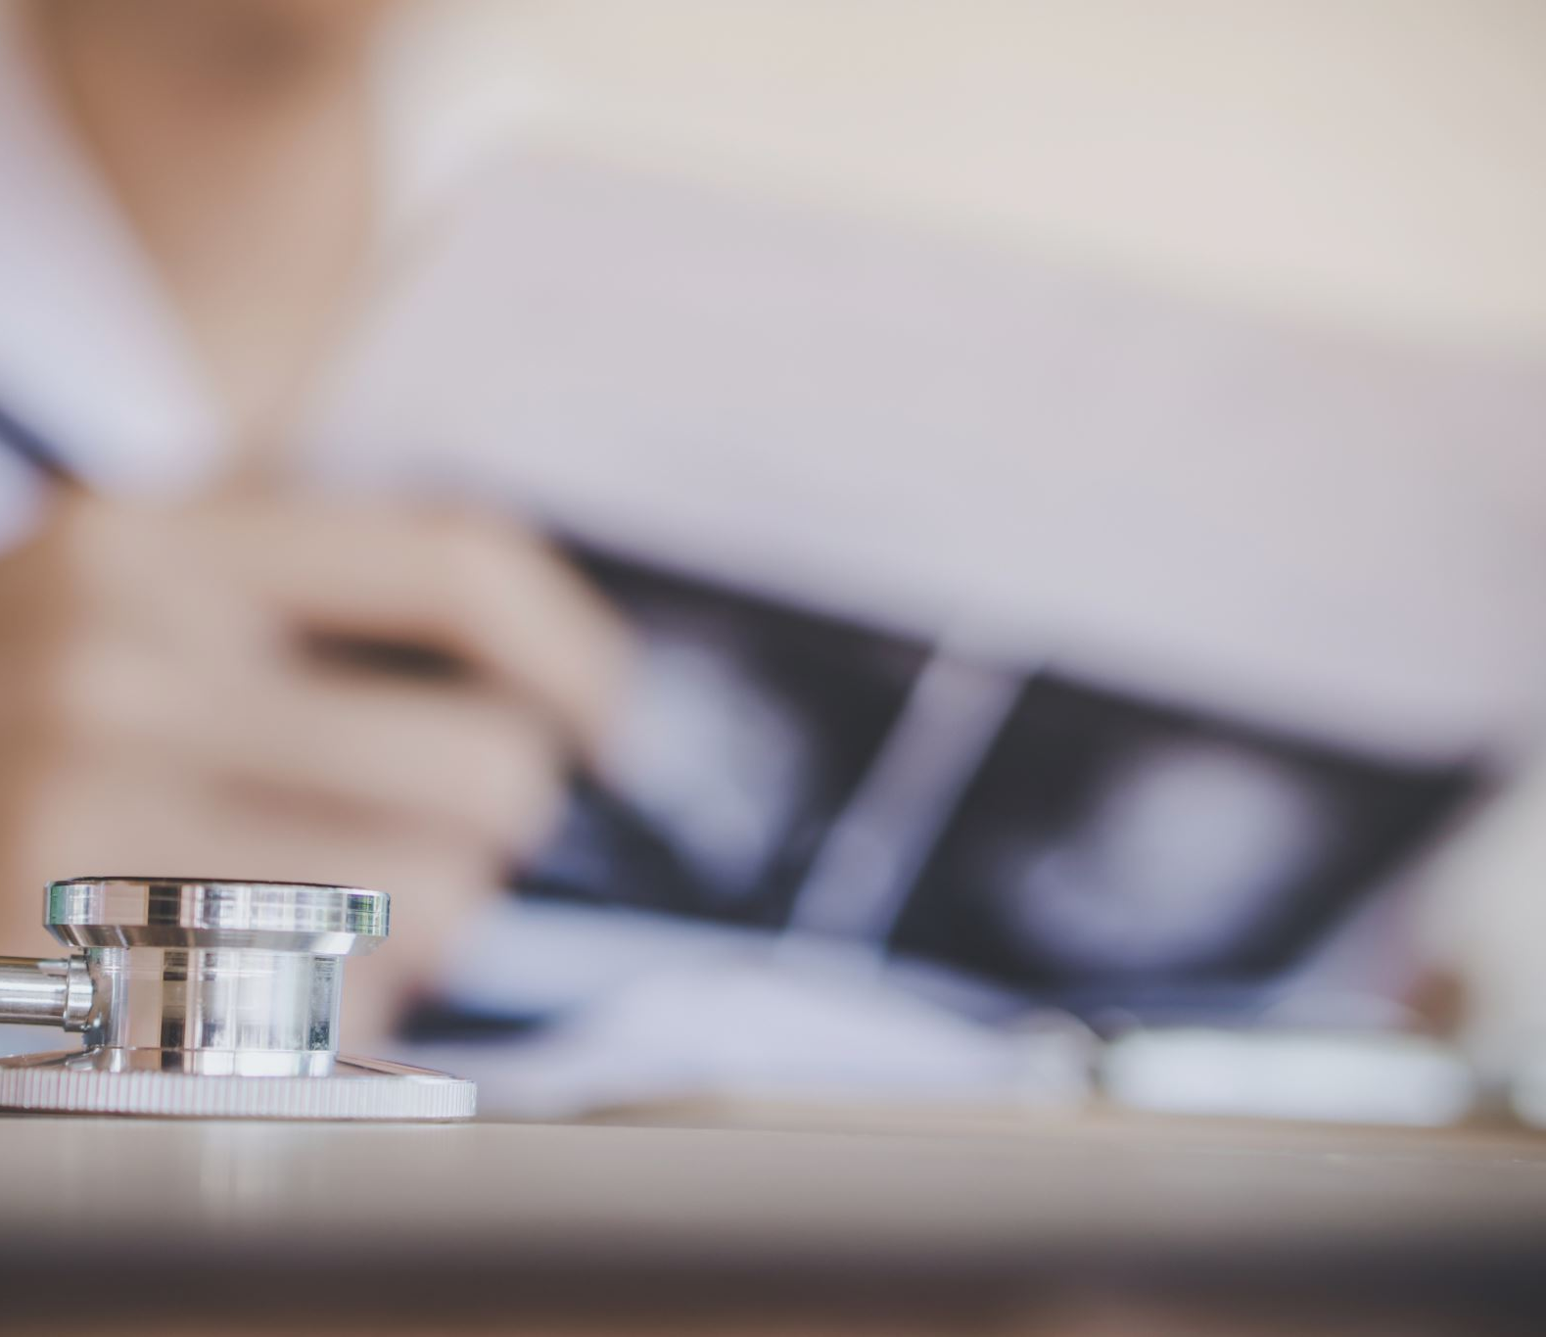
Pre Procedural Checks!
Personnel
Equipment
consent
Check patient has followed pre-sedation instructions
Check medical history, ensure no changes
Pre sedation BP, heart rate and saturation

Slide 9
IV sedation requirements
Suitable environment
Emergency access
Recovery area
Pulse oximeter
Blood pressure equipment / Sphygmomanometer
Equipment for IV cannulation
Emergency equipment and drugs
Flumazenil

Slide 10
Measuring blood pressure
Ideally have the patient seated and their arm at heart level. Make sure that they do not have any tight clothing which may constrict their arm.
Palpate in the antecubital fossa for the point of maximal pulsation of the brachial artery.
Make sure you have a suitable sized blood pressure cuff. Ideally the bladder of the cuff should encircle 80% of the arm.
Apply the cuff proximal to the location of the brachial pulse
The centre of the cuff bladder should be placed over the line of the brachial artery.
It is recommended that the cuff tubing should not cover the antecubital fossa area.
If you are using a mercury sphygmomanometer, make sure that the manometer is positioned at your eye level.

Slide 11
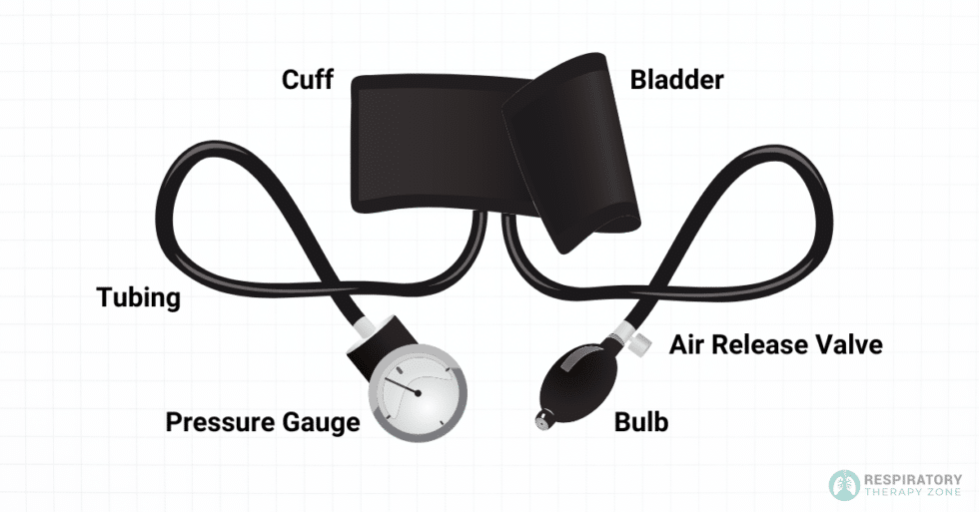
Manual
Sphygmomanometer
Notes:
Use of stethoscope

Slide 12
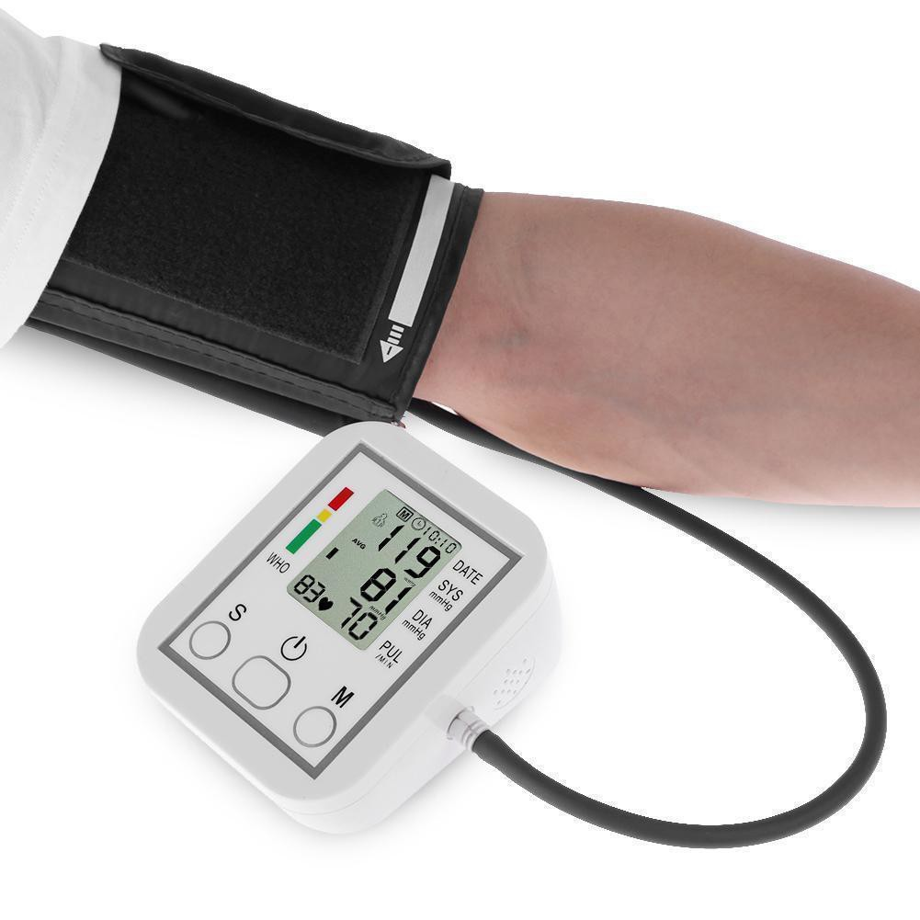
Automated
Sphygmomanometer

Slide 13
Measuring Blood pressure
Ideally have the patient seated and their arm at heart level. Make sure that they do not have any tight clothing which may constrict their arm.
Palpate in the antecubital fossa for the point of maximal pulsation of the brachial artery.
Make sure you have a suitable sized blood pressure cuff. Ideally the bladder of the cuff should encircle 80% of the arm. Apply the cuff proximal to the location of the brachial pulse. The centre of the cuff bladder should be placed over the line of the brachial artery.
It is recommended that the cuff tubing should not cover the antecubital fossa area. If you are using a mercury sphygmomanometer, make sure that the manometer is positioned at your eye level.

Slide 14
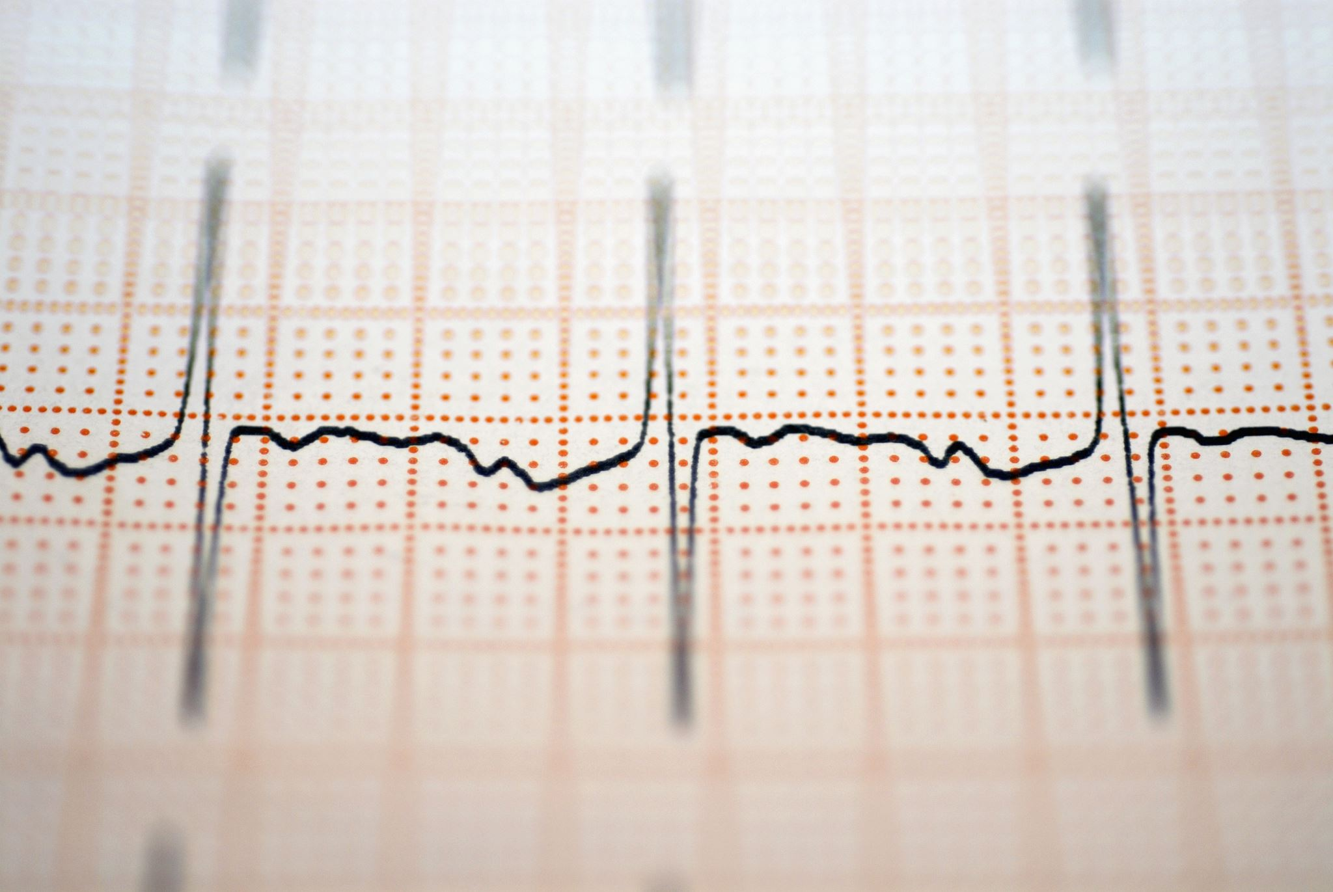
Pulse oximetry
simple and non-invasive
detects hypoxia before it is clinically obvious
displays percentage of haemoglobin (Hb)
saturated with oxygen.
Heart rate (audible)
Audible alarms can be programmed detects hypoxia before the patient becomes clinically cyanosed.

Slide 15
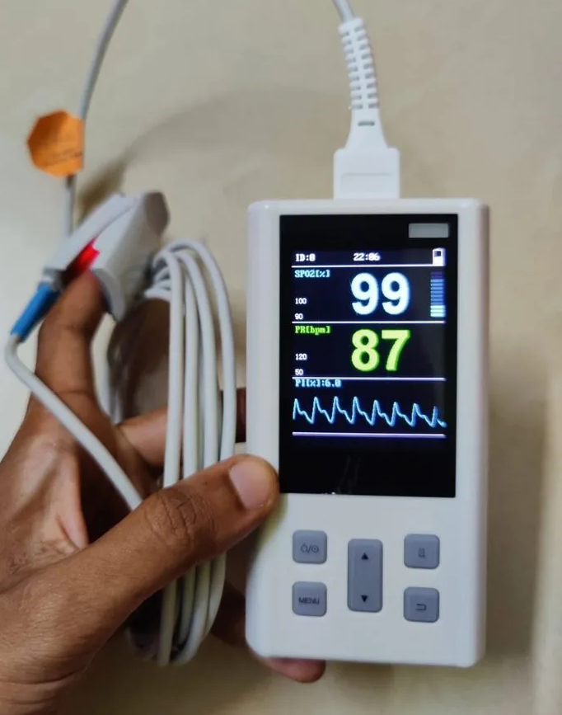
Pulse Oximeter

Slide 16
How does the Pulse Oximeter work?
two wavelengths of light originate from probe (650nm and 805nm).
the light is partly absorbed by haemoglobin
absorption by oxygenated and deoxygenated Hb differ
by calculating the absorption at the two wavelengths the processor can compute the proportion of haemoglobin which is oxygenated.
Recognises arterial blood due to differing pressures (systolic and diastolic)

Slide 17
Limitations
erroneous readings can be caused due to poor perfusion, venous pulsations, movement, excess
light, nail varnish or pigmentation
cannot distinguish between oxyhaemoglobin, and carboxyhaemoglobin (smokers). Errors can be caused by other dyshaemoglobins such as methaemoglobin
gives a percentage reading and does not reflect oxygen carrying capacity of blood e.g. anaemia

Slide 18
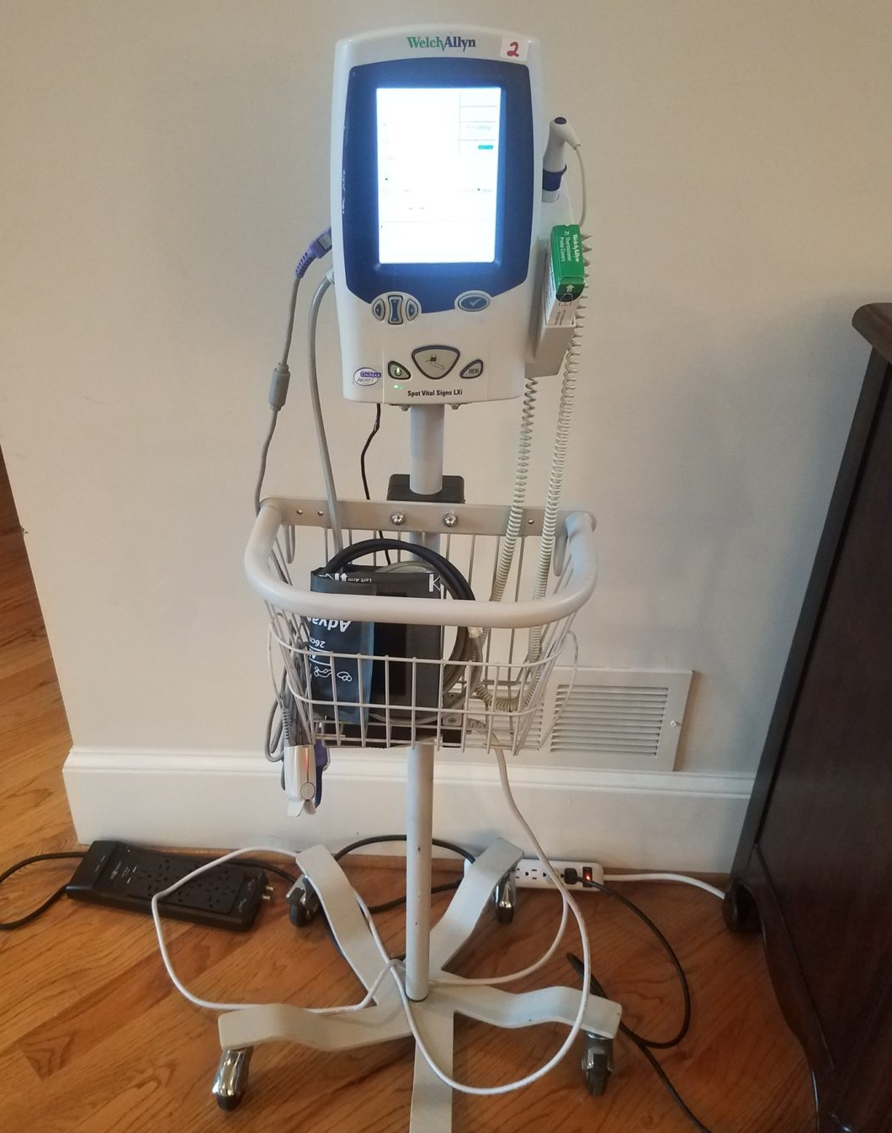
Observation machine, Pulse oximetry and Sphygmomanometer combined

Slide 19
Equipment for IV Sedation
Disposable Tourniquet
Disinfectant Medi-wipe
Cannula/ 22-gauge venflon or Y can
23 gauge drawing up needles x 2 or 3 to have one ready in case of flumazenil
Luer lock 5ml syringe x 3
Labelled stickers for syringes, e.g. Midazolam, Flumazenil, Sodium Chloride
Midazolam
Flumazenil
Sodium chloride
Medi-pore tape
Cotton wool

Slide 20
Luer Lock, what is it?
A ‘Luer Lock’ is a standardised conical fitting that creates a secure, leak proof, and twist-lock connection between medical and laboratory devices, such as syringes, needles and tubing.
Unlike a simple ‘Luer Slip’ that relies on friction, the luer lock features a threaded sleeve on the female part of the fitting that screws onto the male part, preventing accidental detachment and ensuring a more reliable seal under pressure.
We twist it to secure.

Slide 21
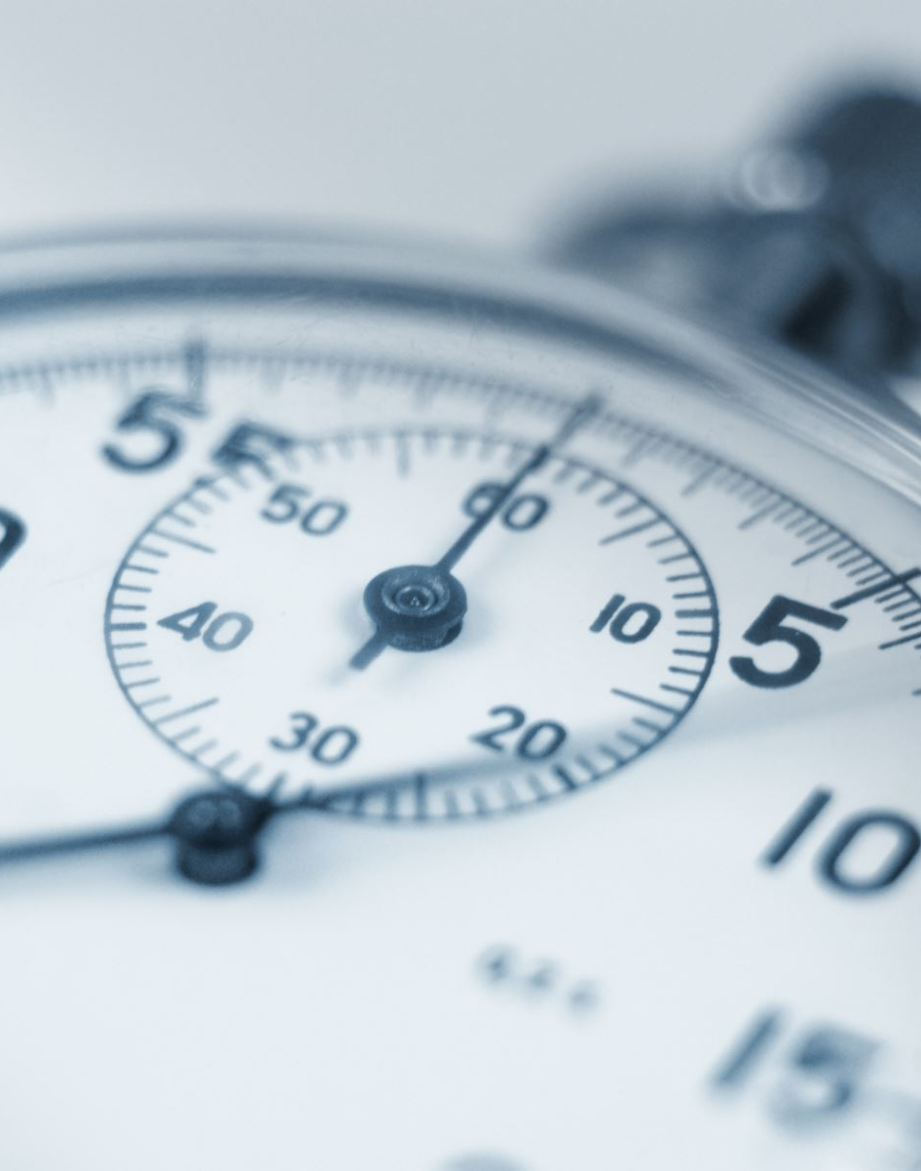
Frequently asked questions
State the function of a tourniquet?
Why is a disinfectant surface Medi-wipe used?
What is the function of a cannula, either a 22-gauge venflon or Y can?
Why are two 23 gauge drawing up needles required?
Explain why a 5ml sodium chloride flush is used?

Slide 22
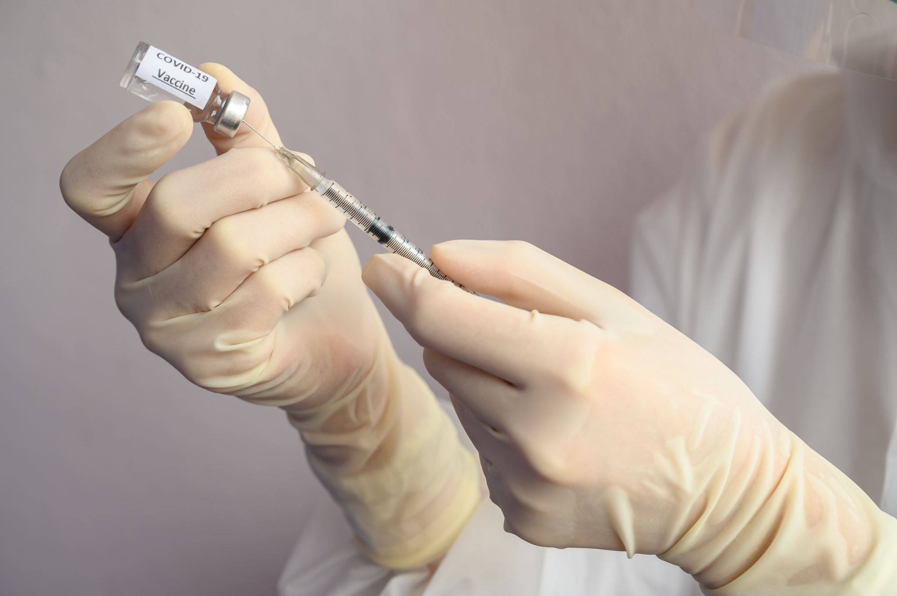
Answers
To restrict the venous return, thereby engorging the vein so that cannulation can take place.
To cleanse the selected cannulation site.
To gain access into the vein, which once sited is known as an indwelling cannula. This is to administer the drug.
One to draw the drug into a sterile syringe and the other to draw the flush into a sterile syringe.
To administer when the cannula is in place after ensuring that it has been sited properly. Sodium chloride is used, because it is compatible with the body.

Slide 23
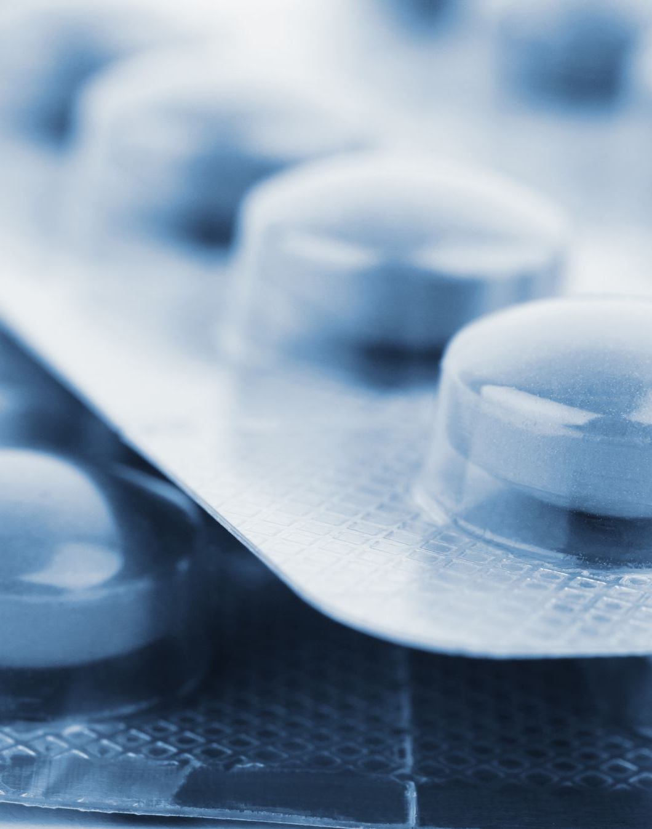
Emergency Drugs
Ensure direct and quick access to the emergency drugs kit
Check all items daily
Date check all items at the end of each month
Portable Oxygen

Slide 24
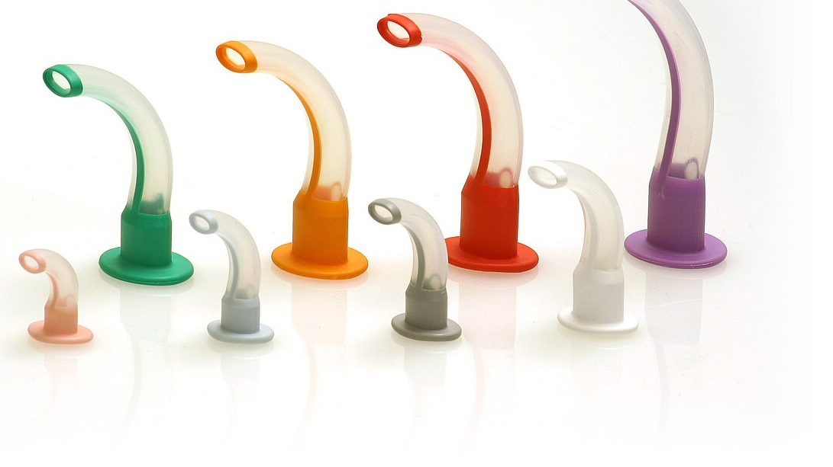
Guedal Airways

Slide 25
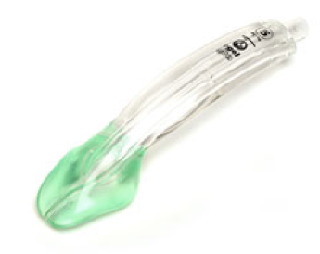
Laryngeal Mask Airway

Slide 26
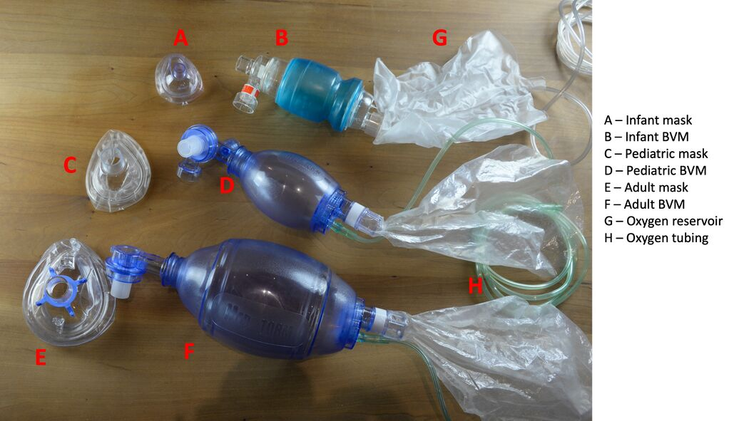
Bag Mask Valve
This Photo by Unknown Author is licensed under CC BY-SA

Slide 27
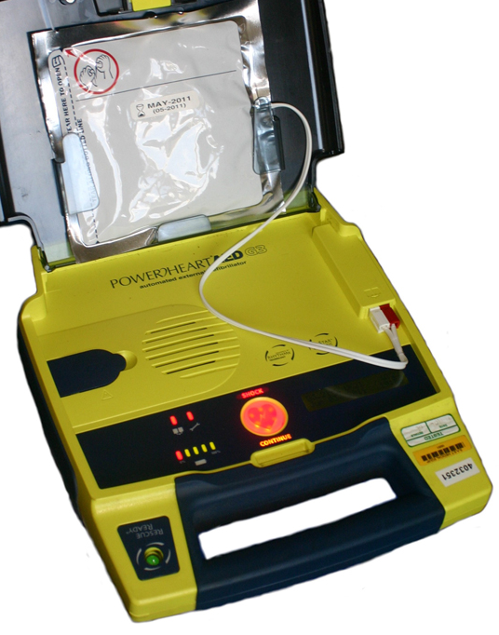
Defribrilator

Slide 28
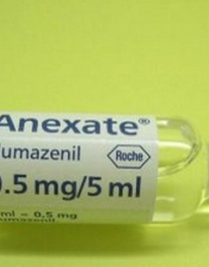
Reversal Agent

Slide 29
Technique
Venepuncture
Titration of sedation agent
Midazolam 1mg/ ml
Drawn up into labelled syringe
1mg administered over 15 seconds
1 minute between increments
When end point is reached, flush with saline

Slide 30

Avoiding Mess!
Notes:
Always try to be as neat as possible for everyone's safety

Slide 31
Technique
How do you know the patient is sedated?
Slurring and slowing of speech
Relaxed demeanour
Delayed response to commands
Willingness to undergo treatment
Verrill's sign (ptosis or drooping of eyelid)
Eves sign ( patient is unable to touch tip of nose)

Slide 32
Technique
Communication must be maintained with the patient throughout the procedure
Recovery, return the patient to the upright position slowly
Move to the recovery area
The patient must remain under direct supervision
Should be monitored whilst in recovery

Slide 33
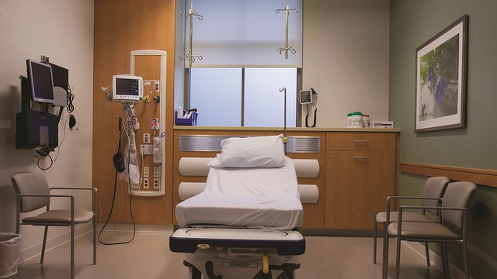
Recovery Area

Slide 34
Recovery area
Needs to be private
Needs to be separate from the rest of the patients
Patients still need monitored in recovery

Slide 35
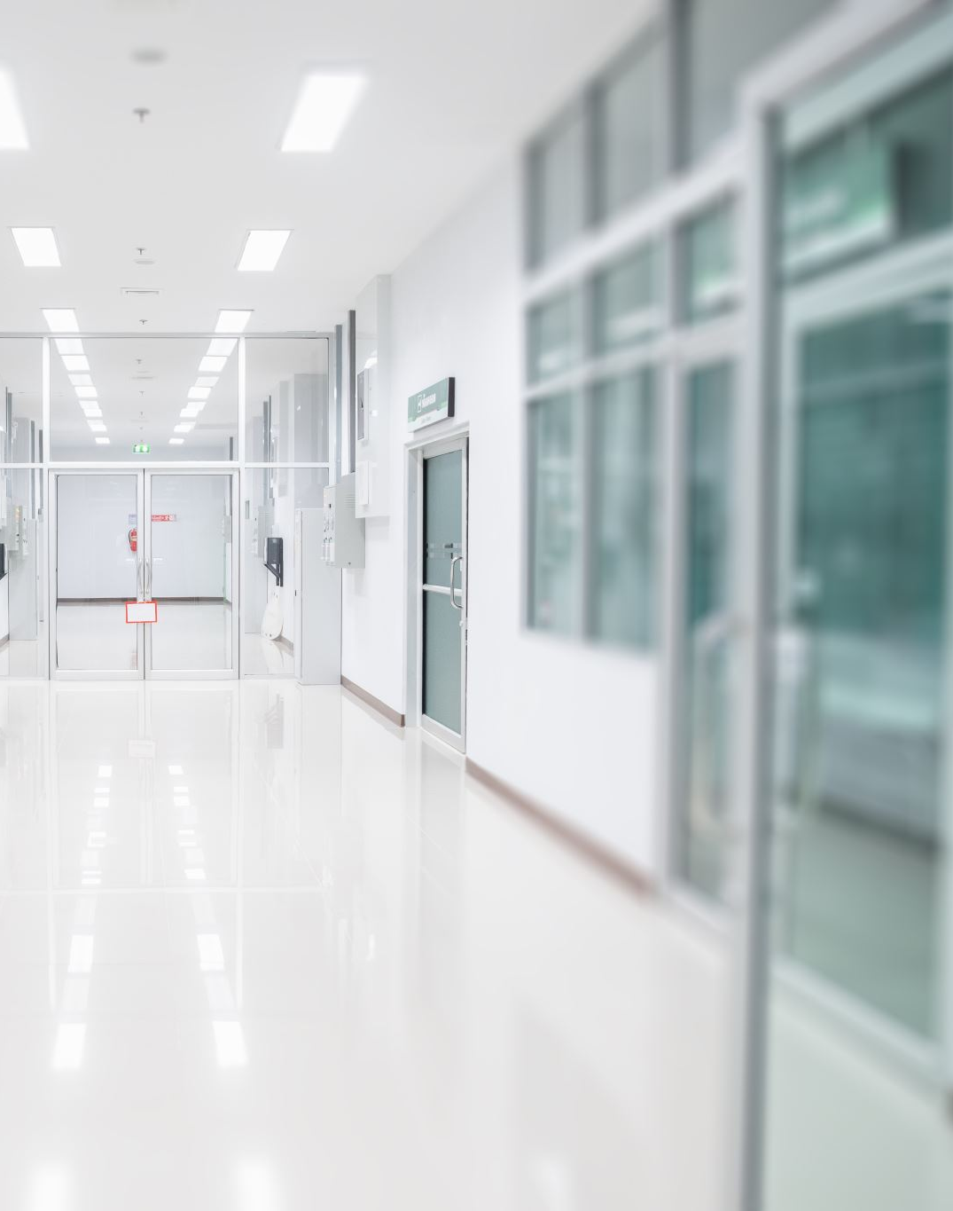
Discharge
Patients are not discharged until 1 hour after the last increment is given
The patient must be able to stand and walk unaided
Full verbal and written instructions must be given to the patient and chaperone

Slide 36


Slide 37

Questions?

Slide 38
Practical Time!

