Slide 1


Pharmacology of Benzodiazepines
Saturday 4th October
9.30-11.00
Helen McGreevy

Slide 2

Housekeeping
Register
Fire Alarm
Fire Assembly point
Toilets
Turn mobile to silent
Feedback and certificates

Slide 3
Timetable for today
9:30 – 11:00
Pharmacology of benzodiazepines
11:00 – 11:15
Break
11:15 – 1:00
Intravenous Sedation Equipment and Technique
1:00 PM – 1:45 PM
Lunch
1:45 PM – 3:00 PM
Intravenous Sedation Monitoring
3:00 PM – 3:15 PM
Break
3:15 PM – 4:30 PM
ROC Audit

Slide 4

Aims
To understand the pharmacology of drugs used for sedation
To understand ‘Half-life’
To know how to manage over-sedation with benzodiazepines
To know drugs that might interact with benzodiazepines

Slide 5
GDC Outcomes
GDC Development Outcome C
NEBDN Conscious Sedation for Dental Nurses 3.3.1,2,3,4,5 & 6

Slide 6
Objectives
To understand the pharmacology of benzodiazepines
To understand the levels of sedation
The importance of drug interactions
Management of controlled drugs
Difference in the pharmacokinetic and pharmacodynamic effects when drugs are administered through different routes

Slide 7
Content
Definition of sedation
Controlled drugs
Benzodiazepines
Benzodiazepines – side effects
Half life of benzodiazepines
Type of benzodiazepines
Reversal agents
Interactions
Managing complications

Slide 8
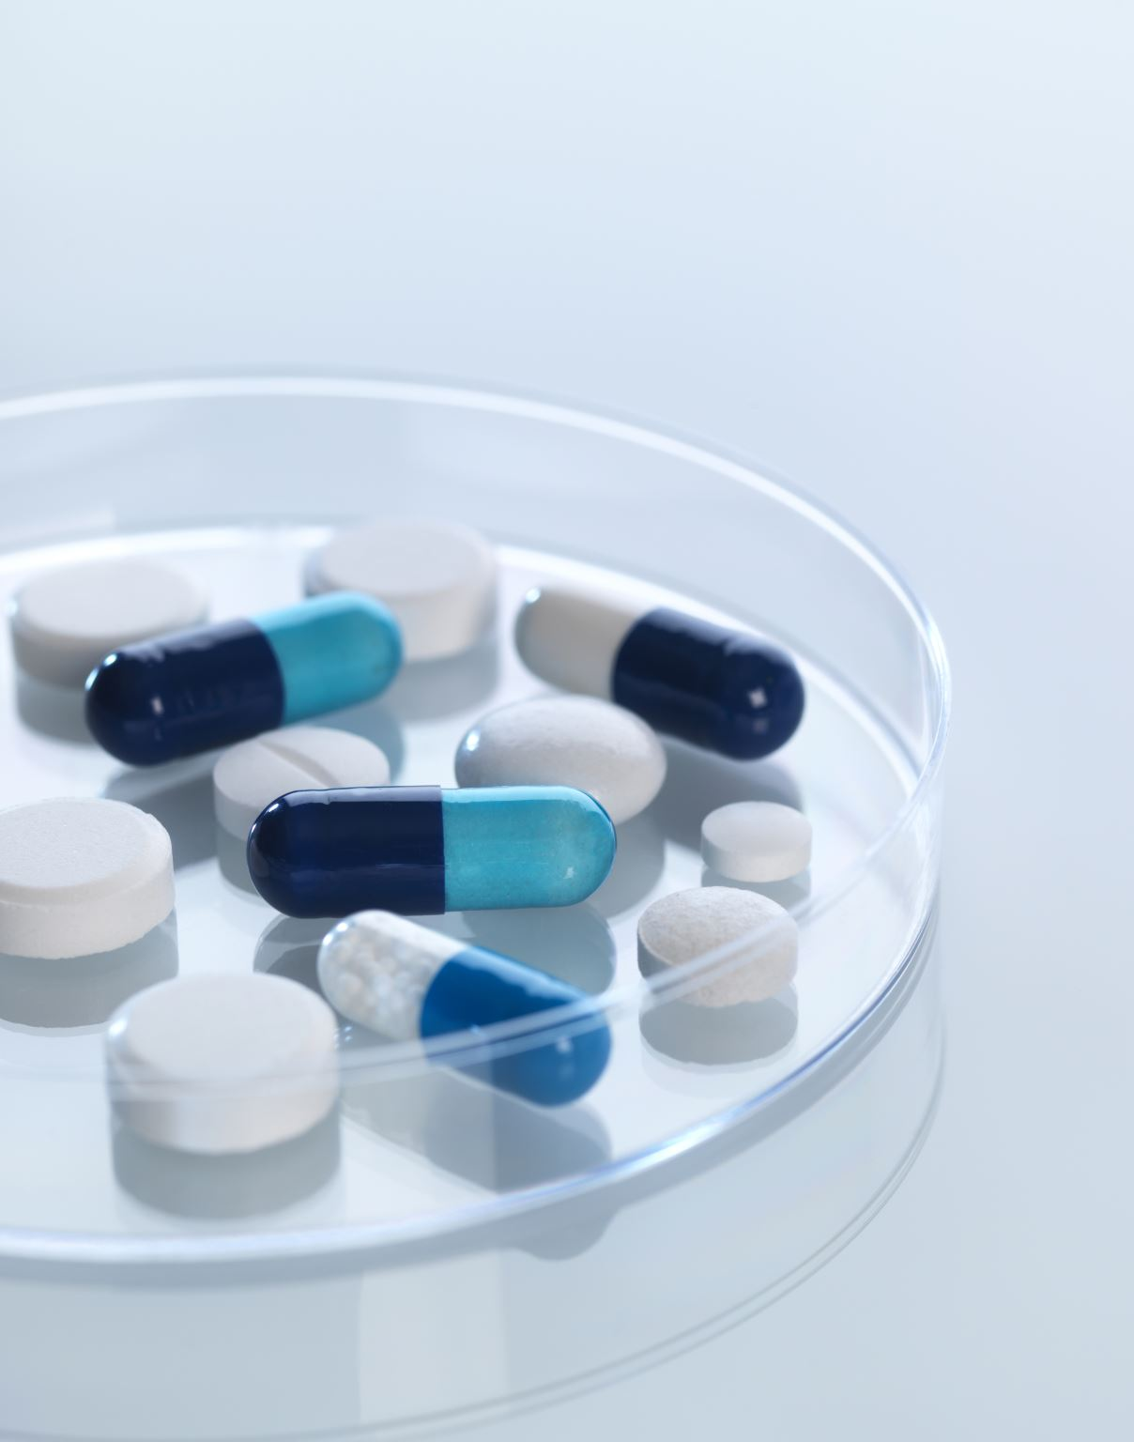
Definition of Conscious Sedation
A technique in which the use of a drug or drugs produces a state of depression of the CNS enabling treatment to be carried out, but during which verbal contact with the patient is maintained throughout the period of sedation. The drugs and techniques used should carry a margin of safety wide enough to render loss of consciousness unlikely.
Conscious Sedation in the Provision of Dental Care. DoH. 2003

Slide 9
The Benzodiazepine Family
It was not until the 1960’s that agents were developed specifically for conscious sedation. At this time, a group of tranquillizing drugs known as the ‘Benzodiazepines’ were discovered in Switzerland by researchers at Hoffman-La Roche. Since then, the benzodiazepines have become the mainstay of modern sedation practice.
Benzodiazepines act throughout the CNS (central nervous system) via the GABA network. Specific benzodiazepine receptors are located close to GABA receptors on neuronal membranes within the brain and spinal cord.
GABA, what is it? ( Gamma-aminobutyric acid ). A system made up of GABA receptors is responsible for filtering or damping down sensory input to the brain.

Slide 10
Benzodiazepine Background
Diazepam was the first benzodiazepine to be used in intravenous sedation practice. This was called (Diazemuls) The organic solvent formulation caused a high incidence of vein damage, ranging from pain to frank thrombophlebitis and even skin ulceration. This type of preparation is no longer used!
Midazolam was introduced into clinical practice in 1983 although it had been synthesized several years previously. It is currently the agent of choice for intravenous sedation in dentistry. Midazolam is a clear liquid, and it is a non irritant to the veins. It is fast acting, has more predicable amnesic properties than diazepam and has a much shorter half life (1-4 hours) meaning that recovery is quicker.
Flumazenil was discovered in 1978; this was a major advance in the practice of intravenous sedation. This is the first drug to effectively and completely reverse the effects of almost all benzodiazepines.
Notes:
Diazemuls had a long recovery period also.

Slide 11
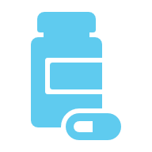
What is a Controlled Drug?
Controlled drugs are medications that are subject to specific regulations to prevent misuse.
Dentists can prescribe these drugs when deemed necessary.
Managing controlled drugs includes, safe administration to patients, secure storage of the drug and safe disposal.
All staff must be trained on how to handle the drugs appropriately to protect both the patients and the dental practice.

Slide 12
Levels of Sedation
Minimal Sedation- Also known as anxiolysis. This is where the patient is conscious and alert but less anxious. This can be achieved with small doses, such as oral premedication.
Moderate Sedation- Also referred to as conscious sedation. This is where verbal contact is maintained, and most reflexes are preserved.
Deep Sedation- The patient retains a degree of responsiveness to pain, but verbal contact is reduced or absent.
General Anaesthesia- This is when the patient is in a full state of complete unconsciousness.

Slide 13
Benzodiazepines
How they work
Anxiolysis
Anticonvulsant
Amnesia
Sedation
Muscle relaxation
No Analgesia
General Anaesthesia (Midazolam)
Notes:
How they work

Slide 14
Benzodiazepines
How they work
Low dose Amnesia
Unpredictable
Most intense for first 20 minutes – 30 minutes
Anterograde

Slide 15
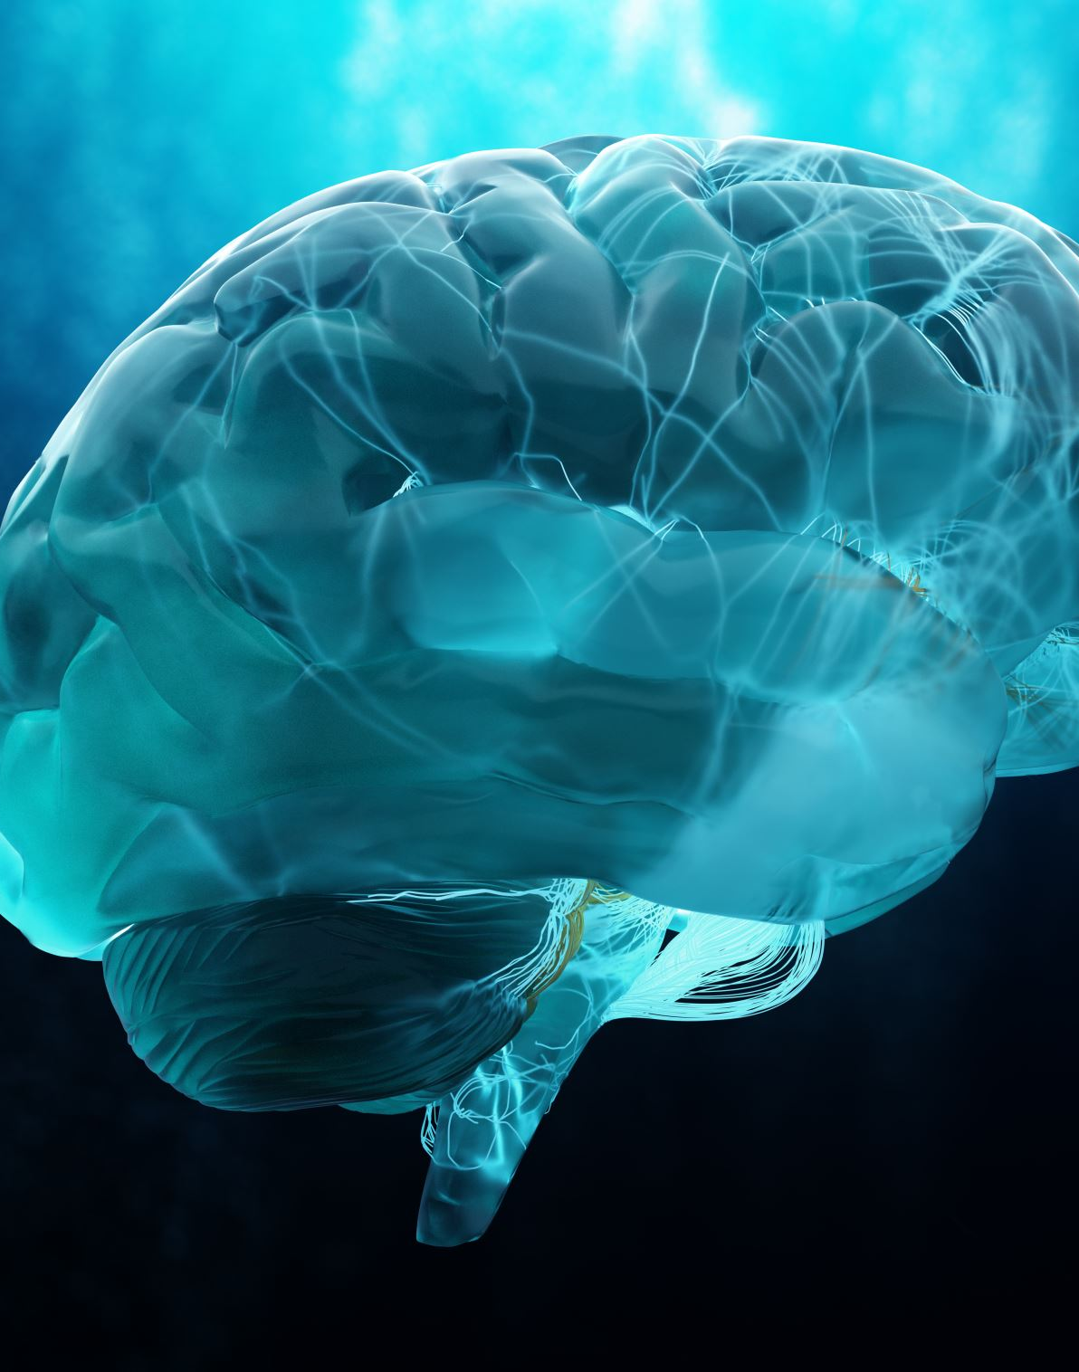
Benzodiazepines
Muscle relaxation
Central effect
Respiratory depression Sedation
Increases with dose
Decreased response to stimuli
Tendency to sleep
Notes:
Midazolam can be used for medical emergencies such as ‘Epilepsy’.

Slide 16
Side Effects from Benzodiazepines
Respiratory depression
Cardiovascular effects
Drug interactions
Sexual Fantasy
Miscellaneous
Hiccoughs,
Coughing,
Headache

Slide 17
Side Effects
Mode of action, this is how the drug interacts with our biological system
Potentiate the effects of GABA
GABA is an inhibitory neurotransmitter
Benzodiazepines bind to their receptor close to the GABA receptor
Notes:
What is GABA? (gamma-aminobutyric acid). It is the primary inhibitory neurotransmitter in the central nervous system. It acts as a natural calming agent by reducing neuronal excitability, blocking nerve signals, and decreasing brain activity. This can lead to effects such as reduced anxiety, stress and fear.

Slide 18
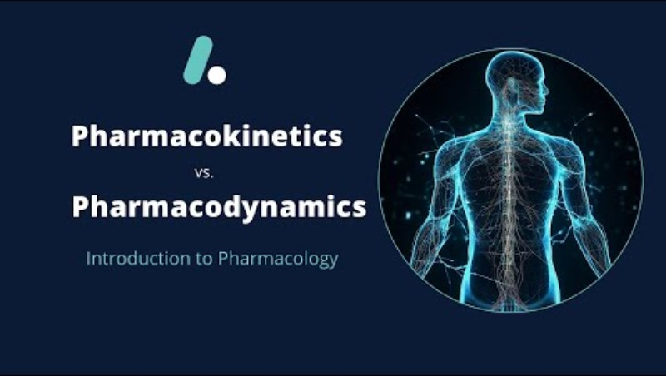
Pharmacokinetic and Pharmacodynamic Effects

Slide 19
Administration by Different Routes
Inhalation: Administered via inhalation, using agents like nitrous oxide.
Oral: Administered directly into the mouth.
Intramuscular (IM): Administered into a muscle.
Intravenous (IV): Administered directly into a vein.
Intranasal (IN): Administered through the nasal cavity.
Sublingual (SL): Administered under the tongue.
Rectal: Administered through the rectum. (Not a normal administration route in dentistry).
These routes allow for various sedation techniques, depending on the patient’s needs and the specific procedure being performed. Not a normal administration route in dentistry.

Slide 20
The effects of benzodiazepines when administered through different routes can vary significantly.
Oral Administration – Benzodiazepines taken orally are metabolised in the liver and can varying effects based on the specific drug individual metabolism
Intravenous Administration – Rapid onset of action
Intramuscular Administration – this can provide a longer duration compared to oral and intravenous routes

Slide 21
Elimination Half-life
What does this mean?
The half-life of a drug is the time it takes for the concentration of the drug in the body to reduce itself by half, which is crucial for determining dosing schedules and understanding how long a drug remains active in the system.
Foe example- if a drug has a half-life of 4 hours, and you start with 100mg, after 4 hours, approximately 50mg will remain in the body. After another 4 hours, this amount will reduce to 25mg and so on.

Slide 22

Factors Affecting the Half-life
Several factors can influence the half-life of a drug including:
Metabolism: How quickly the body processes and eliminates the drug.
Excretion: The efficiency of the kidneys and liver in clearing the drug from the body.
Understanding the half-life of drugs is essential for safe and effective medication management, ensuring that patients receive the correct dosage at appropriate intervals while minimizing the risk of side effects or toxicity.
Notes:
Excretion through urine

Slide 23

What is Midazolam?
Midazolam is a short-acting benzodiazepine frequently used for anaesthesia induction, seizure management, and procedural sedation.
The water-soluble formulation allows for rapid onset and flexible administration routes, including intravenous and intramuscular, making it suitable for managing status epilepticus when intravenous access is limited. (Buccal Midazolam)
Midazolam also provides anxiolysis and hypnosis during the maintenance phase of general anaesthesia and serves as an adjunct to regional and local anaesthesia in various diagnostic and therapeutic procedures.

Slide 24

Midazolam
Mainstay of conscious sedation
Clear liquid
Available in 3 preparations
1mg /ml (5ml amp)
2mg / ml (5ml amp) (no longer used)
5mg / ml (2ml amp) (NEVER!!)
Rapid on set
Reversible

Slide 25
Midazolam
Moderate duration of action
Elimination half life 1-4 hours
Working time 30 - 45 mins
Hydroxylated in liver
Excreted in kidneys
Dose titrated to effect
Notes:
Hydroxylated in liver ( the process of drug hydroxylation can affect how an individual metabolizes the drug, influencing their efficacy and duration of action. Hydroxylation is a chemical process, it adds a hydroxyl group to a molecule typically catalysed by enzymes called hydroxylases.

Slide 26
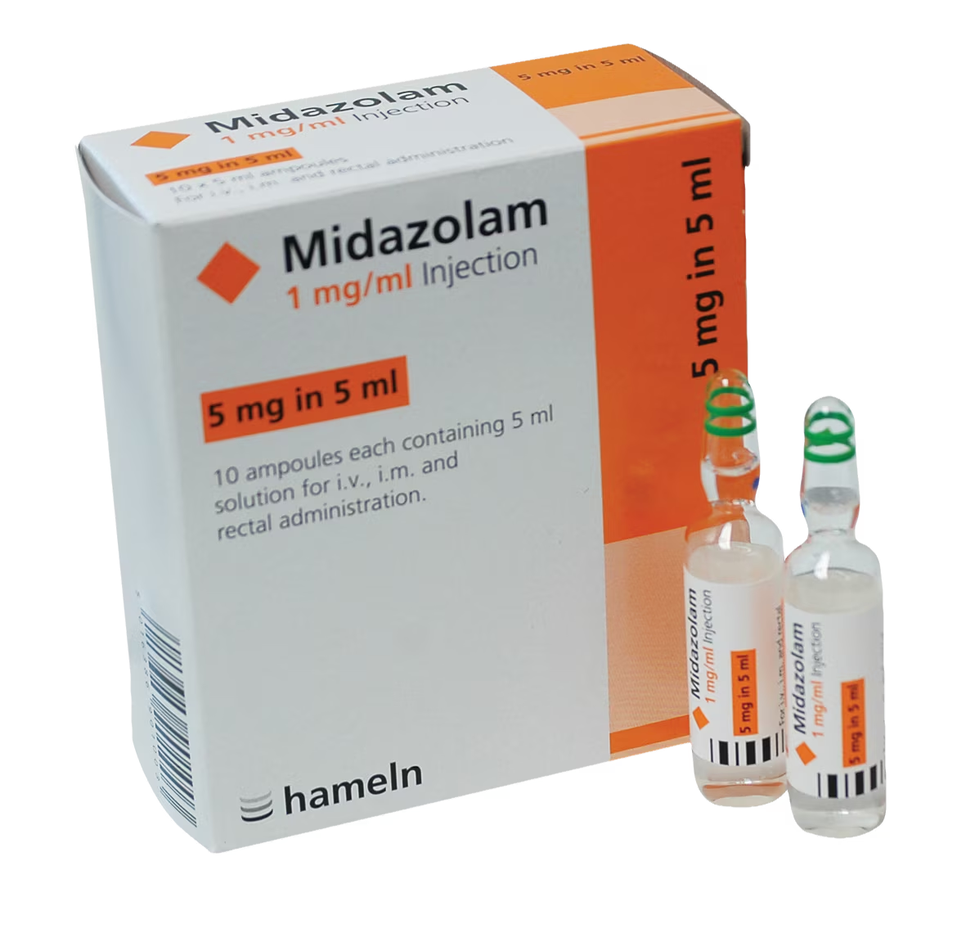
Midazolam

Slide 27
Remimazolam
Approved for use in UK in 2021
Not currently included in the Intercollegiate Advisory Committee for Sedation in Dentistry guidance document
Available as a powder that needs reconstituted
Ultra rapid onset
Rapidly metabolised
Reversible
Notes:
It is new, it is a good idea to know about it and how it works.

Slide 28
Remimazolam
Moderate duration of action
Redistribution half life 0.5 - 2 mins
Elimination half life 35 – 50 mins
Working time 15 - 20 mins
Not used in dentistry
Metabolised by tissue esterases
Excreted in kidneys
Dose titrated to effect

Slide 29
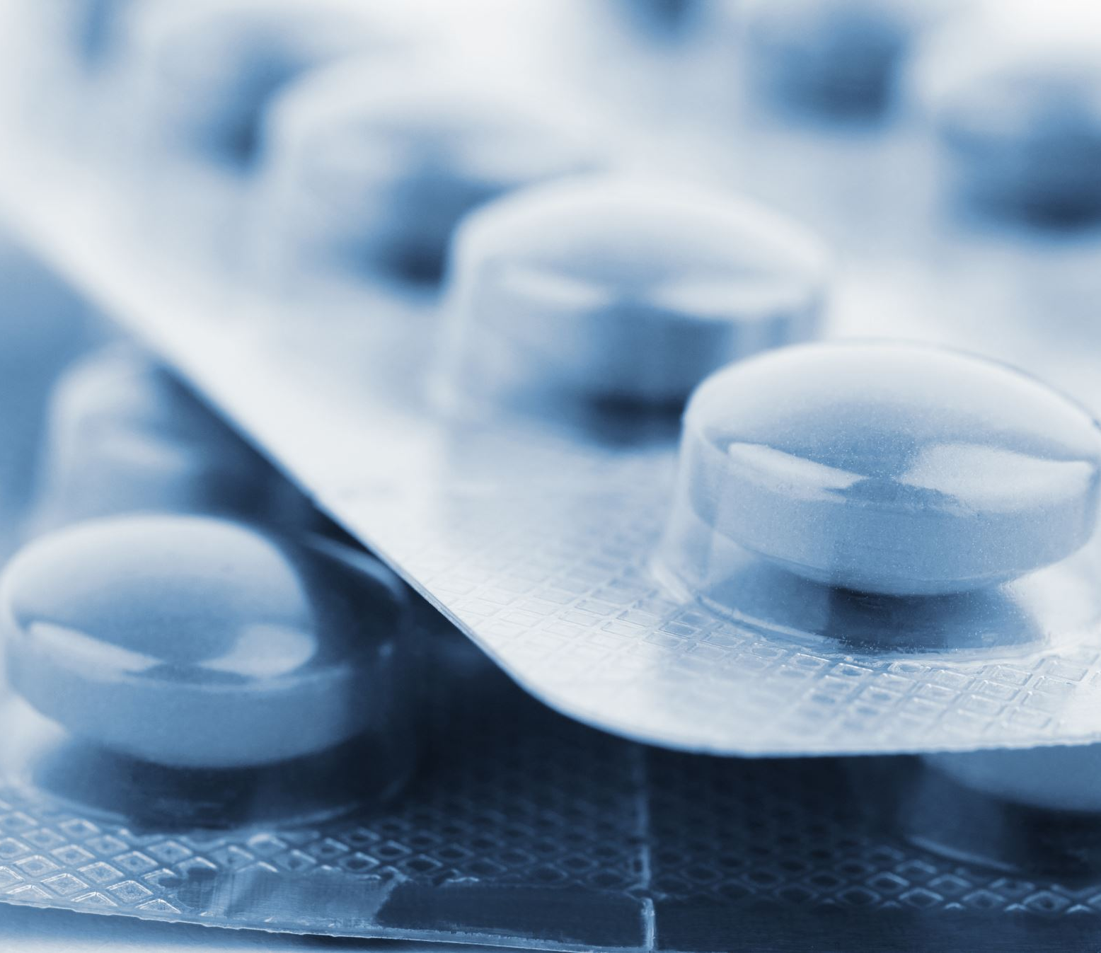
Diazepam
Oral medication
Commonly used as a premed
Usual dose 5-10mg
Slow onset
Unpredictable response
Synergistic with midazolam
Notes:
Synergistic meaning that it will work with midazolam to produce a combined effect greater than the sum of their separate effects, however careful when titrating the midazolam.

Slide 30
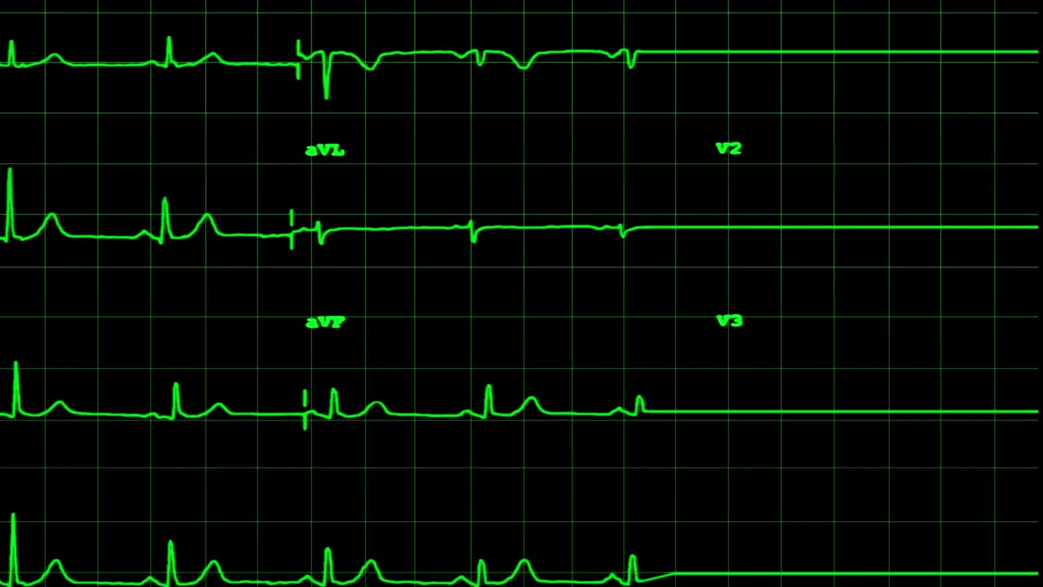
Diazepam
Long duration of action
Peak plasma levels 30 - 90 mins
Plasma half life 20 – 50 hours Long duration of action
Metabolised in liver
Excreted in kidneys
Bolus dose
Notes:
Peak plasma is the highest concentration of a drug in the plasma
Plasma is the liquid part of your blood
Bolus means a single large dose of drug given e.g. the diazepam will be given in tablet form, 10mg one dose

Slide 31
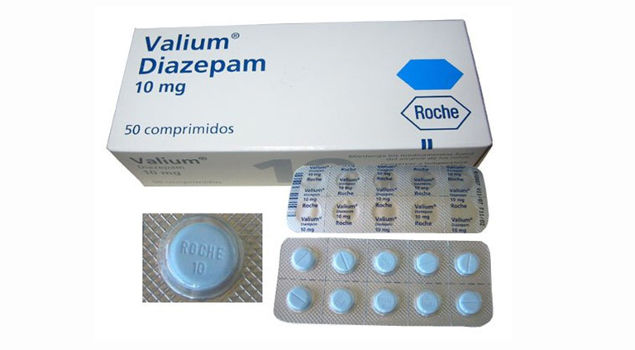
Diazepam

Slide 32
Temazepam
Temazepam was until recently one of the most used oral sedatives.
It was originally marketed as a hypnotic for inducing sleep, but its shorter half-life ( around 4 hours ) makes it ideal for use as a sedative.
Unfortunately, it became one of the most abused drugs as it is highly addictive.
Diazepam is the drug of choice for most dentists.

Slide 33
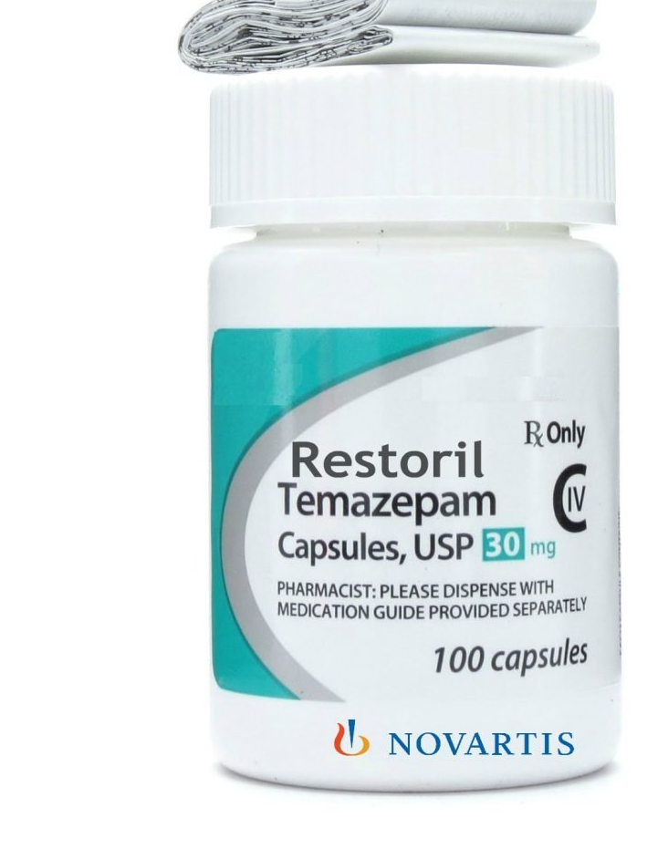
Temazepam
This Photo by Unknown Author is licensed under CC BY-NC-ND

Slide 34

Flumazenil
A benzodiazepine antagonist
No intrinsic activity
50minute half life IV use only , 500ug/5ml amp
Not recommended for routine reversal

Slide 35
Flumazenil, some info on regulations
Reserved for Emergency use only
Incident data suggests frequently used to manage benzodiazepine overdose – NB shorter half life → residual re-sedation
Recommend regular auditing of flumazenil use as marker of excessive dosage of midazolam
Midazolam over-sedation is defined as a “never event” by the DOH, reporting these incidents to the National Reporting and Learning system is Reserved for Emergency use only
Incident data suggests frequently used to manage benzodiazepine overdose – NB shorter half life → residual re-sedation
Recommend regular auditing of flumazenil use as marker of excessive dosage of midazolam
Midazolam over-sedation is defined as a “never event” by the DOH, reporting these incidents to the National Reporting and Learning system is essential

Slide 36
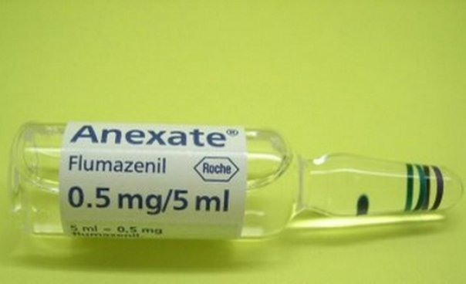
Flumazenil
This Photo by Unknown Author is licensed under CC BY-SA
Notes:
Brand name anexate

Slide 37
Never Events!
Never Events are serious, largely preventable patient safety incidents that should not occur if the available preventative measures have been implemented.
Primary care trusts are required to monitor the occurrence of Never Events within the services they commission and publicly report them on an annual basis.

Slide 38
Midazolam interactions
Alcohol
Amitriptyline
Carbamazepine
Citalopram
Clozapine
Antifungals including fluconazole
Verapamil
Grapefruit juice
Efavirenz/fosamprenavir/nelfinavir (HIV medication)
Certain antibiotics (erythromycin/clarithromycin/rifampicin)
Notes:
Why grapefruit juice? Why CNS drugs? Grapefruit juice inhibits the CYP3A4 enzyme in the intestines and liver, this enzyme is responsible for breaking down midazolam. This will result in an exaggerated effect. Same for CNS drugs….

Slide 39
Time to Think!

Slide 40
Which is the riskiest?
You are working in practice. A patient has attended today for surgical removal of a tooth under IV sedation. Which patient would you be most cautious about and why?
A patient who has been started on antibiotics by his GP for a dental abscess
A patient who has a penicillin allergy and has been started on antibiotics for a periodontal procedure
A patient who has a penicillin allergy and has been started on antibiotics for a dental abscess
A patient with asthma that requires them to take inhalers only when they have a chest infection
Notes:
Asthma…..

Slide 41
How do we manage the risk?
You are working in practice. A patient has attended today for multiple fillings under IV sedation. What risks do we have to manage and how should it be managed?
A patient who has high blood pressure
A patient who has diabetes
A patient who has epilepsy
A patient who is being treated for thrush
A patient being treated for anxiety and depression
Notes:
Which risks should we manage?

Slide 42
Complications
Loss of responsiveness
Reduced oxygen saturation
Snoring
Loss of consciousness
Respiratory arrest
Notes:
Which is the most common complication? How do we manage this?

Slide 43
Loss of responsiveness
Can occur commonly for brief periods
Should be able to be managed by speaking to the patient
Can be a sign of over-sedation
If patient can’t be roused requires continuous monitoring using ABCDE
Can use reversal if a response can’t be elicited or if have concerns about the patient’s vitals

Slide 44
Reduced oxygen saturation
Small reductions can occur commonly
Larger reductions are a sign of over sedation
Most should be managed by speaking to the patient or by stimulating the patient
Oxygen can be provided but can reduce the accuracy of the oxygen saturation monitor

Slide 45
Snoring
Is a sign of over sedation as airway has now partially obstructed
Monitor patient using ABCDE
Can use jaw thrust or head tilt, chin lift

Slide 46
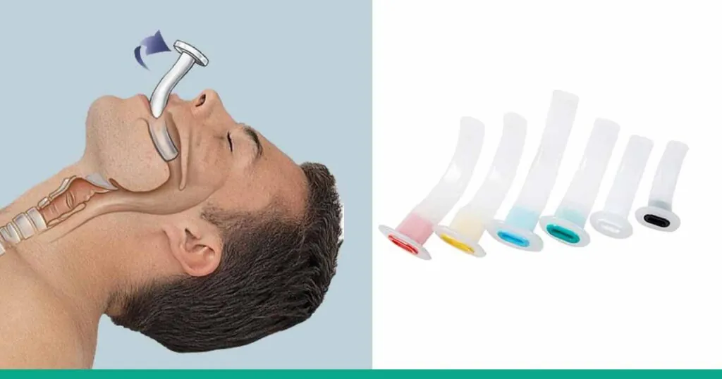
Head tilt, chin lift
Consider use of oropharyngeal airway

Slide 47
Loss of Consciousness
Is a NEVER event in sedation
Unable to rouse the patient
Monitor patient using ABCDE
Provide oxygen
Use reversal agent

Slide 48
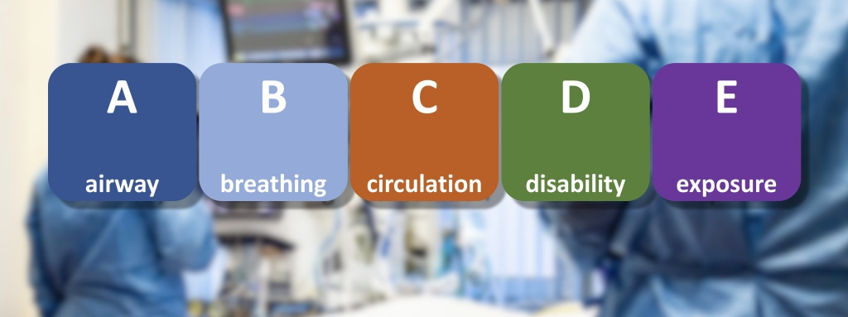
This Photo by Unknown Author is licensed under CC BY
Notes:
Disability, patient unconscious? Exposure, patients' physical appearance?

Slide 49

Respiratory arrest
No signs of breathing but patient still has a pulse
Oxygen will not be useful on its own
Use reversal agent
Reversal can take several minutes so will need to breath for the patient until patient starts breathing again
Reassess patient using ABCDE every 3 minutes
Call for assistance if needed
Notes:
ILS training is an essential requirement, complete training annually.

Slide 50
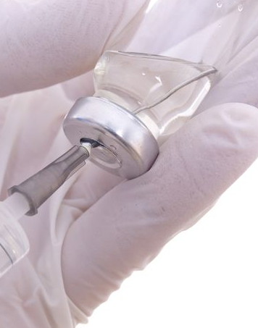
Practical

Slide 51

Questions?

