Slide 1





ROC Guidance & Audit
Saturday 4th October
3.15- 4.30
Helen McGreevy

Slide 2
GDC Outcomes
GDC Development Outcome C
NEBDN Conscious Sedation for Dental Nurses 1.8.1, 1.8.2, 1.8.3, 1.8.4 & 1.8.5

Slide 3
Aims
To understand what is expected of you to meet the NEBDN requirements.
To understand audit.
To understand your ROC.

Slide 4
Objectives
The principles of internal and external quality assurance
The audit process
Have involvement in the completion of the audit process
Demonstrate improvement as the result of the audit
Recognise the benefit of audit to patient care and individual performance

Slide 5
The Principles of Quality Assurance
The principles of internal and external quality assurance in healthcare are essential for ensuring the delivery of high-quality care. Below are the key principles:
CONSISTENCY AND FAIRNESS: Internal quality assurance activities must be conducted consistently, safely and fairly to ensure that all processes meet the required standards.

Slide 6
The Principles of Quality Assurance
COMPLIANCE AND IMPROVEMENT: External quality assurance should not only ensure compliance with the awarding organisation and regulatory requirements but also support the continuous improvement of the services provided to the public.
SUPPORT AND GUIDANCE: External quality assurers should provide support and guidance to all staff to help them improve and maintain the quality of their services.

Slide 7
The Principles of Quality Assurance
DATA AND INTELLIGENCE: Utilising intelligence and data to inform assessment and improve quality assurances processes is crucial.
REGULATORY COMPLIANCE: Ensuring that all activities comply with relevant regulations and standards is a fundamental aspect of quality assurance.
These principles are designed to help healthcare providers deliver the best possible care and outcomes for their patients.

Slide 8
General Dental Council Standards
The General Dental council standards state that:
7.1 You must provide good quality care based on current evidence and authoritative guidance
7.2 You must work within your knowledge, skills, professional competence and abilities
7.3 You must update and develop your professional knowledge and skills throughout your working life”
Carrying out clinical audits within practice will help the dental team to demonstrate that these standards are being met.

Slide 9
The Audit Cycle
Bucknall et al (1992) describe the audit cycle as a spiral, as the aim of a clinical audit is to evolve and not end up where you began.
It is not a cycle. In healthcare, audit encourages a rise in standards and should be reviewed and repeated to improve standards as healthcare is always evolving.
The audit spiral: Measures performance against prescribed standards. Is change required?
If so, perform a root cause analysis to ascertain any underlying cause or the problem.
Draw up an action plan and decide who will implement it.
Make changes.
Re‐measure.
Repeat with any necessary adjustments for new developments.

Slide 10
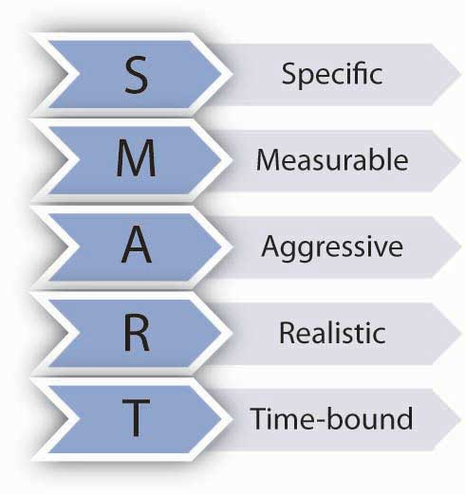
Writing Audit Standards
Standards should be SMART. Specific – Clear, unambiguous and jargon-free.
A standard should only mean one thing to all people who read them.

Slide 11
Involvement in Clinical Audit
Involvement is crucial for improving patient care and outcomes. Below I have outlined a few key points for you to consider:
Patient engagement, this helps ensure that what is being measured matters to patients.
Team structure, they should be involved from the start of the audit process.
Best Practice, involve a structured approach to ensure that audit findings are acted upon and sustained.
Framework and Policy, establishing a clear framework and policy for clinical audits helps maintain a culture of best practice within your organisation.

Slide 12
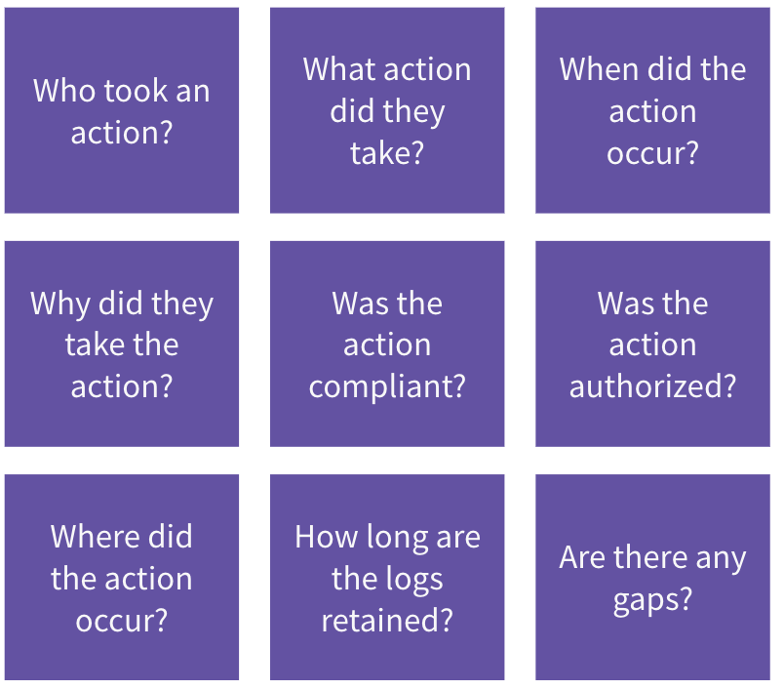
Audit Involvement

Slide 13

Demonstrate Improvement
Identifying area for improvement.
Implementing changes.
Regular Auditing.
Collaborative efforts.
Data collection, this is crucial for the audit process ensuring that the process is valid and reliable without too many variables. By following these steps and outcomes, you can then demonstrate improvement in patient care and outcomes through the audit process.

Slide 14
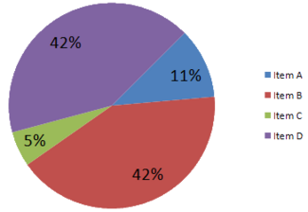
Use a graph or pie chart for your results

Slide 15
Benefits of Audit
Regular audits ensure that care services maintain high standards and individual performance is consistently high.
Regular audits help address issues proactively.
This will enhance compliance and strengthen reputation.

Slide 16

Questions?

Slide 17
Record of Competence
Practical Competence Assessment Sheets x 35
Directly Observed Clinical Skills x 60
Case Study x 2
Supplementary Outcomes x 9
Let’s use this time to discuss what is required of you to meet the requirements.

Slide 18
PCAS
35 to be completed

Slide 19
What are the requirements?
Treatment PCAS: Focus on the patient’s dental and medical history, use brief notes and ensure findings have relevance to treatment under conscious sedation.
Recovery PCAS: This can be a grey area, remember to comment on the patient’s clinical features such as level of consciousness, colour, signs of distress etc.

Slide 20
PCAS
Observations: ensure appropriate units and required observations are recorded. IV patients must include values for heart rate, oxygen saturation and blood pressure. We advise you take as many of the different observations as possible. For patients having treatment under inhalation sedation a measure of respiratory rate is required.
Difficulties: remember to include problems that have occurred, these must be noted, and you could reflect on how you will improve your future performance in your PDP.

Slide 21
Directly Observed Clinical Skills
60 to be completed
Refer to student guide for the requirements of which clinical skills that need to be assessed.

Slide 22
Expanded Case Studies
You can use patient’s that have already been included in your PCAS.
Please include:
Source of patient referral
Patient’s presenting complaint
History of the presenting complaint
Relevant medical history
Relevant dental history
General and social circumstances

Slide 23
ECS
Contacts with other disciplines, not relevant in all cases
Patient assessment, treatment plan
Why does the patient require sedation?
Possible difficulties to be considered before providing treatment including medico-legal
Which sedation technique is being used?
Preparation of the environment and the patient
Monitoring and support provided during the administration of the sedation

Slide 24
ECS
Pharmacology/ drugs administered
Recovery of patient
Difficulties incurred? Not always the case
Arrangements for follow up care
Conclusion, remember to include your reflection

Slide 25

Supplementary Outcomes
You have nine to complete!

Slide 26
Supplementary Outcome 1, Immediate Life Support
You will need to provide evidence that you can assist during the initial management for medical emergencies including cardiac arrest. All members of the sedation team should have annual training and evidence of competence in core rescue skills relevant to the patient being managed.
Your training must confirm that you are competent in the following:
BLS, including assessment, compressions and ventilation
Automated external defibrillation
Use of airway adjuncts including airways, pocket masks and bag valve mask devices
Use of oxygen

Slide 27
Paediatric skills or Adult?
This will depend on what reflects your area of practice.
The copy of your certificate must be signed and dated by a witness who has seen the original certificate.
Your training must conform to all the criteria.
The certificate must be certified by a professional registrant to confirm it is a genuine copy, please ensure that it has been signed, dated, name printed and has your registration number.

Slide 28
Supplementary Outcome 2, Sedation Equipment
Please complete this table listing all pieces of equipment that your practice uses in relation to conscious sedation.
E.g. If you have an inhalation machine, please include the manufacturer and model, the type of breathing system/ nasal hood being used and the type of scavenging being used.
Remember to include the defibrillator, pulse oximeter and automatic blood pressure machine.

Slide 29
Supplementary Outcome 3, Emergency Drugs
Please complete the table. We would expect the minimum to be:
Adrenaline injection ( in 1000)
Aspirin Dispersible tablets (300mg)
Glucagon Injection (1mg unit)
Glucose for administration by mouth
Glyceryl Trinitrate Spray
Midazolam Buccal liquid (10mg/ml) or Midazolam injection for buccal administration (5mg/ml)
Oxygen
Salbutamol Inhaler
Flumazenil
Remember to include what these drugs are used for!

Slide 30
Supplementary Outcome 4, National Guidance on Conscious sedation in Dentistry
Please refer to links provided.
Options for care: Behavioural management, Behavioural therapy, Conscious sedation & General anaesthesia.
Consent for dental treatment: Patients who are already sedated, Children under 16 who are not deemed legally compliant, patient lacks capacity, Consent on the day would not usually be appropriate.
Recovery, discharge and aftercare: Refer to link

Slide 31
Supplementary Outcome 4
Consent for dental treatment: where consent would not be deemed valid: the patient is orientated in time, place and person.
Pain and discomfort have been addressed.
Vital signs are stable and within normal limits for the patient. Respiratory status is not compromised.
Where relevant, haemostasis has been achieved.
The cannula, where inserted, has been removed.
The responsible escort is present, and arrangements have been made for supervision as advised by the seditionist.
Written and verbal post-op instructions have been given to the patient and escort.

Slide 32
Supplementary Outcome 4
Training in Conscious Sedation: Maintain a log of all sedation cases to demonstrate clinical practice.
Undertake regular, relevant, verifiable continuing professional development.
Conduct regular sedation-based audit and reflection.
Maintain competence in the management of medical, dental and sedation-related complications

Slide 33
Supplementary Outcome 5
Ethical Dilemma!
Legal considerations: refer to GDC requirement that written evidence of consent is required for all procedures were consciousness is affected.
Maybe involve the patients husband?
Clinical considerations: the cannulation has been difficult but successful; this procedure may be harder in the future.
The treatment has already been identified as an emergency; re-appointing will inevitably delay treatment and lead to further pain.

Slide 34
Supplementary Outcome 5
How will we deal with this dilemma?
Allow the patient to recover and reappoint, hoping co-operation remains to re-cannulate?
Allow the patient to recover without further treatment. Consent and re-sedate. This would clearly depend on the available clinical time, but the cannula would not need to be replaced.
Consider a reversible option to control pain, e.g. temporary dressing and place under a best interest decision or section 47 certificate. ( Scotland)
Complete treatment under a best interest decision involving the patient’s husband and referring to a verbal and implied consent prior to the treatment.

Slide 35

Supplementary Outcome 6 Audit

Slide 36
How do I complete my Audit?
Set your standards
Design your questionnaire
Results, these must be clear, and you should state whether you have met your targets
Reflection
Audit plan for repeat, how often?

Slide 37
Supplementary Outcome 7
Advantages of Intravenous Sedation Techniques:
Over sedation unlikely
Midazolam is not painful on injection
Cannula is in place in the event of an emergency
Titrated against response so correct level of sedation is reached
Midazolam can be reversed quickly if required
No mask over patient’s nose limiting oral access
No risk of staff becoming sedated

Slide 38
Supplementary Outcome 7
Disadvantages of Intravenous Sedation Techniques:
Requires cannula, may be difficult for needle phobia
Drugs may cause respiratory depression
Propofol is painful on injection
Drugs can cause loss of inhibition
Pulse oximeter must be purchased and maintained
Some techniques require a separate seditionist
Unsuitable for children in general practice
Controlled drugs need to be stored correctly

Slide 39
Supplementary Outcome 8
Reflective practice: It is vital that you reflect on new, challenging or interesting experiences.
Reflective practice 1: Start of training
Reflective Practice 2: End of training

Slide 40
Supplementary Outcome 9
Record of relevant continuing professional development and personal development plan:
Please include a summary of your CPD you have undertaken in the last 12 months which is relevant to a dental sedation nurse.
Begin your personal development plan towards the end of this course relating to your field of practice in this qualification.

Slide 41

Questions?

