Slide 1



National Certificate in Dental Sedation Nursing.
Revision
Saturday 21st February
9.30 – 1.00pm
Helen McGreevy

Slide 2
Exam Revision
Reasons for the provision of Sedation
Role of the Sedation Dental Nurse
The history of pain and anxiety control in Dentistry
Patient Assessment
Pharmacology
Anatomy and Physiology
IHS Sedation

Slide 3

Aims
Revision of NEBDN syllabus for Dental Sedation Nursing
Revision of mock exam, answers explained
Mock exam/ past papers

Slide 4
GDC Outcomes
GDC Development Outcome C
NEBDN Conscious Sedation for Dental Nurses

Slide 5
Why do we provide Sedation?
Anxiety and Phobia
Physiological Reasons
Complex Dental treatment

Slide 6
Anxiety
What is Anxiety?
What might cause a patient to be anxious?
What feelings and experiences might they show when anxious?
Can you think of two things that a patient's fear can be associated with?
What is the reason for a patient’s raised heart rate?

Slide 7
Anxiety answers
Memories, bad experiences, a state of unease.
Being worried, frightened or concerned about dental treatment.
A raised heart rate, fluttering in stomach, sweaty palms.
Fear of the unknown. Pain. Claustrophobia. Trusting another to take care of them
When pain or anxiety is experienced, it can lead to the sympathetic nervous system over reacting. This will lead to a raised heart rate and raised blood pressure.

Slide 8
Phobia
Explain what Phobia means
If a patient became dentally phobic when would this commonly start in their life?
Why might this patient be dentally phobic?
How might this patient respond when attending your surgery?
State one thing that a dental phobic patient is concerned about?

Slide 9
Answers
Phobias are abnormal, deep-rooted, long-lasting fears of something that rarely goes away.
In childhood or adolescence.
Parents phobias can be transferred to the child. Some phobias can occur on their own without a rationale explanation.
They would tense their muscles and could become unco-operative.
Dental injections and sometimes the handpiece.

Slide 10
Understand and Assess Dental Fear
Reassurance
Explanation and information
Uncertainty
Notes:
Reassurance about their fears can help to establish trust and rapport between clinician and patient.
Explanation and information
Good communication leads to successful patient management
Uncertainty is the basis of many fears
Anxiety is fed by uncertainty
When not enough time spent on explaining procedure, potential discomfort, length of treatment time, cost

Slide 11
Patient Management Techniques
Behaviour management
Behavioural therapy
Conscious sedation
General anaesthesia

Slide 12
Options for care
Conscious sedation is not a substitute for effective behaviour management and local analgesia
Under 12s – behaviour management / LA or LA plus inhalation sedation
12–16-year-olds – LA plus Midazolam (all routes)
Referral
.

Slide 13
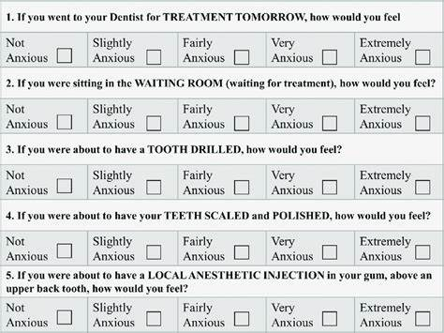
The Modified Dental Anxiety Scale
.
Notes:
Handout – fill it in and assess yourself

Slide 14
Role of the Dental Nurse
Why must an appropriately trained person be available in the dental surgery when any form of conscious sedation is provided?
Why is it important for the sedation nurse to prepare all items required for the treatment prior to the appointment?
State the equipment needed when the patient is receiving dental treatment with intravenous sedation.
State the equipment needed when the patient is receiving dental treatment with inhalation sedation.

Slide 15
Answers
To meet the GC guidelines.
To allow safe treatment to be received, everything that is required must be available and checked that it is in working order and that the clinian is not left unsupervised.
Tourniquet, Medi-wipe, cannula, either a 22-gauge Venflon or, a Y-can, two 23 gauge drawing up needles, a 5ml sodium chloride flush, a 2ml sterile syringe with a sodium chloride label placed, a 5ml syringe with midazolam label, ampoule of midazolam, ampoule of flumazenil together with a syringe and 23 gauge drawing up needle. The emergency drugs and equipment should also be available along with a blood pressure monitor, pulse oximeter.

Slide 16
Answers
A relative analgesia machine, whether it is a mobile machine or a piped system. It will be checked to ensure it is safe for use. A scavenging system will be attached and functional along with a range of nasal masks. The emergency drugs and equipment should also be available along with the patient’s notes, signed consent forms and any radiographs. (This applies to IV pt also)
Always ensure good ventilation is being provided within the surgery.

Slide 17
Sedation Nurse Roles
Assist with sedation
Monitoring
Assist with dental treatment
Chaperone
Assist in case of emergency
Notes:
How many sedation roles did you think of?

Slide 18
Role of Sedation Nurse in an emergency
Emergency drugs and equipment: Access
Spot an unwell patient and inform dentist
Administer oxygen
Monitor unwell or collapsed patient
Manage a faint
Help an unwell patient to administer their prescribed drugs
Prepare emergency drugs at request of dentist
Initiate and perform BLS with or without a dentist
Manage a choking patient
Liaise with paramedics

Slide 19
Assisting with sedation
Preparation
Drugs
Sedation equipment including monitoring equipment
Cannulation
Dental equipment and materials etc
Informed consent
Documentation
Notes:
Handout - checklist of DN duties when preparing for and assisting with Sedation
Use the textbook (P209)
Notes

Slide 20

Monitoring
Clinical
Mechanical
Continuous
Ability to quickly respond to changes
Notes:
What is clinical monitoring? Observation
What is mechanical monitoring? Pulse oximeter, BP etc
What is continuous monitoring?
Quick response
More later in the course

Slide 21
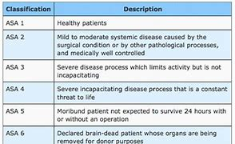
ASA Physical Status Scale
.
Notes:
Textbook page 169 - 170
The American Society of Anaesthesiologists (ASA) physical Status Scale
An assessment tool
To classify patients in terms of the risks that their medical history poses when being treated under sedation
ASA 1 & 2 – suitable for for treatment under sedation in GP
ASA 3 & 4 – should receive treatment in specialist unit or hospital
Age – Caution in very young or elderly patients. Young = unpredictable response & immature personalities Elderly –possible hightened sensitivity to sedative / reduced ability to metabolise drug – care must be taken to titrate slowly in small increments to avoid risk of overdose.
Pregnancy – avoid wherever possible. Precautions in breast feeding mothers – drug may be secreted in breast milk.
Cardiovascular / respiratory disease (significant) = sedation contraindicated.
Asthma / angina / hypertension = may be benefits to treating under sedation if anxiety aggravates their condition
Liver & kidney disease = drug abusers / alcoholics' renal & hepatic (liver) function may be impaired. May self-administer pre-meds
Psychological / psychiatric disease = may be unpredictable – medications may interact with sedatives
Obesity = may be difficult to cannulate. BMI over 25 may not be suitable. May be airway management & patient handling problems.
Severely underweight = may be malnourished

Slide 22
Blood Pressure Assessment
Blood Pressure | ASA Class
Less than 140/90 | I
140/90 - 159/94 | II
160/95 - 199/114 | III
Over 200/115 | IV
.

Slide 23
Patient's Appearance
Observe the patient
Monitor the patient
Share your observations
Remember that if a patient looks unwell, they usually are!.

Slide 24
Consent
The patient is given clear and comprehensive information
Valid consent
Confirmed in writing
Usually not appropriate to be given on the day
Should be confirmed on the day of the treatment
Notes:
More on Medico-legal aspects of sedation later in the course

Slide 25
Pre-operative Instructions
Confirmation of the treatment plan
Confirmation of the effect of sedation (not GA)
Confirmation that informed consent is signed
Any pre-medication and any other medications are prescribed
Confirm that escort and care at home is in place
Pre and post written sedation instructions are given
Answer any questions that the patient may have
Notes:
Handouts for IV & IS

Slide 26
Written Records
Assessment record
Record of consent
Pre-sedation information sheet
Post-sedation information sheet
Monitoring record
Discharge sheet
What is required?

Slide 27
Pharmacology Revision

Slide 28
The Benzodiazepine Family
It was not until the 1960’s that agents were developed specifically for conscious sedation. At this time, a group of tranquillizing drugs known as the ‘Benzodiazepines’ were discovered in Switzerland by researchers at Hoffman-La Roche. Since then, the benzodiazepines have become the mainstay of modern sedation practice.
Benzodiazepines act throughout the CNS (central nervous system) via the GABA network. Specific benzodiazepine receptors are located close to GABA receptors on neuronal membranes within the brain and spinal cord.
GABA, what is it? ( Gamma-aminobutyric acid ). A system made up of GABA receptors is responsible for filtering or damping down sensory input to the brain.

Slide 29
Benzodiazepines
How they work
Anxiolysis
Anticonvulsant
Amnesia
Sedation
Muscle relaxation
No Analgesia
General Anaesthesia (Midazolam)
Notes:
How they work

Slide 30
Benzodiazepines
How they work
Low dose Amnesia
Unpredictable
Most intense for first 20 minutes – 30 minutes
Anterograde

Slide 31
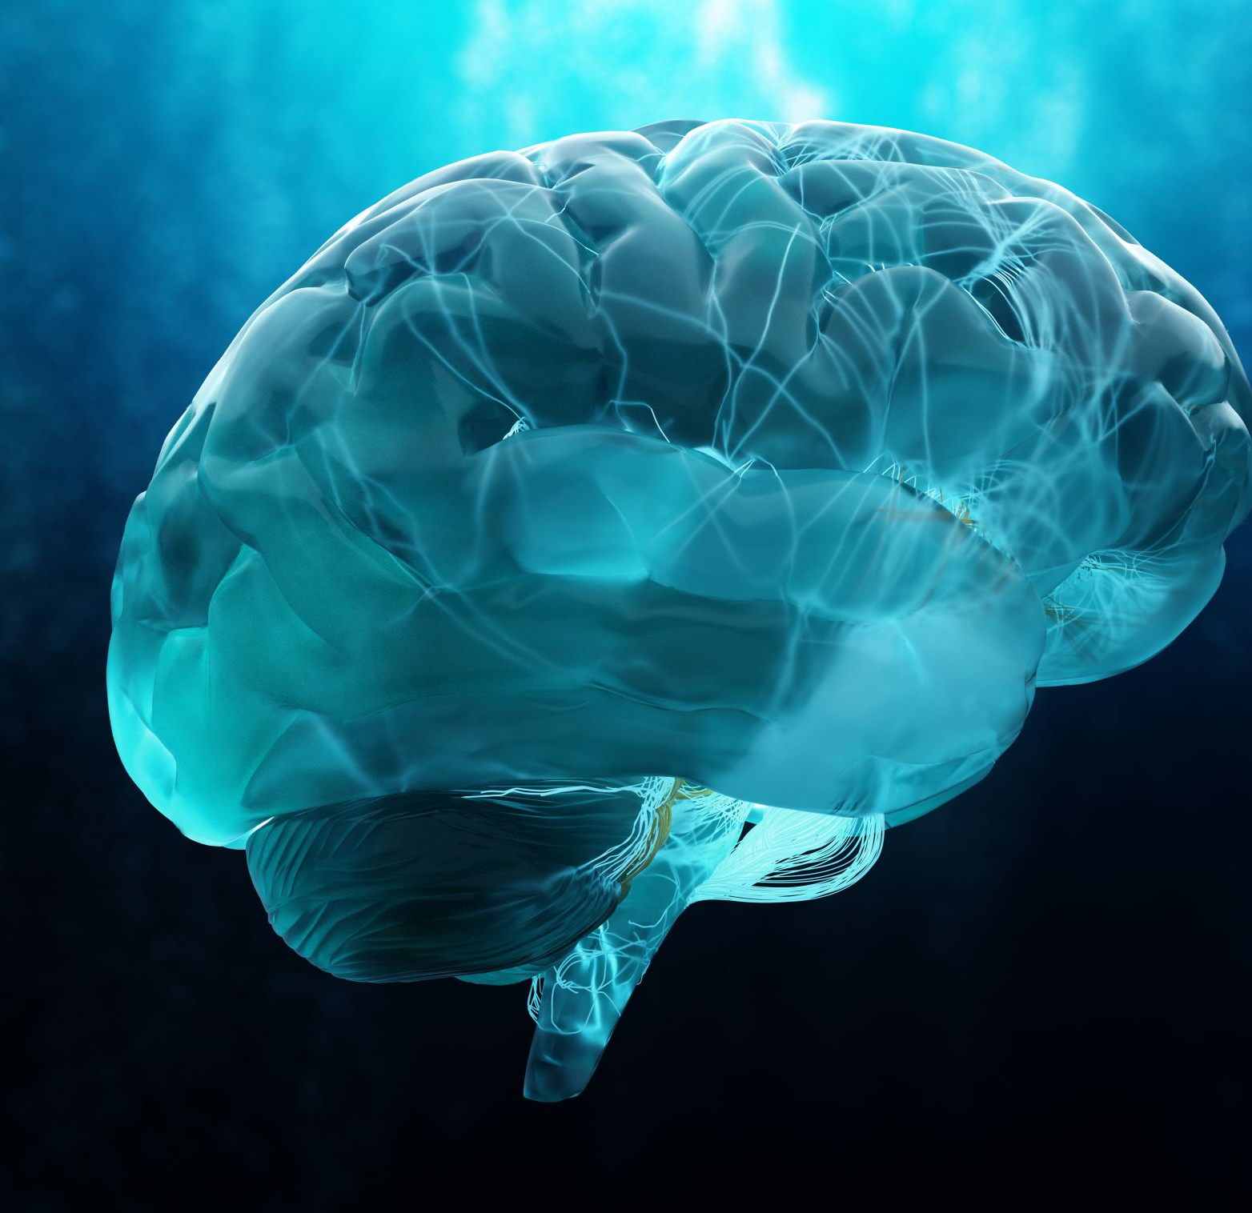
Benzodiazepines
Muscle relaxation
Central effect
Respiratory depression Sedation
Increases with dose
Decreased response to stimuli
Tendency to sleep
Notes:
Midazolam can be used for medical emergencies such as ‘Epilepsy’.

Slide 32
Side Effects from Benzodiazepines
Respiratory depression
Cardiovascular effects
Drug interactions
Sexual Fantasy
Miscellaneous
Hiccoughs,
Coughing,
Headache

Slide 33
Administration by Different Routes
Inhalation: Administered via inhalation, using agents like nitrous oxide.
Oral: Administered directly into the mouth.
Intramuscular (IM): Administered into a muscle.
Intravenous (IV): Administered directly into a vein.
Intranasal (IN): Administered through the nasal cavity.
Sublingual (SL): Administered under the tongue.
Rectal: Administered through the rectum. (Not a normal administration route in dentistry).
These routes allow for various sedation techniques, depending on the patient’s needs and the specific procedure being performed. Not a normal administration route in dentistry.

Slide 34
The effects of benzodiazepines when administered through different routes can vary significantly.
Oral Administration – Benzodiazepines taken orally are metabolised in the liver and can varying effects based on the specific drug individual metabolism
Intravenous Administration – Rapid onset of action
Intramuscular Administration – this can provide a longer duration compared to oral and intravenous routes

Slide 35
Midazolam Revision

Slide 36

What is Midazolam?
Midazolam is a short-acting benzodiazepine frequently used for anaesthesia induction, seizure management, and procedural sedation.
The water-soluble formulation allows for rapid onset and flexible administration routes, including intravenous and intramuscular, making it suitable for managing status epilepticus when intravenous access is limited. (Buccal Midazolam)
Midazolam also provides anxiolysis and hypnosis during the maintenance phase of general anaesthesia and serves as an adjunct to regional and local anaesthesia in various diagnostic and therapeutic procedures.

Slide 37
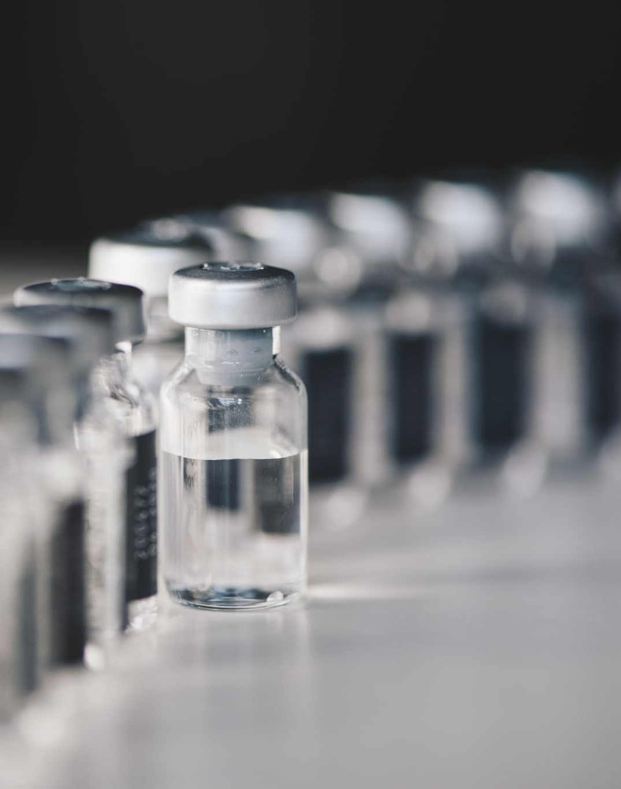
Midazolam
Mainstay of conscious sedation
Clear liquid
Available in 3 preparations
1mg /ml (5ml amp)
2mg / ml (5ml amp) (no longer used)
5mg / ml (2ml amp) (NEVER!!)
Rapid on set
Reversible

Slide 38
Midazolam
Moderate duration of action
Elimination half life 1-4 hours
Working time 30 - 45 mins
Hydroxylated in liver
Excreted in kidneys
Dose titrated to effect
Notes:
Hydroxylated in liver ( the process of drug hydroxylation can affect how an individual metabolizes the drug, influencing their efficacy and duration of action. Hydroxylation is a chemical process, it adds a hydroxyl group to a molecule typically catalysed by enzymes called hydroxylases.

Slide 39
Half life
Benzodiazepines have two stages which form their half-life and comprise the following:
ALPHA: distribution and redistribution. This is where the drug is introduced into the body, taken to the brain and then redistributed to other areas of the body.
BETA: metabolism and excretion. This is where the drug is broken down by the body and eliminated.

Slide 40
The distribution (alpha) half-life of midazolam is 4-18 MINUTES, with the elimination (beta) half-life being 1-4 hours.

Slide 41
Approximately 5mg of the drug will be eliminated from the body within 5 hours.
Notes:
Elderly and adolescents, the elimination half-life is longer. Liver blood flow decreases with age. Liver in teenagers is still developing.

Slide 42
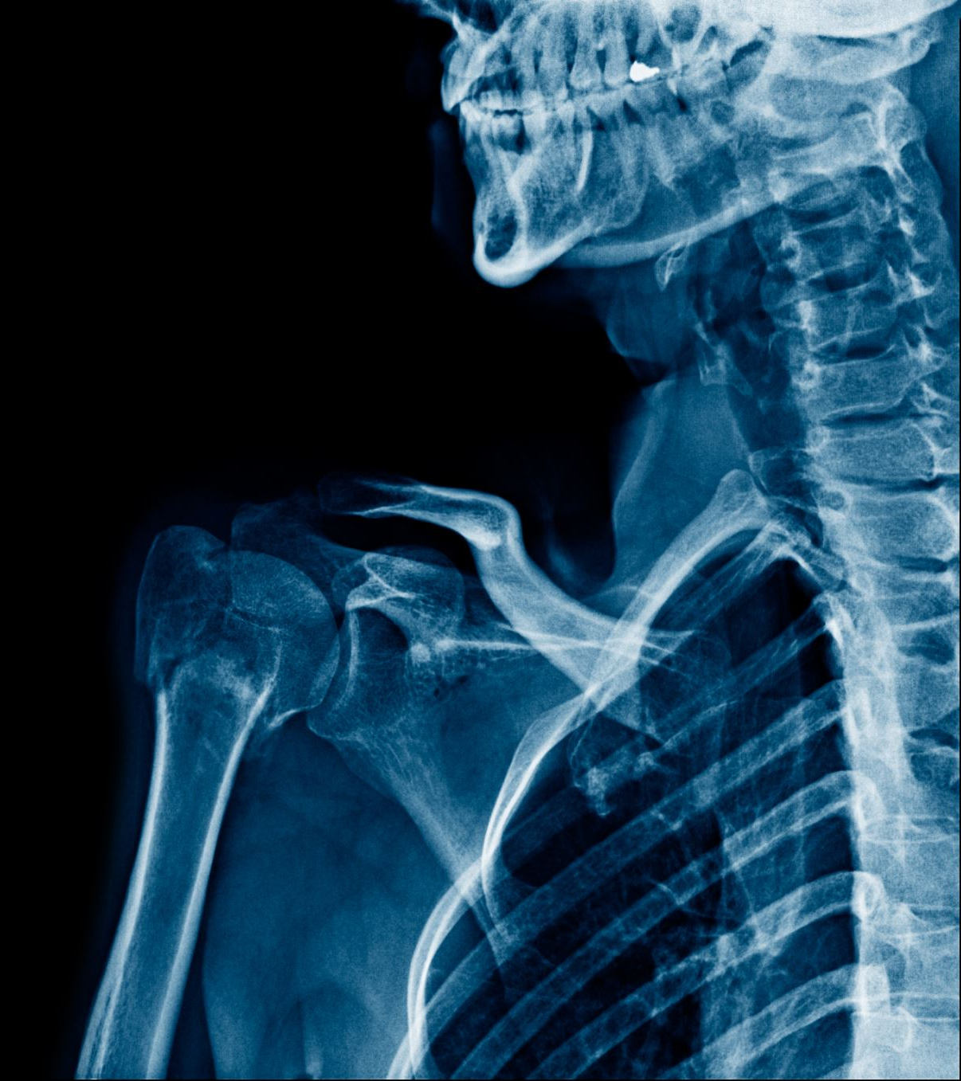
Anatomy and Physiology
Revision Questions

Slide 43
Questions
Into which heart chamber does
blood from the body arrive?
Blood in the aorta comes from which chamber of the heart?
Name the blood vessels which supply the heart muscle itself:
Name the very small blood vessels which usually connect arteries with veins:
What are the 2 components of
blood pressure called?

Slide 44
Questions
Into which heart chamber does
blood from the body arrive?
Blood in the aorta comes from which chamber of the heart?
Name the blood vessels which supply the heart muscle itself:
Name the very small blood vessels which usually connect arteries with veins:
What are the 2 components of
blood pressure called?
Right atrium
Left ventricle
Coronary arteries
Capillaries
Systolic / Diastolic

Slide 45
Questions
What is the name of the small sacs in the lung where gas exchange takes place?
How does the diaphragm enable
breathing?
Which nerves controls the diaphragm?
What is the pathological term which includes chronic bronchitis and emphysema?
Intravenous sedation is safe in patients with COPD: True or False?
Alveoli
Contraction causes it to flatten, increasing the volume of the thoracic cavity, and drawing air in (inspiration)
Phrenic nerves (from the neck)
Chronic obstructive pulmonary
disease (COPD)
False, sedation should usually be avoided in patients with COPD in primary care

Slide 46
Questions
A patient has a resting blood pressure of 145/95, what is this condition?
A patient has a resting heart rate (pulse) of 50 per minute, what is this condition?
What is a typical Tidal
Volume?

Slide 47
Questions
A patient has a resting blood pressure of 145/95, what is this condition?
A patient has a resting heart rate (pulse) of 50 per minute, what is this condition?
Hypertension
Bradycardia
What is a typical Tidal
Volume?
500 ml

Slide 48
Revision, Inhalation Sedation

Slide 49
Inhalation Sedation
Analgesia by inhalation of ether has been divided into 4 stages
1. Analgesia (Plane 1 - 3) Moderate sedation and analgesia
Dissociation Analgesia
        Total Analgesia
2. Excitement (delirium)
3. Surgical anaesthesia (plane 1 - 4)
4. Respiratory paralysis
As the patient passes through these stages there is a selective depression of the nervous system, probably in phylogenic order.

Slide 50
Planes of Analgesia
Planes of Analgesia - APPROXIMATE PERCENTAGES as per Harry Langa 1937
The principal changes that occur from inhalation of low to moderate concentrations of N₂O
Plane 1 5% to 25% N₂O - Moderate sedation and analgesia
Plane 2 25% to 55% N₂O - Dissociation Sedation and Analgesia
Plane 3 55% to 70% N₂O - Total analgesia

Slide 51
Plane 1 Relative Analgesia 5-25% Nitrous Oxide
Patient wide awake and does not look particularly relaxed
Objective signs:-
Pain threshold elevated
HR, RR, BP all normal
Subjective symptoms:-
Fear reduced
Possibly slight amnesia
Relaxation begins
Tingling beginning in fingers & toes lips or tongue
Physiology otherwise normal
Patient responds clearly to questions and commands and feel almost normal

Slide 52
Plane 2, 25-55% Nitrous Oxide
Objective signs:-
Reduction in the blink rate
Pain threshold further elevated
HR, RR, BP all normal
Subjective signs:-
Fear eliminated
Widespread paresthesia
Other senses such as hearing taste visual are partially impaired.
Amnesia more likely
Pleasant euphoria, mild intoxication
Patient less bothered by surroundings
Sense of detachment, floating or lethargy
Change in character of voice (throaty)
Communication easy but responses to command may be sluggish
Mouth stays open
Nausea is rare

Slide 53
Plane 3, 50-70% Nitrous Oxide
Analgesia is nearly eliminated
Pt sleepy
Fear is eliminated (may return after 1-2 minutes)
Amnesia is complete
Gag reflex reduced
Laryngeal reflex although reduced still functions satisfactorily
Verbal contact is beginning to be lost
Therefore, in Plane 3...The deterioration of co-operation deteriorates Treatment may become impossible

Slide 54
Plane 3
Plane 3 acts as a buffer between the end of stage 1 Analgesia and stage 2 the Excitement stage
Nausea more likely.
Laryngeal reflex becomes a matter of concern
Never ever use a mouth prop. As the patient loses consciousness the patient cannot keep his/her mouth open and loses the ability to co-operate
The amount of IHS (N₂O) that a pt will require will depend on the individual. Susceptibility to the gas ( in this case N₂O) is merely a guide. In all cases the level is determined by the pt reaction rather than % of the N₂O given.

Slide 55
Patient preparation for IHS
Patient selection is essential for successful treatment
Written information sheets
What inhalation sedation is
What are the effects
Pre- and post-operative instruction
Post operative treatment instructions

Slide 56
Preoperative instructions
A light meal 2 to 4 hours before appointment
Children must be accompanied by responsible adults
Sometimes it is advisable that an adult may be accompanied by a responsible adult
Children ought to be supervised by an adult for the rest of the day

Slide 57
Role of the Dental Nurse
Integral part of the team
Assist at assessment visit
Checking sedation equipment
Pre-operative checks
Assisting throughout
Giving post operative instructions

Slide 58
IHS Technique
Using the Quantiflex MDM machine: -
Check the machine, scavenging before use
Explain the procedure and answer/deal with any anxieties, doubts or fears that the patient may have.
The mask is shown to the patient, and they are invited to place it over their nose. Check that the mask is seated correctly.
When the patient is nicely seated in the chair and gently lowered into supine position.
In a quiet hypnotic voice, briefly describe the sensations which he/she may experience.

Slide 59
IHS Technique
Induction
Set dial to 100% oxygen
Settle patient in the chair
Turn on oxygen at a rate of approx. 6L/min – rate is set at this rate because tidal volume is 0.5L/min and on average RR is 12/min – hence 6l/min)
Ask patient to place nasal hood on nose
Ensure good seal of hood
Adjust flow rate – watch reservoir bag
Make sure breathing through nose

Slide 60
Continual reassurance
Turn dial to 90% oxygen
After 1 minute turn dial to 80% oxygen
And then in increments of 5% until the patient appears and feels sufficiently relaxed
Concentrations between 20% - 50% commonly allow state of detached sedation and analgesia without loss of consciousness or danger to or obtunded laryngeal reflexes.
Commence treatment
Continue Reassurance, Suggestion, Distraction as this will enhance sedative effects

Slide 61
Signs & Symptoms - Early to ideal sedation
Symptoms
Light headedness
Tingling in hands and feet
Warmth
Feeling light or very heavy
Some analgesia
Signs
Respiration normal
Peripheral vasodilation
Decreased muscle tone

Slide 62
Signs showing - readiness for treatment
Patients awake & verbal contact
Feeling warm
Paraesthesia – tingling in hands and legs
Reduced awareness to painful stimuli
Mental and physical relaxation
Lethargy
Flushed
Indifference to surroundings and passage of time
Vital signs and reflexes intact

Slide 63
Study blast!
Past Papers
Revise mock exam
Quiz
Questions

