Slide 1
Achieve Compliance for Patient
Safety with RQIA Update
Course Aim
Understand how to achieve compliance with The Health and Personal Social Services (Quality Improvement and regulation) (Northern Ireland) Order 2003; The Independent Health Care Regulations (Northern Ireland) 2005; the Minimum Standards for Dental Care and Treatment (March 2011) and relevant professional standards.

Slide 2
Course Objectives:
Understand the records to be retained with respect to staff working in the practice. (staff register; recruitment of staff, staff training).
Understand the systems and processes required with respect to the environment.
Understand the systems/processes and records to be retained to demonstrate compliance with decontamination of reusable dental instruments.
Understand the arrangements to be in place to manage a dental medical emergency.
Understand the arrangements with respect to radiology and radiation safety.
Understand when a regulation 26 unannounced visit should be undertaken.
Understand the systems/processes to demonstrate compliance with the management of complaints and incidents.

Slide 3
Background
From 2011 establishments providing private dental care and treatment were required to register with the Regulation Quality Improvement Authority (RQIA) under the service type of an Independent Hospital (IH) – with a Dental Treatment category of care.
The only exclusion to this requirement to register was if a dental practice was delivering exclusively health and social care (HSC) services (that is public services) without any private dental care and treatment.

Slide 4
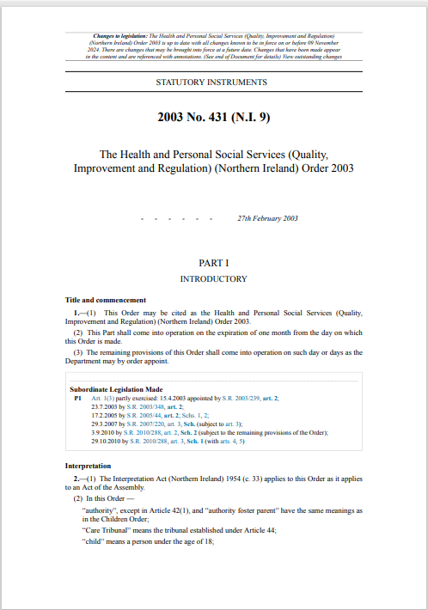
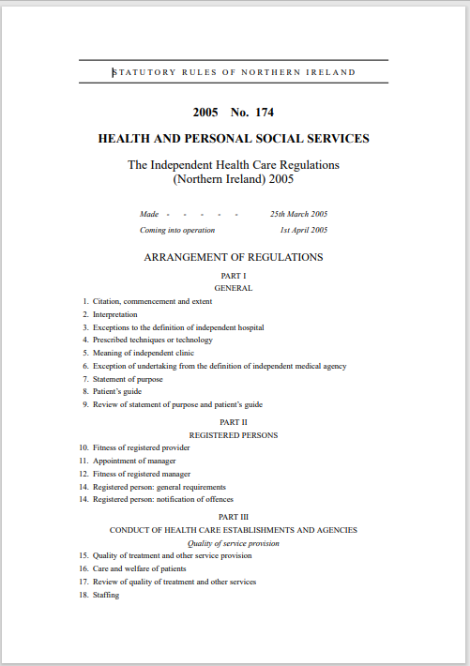
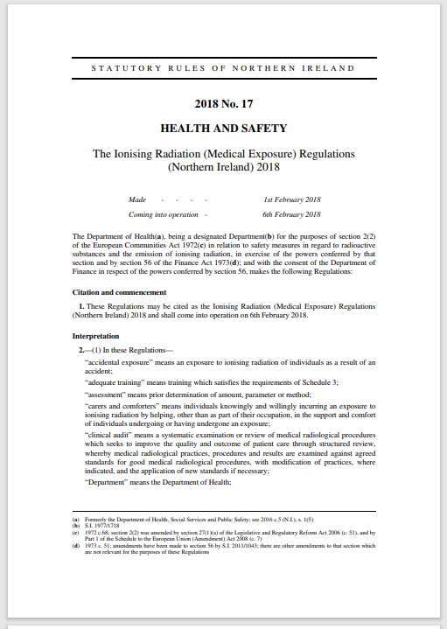
Legislation

Slide 5
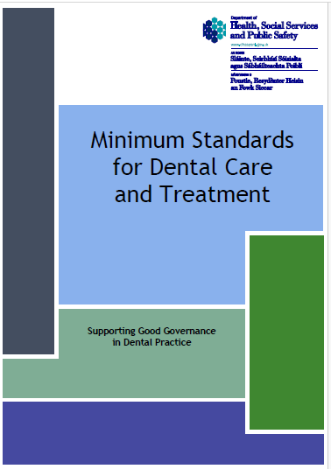
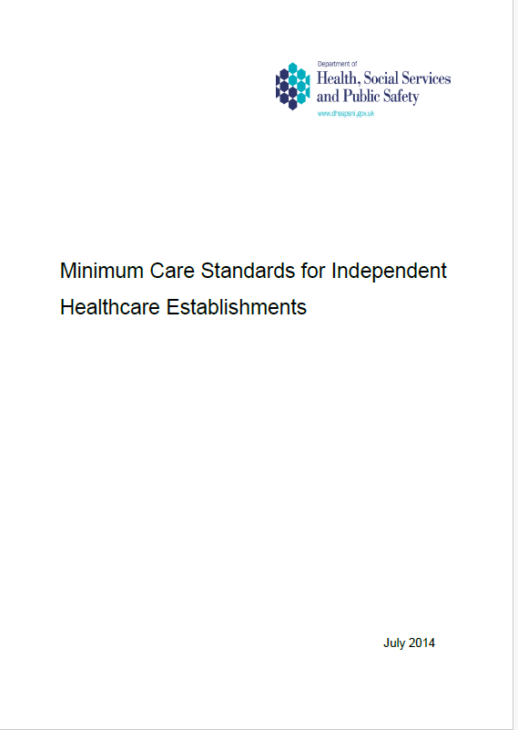
Minimum standards

Slide 6
Records pertaining to staff
Staff rota - Regulation 18 (5) – ‘The registered person shall maintain a record of the rostered shifts for each employee and a record of the hours worked by each person’.
Recruitment of staff – The legislation does not distinguish between staff directly employed by the practice and self-employed staff. The regulations apply to all staff that work in the practice. Regulation 19 Fitness of Workers, 19 (2) (d) ‘full and satisfactory information is available in relation to him in respect of each of the matters specified in Schedule 2’, as amended
Staffing - Regulation 18 (2) (a) – ‘Receives mandatory training and other appropriate training, supervision and appraisal’

Slide 7
Fitness of Premises
Fitness of premises – regulation 15 – ‘the premises used as an establishment or agency must be in a location and of a physical design and layout, which are suitable for the purpose of achieving the aims and objectives set out in the statement of purpose’
Fire – regulation 25 (4) includes fire training (3 (c)); fire drills (3 (d)); review of fire precautions (annually) (3 (e) and fire risk assessment (3 (f))
Estates inspectors – review and approve all service applications, may undertake a desktop review of variation applications if application includes physical changes to the footprint of the practice.

Slide 8
Decontamination of reusable dental instruments
Quality of treatment and other service provision – Regulation 15 ((5) ‘ensure that reusable medical devices are handled safely and decontaminated effectively prior to reuses’.
Health Technical Memorandum 01-05: Decontamination in primary care dental practices and PEL (13) 13 (issued 1 October 2013)
Key Compliance areas – Decontamination room; decontamination equipment; decontamination process; Periodic tests; instrument storage; staff roles and responsibilities; policies and procedures.

Slide 9
Management of a medical emergency
Standard 12 – Medical and other emergencies
Written protocol for dealing with recognised medical and dental emergencies.
Team suitably trained
Emergency medicines are specified with the British National Formulary
Medical emergency equipment in keeping with Resuscitation Council (UK) guidelines; Quality Standards: Primary dental care and Quality Standards: Primary dental care equipment list
RQIA training guidance

Slide 10
Radiology & Radiation safety
The Ionising Radiation (Medical Exposure) Regulations (Northern Ireland) 2018
The Ionising Radiations regulations (Northern Ireland) 2017 HSE responsible for assessing compliance with these regulations
Radiation protection file
Appointed Radiation Protection Advisor and Medical Physics Expert
Employer identified, Radiation Protection Supervisor and entitled staff
Local Rules
Employer’s Procedures

Slide 11
Visits by registered provider
Visits by registered provider – Regulation 26 – applies to individual owners, corporate bodies or partnerships where the responsible individual is not in day to day management of the operation of the practice.
Report should be generated at least on a six monthly basis.
Regulation 26 visits can be delegated to an individual who does not work in the practice.
Report must be signed and dated by the responsible individual

Slide 12
Complaints
Complaints – Regulation 23
Complaints policy and procedure
Complaints records
Complaint log and audit
Staff training

Slide 13
Incidents
Notification of deaths and other events – Regulation 28
Notifications must be submitted via the WebPortal by an individual that has delegated authority to do so
Notifications must be submitted within 24 hours of the incident
Notifications should be anonymised, the names of patients or staff involved with or connected to an incident should not be recorded on the Form 1a, a unique identifier should be used.
Following review of the notification the aligned inspector may request further information through the submission of a Form 2.

Slide 14
Contact Information
Jane Kennedy, Director for Independent Healthcare, Jane.Kennedy@rqia.org.uk
Stephen O’Connor, Assistant Director, Stephen.O’Connor@rqia.org.uk
Carmel McKeegan, Senior Inspector, Carmel.McKeegan@rqia.org.uk
Patricia Mackey; Senior Inspector, Patricia.Mackey@rqia.org.uk
Sinead O’Flaherty, Inspector, Sinead.Oflaherty@rqia.org.uk
Jennifer Snoddy, Inspector, Jennifer.Snoddy@rqia.org.uk
Jenyth Gorzalska, Inspector, Jenyth.Gorzalska@rqia.org.uk
Lucy Pearson, Inspector, Lucy.Pearson@rqia.org.uk
Norma Munn, Inspector, Norma.Munn@rqia.org.uk
Marie Quinn, Inspector, Marie.Quinn@rqia.org.uk
Joelle Black, Inspector, Joelle.Black@rqia.org.uk
David Marshall, SPPG Dental Advisor/Inspector, David.Marshall@rqia.org.uk
RQIA Information team, info@rqia.org.uk

