Slide 1

Dental Radiography Film Holders
Nicky Shanks
Dental Advisor for Simulation & Quality
NIMDTA

Slide 2
Aim
This session aims to discuss and explain the benefits of using dental intra-oral film holders and demonstrate the assembly of dental intra oral film holders.

Slide 3
Learning outcomes
By the end of this session the successful delegate should be able to:
  Describe the benefits of using dental intra-oral film holders
  Demonstrate how to assemble dental intra-oral film holders
GDC Development Outcomes: A, C

Slide 4

IRMER
Ionising Radiation (Medical Exposure) Regulations 2017 often known as IRMER, it is an overall umbrella under which the team works to ensure that X-ray films are taken to the highest standards with the lowest possible exposure that gives a good diagnostic image.
ALARA
The patient dose must be “as low as reasonably achievable”.
Film holders incorporating beam-aiming devices using the paralleling technique and facilitating rectangular collimation should be used for intra-oral radiography wherever possible.

Slide 5

Dental nurses’s role in IRMER team
Often the first person to be in contact with the patient
Ensuring the patient details are in order
Previous radiographs are on hand to view
Setting up of film holders
Documentation of the radiographs that are taken e.g. no. of films taken, exposure factors, processing or scanning of films

Slide 6
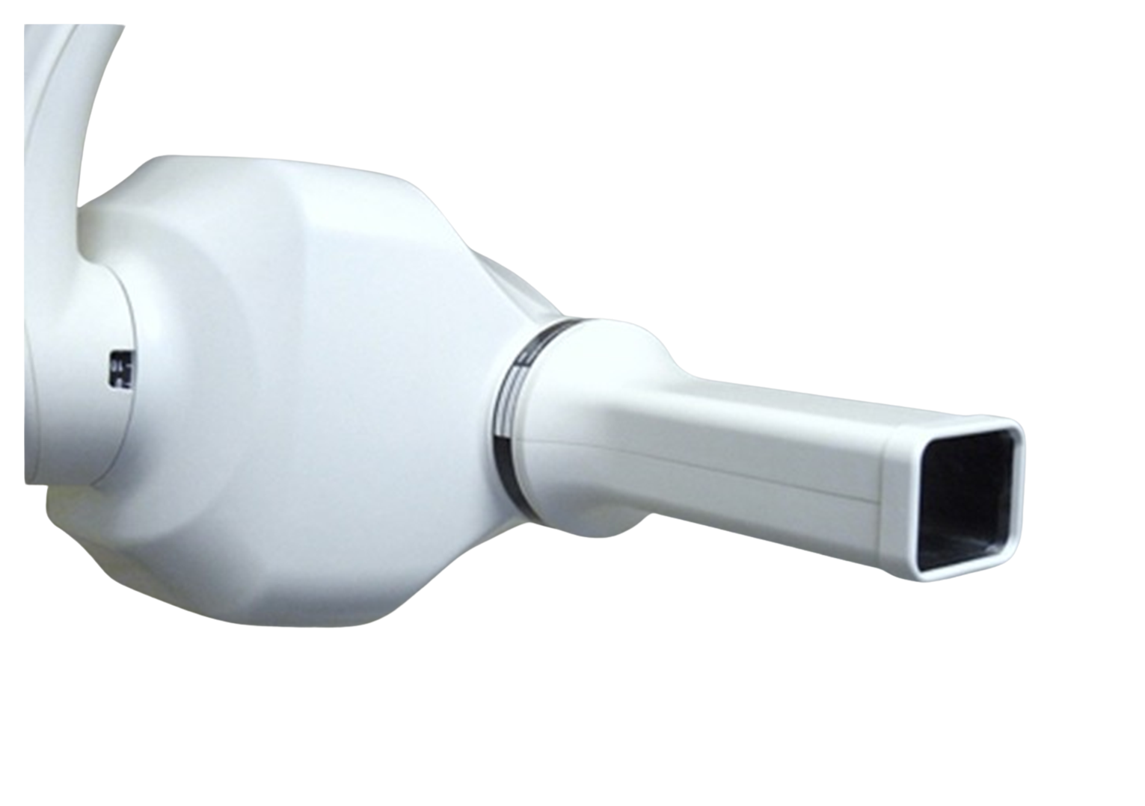
A rectangular collimator reduces the beam dimensions in periapical and bitewing radiography

Slide 7
Why use film holders?
  attempted to standardize radiographic images and techniques
  allow easy and predictable alignment of the X-ray tube
  reduce radiation dose to patient

Slide 8
Image quality advantages
The film is more parallel to the tooth and allows a more reproducible and less distorted image to be taken
Most film holders incorporate a stalk which is outside the mouth that allows accurate location of the x-ray beam to cover the film
Used properly the film is less likely to move than if held by the patient

Slide 9
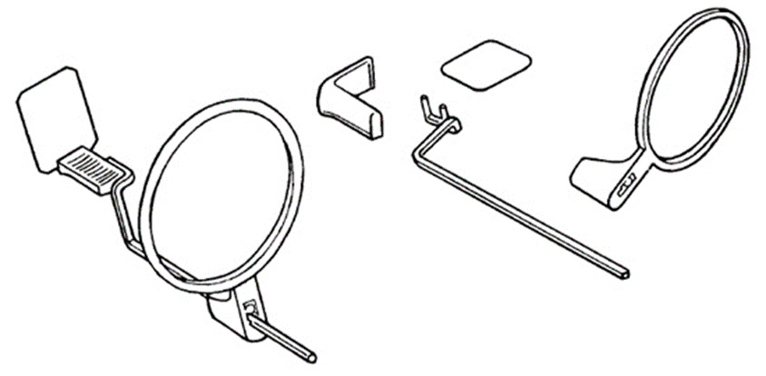
Assembly of film holders
  plastic bite-blocks
  indicator rods
  plastic locator rings

Slide 10
Anterior instrument assembly
  The shielded or printed side of the film packet is placed against the backing support of the bite-block
  It is inserted vertically into the slot by using a downward motion and, at the same time, placing slight pressure against the backing support to open the slot
  There is an embossed dot on the corner of the periapical film. This embossed dot is always placed in a downward position when placing the film into the slot on the plastic bite-block
  The offset position of the indicator rod is held away from the biting surface of the block. The pins are inserted in the proper holes
  The plastic locator ring is fitted onto the indicator rod opposite the film packet
  The assembly is then positioned in the mouth

Slide 11
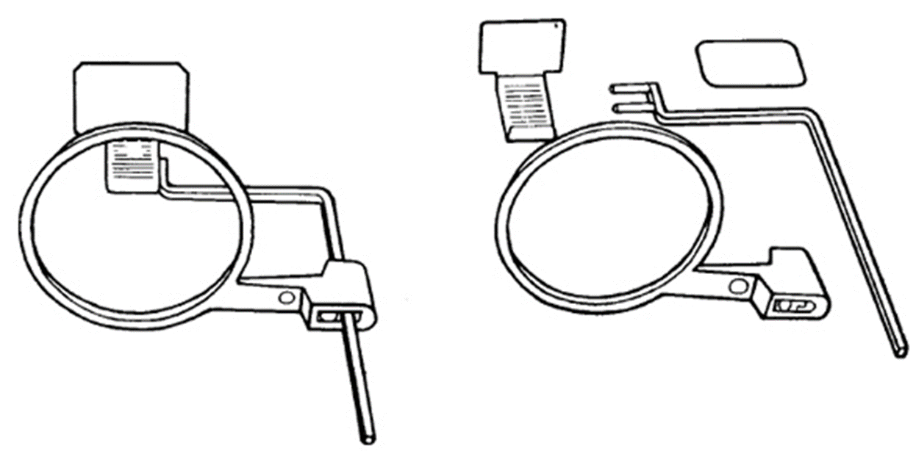
Posterior instrument

Slide 12
Posterior instrument assembly
  The shielded, printed or broken side of the film packet is placed against the backing support of the bite-block
  It is inserted horizontally into the slot by using a downward motion and, at the same time, placing slight pressure against the backing support to open the slot
  The embossed dot on the corner of the film is also placed in a downward position when placed in the plastic bite-block
  The right angle portion of the indicator rod is held anterior to the bite-block and away from the film
  The pins are inserted into the proper holes. (The three holes allow a choice for the desired lingual positioning of the film.)
  The plastic locator ring is fitted onto the indicator rod opposite the film packet
  The assembly is then positioned in the mouth.

Slide 13
Careful technique
Includes:
  Good communication with patient to let them know what is expected
  Head immobilisation using head rest for intra-orals or chin rest and head clamp for panoramic films
  Correct positioning of film and angulation of tube head for intra-orals
  Use of film holders to help achieve the correct relationship of teeth, film and beam
  Correct exposure selection
  Removal of radiopaque objects prior to exposure. Earrings, necklaces, braces, spectacles will all cause obvious artefacts on the image, and may obscure important features.

Slide 14

Questions?

