Slide 1

Clinical Logbook
Using your clinical logbook effectively within the DCT E.Portfolio
Corrin Penman
DCT 3
7/9/26

Slide 2
Learning Objectives
By the end of the session, you should understand
What a clinical logbook is
Why maintaining one is important during DCT
Different ways of keeping a logbook
What information should – and should not be recorded
How to upload your logbook safely to the E.portfolio
How your logbook can support your development and future career

Slide 3
What is the Clinic logbook?
The clinical logbook / E – logbook is a structured record of your clinical experience
Records the clinical procedures and cases you undertake including those you have observed and assisted in
Demonstrates the range and development of your clinical experience
Evidence for your DCT E.portfolio which must be uploaded at IRCP and FRCP
If you don’t record it, it is difficult to demonstrate that you did it!

Slide 4
The importance of the Logbook
Track
the procedures you have completed
Cases you have assisted in
Cases you have observed
Cases you have supervised
Develop
Independence in treatment / procedures
What procedures you need more experience in
Evidence
Demonstrate clinical experience
Support portfolio reviews
Evidence for progression
Future Career : Essential for preparing for applications and for speciality training (self assessment forms)

Slide 5
Clinical logbook Options
Surgical eLogbook
good for oral surgery / OMFS posts
Excel Logbook
good for restorative / Ortho / Paeds posts
Word document logbook
good for restorative / Ortho / Paeds posts
But as long as you keep it consistent and up to date – either format is good

Slide 6
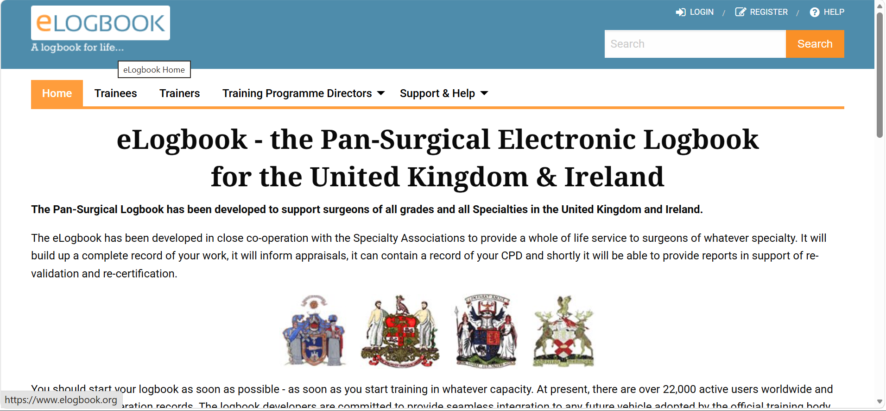
Surgical E logbook

Slide 7
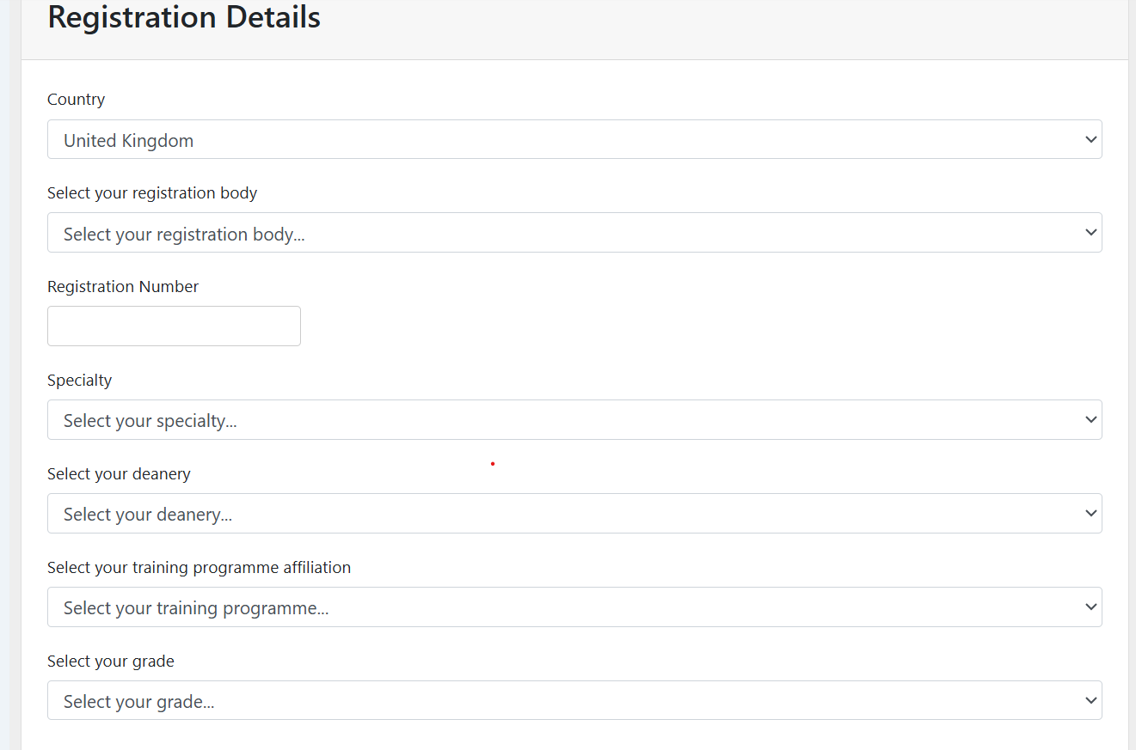
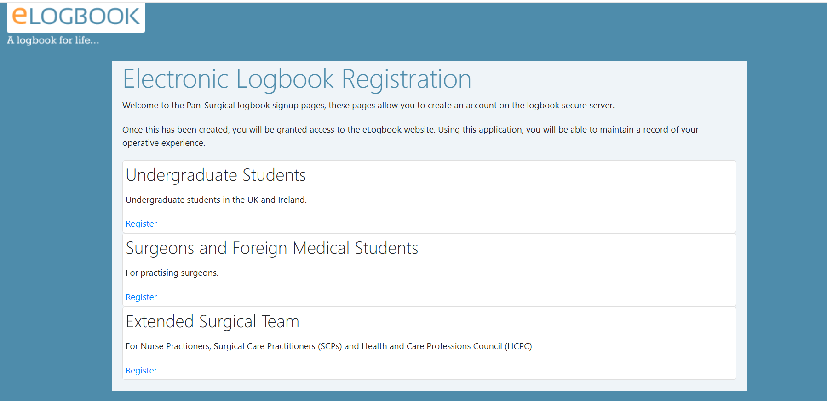
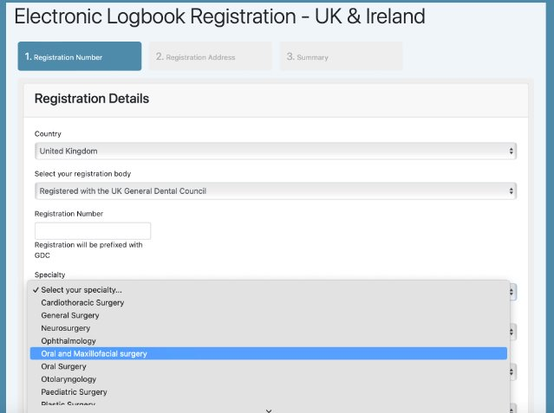

Slide 8
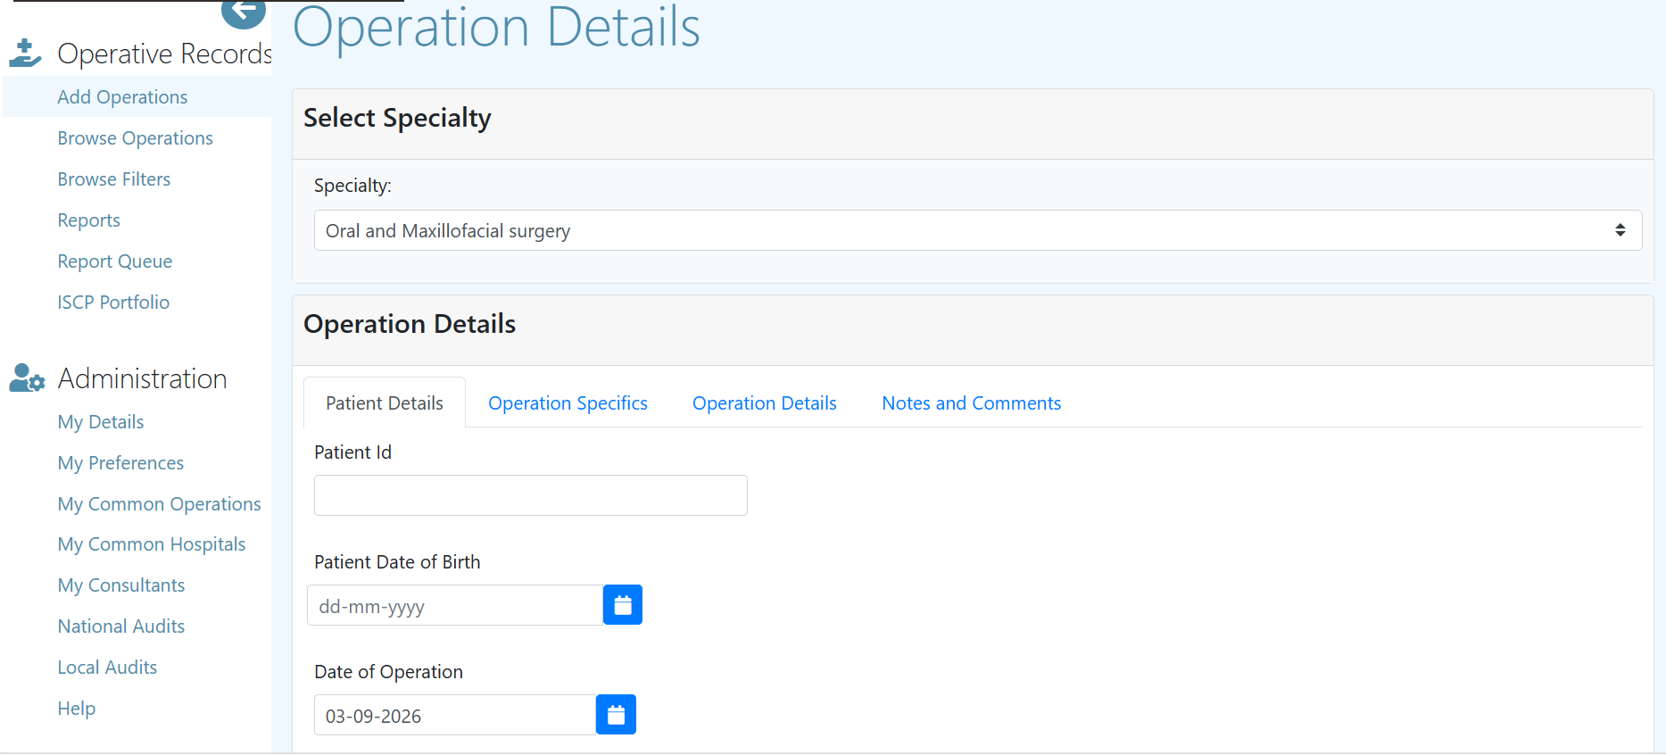
Add operations
Fill in the operation details
Pt details
Operation details
Notes and comments
Patient ID , date of birth​ , date of Operation
ASA grade of the patient​
Responsible Consultant to link for validation​​
Assisted, observed or performed​

Slide 9
Word documents / Excel documents
Simple and easy to customise to your rotation
Easy to access when in clinic
Include procedures/cases/clinics relevant to your specialty

Slide 10
What to include
Date​
Details of Procedure​
Supervising Consultant or Staff Member​
Location of Procedure​
Elective, Urgent or Emergency​
Performed, Assisted or Observed
Important to record if procedure was Performed, Assisted or Observed. Also helpful for recording if procedure was taught/supervised if you supported another trainee or student

Slide 11
What not to include in the logbook
The surgical e logbook will want you to put in details such as patient ID, DOB
When uploading to the E.Portfolio for IRCP and FRCP you need to ensure there is no patient identifiable details. This includes:
Name
Age
Gender
Date of birth,
Health and care number
Ask yourself: Could someone identify this patient from what I have uploaded?
If Yes – remove or reduce the information – the patient's gender should not be included in the upload

Slide 12
When should I update my logbook?
After the clinical session or procedure
Record the cases and you can use this information to send through DOPs, CBD
CONTEMPRRANEOUS RECORDING IS ESSENTIAL
More accurate
Less likely to forget cases
Avoids huge backlog

Slide 13
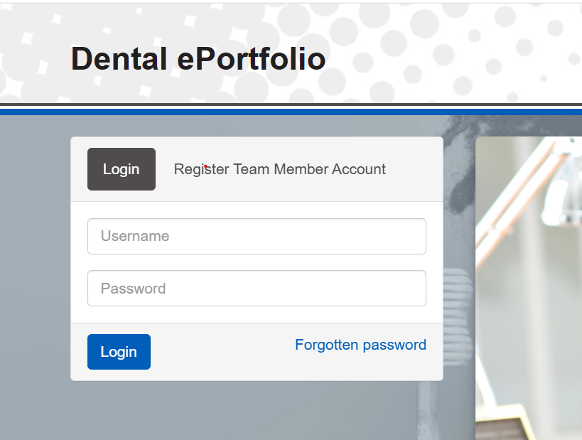
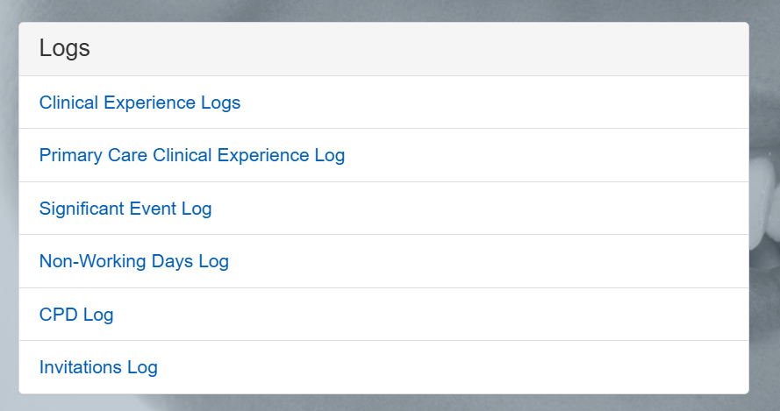
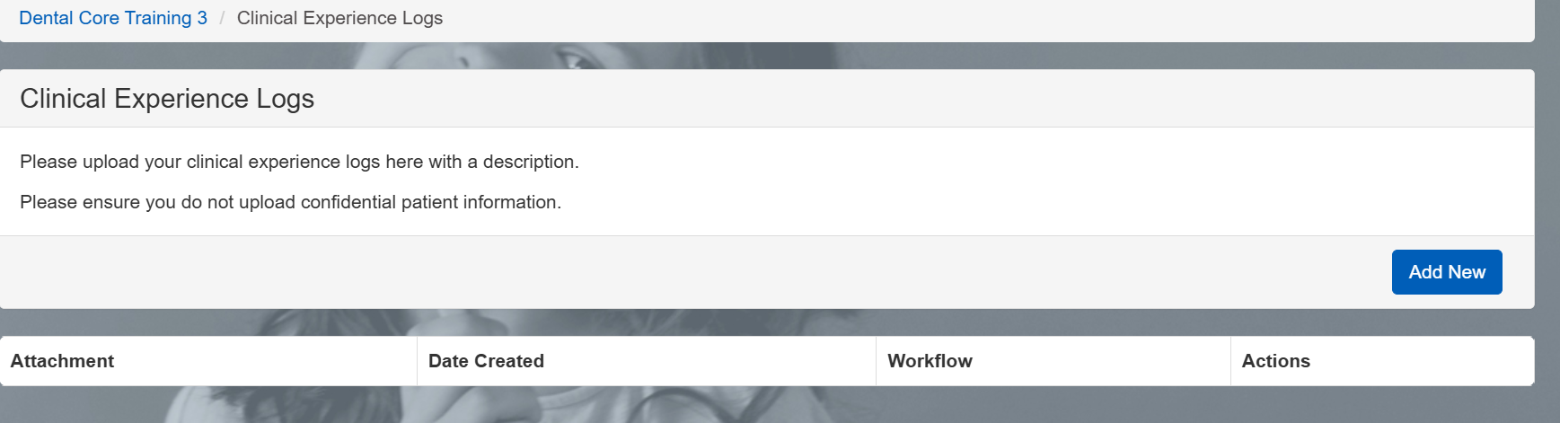
Uploading the Logbook to the E.Portfolio

Slide 14
Top tips and Advice
Start filling in the logbook from day 1 and update it regularly – don’t wait until the IRCP / FRCP Deadline
Record all the clinical aspects of your training as this can help for speciality training
Validations – especially for oral surgery/OMFS posts
Remember to not include patient identifiers when uploading to E.portfolio

