Slide 1
Patient Satisfaction Questionnaires, Multi-Source Feedback and Supervised Learning Events
NIMDTA
Regional Induction
07/09/2026
Andrew Irvine
DCT 2

Slide 2
Learning Outcomes
To summarise the processes involved in the completion of patient satisfaction questionnaires, multi-source feedback and supervised learning events
To outline the requirements for each component to enable successful completion of the DCT year

Slide 3
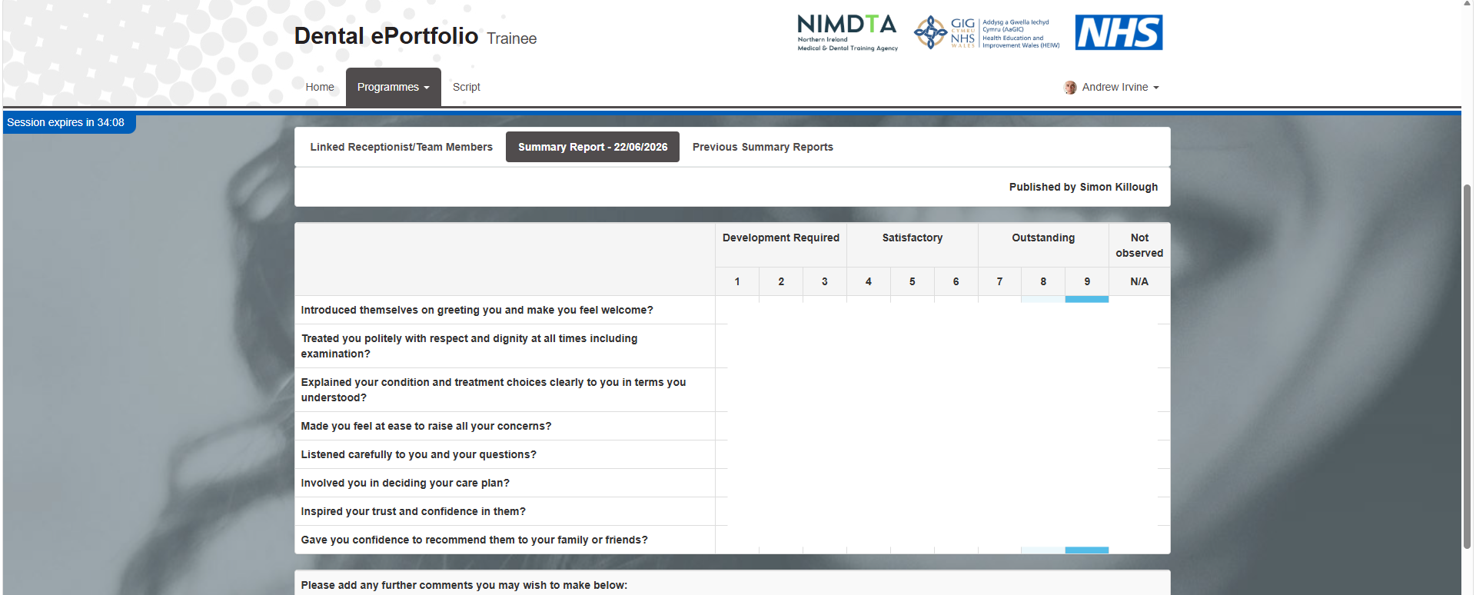
Patient Satisfaction Questionnaires
Notes:
Patient Satisfaction Questionnaires are anonymous questionnaires which patients complete to provide feedback on your professionalism and communication skills.
The aim is to provide you with an understanding of how others regard the care you provide, and it is an opportunity for you to reflect and improve.

Slide 4
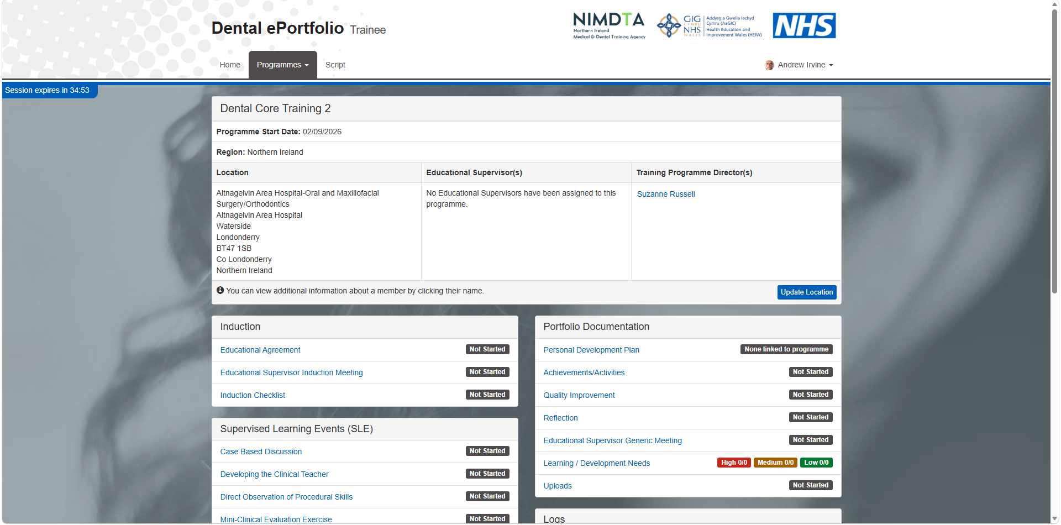
Patient Satisfaction Questionnaires
Notes:
To start the process, log into the dental e-portfolio and you will see this home screen

Slide 5
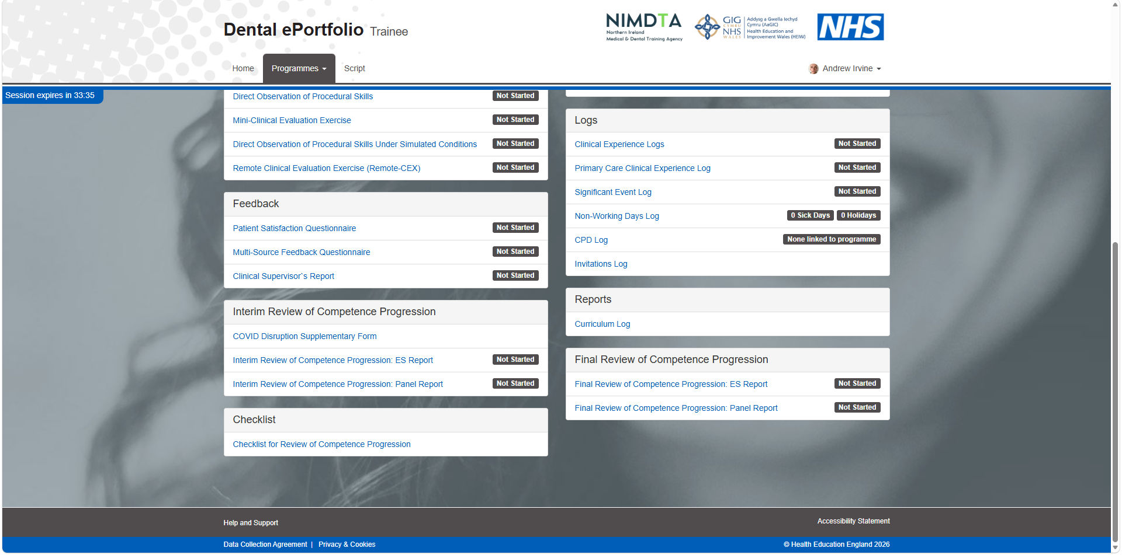
Patient Satisfaction Questionnaires
Notes:
Scroll down to patient satisfaction questionnaire

Slide 6
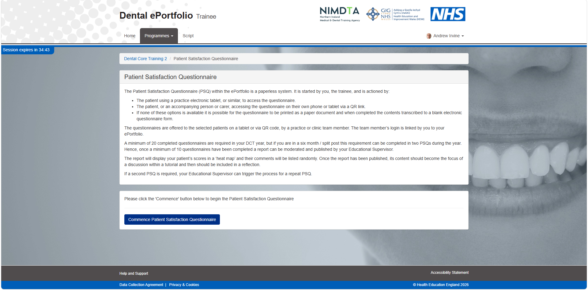
Patient Satisfaction Questionnaires
Notes:
And then select Commence

Slide 7
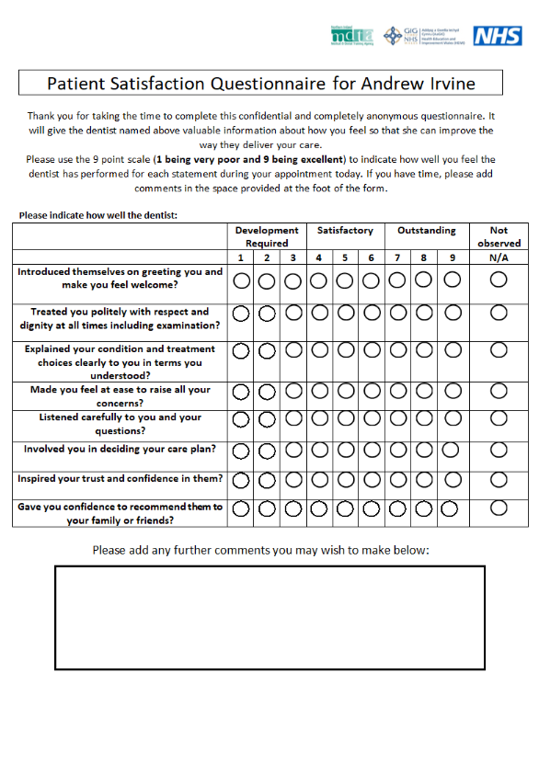
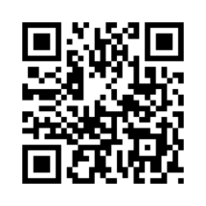
Patient Satisfaction Questionnaires
Notes:
The Patient Satisfaction Questionnaire (PSQ) within the ePortfolio is a paperless system. It is started by you, the trainee, and is actioned by either:
The patient, using a practice electronic tablet, or similar, to access the questionnaire.
The patient, or an accompanying person or carer, accessing the questionnaire on their own phone or tablet via a QR link.
If neither of these options are available it is possible for the questionnaire to be printed as a paper document and when completed the contents transcribed to a blank electronic questionnaire form, which is what I did last year and this is the form I used.
So, print out the template and provide patients with physical copies of it to fill out and then instruct them to place the completed forms in an opaque, sealed envelope and return it to a nominated team member for transcription.
The team member’s login is linked by you to your ePortfolio.

Slide 8
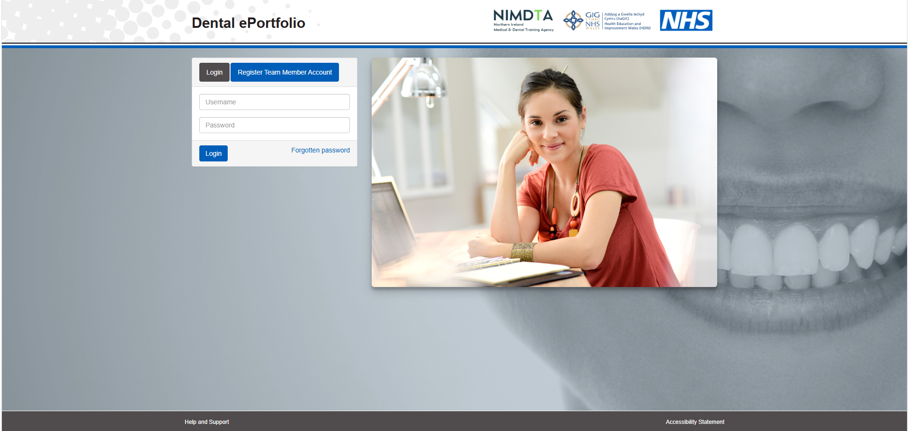
Patient Satisfaction Questionnaires
Notes:
To link a team member, select register Team member account and invite them via email.
Team members can be another DCT, dental nurse, administrative staff or another clinician
The report will display your patient’s scores in a ‘heat map’ and their comments will be listed randomly.
Once the report has been published, its content should become the focus of a discussion with your educational supervisor and should be included in a reflection.

Slide 9
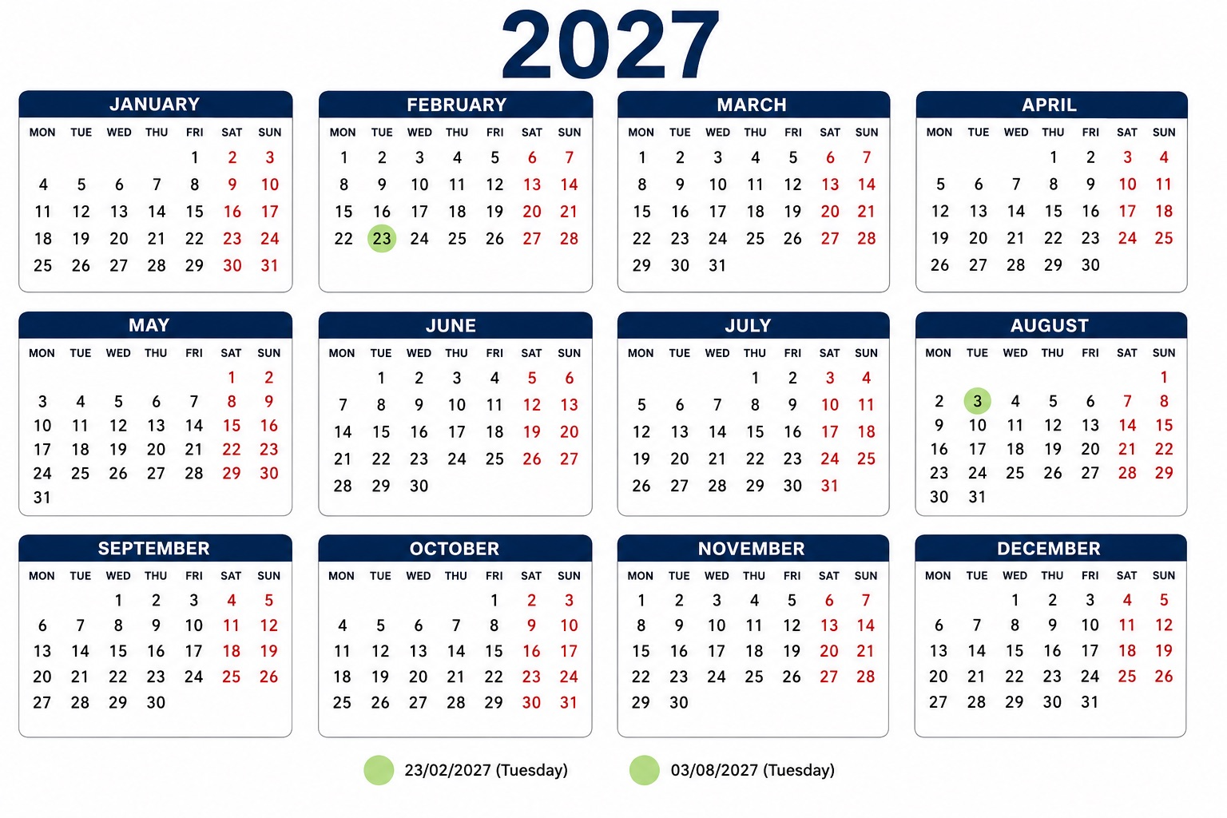
Patient Satisfaction Questionnaires
Notes:
So you need a minimum of 20 completed questionnaires in your DCT year.
Once a minimum of 10 have been completed a report can be moderated and published by your Educational Supervisor.
If you are in a six month / split post this requirement can be completed in two PSQs during the year.
If a second PSQ is required, your Educational Supervisor will need to trigger the process.
Deadline for the first round is the interim review of competence progression panel on Tuesday the 23rd of February 2027 and deadline for the second round is the final review of competence panel on Tuesday the 3rd of August next year.

Slide 10
Multi-source Feedback
Notes:
Multi-source feedback is an assessment tool that gathers feedback from a wide range of individuals who interact with you in your daily practice.
This feedback offers a comprehensive perspective on the your performance, focussing on various competencies such as communication, teamwork, leadership, professionalism, and clinical skills.
To start this process, again, log into the dental e-portfolio and you will see this home screen

Slide 11
Multi-source Feedback
Notes:
Scroll down to multi-source feedback questionnaire

Slide 12
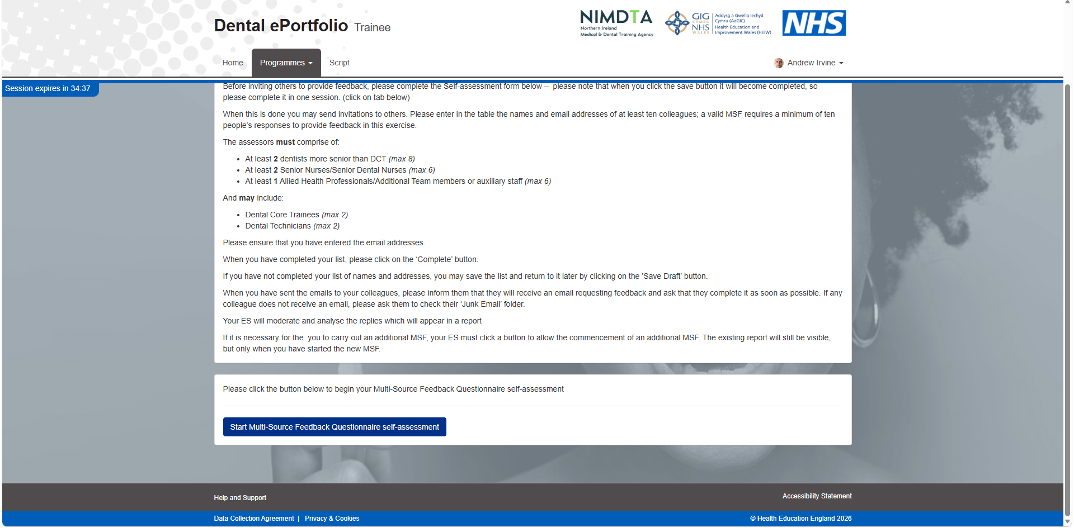
Multi-source Feedback
Notes:
And select start.

Slide 13
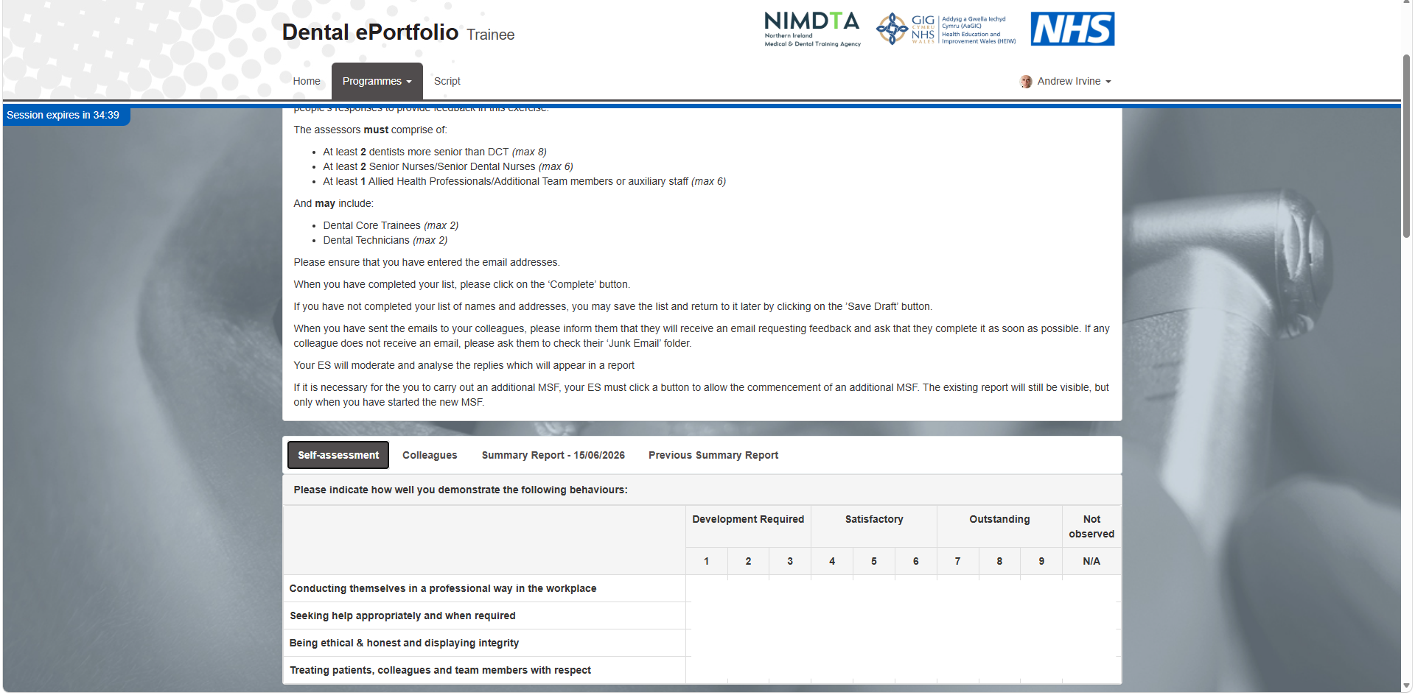
Multi-source Feedback
Notes:
Before inviting others to provide feedback you must complete the Self-assessment form – note that when you click the save button it will become completed, so make sure you complete it in one session.
When this is done you may send invitations to others.
Enter in the table the names and email addresses of at least ten colleagues; a valid MSF requires a minimum of ten people’s responses to provide feedback.
And if you have not completed your list of names and addresses, you may save the list and return to it later by clicking on the ’Save Draft’ button.
When you have completed your list, click on the ‘Complete’ button.

Slide 14
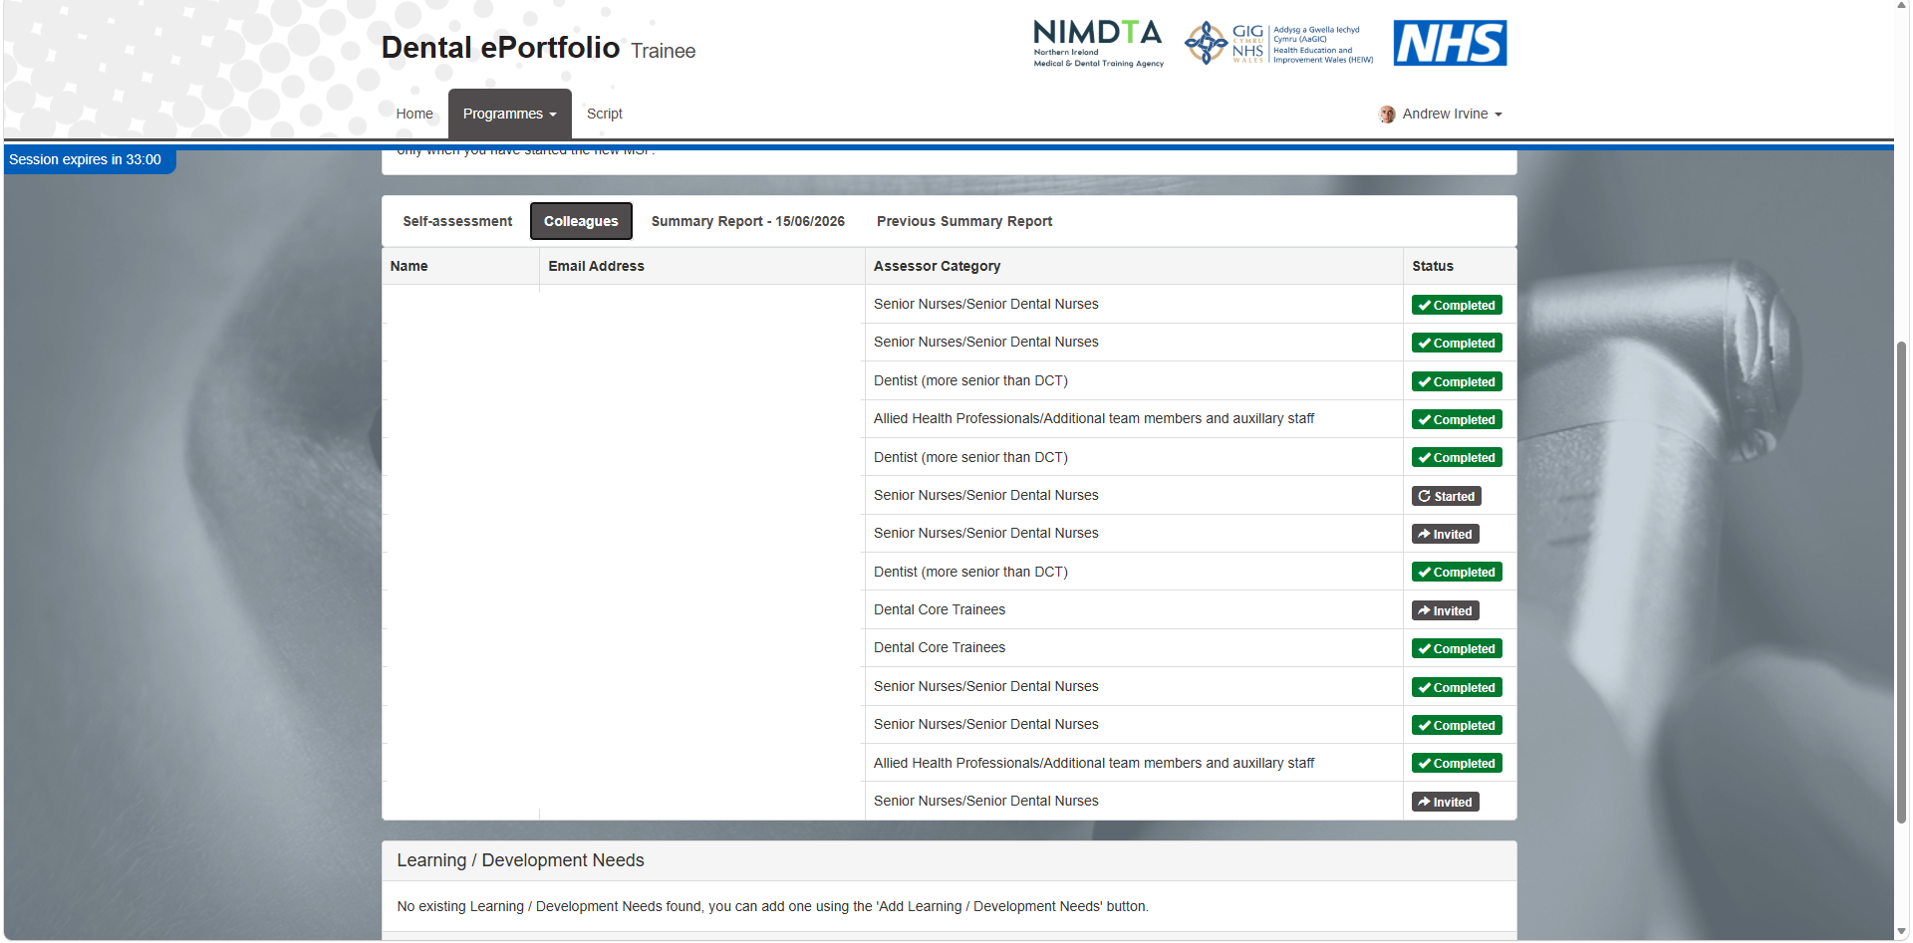
Multi-source Feedback
Notes:
It’s probably best to check with people beforehand that they’re happy to fill in the form and when you have sent the invites to your colleagues, inform them that they will receive an email requesting feedback and ask that they complete it as soon as possible.
If any colleague does not receive an email, ask them to check their ‘Junk Email’ folder.
Your educational supervisor will moderate and analyse the replies which will appear in a report
If you are in a six month / split post you will need to complete two during the year and your educational supervisor will need to trigger the commencement of the second MSF.
The existing report will still be visible, but only when you have started the new MSF.
For each 6 month split, I invited more than required to ensure I got the ten needed.

Slide 15
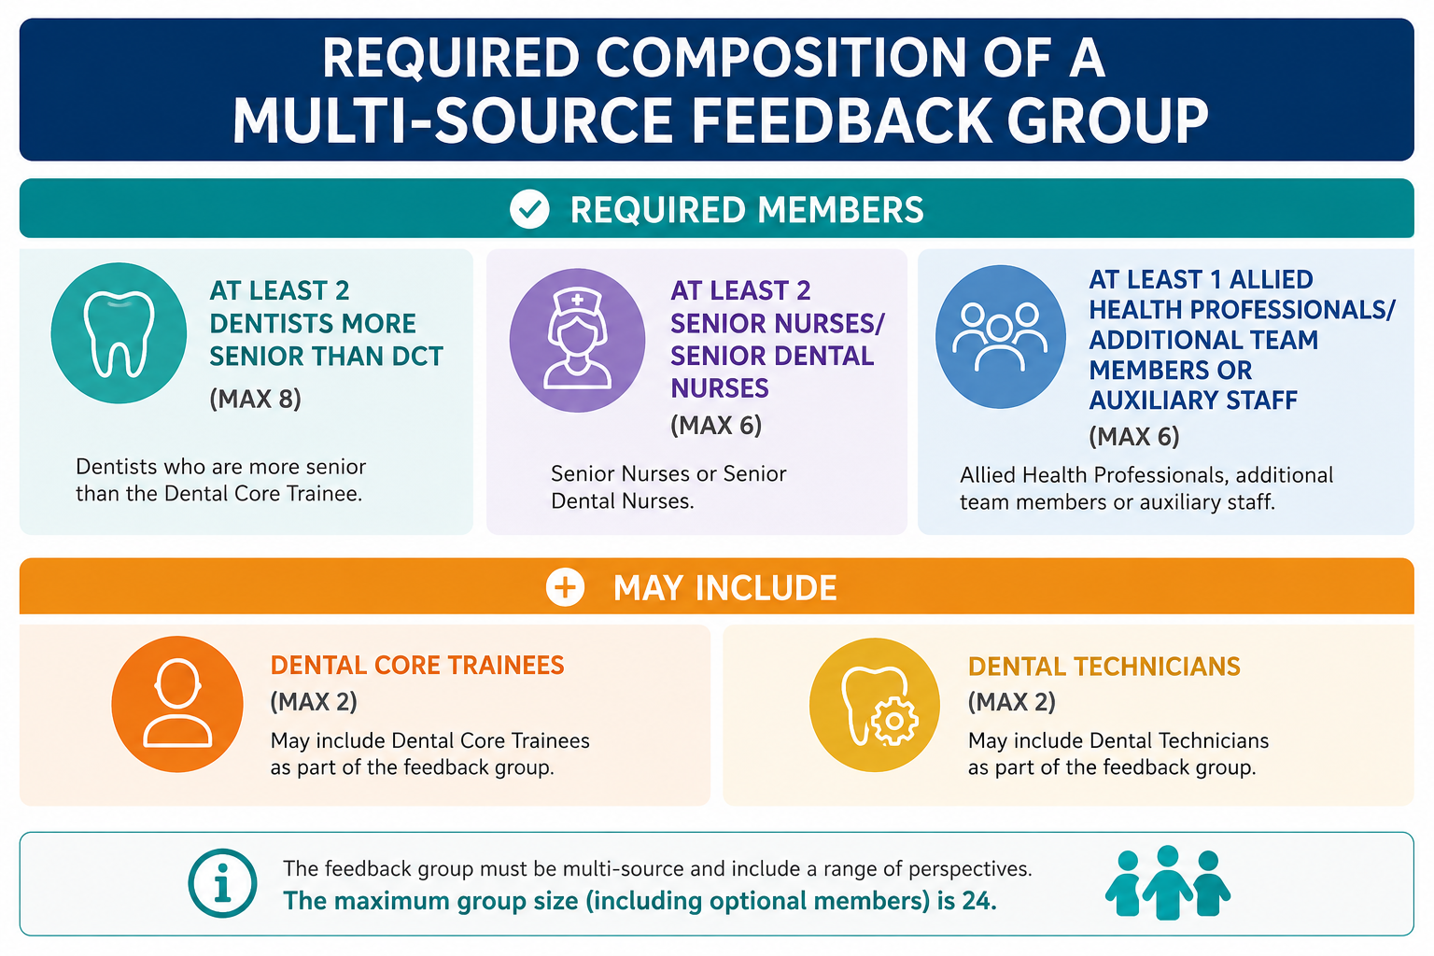
Multi-source Feedback
Notes:
When inviting assessors, they must comprise of:
At least 2 dentists more senior than DCT such as consultants maximum 8
At least 2 Senior Nurses or Senior Dental Nurses maximum 6
At least 1 Allied Health Professionals or Additional Team members or auxiliary staff again maximum 6 and this could include reception staff
And finally, you can have:
a maximum of 2 DCTs providing feedback
a maximum of 2 Dental Technicians
Ensure that you have entered the email addresses correctly.

Slide 16
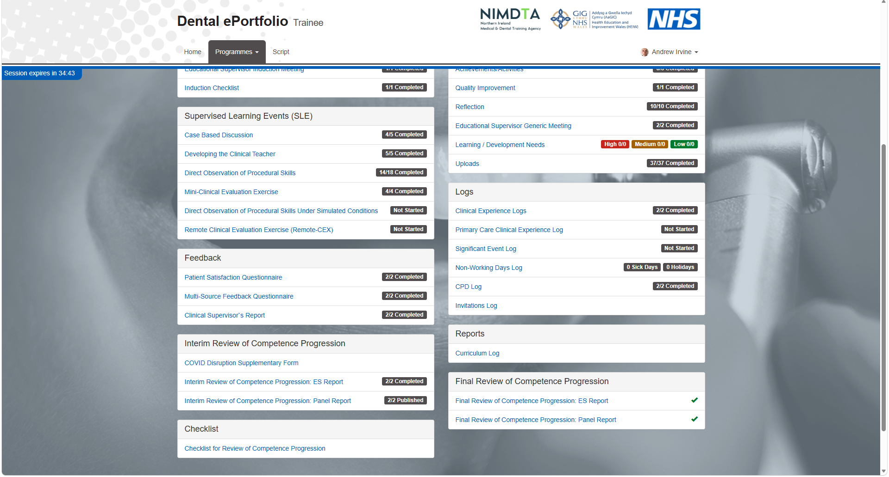
Supervised Learning Events
Notes:
And lastly we have supervised learning events which are composed of case-based discussion, developing the clinical teacher, direct observation of procedural skills and mini-clinical evaluation exercises
Assessors are invited to provide feedback via email and you need to complete a minimum of 24 in total throughout the year; with at least 12 completed by the interim review of competence progression panel on Tuesday the 23rd of February next year.

Slide 17
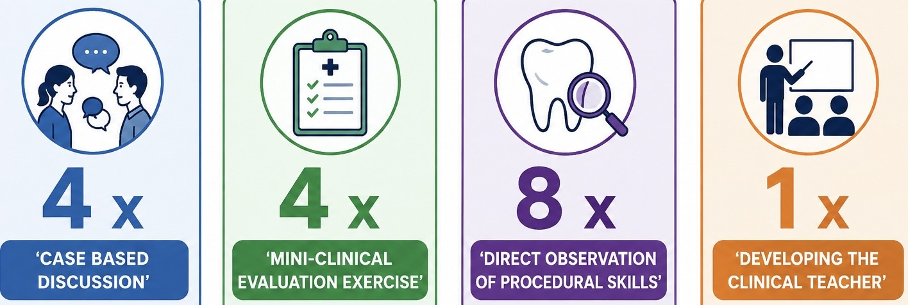
Supervised Learning Events
Notes:
A case-based discussion is a structured, one-on-one professional evaluation where you talk through a real clinical case with an experienced supervisor or assessor.
So if you've seen an interesting case you can just ask your supervisor if you can do a case-based discussion on it and you need to do at least 4 of these.
Developing the clinical teacher involves any teaching event you carry out throughout the year such as the lunchtime teaching sessions with the other DCTs and you need at least 1.
Direct observation of procedural skills involves any structured practical application of knowledge to evaluate your technical, operative, and professional competence in a real-time clinical setting.
This can be a treatment you carry out such as a bond-up or a debond if you’re in ortho or an extraction you carry out but just make sure you say to your supervisor beforehand and they’re happy enough and you need a minimum of 8 of these.
Mini-clinical evaluation exercises are short, structured workplace-based assessments where a senior clinician observes you interact with a real patient to evaluate your core clinical and communication skills.
This could be taking consent for a procedure for example and you'll need at least 4.

Slide 18
Questions?

Slide 19
References
Health Education England (2026). Available at: https://dentaleportfolio.hee.nhs.uk/framework/analysis/displayresults.aspx?memberqueryid=dbc7a9c2-c84b-4393-a692-45d5f88f1283&pid=07c193db-a8a9-49f0-9773-d7b9a59f8df2&switch=yes (Accessed: 26 August 2026).
National School of Healthcare Science (2025) 3.1 The purpose of case-based discussions — NSHCS work-based assessment standards. Available at: National School of Healthcare Science (Accessed: 26 August 2026).

