Slide 1
OT
2026
Infection Prevention
and Control
Amanda Jackson
Notes:
Thank you for inviting us to you practice
Get to know who is there: introduce us
Highlight: evaluations
we are education not any inspection of any form
gold standard education; if anything highlighted which is not being done it is not a reflection on the practice
informal training happy to be interrupted and open up discussions or answer questions
format some ground work or theory and move into the clinics and LDU for some practical experience

Slide 2
AIM
To provide information pertaining to the current guidance/legislation regarding Infection Prevention and control & Decontamination, that will assist Orthodontic Therapists in adhering to current standards.

Slide 3
Objectives
By the end of the session you should be able to:
Highlight standard infection control precautions
Demonstrate an 8 step hand hygiene technique & outline its importance.
Select appropriate personal protective equipment & use correctly
Safe sharps & waste disposal
Clear, clean and disinfect work units
Outline the workflow within your LDU/designated decontamination area
State the equipment used in an LDU to render instruments safe to reuse, and complete tests required on all equipment

Slide 4
Learning content
This session is intended to create an understanding of the need to apply infection prevention and control measures including decontamination of dental instruments to reduce potential risk factors to both patients and the dental team.
GDC Development Outcome: C

Slide 5


Infection control: Why??????
Whose Responsible??
Notes:
Our responsibility in all health care not just dentistry is that our treatment should never cause our patients harm or be detrimental to their health or well being
One of the evidence based risks within the whole of health care is the transfer of infection.
We must ensure as far as is reasonably practicable we have measures in place to reduce the risk to our patients
HCAI
Break down in acute: compare to dentistry
Organisms are continually develop12w

Slide 6
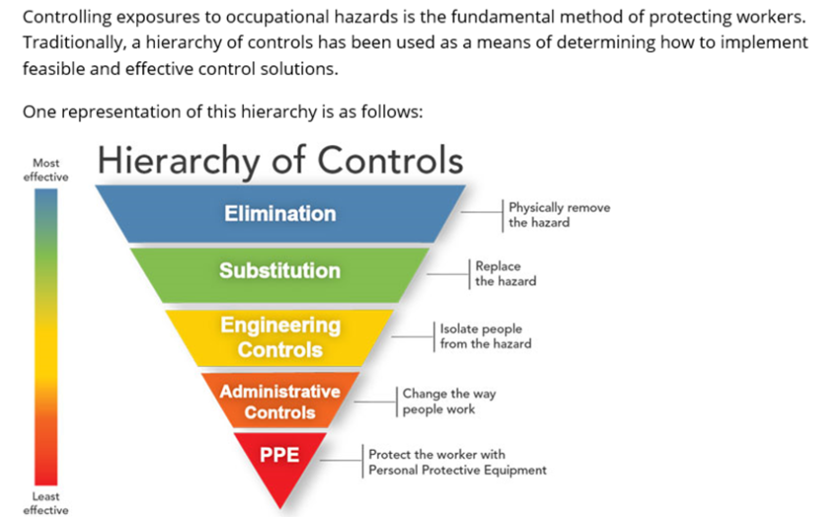
Steps you can take
Notes:
Dental practices will need to monitor: community prevalence of infections, new variants of concern, number of outbreaks

Slide 7

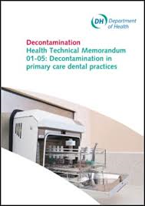
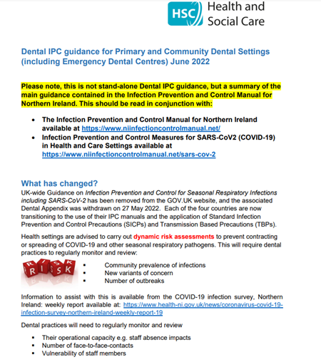

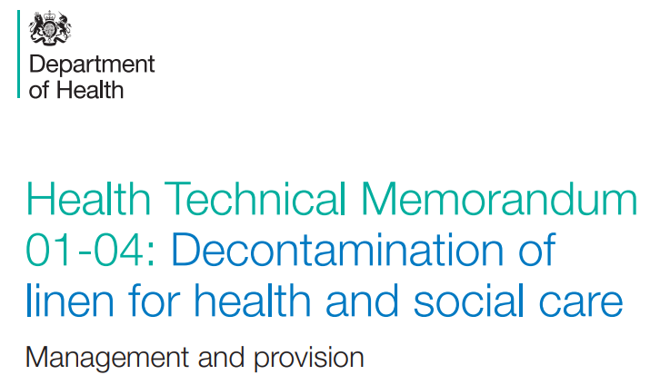

Notes:
RQIA assess practices against the minimum standards for dental care and treatment to ensure patients are not exposed to risks, including the risk of infection:
The premises are clean
The practice adheres to the appropriate infection control policies and procedures, in line with current best practice and legislation
Systems are in place, including induction and on- going training, to make sure these policies and procedures are known, and are being used appropriately at
all times
The practice meets current best practice guidance on the decontamination of reusable dental and medical instruments
Where required, patients are informed about the need for procedures designed to prevent and control infection
The dental team meets CPD requirements in relation to disinfection and decontamination.

Slide 8
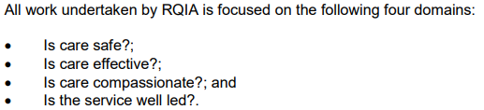
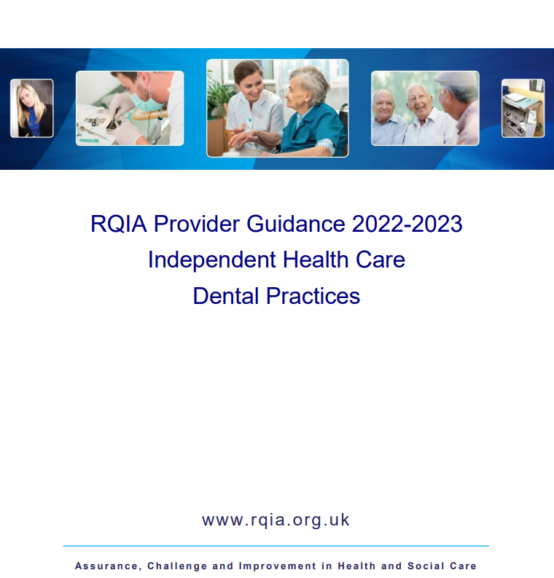
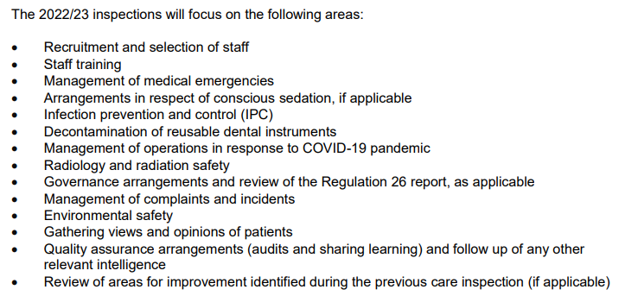

Slide 9
CQC inspections
The CQC will assess a dental settings against the code of practice on the prevention and control of infections.
The main purpose of the Code is to ensure that registered providers understand the requirements for cleanliness and infection control and how to comply.
It also provides compliance guidance for the CQC and information for patients, commissioners and the public.

Slide 10
Decontamination Lead
For RQIA inspections please note:
HTM 01-05 Decontamination in primary dental care practices
HTM 07-01 Safe management of healthcare waste
HTM 01-04 Decontamination of linen for health and social care
Do you have re-useable bibs
Protocol for scrubs & uniforms

Slide 11
Policy & Procedures
Minimising the risk of transmitting infection and sharps injuries, and occupational health arrangements for staff at risk of hepatitis B
Decontamination and storage of instruments
Procedures for cleaning, disinfection and sterilisation of instruments
Management and disposal of clinical waste
Hand hygiene
Decontamination of new reusable instruments
Use of personal protective equipment
Recommended disinfectants and their use, storage and disposal
Spillage procedure
Environmental cleaning.
Notes:
Review every 2 years - discuss at practice meetings

Slide 12

Incident Reporting
Reduction of general Adverse Incident Reporting
NIAIC has updated:
Adverse Incident Reporting form
Reporting adverse Incidents and disseminating safety information updated
https://applications.healthni.gov.uk/NICAS/Public/Home.aspx

Slide 13
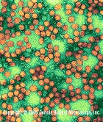
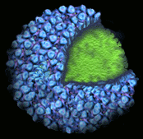
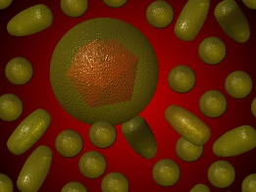
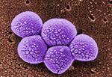
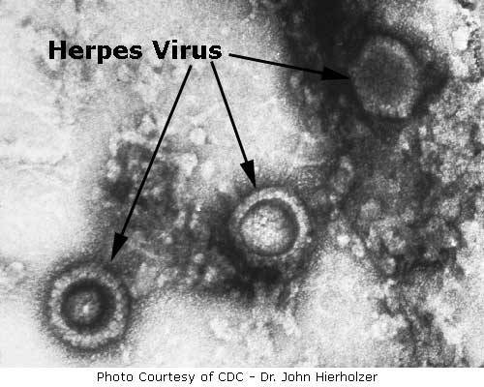
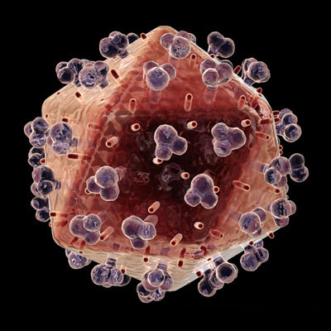
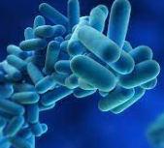
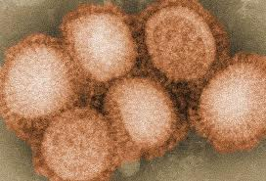
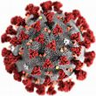
Are we Now complacent?
Hepatitis C Hepatitis B Norovirus
MRSA HIV
Legionella
Flu
COVID 19
Notes:
Dentistry has proven over the years that is can adapt to microbial threats such as bloodborne viruses – hep b, wearing of gloves and steam sterilisers then with CJD we embraced the decontamination cycle!!
Understandably people are scared and uncertain at the moment: a new disease…however we will find ways to overcome this in our profession. There is some similarities with the 2003 SARS-covid outbreak. However at this stage it is very early days and there is a lot of ‘fake news’ which we need to be careful of, important to only go by official documents at present.
Influenza is a respiratory illness characterised by rapid onset of a wide range of symptoms including fever, cough, headache, sore throat and aching muscles and joints.
It has an average incubation time of two to three days and people are most infectious soon after they develop symptoms. Transmission is through close contact with an infected coughing or sneezing person.
Hand washing (with soap and water or alcohol hand rub) and environmental cleaning will deactivate the virus and help control spread through contact.
The main measures for containing the infection include:
Standard infection control measures and droplet precautions
A ‘stay at home’ approach for anyone with flu-like symptoms
Separating flu-infected patients from well patients when dental care is needed
Preventing symptomatic visitors (accompanying well patients, for example) from attending the practice.

Slide 14
Medical History
Detailed medical history should be taken when a patient first attends the practice and review it at subsequent appointments; it must be retained as part of the patient’s dental records.
Direct questioning and discussion in a confidential environment will allow the patient to disclose sensitive and confidential personal information. Using a questionnaire will ensure that you ask the same questions of each patient.
The medical history and examination may not identify asymptomatic carriers of infectious disease, so the same infection control procedures must be used for all patients.

Slide 15
Hepatitis C in NI
From July 2021 hepatitis C is notifiable disease in NI…
This means:
Medical Practitioners are required to share patient information with the Public Health Agency (PHA) if they become aware or suspect that a person has Hep c

Slide 16
To survive a microorganism needs:
Time
Heat
moisture
food

Slide 17
What microorganisms have you been in contact with today??
MRSA: over 6mths
Nora virus: weeks HS/12dys fabric
HCV: 3 weeks
HBV: approx 7 days
COVID-19 72 hours (3 days on steel, plastic)
Flu: 24 hours
HIV: few hours
Herpes: few hours

Slide 18
How resilient are our patients?
Elderly patients
Patients undergoing chemo or radiotherapy
Medication- High dose steroids or immune suppressants
Auto immune diseases
₌
Immunity

Slide 19
Infection
Invasion of the body by microbes
Main Concern in dental practice:
Direct: Contact from Patients blood/saliva
Indirect: Instruments & equipment
Airborne droplets: Water spray/aerosol/Flying particles
Notes:
Inflammation: the body’s response to irritation
5 signs: pain, heat, swelling, redness, loss of function

Slide 20
Chain of infection
Infectious
agent
Reservoir
Portal of exit
Mode of transmission
Portal of entry
Susceptible host

Slide 21
Hep B
Blood stream
Bleeding wound
LA needle
Sharps injury puncture wound
Unvaccinated dental professional

Slide 22
What link?
Giving the hepatitis B vaccination removes what in the chain of infection?
Susceptible host
Washing your hands before treatment is what in the chain of infection?
Mode of transmission
Cleaning work surfaces between patients and at the end of the day removes what in the chain of infection?
Reservoir

Slide 23
Infection Prevention & Control
How do we break the chain of infection and prevent or control infection from spreading?
Adhere to legislation, local guidance, policy & procedures: HTM 01/05 & Minimum Standards
Use Standard Infection Control Precautions
Have an Infection control policy & follow procedures within your practice
Notes:
Difference between policy & procedures.

Slide 24
Standard Infection Control Precautions
11 in total
Must be used on all patients when there is a possibility of contact with:
  Blood
  All other body fluids (except sweat)
  Non intact skin
  Mucous membranes
Used at all times in the care setting, whether an infection is known to be present or not
Additional transmission based precautions (TBP) applied in conjunction with SICPs
Notes:
Transmission based precautions are brought in depending on the route of transmission of each disease

Slide 25
Standard Infection Control Precautions
Cough etiquette
Patient placement & assessment for infection risk
Hand hygiene
Personal protective equipment
Prevent occupational exposure
Management of blood and body fluids
Patient care equipment
Control of the environment
Safe handling of waste
Linen
Maintaining social/physical distancing

Slide 26
Transmission Based Precautions (TBPs)
Applied when SICPs alone are insufficient to prevent cross infection
Are additional IPC precautions required when caring for a patient with a known or suspected infectious agent
Categorised by the route of transmission of the infectious agent:
> Contact precautions: to prevent and control transmission via direct or indirect contact e.g. environment /equipment. Most common route of infection transmission
> Droplet precautions: to prevent and control transmission over short distances via droplets (≤ 5µm) from the respiratory tract of someone directly onto a mucosal surface or conjunctivae of another: Approx. 2 metre around the infected individual considered area of risk
> Airborne precautions: To prevent and control transmission via aerosols (≤ 5µm) from the respiratory tract of someone directly onto a mucosal surface or conjunctivae of another
Notes:
SICPs may be insufficient to prevent cross transmission of specific infectious agents. Additional precautions called TBPs are required to be used by staff when caring for patients with a known or suspected infection or colonisation including COVID-19
Tuberculosis (TB) is spread by water droplets or by direct contact and has been transmitted by dental procedures.
Dental professionals are more likely than the general population to come into contact with the infection and unvaccinated.
Those who are tuberculin-negative and aged under 35 years should be vaccinated.

Slide 27
Preparation
Steps you should take before starting work in the surgery
Vaccinations: Green book provides information
  Hep B
  Rubella
  Tetanus
Occupational Health assessment (for all clinical dental staff)
Hair off collar/ long, tie up / clip back
Nails short, no polish or false nails
Jewellery – bare below the elbow, no dangly earrings
Uniform (Linen SICP)
  Must be clean everyday / not worn to or from work
  Washed separately at suitable temperature for the fabric, min 40° / tumble dried or ironed
  Bare below the elbow
  Closed in flat shoes
Notes:
Vaccinations: Hep B you must not work without this.
Occupational health should now see all new staff before starting.
In healthcare and laboratory workers, Hepatitis B surface antibody (anti-HBs) titres should be checked one to two months after the completion of a primary course of the vaccine (either the standard 0, 1, and 6 months; or the accelerated 0, 1, 2 and 12 month schedules can be used).
When using the accelerated course, the fourth dose given at 12 months is the final dose of the primary course, not a booster.
The advice to test anti-HBs titres one to two months after completion of the primary course therefore means after the fourth dose in a 0, 1, 2 and 12 month schedule.

Slide 28
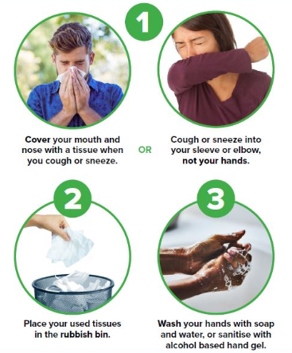
Cough Etiquette
In the clinical environment:
Cough into your elbow
If you can:
‘Catch it, kill it, bin it!
Always perform hand hygiene

Slide 29
Preparation Checklist
Keep nails short.
Avoid wearing rings with ridges/stones.
Do not wear artificial nails/polish.
Remove wrist watches etc.
Select the correct cleaning agent.
Use a designated sink.

Slide 30
Products
Liquid soap
    plain
    uncoloured
    unperfumed
Alcohol rubs (at least 60% alcohol)
Antimicrobial hand wash (for surgical procedures)
    chlorhexidine, videne
No decanting of dispensers
No standard use of nail brushes

Slide 31
Alcohol-based Preparations
Benefits
Rapid and effective anti-microbial action
Improved skin condition
More accessible than sinks
Limitations
Cannot be used if hands are visibly soiled
Build up may occur and hands still need to be washed once ‘stickiness’ occurs
Should not be used when spore forming organisms are present, e.g. Clostridium difficile, or when a patient/client has viral gastroenteritis e.g. Norovirus

Slide 32
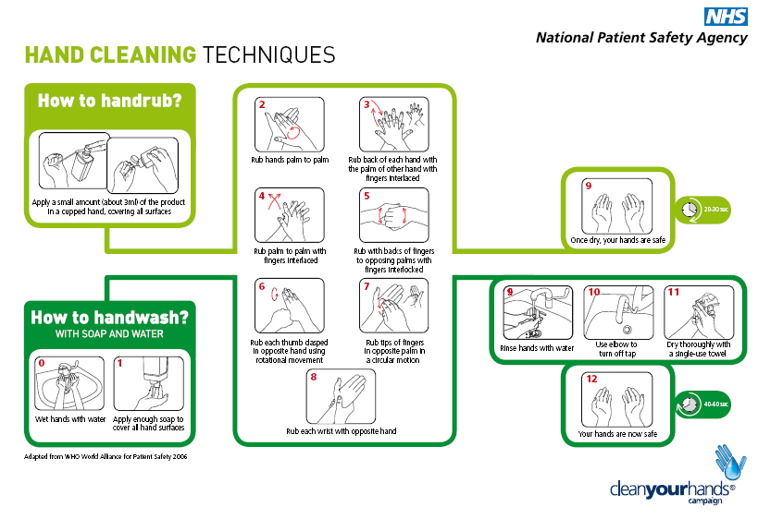
8 Step Technique

Slide 33
So if it works?
Why Don’t
we perform hand hygiene
when they should?
(Compliance estimated at less than 50%)
Notes:
Hand out article and ask participants to get into small groups and select 5 most common reasons they do not was hands from the reasons listed in the article – table 2 and list any other reasons they might think of in their own agencies.
5 – 10 minutes
Discuss each groups list and collate list on white board
Mark off those that repeat – number list in order of most common (1) to least common (2)
Ask for other reasons group have come up with – list on board

Slide 34
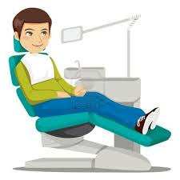
“My 5 moments for Hand Hygiene”
4 After patient
Contact
2 Before a
clean/aseptic
procedure
1 Before patient
Contact
5 After contact with
patient surroundings
3 After body
fluid exposure
risk

Slide 35
Personal Protective Equipment
The Personal Protective Equipment at Work Regulations require employers to provide necessary protective equipment (PPE) to ensure safe systems of work.
Employers cannot charge employees for supplying, cleaning, repairing or replacing PPE, including protective clothing.
Protective clothing can minimise the risks at work but is not a substitute for more basic safety measures.
Notes:
Nurse: no goggles, mask wrong. Dentist: watch

Slide 36

Personal Protective Equipment
A major component of standard infection control precautions
Specialist clothing or equipment worn to protects the skin and mucus membranes from exposure to infectious materials in spray/spatter
Don prior to patient arrival
Should be removed when leaving treatment areas
Additional transmission based precautions applied in conjunction with SICPs when necessary (e.g. TB / Coronavirus / Respiratory)
Generally Single Use: Use once and bin

Slide 37
Considerations
Gloves (to BS EN 455, parts 1 and 2)
They should also be low in extractable proteins (<50μg/g) and low in residual chemicals.
Alcohol gels should never be used on gloves.
Aprons
Gowns for sterile/surgery procedures
Masks
Fluid resistant
Goggles/visors/disposable options
Visors for Patients
All Single use?
Notes:
Don prior to patient coming into the surgery
Remember putting on PPE: gloves are last to go on 1st to come off.
Do not leave the clinical area wearing your PPE

Slide 38
Changes to PPE Law
Changes made April 22
They extend employers’ and employees’ duties regarding personal protective equipment (PPE) to limb (b) workers.
PPE is required, employers must ensure their workers have sufficient information, instruction and training on the use of PPE.
https://www.hse.gov.uk/ppe/index.htm?utm_source=govdelivery&utm_medium=email&utm_campaign=ppe-regs&utm_term=ppe-1&utm_content=digest-7-jul-22
Notes:
A limb worker is imb (a) describes those with a contract of employment and those who have a more casual employment relationship and work under a contract for service – they do not currently come under the scope of PPER 1992

Slide 39
Masks
Fluid resistant surgical mask
FFP1
FFP2
FFP3
Notes:
FFP stands for filtering face piece mask

Slide 40
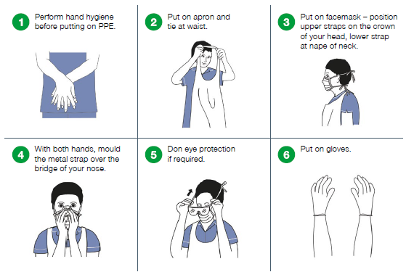
Putting on PPE (Donning)
Notes:
Level 1 PPE, prior to patient arrival

Slide 41
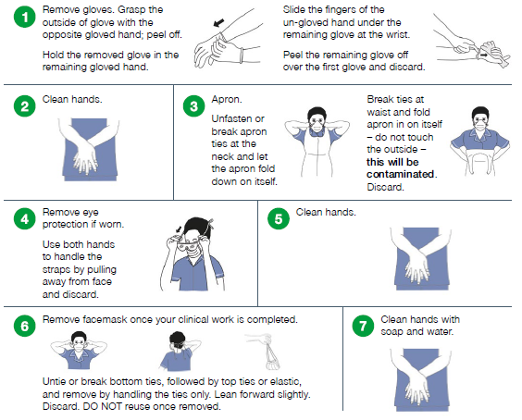
Removing (Doffing) PPE

Slide 42
Bad Habits?

Slide 43
Waste Guidance
HTM 07-01
Your statutory duty of care, is to ensure:
Correct segregation, store safely/securely on premises
Packaged appropriately for transport
Described accurately/fully on the accompanying documentation when removed
Transferred to an authorised person for transport to an authorised waste site
Appropriately registered for hazardous waste, records & returns on premises
Staff are trained
Notes:
Hazardous waste is: bagged clinical wastes, sharps, amalgam waste, x-ray waste, chemical.
Non-hazardous waste is: offensive wastes – PPE not contaminated with body fluid, uncontaminated detergent wipes, hygiene waste, office waste & x-ray film & lead foil.

Slide 44
Documentation
Needs to be complete and accurate
Waste transfer documentation:
Consignment notes: for hazardous
- Tracks movement
- Ensures safe disposal
- New note for each collection of waste
Waste transfer notes: for non-hazardous
- Describes the waste and can cover a 12
month period
Notes:
Each consignment note consists of a copy for the producer, carrier and consignee
Practice completes part a, Part b, and part d after carrier completes Part c.

Slide 45
SHARPS

Slide 46
Sharps
Medical instruments or other objects that are necessary for carrying out healthcare work and could cause an injury by cutting or pricking the skin or splash to eye.
Risk of transmission of blood-borne viruses from patient to healthcare worker.
Hepatitis B: up to 30%
Hepatitis C: 1-3 %
HIV: 0.3%
Percutaeous injury /non vaccinated
Ref:
Bloodborne viruses: Eye of the needle - GOV.UK (www.gov.uk)
Notes:
Which one am I more likely to develop?

Slide 47
The Health & Safety (Sharp Instruments in Healthcare) Regulations 2013
Implementation by 11th May 2013
Applies to sharps across all sectors
Key requirements
  Risk assessment
  Elimination, prevention and protection
  Information and awareness raising
  Training
  Reporting
  Response and Follow-up
Notes:
It is not a legal requirement to use a safer sharp but they must where reasonably practicable. Justifying the use of a metal syringe if something happens could prove difficult.

Slide 48
WHO Hierarchy of Controls
•Elimination or substitution (e.g. eliminate unnecessary injections, needle free systems)
•Engineering Controls (e.g. safer needle devices, sharps containers)
•Administrative (policies and training programmes)
•Work Practices (Universal Precautions, no recapping)
•Personal Protective Equipment (gloves, masks, gowns, etc)
Ref. ILO/WHO (2005) Joint Guidelines on Health Services and HIV/AIDS
Most effective
Least effective

Slide 49
Identify potential risk | Who might be harmed | How likely is the risk | How will risk be controlled
Sharps box | Patient Dental team Relatives | Possible | Only ¾ fill Sharps box wall mounted Keep closed when not in use Operator disposes of sharps
Matrix bands | Dental team | Possible | Use tweezers and or scissors to remove band Decontaminate retainer before re-making Band - sterile

Slide 50
Safer sharps?
..means a medical sharp that is designed and constructed to incorporate a feature or mechanism which prevents or minimises the risk of accidental injury from cutting or pricking skin”
The health & safety (sharp instruments in healthcare) regulations 2013

Slide 51
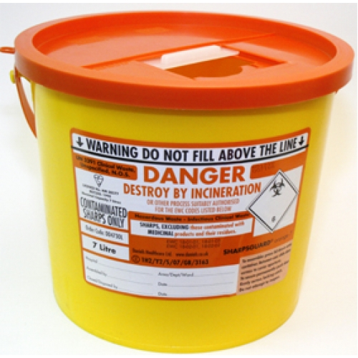
SHARPS AWARENESS
Lock when contents reach the fill line
Close temporary closure when not in use
Assemble it correctly.
Snap lid on all round
Identify your practice on label
Place on bracket, securely fitted to wall or trolley
Notes:
51
YOUR RESPONSIBILITIES – this shows the responsibilities of the users.
Must be locked when two thirds full.
Temporary closure in place when not in use.
Correct assembly of sharps bin.
Place in a safe are and position.
Enter label details - Hospital
Ward/dept
Assembled by
Closed by

Slide 52
Reusable Sharps bins
Currently, there are two companies in the UK distributing reusable sharps containers: Sharpsmart and Bio Systems RSC (by Stericycle UK). Sharpsmart have also begun recycling non-sharp single-use metal medical devices

Slide 53
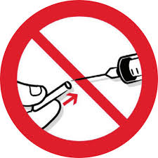
Safe disposal
Keep hands behind sharps
Dispose at point of use by user
Never bend or manipulate needles
No recapping
Never put hands or fingers into sharps container
Visually inspect sharps container for overfilling
Replace containers before they become overfilled
Keep filled containers for disposal in a secure area
No transportation of contaminated sharps to LDU

Slide 54
Managing an injury
Deal with immediately
First aid
    Encourage wound to bleed
    Rinse under cold running water
    Apply a covering
Risk assessment
    Source (If source unknown risk assess clinical session)
    Injury & vaccine status of recipient
    Item causing injury
Source referred to GMP for BBVs blood screening (sent to regional virus lab)
Contact local occupational Department immediately with above information and follow advice
Complete all necessary documentation

Slide 55
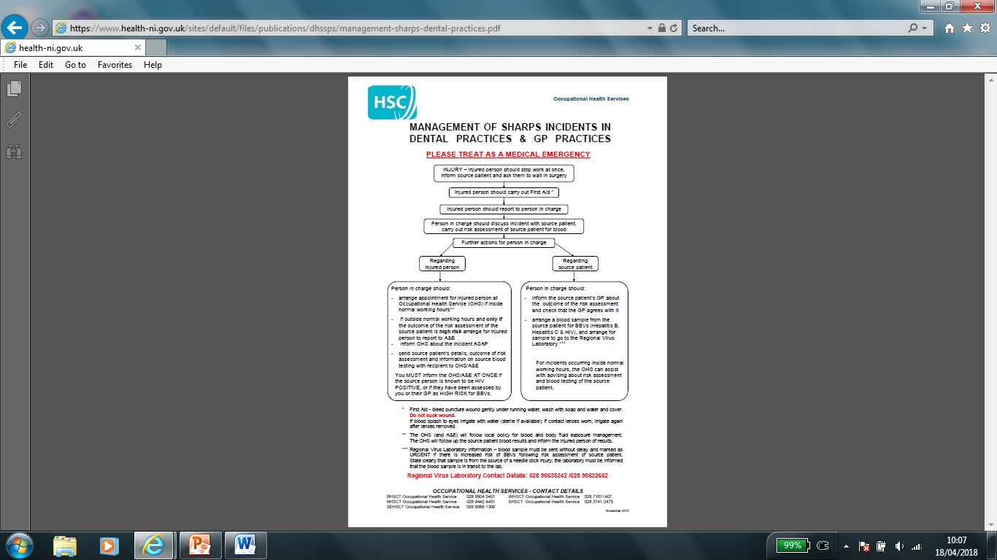

Slide 56
What happens in Occupational health?
Appointment should be as soon as possible
Advise on risks and on safe use of sharps
Blood screening for BBVs
Follow-up appointment and tests
Source patients results will be checked by occupational health

Slide 57
Staff with BBV
Change in guidance:
Jan 14: HIV infected HCW could undertake EPP if on effective cART with low viral load
2007: HBV infected HCW could undertake EPP if on appropriate treatment, low viral load & tested every 3 months
Currently: HCW with HCV cannot carry out EPP unless sustained viral response to therapy & tested 6 monthly
Notes:
From 1988 HCW with HIV were advised not to work in EPP environment, Florida dentist incident in 91 componded this
1994 first incident of HCV transmission from HCW to patient

Slide 58
New staff member
Attend Occupational Health Dept
Tested for BBV / commence Hep B course
If no vaccine available: use advise sheet: HSS (MD) 20/2017, where necessary seek advice from occupational health re risk assessment and duties.
Training provided on:
  Hand hygiene
  PPE
  Safer sharps
  IPC policy within the practice
Notes:
Limit the duties of dental nurses to non-EPP until vaccinated. Boosters usually given after 5 years however can be deferred.
Those health professionals who routinely carry out EPP i.e. dentists are high priority for vaccine.
Dental nurses are also mentioned if carrying out EPP
EPP are those are invasive procedures where there is potential for direct contact between the skin, usually finger or thumb of the healthcare worker, and sharp surgical instruments, needles, or sharp tissues (e.g. fractured bones), spicules of bone or teeth in body cavities or in poorly visualised

Slide 59
Control of the Environment

Slide 60
Control of the environment
We can control the environment in two ways:
> Zoning
> Cleaning
Notes:
What do you clean with? Detergent

Slide 61
Zoning in the Surgery
Aim:
To separate areas likely to be contaminated with direct splatter or touch with PPE - ‘dirty zones’ - from those less likely to be contaminated - ‘clean zones’
Advantage:
Minimizes the contamination of clean equipment, areas, instruments and materials.
Simplifies and speeds up the cleaning/disinfection process between patients

Slide 62
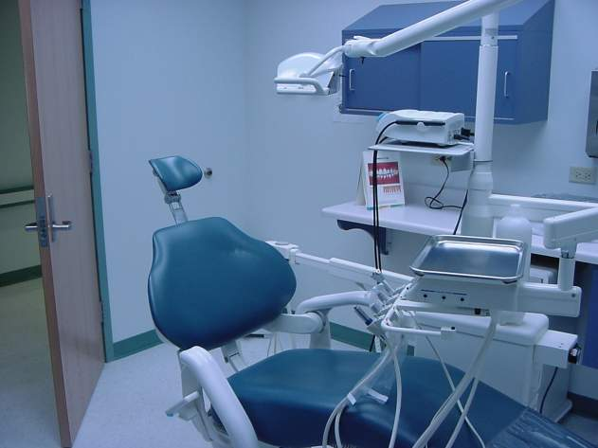
  Clinical Contact Surfaces
  High potential for contamination from spray or splatter or by hand contact
Notes:
This slide shows some examples of clinical contact surfaces, including a light handle, countertop, bracket tray, dental chair, and door handle (shown by arrows). How far does spray and splatter travel from source: 1 meter in any direction – smaller particles might go further.
Photo credit: Lt. Col. Jennifer Harte, U.S.A.F. Dental Investigation Service, Great Lakes, IL.

Slide 63
What’s in your drawers?
REFLECT
Where are your burs stored?
What do you put out?
Are the clinical areas tidy and free from clutter
Do these items get the same standard as other instruments?
Notes:
Remember burs are an instrument and the same decontamination issues apply.

Slide 64
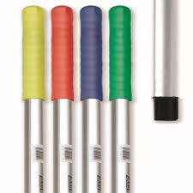
National colour coding scheme for cleaning equipment
Red – Wash rooms
Blue – Offices
Green – Kitchens
Yellow – Clinical & decontamination areas
Notes:
Slightly different within hospital setting.

Slide 65
What to do when?
Damp dust clinical areas every morning
Look at the 1-2 meter radius
Put all items away or cover if needs to be out
Close door during patient treatment episode
Decontamination following all treatment
Notes:
Could put PPE on before entering room
Level 1 PPE for cleaning
If the room has 6 air changes or unknown then 1 hr fallow time
If the room has 10 air changes it can be 20 minutes
ACH = Air Flow Rate from manufacturer’s specification (m3 per hour)
Surgery size (m3)5
• Alternatively the ACH can be measured and verified by a ventilation engineer

Slide 66
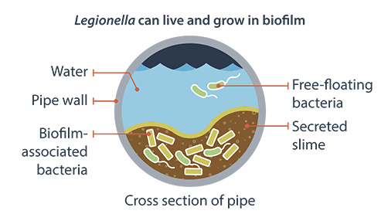
Dental Water lines
Water companies are required to keep (bacterial limits) them within the very strict limit of 100 Colony Forming Units (CFUs).
https://www.cqc.org.uk/guidance-providers/dentists/dental-mythbuster-5-legionella-dental-waterline-management
Notes:
All businesses must assess the risks from legionella and prepare a course of action for preventing or controlling the risk; you must have competent help to do this. The HSE publication Legionnaire’s Disease: the control of legionella bacteria in water systems (L8) provides further information.

Slide 67
Dental Unit Water Lines
Legionella risk assessment Legionnaire’s Disease: the control of legionella bacteria in water systems (L8)
Combination of methods of maintenance and cleaning will help reduce risk of bio contamination
  Daily maintenance:
    Flush through hand piece for at least 2 mins before and at the end of each session
    Flush for 30 secs between each patient
    Use of good quality water in your unit bottles
    Daily dosage system: ensure correct dosage to water / follow manufacturers instructions
    Empty water bottle, clean according to manufacturers instructions and leave inverted to dry
    Dental equipment with potential for backflow should have anti-retraction valve
  NB Always refer to manufacturers guidelines
Notes:
Currently no single available method will completely eliminate bio contamination

Slide 68
Water lines
  Periodical disinfection:
    HTM states ‘this should be done periodically not specific on how often’
    There are a number of effective products
    In all cases the manufacturers instructions should be consulted
    Aids the removal of Bio-film
    Ensure lines are flushed for at least 3 mins after disinfection before return to clinical use
  NB Always refer to manufacturers guidelines
For surgical procedures sterile water or saline from a separate single source should be used

Slide 69
Decontamination

Slide 70
Infection control
The requirements for in-house decontamination are described in the following guidance:
England – HTM 01-05: Decontamination in primary care dental practices and the Health and Social Care Act 2008: Code of practice on the prevention and control of health associated infection and related guidance
Scottish Dental Clinical Effectiveness Programme – Decontamination into Practice
Northern Ireland – HTM 01-05 as amended by PEL 13-13
Wales – WHTM 01-05: Decontamination in primary care dental practices and community dental services

Slide 71
Local Decontamination Unit
Should be separate from clinical treatment area
A dirty to clean workflow should be clearly followed
Segregation between dirty and clean
Surfaces should be continuous and easily cleaned/disinfected
Where possible the air movement should be from clean to dirty areas
RO or other provision of good quality water
Separate hand washing facilities
Administrative area
Notes:
Door remain closed during process

Slide 72
Manager
Manager e.g. practice principal
Person ultimately accountable for the operation of the LDU (local decontamination unit)
------------------------------
User e.g. Practice manager/senior nurse
Person responsible for the day to day management of the decontamination equipment. Main responsibilities include:
    Certify sterilisers fit for use
    Hold all documentation relating to decontamination equipment and details of key personnel
    Ensure periodic testing/maintenance/records retained
    Appoint and ensure training of operators
Notes:
Manager and User may be the same person.

Slide 73
Your team
The manager will appoint the following roles.
User e.g. Practice manager/senior nurse
Decontamination lead e.g. Practice manager/senior nurse
Operator e.g. Dental nurse
Authorising Engineer (decontamination)
Competent Person/service engineer
Microbiologist (Decontamination)
Control of Infection Officer
Notes:
Sometimes the User is the same person as the manager. They hold full responsibility for the equipment.
In NI we don’t have a microbiologist however work closely with Scotland

Slide 74
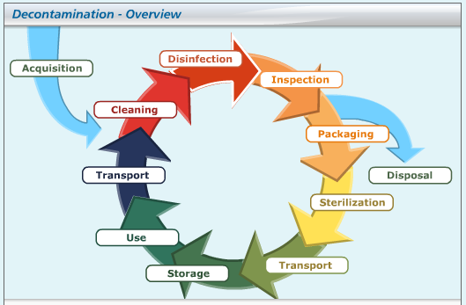
Decontamination Life cycle/Process
Notes:
Diagram of the decon life cycle.
Acquisition of new devices plays a part in the process must be decontaminated before use
Disposal- A device must be processed before disposal or going for repair to protect any person who may come into contact with the device.
An LDU is simply a practical application of this cycle in other words this cycle super imposed onto a room with all of the processes follow the correct order

Slide 75
Acquisition / Procurement
Must be:
  Suitable for purpose
  Processed to meet standards
  Commissioned/validated at installation on site
  Should be procured against relevant model engineering specification (advice available from authorising engineer decontamination)
  Should display CE mark
  Testing schedule
  Maintenance and servicing schedule in place
Notes:
It is essential that you match your required amount of instrumentation with the capacity of your equipment. Ensuring that your capacity is correct, is imperative, it is false economy to run half full cycles and can also be detrimental to you work practice if you run out of instruments due to lack of capacity.
Manufactures instructions are particularly important with implant components.
Health Technical Specifications for sterilizers and washer disinfectors are available from the department they include a 2 sections one can be used as a pre procurement specification with a supplier and once signed by them is a legal binding document. I.e. the piece of equipment must be able to do what they have specified.
The Scottish procurement list, all of the equipment has been tested and meets the standards required.
NHS supply chain
Tim Bull 01924328507 www.supplychain.nhs.uk/dentaldecon
www.supplychain.nhs.uk
They will give impartial recommendations for equipment only the equipment which passed testing made their lists.
If you go to them with your defined capacity they will advise on equipment
The prices they quote you will include delivery installation and staff training. No hidden costs.
They are presently checking with their suppliers regarding delivery to northern Ireland
Ongoing testing schedules, reference should always be made to the manufactures instructions as well as HTM 01-05.

Slide 76

Single use Items
Single use means an item can be used once on a single patient for treatment then discarded
They must not be reprocessed
Single use items include:
  Gloves/aprons/masks
  Salvia ejectors
  Matrix bands
  Endodontic files/reamers/broaches
  S/S burs
  Single use diamond burs
  Single use dental instruments

Slide 77
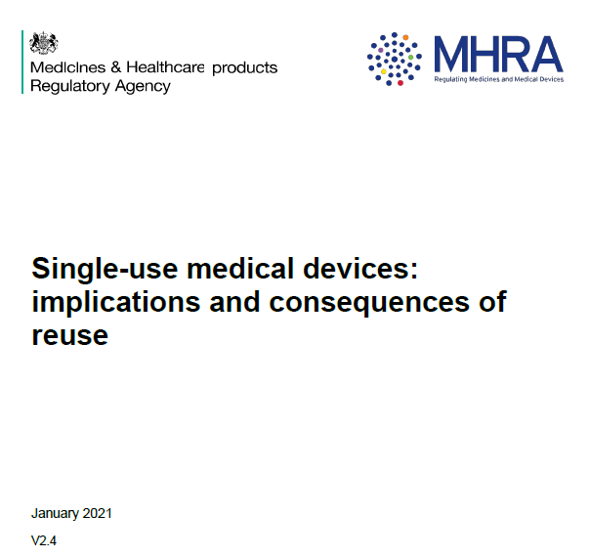
Updated Guidance

Slide 78
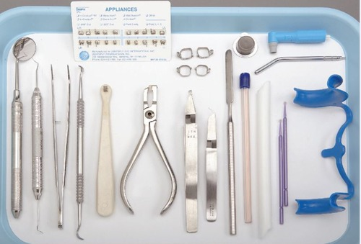
Segregation
Sorting of instrument trays at the end of each patient
Disposal sharps/single use items in surgery
Correct disposal of waste

Slide 79
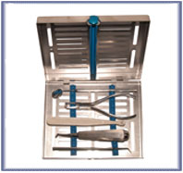
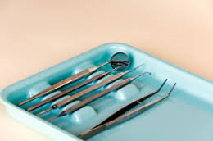
Instrument Tray Systems
Keep instrument sets together
Give protection to the operator
Protect instruments
‘a separate clean/sterilised instrument tray should be used for each patient, alternatively a disposable tray may be used’

Slide 80
Instrument Transfer
Instruments should be transferred as soon as possible after use
Containers should protect both instrumentation and handler
Transfer containers should be
    Leak proof
    Clean/disinfected every use
    Rigid
    Clearly labelled
    Separate dirty/clean boxes
    Sterilised unwrapped instruments preferably should not contact the box

Slide 81
Used instruments
To Spray Or Not To Spray
3.5 Instruments cleaned as soon as possible... Where this is not possible, water immersion or the use of foam spray or gel are thought to be useful….Long periods of wet storage should however be avoided.
Notes:
A damp cotton wool roll inside the closed box should be suffice to keep the atmosphere moist. As long periods of wet storage should be avoided.

Slide 82
Remember…..
Non refillable bottles:
6.58
It is not good practice to refill spray bottles used to apply cleaning or disinfecting solutions…..
Such bottles should be single use.
Notes:
If using spray bottle, spray into a disposable cloth to prevent spread of particles and inhalation of solution sprayed.

Slide 83
Cleaning
Cleaning is the process by which you physically remove contamination from the device
Why is Cleaning important?
    Greatly reduces the bio burden on the device
    Soil/debris can provide protection for the microbes during sterilization
    It is essential to maximise the chances of the item finishing in a sterilized state

Slide 84
Manual Cleaning
Not a validated process
Can be hazardous to the operator
Used as a back up process when:
  Washer disinfector is broken down
  Washer disinfector is being serviced/validated
  When manufacturers instructions do not recommend placement in a WD
Must have written procedures for the task (P 64 HTM01-05)
Notes:
Manual cleaning
This process cannot be validated ,you cannot show that the process is reproducible each time as there are no parameters which can be consistently repeated or measured. However a set policy which has clear steps and which all staff are trained in and use can help improve the consistency and effectiveness of the process.
It is important to remember the health and safety issues which arise as a result of manual cleaning.
The risk of a sharps injury
The fact that the contaminated water becomes a bacteria soup during cleaning and is a cross infection risk to the operator
PPE is essential for protection of the operator and should be worn at all times the manager/user has a responsibility to ensure that this is available and is used.
The temperature of the water has two important bearings
The water temp shouldn’t be too high as this can help to coagulate blood products on the instruments and can increase the difficulty of removal.
Careful attention should be paid to the manufactures instructions of the detergent being used. Often they will recommend a temperature if it is to low or too high the detergent may become inactive which could make the cleaning process more difficult.
Volume is also important if under diluted the detergent cannot work effectively if over diluted it may be difficult to remove from your instruments and leave behind a residue, cost is also a consideration you are using more than you need therefore spending money you don’t need to spend.
It is vital that aerosols are kept to a minimum during this process to protect the operators to enable this the use of a long handled brush and washing below the water line is imperative.
Rinsing with a good quality such as RO (reverse osmosis) water or distilled water. This simply means that the mineral content is lower and it has a lower conductivity than tap water. This ensures that you are not introducing any hard salts or minerals onto your instruments and may therefore prolong the life of them.
Drying with a lint free cloth prevents any fibers being introduced into the process.

Slide 85

PPE
Detergent neutral ph /dilution
Temperature
Avoid aerosol
Rinse
Dry
Not disinfected

Slide 86
Manual Cleaning
Can be hazardous to the operator:
Full PPE & heavy-duty gloves
The process of manual cleaning:
    Only used specifically formulated detergent (neutral ph)
    Volume of water/detergent important, gradients on sink (ref to instructions on detergent)
    Temperature of water 45oC or lower
    Personal protective equipment:
    Household gloves/goggles/apron/mask
    Wash below the water line to avoid aerosol
    Use a long-handled nylon bristle brush fit for purpose (no abrasive pads)
    Keep kits together be aware of sharp instruments
    Rinse in separate sink with good quality water i.e., RO water
    Dry with a lint free disposable cloth
Notes:
It is important everyone knows and can manually clean correctly should the washer break down .

Slide 87
Washer Disinfectors
Validated cleaning Process
Requirement for achievement of Best Practice in HTM01-05
Independent monitoring
Can be single or double door
Require good quality water i.e. RO water

Slide 88
The Cycle
FLUSH
Removes gross contamination
Water temp under 45°c
WASH
Detergent wash
Chemical processes loosen & break up debris
RINSE
Removes detergent
Good quality water should be used
Thermal
Disinfect
Temperature raised & held at pre-set disinfection temperature
E.g. 80°c for 10 minutes or 90°c for 1 minute
Drying
Purges the load and chamber with heated air to remove residual moisture
Notes:
Instruments are safe to handle after this process

Slide 89
Using a Washer Disinfector
No overlapping or shadowing of instruments
Bowls and similar items should be inverted
Devices with lumens should be connected to irrigation ports and filters if required
Hinged instruments should be opened
Heavy objects should be placed on the lower baskets to protect lighter items
The spray arm should not be impeded by the load

Slide 90
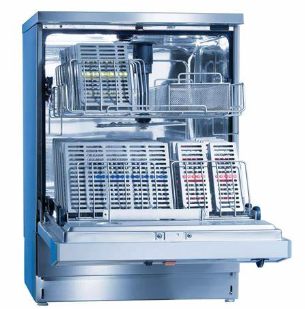
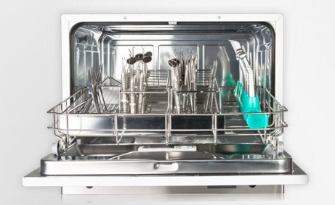
Loading: Good Practice

Slide 91
Washer Disinfectors
Test | Description | Performed by
Daily
Remove & clean strainers and filters | Filters & strainers must be clean | User or delegated to operator
Cleaning efficiency | Visual examination of all load items | User or delegated to operator
Weekly (in addition to daily)
Protein residue test | Confirms process retains the capability of removing proteins | User or delegated to operator
Safety checks | Check condition of door seal | User or delegated to operator
Notes:
Are these being done? It is important if the user has delegated these tasks they do check and confirm periodically.
You may also carry out a cleaning indicator test – monthly basis is required by manufacturer.

Slide 92
Washer Disinfector
Service Engineer Requirements
Test | Description
Quarterly (weekly tests plus)
Safety checks | Check safe operation of door, seal
Cleaning efficiency test
Chemical dosing | Confirm delivery of detergent /additives
Thermometric disinfection test | Use of thermocouples on worst case load to confirm disinfection parameters
Annually
Completion of all validation tests above
Notes:
You should receive a report

Slide 93
Particularly Problematic
Handpices
3 in 1
Bur stands
Notes:
For the washer disinfector

Slide 94
Handpieces
If you experienced instances of reduced handpiece service intervals or increased frequency of repairs, report this, with evidence to NIAIC
www.shsspsni.gov.uk/index/phealth/niaic.htm
Only after submission of an adverse incident report and evidence to NIAIC can manual cleaning following a written protocol be undertaken as a interim measure.
RQIA will want to see evidence, if manual handpiece cleaning is taking place.
Notes:
NIAIC: Northern Ireland Adverse Incident Centre
Evidence would be: the handpiece and washer disinfector manufacturers instructions and assorciated records indicating increased instances of handpiece servicing or repair.

Slide 95
Careful Consideration..
How do we oil a handpiece?
Manually – can of oil
Oiling machine
Dac

Slide 96
Inspection
Is it clean no visible debris
Is it functional
Is it in good repair no rust areas or cracks

Slide 97
Packaging and Storage
Storage
Wrapped instruments
1 year
Pre-sterilization wrapping
Type B/S
Post-sterilisation wrapping
Type N
Unwrapped instruments
Clinical area:
1 day
Non-clinical area:
1 week
Notes:
2013 policy full implemented in NI & will be kept under review as further knowledge develops in this area. If pre sterilisation make sure instruments are separated.

Slide 98
Quality Systems
Ensure correct processing
Expiry date required on packaged items
Rotation of instruments
Notes:
Quality system required to prevent storage of wrapped instruments exceeding 1 year. Expiry date is preferred date.

Slide 99
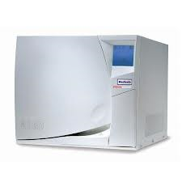
Sterilisers
Types
Role
Parameters
Notes:
What do sterilisers do? They kill all bacteria including spores and other micro organisms.
What do they not do? Remove prions or sterilise under debris
Parameters: Temp: 134 -137 degrees/ Pressure 2.0 -2.3 or 328 kilopascals / 3 mins Holding time

Slide 100
Daily House Keeping
Steriliser
Wipe & check door seal
Remove furniture and wipe
Drain reservoir
Check paper / tests

Slide 101
Sterilisers
Test | Type | Performed by
Daily
Automatic Control Test | B,N,S | User or delegated to Operator
Steam Penetration Test | B, S | User or delegated to Operator
Weekly (in addition to daily)
Air leakage | B, S | User or delegated to Operator
Residual air test | S, N | User or delegated to Operator
Notes:
Weekly tests can only be done if the facility is there on the machine (not on old machines)

Slide 102
Sterilisers
Service Engineer Requirements
Test | Type
Quarterly
Thermometric test | B, N, S
Annually (quarterly test plus)
Steam generator overheat cut out test | B, N, S
Thermometric Test Small load Large load | B, N, S
Dryness test Small load Large load | B, S

Slide 103
Automatic Control Test
(ACT)
A daily observational test performed on all sterilisers to ensure the cycle is within the required specification:
Observations include:
The cycle times and temperatures are within the correct parameters.
Time & temperature, consistent with previous tests results.
No deviation from normal performance.
The machine displays ‘complete cycle’.
Notes:
What and why are we recording this

Slide 104
Test
Temperature, steam, time test strip (TST) can be used to check type N sterilisers
Place the strip in the chamber during a
cycle, along with the instruments
This does not replace ACT

Slide 105
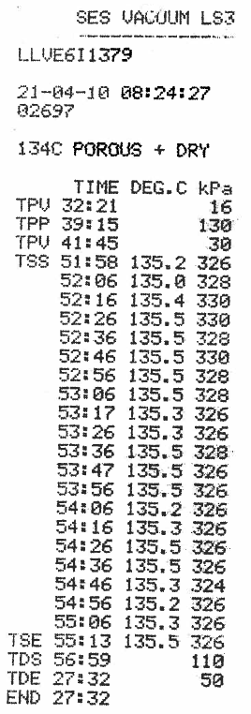
Serial Number (Unique Identifier of Steriliser)
Cycle start Time
Date
Cycle Number
Cycle Program
Sterilisation Time
134 - 137ºC
Mid-Point
temp & pressure reading taken
Notes:
Time Sterilisation starts/ends
Time drying starts/ends

Slide 106
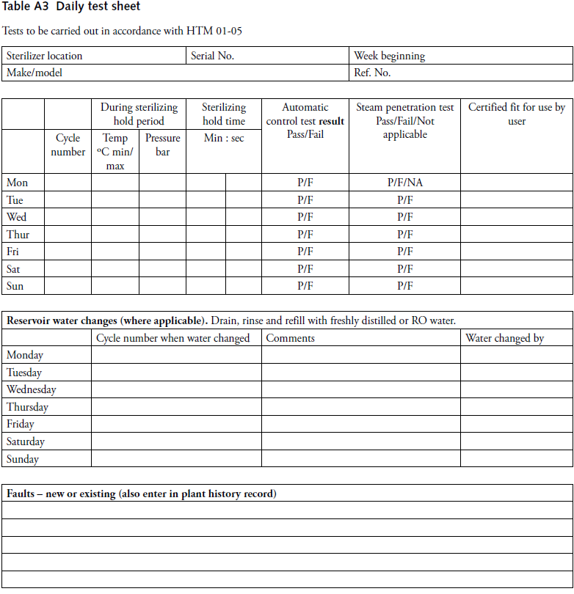
Example of Daily test sheet

Slide 107
Steam Penetration Test
Use manufacturers` recommended test
Bowie dick
Helix
Special for ‘S’ type

Slide 108
Validation Report Check List
Given to you by service engineer
The test report must contain all the relevant information:
Site (your practice)
Location (room number)
Machine make, model, serial number
Machine identification number
Time & date test was carried out
Summary of tests and results
Test person`s name & declaration
Test person`s qualifications
List of calibration equipment used
Calibration equipment is within date
Calibration report (shows the thermocouples were calibrated to test the equipment)
Type & purpose of each test undertaken
Data collected
Photograph of load
Printouts from machine
Notes:
All equipment: washer disinfector and sterilisers have to be installed, validated and maintained in line with HTM & manufacturers instructions. Your test report should contain the above information – you are paying for this!

Slide 109
Only what is required?

Slide 110
Audit
Identify standards
Collect data on current practice
Compare to standards
Plan necessary change
Implement change
Re- audit
Notes:
Keeps focus so improvements are implemented
Electronic version of IPS audit tool indicates HTM guidelines
Re audit

Slide 111

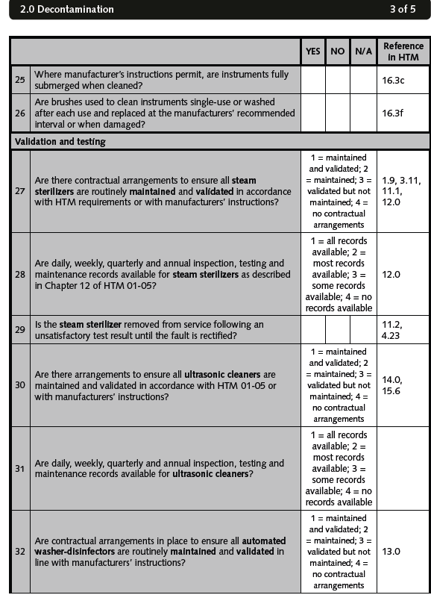
Audit tool
Complete every 6 months retain for 2 years

Slide 112
References
NHS England https://www.england.nhs.uk/clinaudit/
Pel 13 13
Minimum standards for dental care and treatment
Infection Prevention society
PPE regulations
https://www.hse.gov.uk/pubns/books/l25.htm?utm_source=govdelivery&utm_medium=email&utm_campaign=ppe-regs&utm_term=body-2&utm_content=ppe-6-apr-22
HSC doc: Management of sharps incidents in Dental Practice and GP Practice
Preparation for the Re-establishment of the General Dental Services - Operational Guidance
http://www.hscbusiness.hscni.net/pdf/Preparation%20for%20the%20Re-establishment%20of%20the%20GDS%20Updated%2022%20June%202020.pdf
https://hscbusiness.hscni.net/pdf/Annex_3_Ventilation_in_Dental_Practices_Jan_2022.pdf

Slide 113
FYI
https://assets.publishing.service.gov.uk/government/uploads/system/uploads/attachment_data/file/881489/COVID-19_Infection_prevention_and_co ntrol_guidance_complete.pdf
https://www.publichealth.hscni.net/news/covid-19-what-situation-northern-ireland
https://www.gov.uk/government/publications/covid-19-personal-protective-equipment-use-for-aerosol-generating-procedures
https://assets.publishing.service.gov.uk/government/uploads/system/uploads/attachment_data/file/910885/COVID-19_Infection_prevention_and_control_guidance_FINAL_PDF_20082020.pdf
http://www.sdcep.org.uk/wp-content/uploads/2020/05/SDCEP-Dental-Practice-Reopening-Following-COVID-19-checklist-250520.docx
Disinfecting using fog, mist and other systems during the coronavirus (COVID-19) pandemic - HSE news
https://www.gov.uk/government/publications/wuhan-novel-coronavirus-infection-prevention-and-control/covid-19-guidance-for-maintaining-services-within-health-and-care-settings-infection-prevention-and-control-recommendations
https://www.niinfectioncontrolmanual.net/basic-principles

