Slide 1
Equality, Diversity & Inclusion
Training for Dental Professionals
Amanda Jackson

Slide 2
Aim
To raise awareness of Equality, Diversity & Inclusion amongst dental professionals

Slide 3
Objectives
Outline equality and diversity within NI context
Identify equality and diversity legislation in NI
Explore unconscious bias
Consider equality, diversity & inclusion within your practice context

Slide 4
Learning Content
This training session intends to raise an awareness of Equality and diversity by highlighting current legislation. Participating in questionnaires and case studies.
GDC Development Outcome: A, D

Slide 5
Equality & Diversity
The population we serve and our workforce are becoming increasingly diverse….
We can demonstrate that equality, good working relations and human rights is for everyone by making it a part of our everyday working life.

Slide 6
What is Equality & Diversity?
Equality and diversity is about creating a fairer society where everyone can participate and has the opportunity to fulfil their potential.

Slide 7
Equality is not treating everyone the same, but:
Making sure people are treated fairly, with dignity and respect
Meeting individuals’ needs appropriately
Challenging the factors that limit individuals’ opportunity

Slide 8
Why Equality Matters
Around 45% of LGBT pupils experience bullying related to sexual orientation or gender identity.
Older people are more likely to face refusal or unaffordable premiums for travel insurance, with age and pre‑existing conditions remaining major barriers.

Slide 9
Why Equality Matters
Women continue to earn less than men, with a 7% gender pay gap in full‑time hourly pay.
Disabled people are significantly less likely to be in work, with employment rates around 30 percentage points lower than non‑disabled people.
Employment rates differ by ethnicity, and people from some ethnic minority backgrounds are less likely to be in work than White people.

Slide 10
Diversity is:
Recognising and valuing individual and group differences
Ensuring many different types of people contribute to society

Slide 11
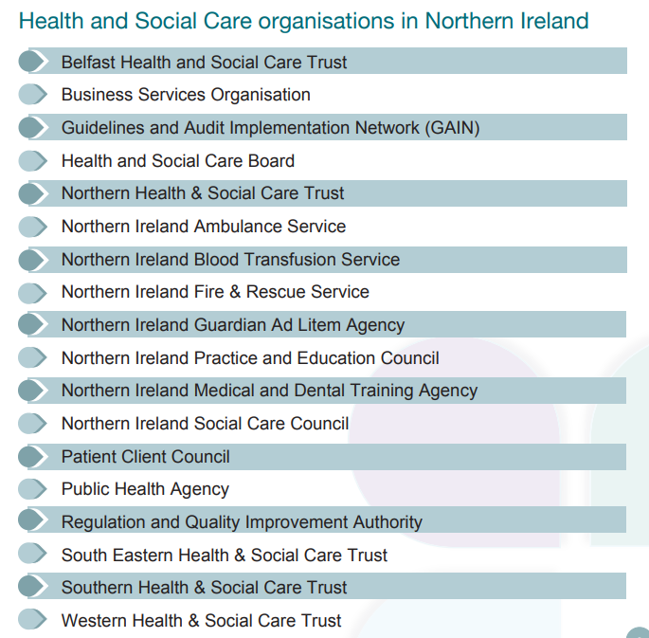
NI health care, we aim to improve health & wellbeing of our population and to reduce health inequalities

Slide 12
Inclusion is
Being yourself
Belonging
Understanding differences
Everyday occurrences
Engaging all
Everyone is valued
Social rights

Slide 13

Public Sector Equality Duty
NI Section 75
Public authorities are required to have due regard to promote equality of opportunity:
Between persons of different religious belief, political opinion, racial group, age marital status or sexual orientation;
Between men and women generally
Between persons with a disability and persons without; and
Between persons with dependents and persons without.
Public bodies have an obligation to produce an Equality Scheme.

Slide 14
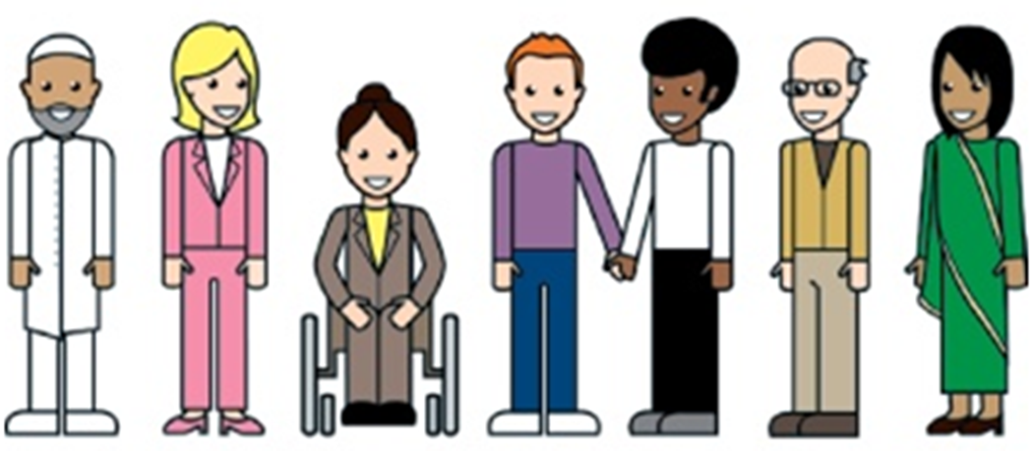
Protected Characteristics

Slide 15
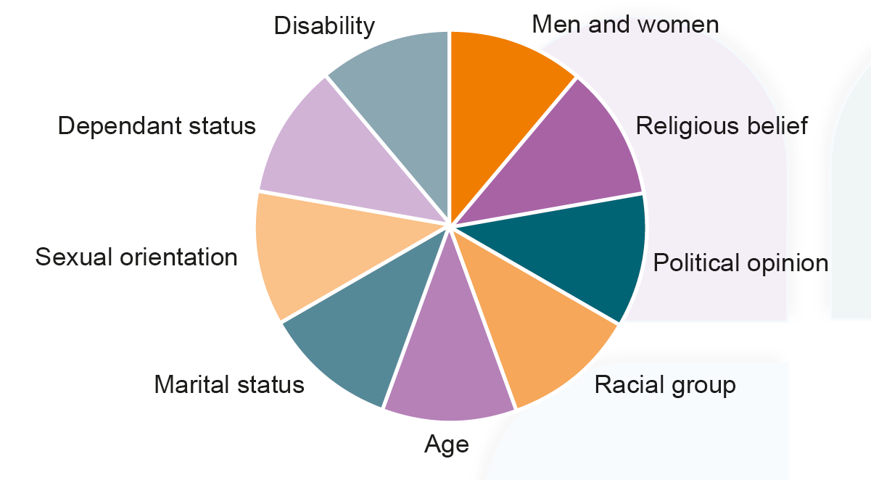
Protected Characteristics in
Northern Ireland

Slide 16
UK Guidance: England,
Scotland and Wales
Equality Act 2010: Guidance
The Equality Act 2010 legally protects people from discrimination in the workplace and in wider society.
Protected characteristics:
age
gender reassignment
being married or in a civil partnership
being pregnant or on maternity leave
disability
race including colour, nationality, ethnic or national origin
religion or belief
sex
sexual orientation

Slide 17
Equality Legislation
The Sex Discrimination (NI) Order 1976
The Disability Discrimination Act 1995 and the Disability Discrimination (NI) Order 2006
Employment Rights (NI) Order 1996
The Race Relations (NI) Order 1997
The Fair Employment and Treatment (NI) Order 1998
Sex Discrimination (Gender Reassignment) Regulations (NI) 1999
Employment Equality (Sexual Orientation) Regulations (NI) 2003
The Employment Equality (Age) Regulations (NI) 2006

Slide 18
Change
Discrimination
Bullying
Harassment
Unconscious bias
To ensure we think differently we need to look at some things that can happen

Slide 19
Discrimination
Direct
Someone is treated less favourably than another person because of a protected characteristic
Indirect
A rule or policy that applies to everyone but disadvantages a particular individual or group

Slide 20
Discrimination
Associative Discrimination
Treating someone less favourably as a result of their association with a person who holds a protected characteristic
Disability Discrimination
Is less favourable treatment of someone with a Disability or failure to make reasonable adjustment by an employer for someone with a Disability.
Perceived Discrimination
Unlawfully discriminating against someone on the mistaken assumption they hold a protected characteristic

Slide 21
Discrimination
Harassment
Unwanted conduct related to a relevant protected characteristic.
Victimisation
This happens when an individual is singled out because they have used the system to make a complaint or challenge treatment received.
Notes:
In addition, employers can be legally liable for the harassing conduct of third parties.
A third party would include a client, customer, supplier, visitor, contractor, service user etc.

Slide 22
Bullying or harassment
The effect on an individual is more important
than the intention of the bully/bullies
Can involve:
Verbal abuse, taunting, nasty comments
or jokes
Physical force
Deliberately isolating/ignoring someone
Unfair allocation of work
Display or circulation of offensive materials
Inappropriate sexual comments

Slide 23
Definition of A Disability
The Act defines a `disabled’ person as a person with:
A physical or mental impairment which has a substantial and long term adverse effect on his/her ability to carry out normal day to day activities
Persons with progressive conditions such as Cancer, MS, Muscular Dystrophy or HIV are regarded as disabled on diagnosis
Long term impairment is likely to last 12 months, has lasted 12 months or is likely to last for the remainder of the life of the person affected
Normal day to day activities include mobility manual dexterity, physical coordination, continence or ability to lift carry or move objects
Notes:
The Equality Act 2010 applies in England, Scotland and Wales Northern Ireland uses different but closely aligned legislation: Disability Discrimination Act 1995
Special Educational Needs and Disability (NI) Order 2005

Slide 24
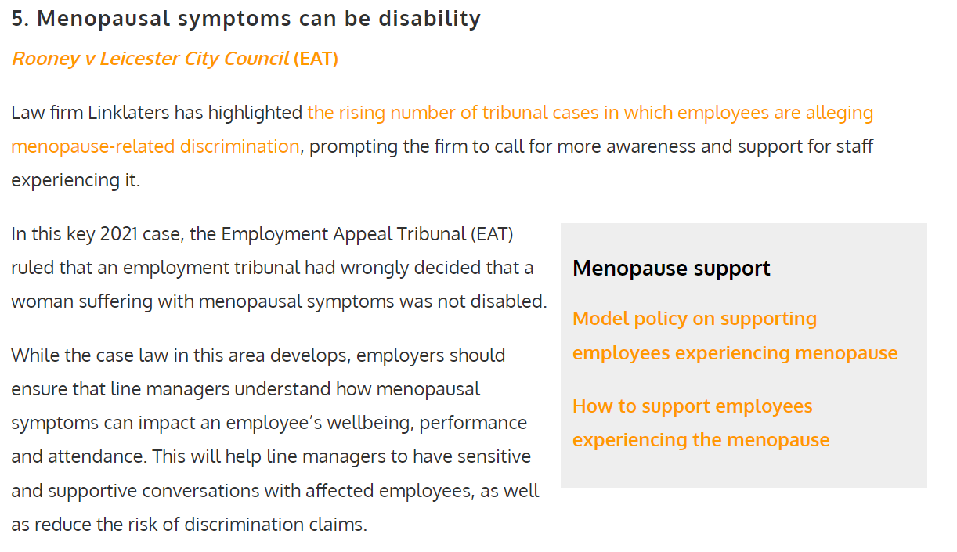
The next big thing in case law….

Slide 25
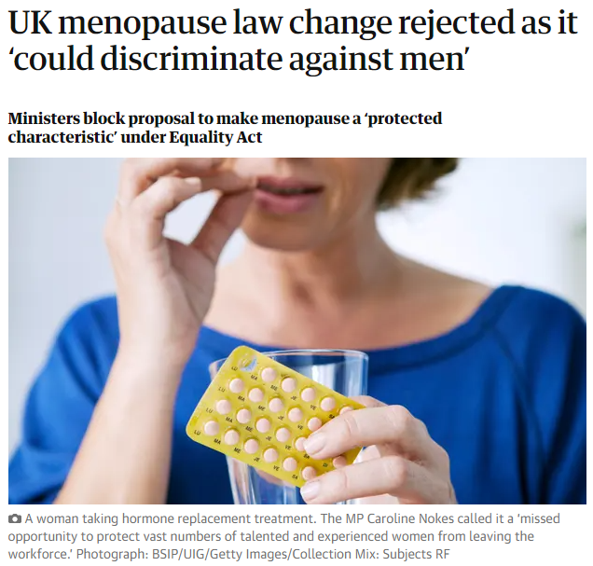

Slide 26
However….
Menopause is not automatically a disability under the Equality Act.
However, employment tribunals now recognise that menopausal symptoms can amount to a disability where they have a substantial and long‑term impact on day‑to‑day activities. Employers may therefore have a duty to make reasonable adjustments.
Recent and influential cases
Shearer v South Lanarkshire Council (2024)
Tribunal accepted that menopause symptoms and related poor mental health met the Equality Act disability definition.
Employer ignored occupational health advice.
Award: over £61,000 for disability discrimination and unfair dismissal.

Slide 27
The basis of Discrimination
Stereotype
To make assumptions about
a person on the basis of their
age, sex, race, nationality,
sexuality and so on.
Prejudice
Favouring or disfavouring an individual because of preconceived ideas relating to their age, sex, race, nationality, sexuality and so on.

Slide 28
Unconscious Bias
When you make spontaneous judgements about people or situations based on your past experiences, culture, background or exposure to media.
These hidden preferences or prejudices can affect nearly every decision you make.
Notes:
Unconscious bias is a complex area, important again to highlight this area.

Slide 29
Unconscious Bias
As Humans we make instinctive decisions about people.
Feel right at the time.
Our unconscious people preferences play a significant part in the way we engage with people and the decisions we make about them.
Notes:
Our brains are hard wired to rapidly categorise people instinctively and we use the most obvious and visible: Age, body weight, physical attractiveness, skin colour, gender and disability.
May use less visible dimensions: accent, social background, sexual orientation, nationality, religion, education, and even job title.
The unconscious biases operate below the level of our consciousness such that we continue to see ourselves as fair and unbiased whilst our subtle behaviours give away our unconscious feelings.

Slide 30
Bias
Patel et al (2019) measured explicit bias in the treatment offered by Dentists.
White patients are more likely to be offered root canal treatment.

Slide 31
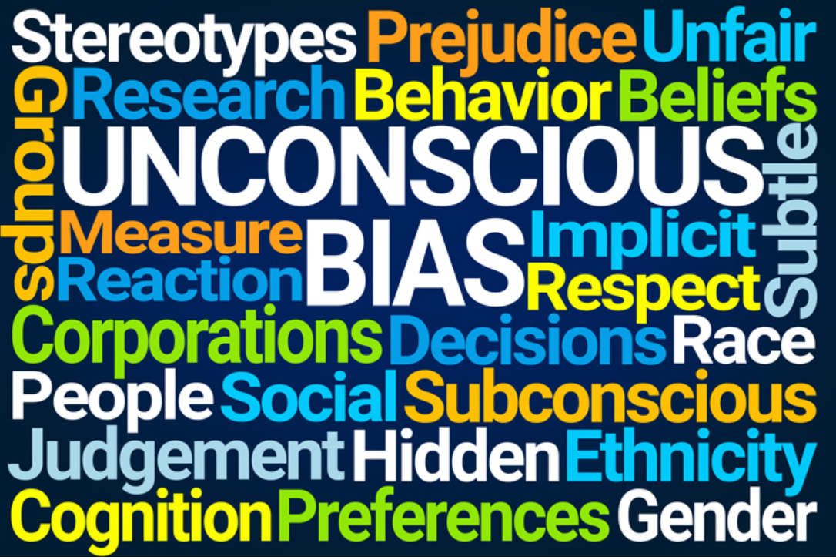
Types of unconscious bias
Affinity bias, we tend to befriend or favour people who we feel we are similar to
Attribution bias, we assess other people on their achievements
Confirmation bias, to search for, interpret, focus on and remember information that aligns with our preconceived opinion.
Notes:
There are other types of bias such as halo effect (something positive means you always see them in a positive light,
Horns effect – you hear something negative therefore you always see them in a negative light

Slide 32
Faith, Religion and Belief
Northern Ireland has a diverse population
Faith, religion and belief can mean different things to different people
Some do not practise all aspects of a religion or may interpret or practice it differently
Belief can include humanism, atheism, other non-religious beliefs
Whilst Christian holidays are calendarized it can be helpful to be mindful of other celebrations/events such as Ramadan
Notes:
For many faith can play an important and integral role in how a person sees their identity and experiences every aspect of daily life

Slide 33
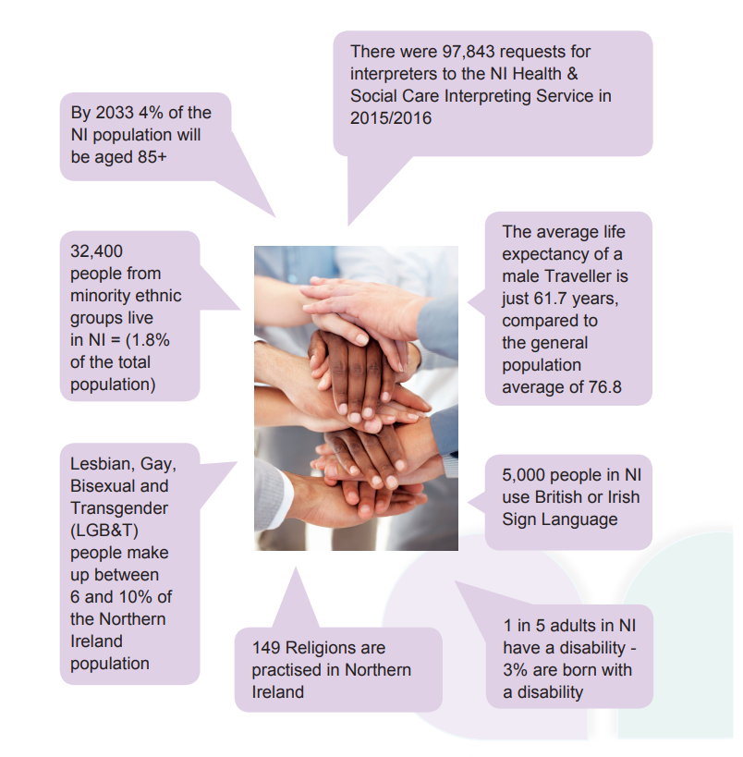

Slide 34
Your PRACTICE
Think about Equality and Diversity in your practice, do you…..
Implement changes required for those who need it?
Treat all with dignity, fairness and respect?
Have a fair Interview and recruitment process?
Notes:
How many practices have over 11 employees?
Therefore how many practices are registered with the equality Commission? If you have 11 or more employee working over 16 hrs you would have to show how you have a fair recruitment process and how employment figures are in line with local community area on a yearly or 3 yearly basis, depending on size. Showing that you have same number of Catholics as Protestants etc.
Equality commission website – lots of free courses available.

Slide 35
Unlawful to discriminate
Religious belief/Political opinion
Gender/marital status/Gender reassignment
Race/ethnic or national origin
Sexual orientation
Age
Disability

Slide 36
Guaranteed Interview
A Disabled person is entitled to receive an interview if they meet the Essential Criteria in the Person Specification
A Disabled person is entitled to have special adjustments made for them to undertake the interview, test etc

Slide 37
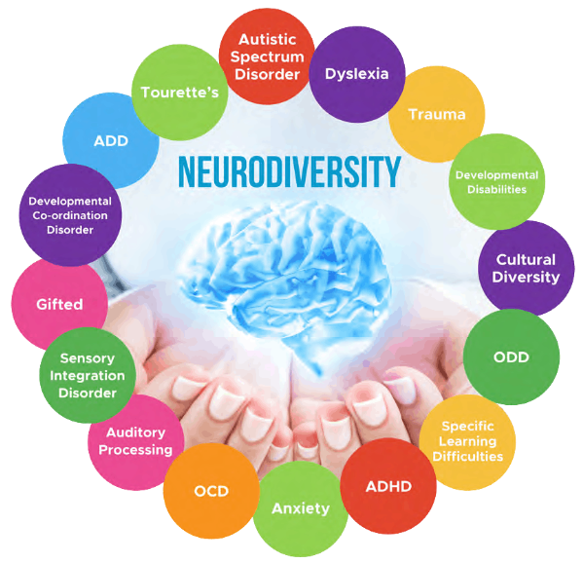
Neurodiversity
Understanding Neurodiversity is a call to include and respect people whose brains work in atypical ways
These have been seen as developmental disorders that need managing and even curing, for a very long time
https://suelarkey.com.au/neurodiversityblog/

Slide 38
Reasonable adjustments
Glasses
Hearing aid
Walking aid
Giving instruction in a clear way with date/time expectations
Providing a quiet space to eat lunch
Notes:
What reasonable adjustments might you have to make for colleagues or patients?

Slide 39
Acceptable or Not Acceptable
‘Wheelchair bound’
Unacceptable: it gives the view that people in wheelchairs are helpless and dependent; ‘Wheelchair user’ acceptable
‘Old Person’
not acceptable:`old’ carries connotations of being worn out or of little further use; ‘Older person’

Slide 40
The Safe Practitioner: Professionalism
Demonstrate cultural competence, accepting and respecting the diversity of patient and colleagues
Speak up to protect others from harm
Active by-stander training can help with this…

Slide 41
Active By-Stander
What’s worse that being harassed in public is being surrounded by bystanders who see it but do nothing….
When we intervene, not only do we reduce the trauma of harassment for the person who was harmed, we also chip away at the culture of harassment and replace it with one of humanity.

Slide 42
Active bystander
Distract
Document
Delay
Delegate
Direct
Notes:
Distract: ignore the person who is harassing and engage with the one being harassed – e.g. ask for directions / accidently spill or drop something in between them
Delegate: Look for someone who is ready and willing to help you to distract
Document: Record or write down what you are witnessing and after the event ask the harassed person if they would like it.
Delay: Even if you didn’t help in the moment, ask the person after if they are ok or can you support them to report it ect.
Direct: If you are safe and it is appropriate you may want to confront the person directly indicating ‘that is an inappropriate comment’ / ‘Please stop’/ ‘they have asked you to stop and I am here to support them. ‘

Slide 43
Your roles and responsibilities
Top Tips
Ensure your behaviour is in line with your workplace equality policies and procedures
Help ensure your working environment is one in which the dignity of all staff, patients, visitors is respected
Challenge or report incidents of discrimination, bullying or harassment
Remember – Equality doesn’t always mean treating everyone the same
Service users and staff have diverse needs. Stereotyping is often based on assumptions which are wrong & can lead to discrimination
Remember FREDA – Fairness, Respect, Equality, Dignity, Autonomy

Slide 44
Resources
Commissioner for Older People for NI (COPNI) http://www.copni.org/
NI Commissioner for children and Young People http://www.niccy.org
Disability Action http://www.disabilityaction.org/services-and-projects/
NI Human Rights Commission (NIHRC) http://www.nihrc.org
The Rainbow Project http://www.rainbow-project.org/
Equality, Good Relations and Human Rights manual BT16-1444 Equality training manual (Regional).indd (cmbackbone.net)

